Slide 1
Introduction to the Human Cardiovascular System

Slide 2
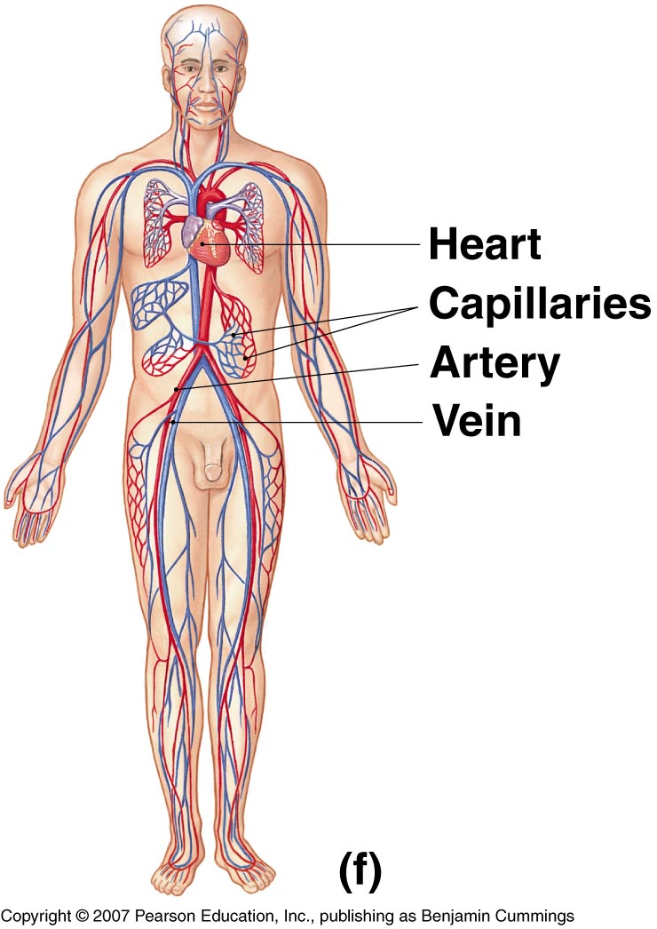
INTRODUCTION
The cardiovascular system is transport system of body
It comprises blood, heart and blood vessels.
The system supplies nutrients to and remove waste products from various tissue of body.
The conveying media is liquid in form of blood which flows in close tubular system.
Figure 1-2(f)

Slide 3
FUNCTION OF CARDIOVASCULAR SYSTEM
Transport nutrients, hormones
Remove waste products
Gaseous exchange
Immunity
Blood vessels transport blood
Carries oxygen and carbon dioxide
Also carries nutrients and wastes
Heart pumps blood through blood vessels

Slide 4
COMPONENTS OF CARDIOVASCULAR SYSTEM
BLOOD
HEART
BLOOD VESSELS

Slide 5
BLOOD
The Blood: Blood cells & Plasma
Blood cells
1- Erythrocytes - Red Blood Cells
2- Leucocytes
3- Thrombocytes
Plasma is fluid portion

Slide 6
HEART
Heart is a four chambered, hollow muscular organ approximately the size of your fist
Location:
Superior surface of diaphragm
Left of the midline
Anterior to the vertebral column, posterior to the sternum
Chapter 18, Cardiovascular System
6

Slide 7
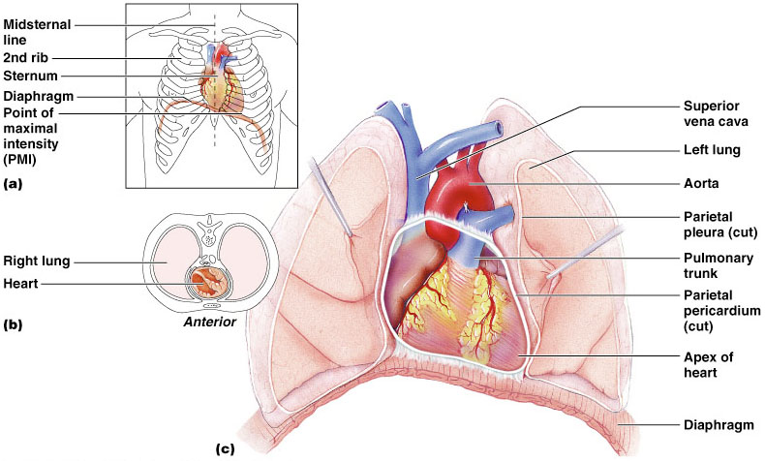
HEART
Chapter 18, Cardiovascular System
Figure 18.1
7

Slide 8
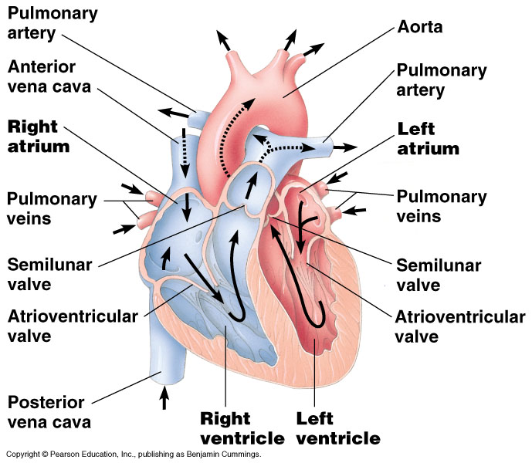

Slide 9
FUNCTIONS OF THE HEART
Generating blood pressure
Routing blood
Heart separates pulmonary and systemic
circulations
Ensuring one-way blood flow
Heart valves ensure one-way flow
Regulating blood supply
Changes in contraction rate and force match
blood delivery to changing metabolic needs

Slide 10
BLOOD VESSELS
Blood Vessels -A closed network of tubes
These includes:
Arteries
Capillaries
Veins

Slide 11
BLOOD VESSELS
-Arteries(Distributing channel)
Thick walled tubes
Elastic Fibers
Circular Smooth Muscle
Capillaries (microscopic vessels)
One cell thick
Serves the Respiratory System
Veins (draining channel)

Slide 12
BLOOD VESSELS
General structure
1.Tunica intima
2.Tunica media
3.Tunica adventitia

Slide 13
CLASSIFICATION OF BLOOD VESSELS
Conducting Vessels
Distributing Vessels
Resistance Vessels
Exchange Vessels
Capacitance / Reservoir Vessels

Slide 14
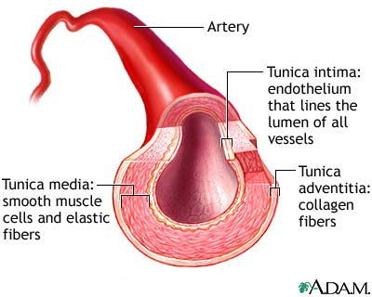
ARTERIES
Blood vessels that carry blood away from the heart are called arteries.
They are the thickest blood vessels and they carry blood high in oxygen known as oxygenated blood (oxygen rich blood).

Slide 15
ARTERIES
Accompanied by vein and nerves
Lumen is small
No valves
Repeated branching

Slide 16
CLASSIFICATION OF ARTEIES
Elastic- e.g. (Aorta & its Major branches)
Muscular -e.g.(Renal, Testicular, Radial, Tibial etc.)
Arterioles (<0.1 mm)-
Terminal arterioles
Meta-arterioles
Thoroughfare
channel/ preferred

Slide 17
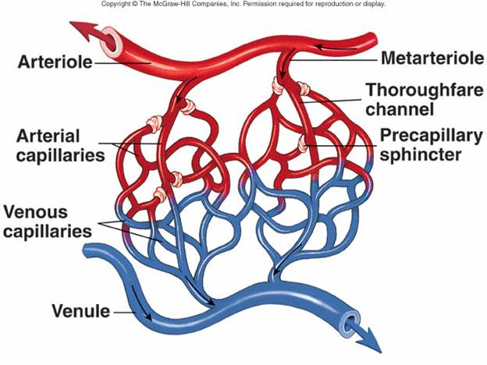
CAPILLARIES (5-8 micron)
The smallest blood vessels are capillaries and they connect the arteries and veins.
This is where the exchange of nutrients and gases occurs.

Slide 18
BODY CONTAINS TWO KINDS OF CAPILLARIES
CONTINUOUS-SKIN, LUNG, SMMOTH MUSCLE, CONNECTIVE TISSUES
FENESTRATED- PANCREAS,ENDOCRINE GLANDS, SMALL INTESTINE,CHOROID PLEXUS,CILLIARY PROCESS etc.

Slide 19
SINUSOIDS
SINUSOIDS- Large irregular vascular space (30-40 micron) eg.Liver, Spleen, Bone marrow, suprarenal, Parathyroid etc.

Slide 20
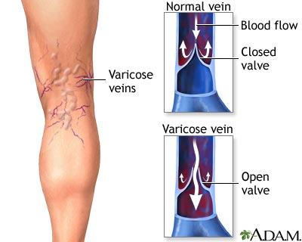
VEINS
Blood vessels that carry blood back to the heart are called veins.
They have one-way valves which prevent blood from flowing backwards.
They carry blood that is high in carbon dioxide known as deoxygenated blood (oxygen poor blood).

Slide 21
VEINS
Thin Walled
Large irregular lumen
Have valves
Dead space around
Types:
Large
Medium
Small

Slide 22
VEINS
Veins without valves:
SVC & IVC
Hepatic, Renal
Uterine, Ovarian not Testicular
Facial
Pulmonary
Umbilical
Emissary
Portal Veins <2mm

Slide 23
VEINS
Veins without Muscular tissue:
Dural venous sinuses
Pial Veins
Retinal
Veins of erectile tissue of sex organs
Veins of spongy bones

Slide 24
VEINS
Factors responsible for venous return:
Muscle contraction
Negative intrathoracic pressure
Pulsation of arteries
Gravity
Valves

Slide 25
ANASTOMOSIS
Communication between vessels
ARTERIAL:
Actual( end to end & convergent)-Palmar, plantar, Circle of Willis, Labial Intestinal arcade, etc.
Potential-Coronary, around joints etc.

Slide 26
ANASTOMOSIS
ARTERIOVENOUS ANASTOMOSIS:
Skin of nose
Lips
External Ear
Mucus membrane of GI & nose
Erectile tissue of sex organ
Thyroid
Tongue

Slide 27
END ARTERIES
END ARTERIES:
Central artery of retina
Arteries of spleen, liver, kidneys, metaphyses of long bones
Central branches of cerebral cortex

Slide 28
CIRCULATION
Coronary circulation – the circulation of blood within the heart.
Pulmonary circulation – the flow of blood between the heart and lungs.
Systemic circulation – the flow of blood between the heart and the cells of the body.
Fetal Circulation

Slide 29
SYSTEMIC AND PULMONARY CIRCULATION
Pulmonary circulation
The flow of blood between the heart and lungs.
Systemic circulation The flow of blood between the heart and the cells of the body.
Chapter 18, Cardiovascular System
Figure 18.5
29

Slide 30
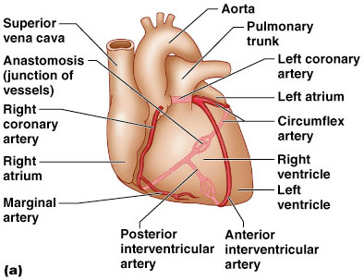
CORONARY CIRCULATION: ARTERIAL SUPPLY
Chapter 18, Cardiovascular System
30
Figure 18.7a

Slide 31
PORTAL CIRCULATION
Portal circulation - the flow of blood between tow set of capillaries before draining in systemic veins.

Slide 32
FETAL CIRCULATION

Slide 33
UMBILICAL ARTERY
DESCENDING AORTA
(Through Ductus Arteriosus)
PULMONARY TRUNK
RIGHT VENTRICLE
ASCENDING AORTA
UMBILICAL VEIN
PORTAL VEIN
(Through Ductus Venosus)
INFERIOR VENA CAVA
RIFHT ATRIUM
(Through Foramen Ovale)
LEFT ATRIUM
PLACENTA

Slide 34
APPLIED
Diseases and Disorders
BLOOD PRESSURE
HAEMORRHAGE/STROKE
ARTERIOSCLEROSIS
ANEURYSM
CORONARY ARTERY DISEASE (CAD)
HEART ATTACK
CONGESTIVE HEART FAILURE (CHF)
ANEMIA, HEMOPHILIA, AND LEUKEMIA

Slide 35
APPLIED
Problems with the cardiovascular system are common, but they don’t just affect older people.
Many heart problems affect children and teenagers.

Slide 36
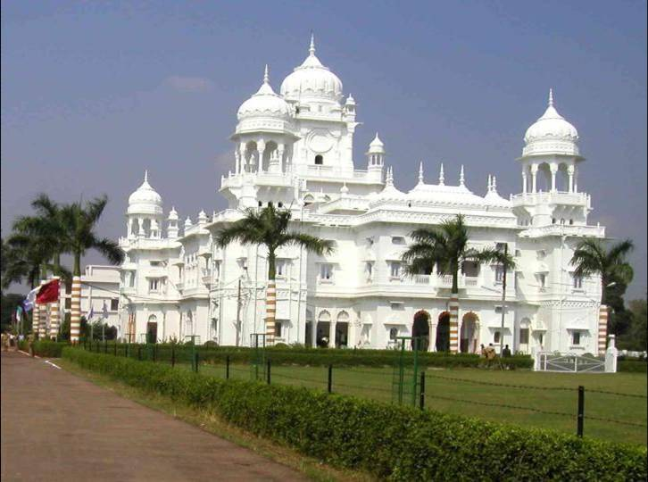
THANK YOU

