Slide 1
IMF
Dr. Pravin Kumar Agrawal
Assistant Professor
Department of Business Management
CSJMU

Slide 2
International Monetary Fund (IMF)
The institutional framework within which international payments are made, movements of capital are accommodated and exchange rates among currencies are determined.
The International Monetary Fund (IMF) promotes international financial stability and monetary cooperation. It also seeks to facilitate international trade, promote high employment and sustainable economic growth, and reduce poverty around the world. The IMF is governed by and accountable to its 189 member countries.

Slide 3
IMF
The IMF works to achieve sustainable growth and prosperity for all of its 190 member countries. It does so by supporting economic policies that promote financial stability and monetary cooperation, which are essential to increase productivity, job creation, and economic well-being.

Slide 4
Facts on the IMF
Membership: 190 countries
Headquarters: Washington, D.C.
Executive Board: 24 Directors each representing a single country or a group of countries
Total quotas: SDR 973 billion or US$ 1 trillion (as of March 2021)
Argentina has the highest level of outstanding IMF financing ($40.18 billion), 902% of its quota. Other large borrowers include: Egypt ($19.6 billion), Ukraine ($9.8 billion), Pakistan ($7.84 billion) and Ecuador ($6.86 billion). (March 2022)

Slide 5
Introduction
Toward the end of the Second World War, in July 1944, representatives of the United States, Great Britain, France, Russia, and 40 other countries met at Bretton Woods, a resort in New Hampshire, to lay the foundation for the post-war international financial order. Such a new system, they hoped, would prevent another worldwide economic cataclysm like the Great Depression that had destabilized Europe and the United States in the 1930s.
Therefore, the United Nations Monetary and Financial Conference, as the Bretton Woods conference was officially called, created the International Monetary Fund (the IMF) and the World Bank to prevent economic crises and to rebuild economies shattered by the war.

Slide 6
The Origins of the IFIs
At the time of Bretton Woods, there was serious concern about the stability of global economic markets. The world-wide depression of the 1930s had been deepened by the instability of international currency markets and the contraction of international trade, so that stabilization of those markets and promotion of trade were considered crucial to avoid another crisis. Likewise, the widespread destruction of Europe and uncertainty about its future also threatened to cause economic and political disruption

Slide 7
Contd…
The Bretton Wood conference therefore gathered together some of the world's most prominent minds in economic policy and some of its most powerful policy-makers to chart a new course. Representing the United States and serving as chairman of the conference was Henry Morgenthau, the U.S. Secretary of the Treasury. Morgenthau was accompanied by Harry Dexter White, the Assistant Secretary of the Treasury, who had laid the groundwork for the conference and originated the key ideas and policies to be discussed.

Slide 8
Contd…
Some leading economists from smaller nations were also quite influential at the conference, such as Louis Raminsky of Canada, Kyriakos Varvaressos of Greece, and Johan Beyen of the Netherlands. Morgenthau opened the conference by telling his fellow participants, "What we do here today will shape to a significant degree the nature of the world in which we are to live.
The aim of the conference was to draw up plans for the IMF and World Bank (as well as a proposed International Trade Organization, which never got off the ground as a result of concerns among many countries over their economic sovereignty).

Slide 9
Contd…
The conference was controversial, however, with the public, politicians, and media in many of the countries especially the United States—that were wary of international control of their sovereign economic policy. Even the U.S. and British delegations, the leading countries at the conference, commented to each other that their plans had to be politically amenable to their home governments to be ultimately approved.
At the same time, the conference was largely opaque to the public. The prominent American commentator Walter Lippman said, "It has been impossible for the general public to obtain any idea of what the Bretton Wood conference is about. Though it is concerned with questions which will affect men's lives deeply, the language of monetary policy is understood by very few men in any country.

Slide 10
Contd…
Negotiations at the conference were, therefore, contentious. Although White had drawn up plans for the proposed organizations, many details, especially regarding financial contributions to the new institutions, were still to be worked out. Countries were concerned about the balance of power within the organizations as reflected in their proportions of contributions of gold to the IMF and their ability to draw from the IMF (their "quotas").

Slide 11
Contd…
There were extensive IMF negotiations regarding how to divide the total amount of money the IMF would have among the 44 participants. India insisted on having as high a quota as China, for example, while France insisted on having more than India and more than the three Benelux countries (Belgium, the Netherlands, and Luxembourg), who were coordinating their monetary policy. The Russians insisted on a quota of not much less than the British and argued that they should have to contribute less gold to the fund than other countries because of their suffering in the war, but be able to draw a higher proportional quota than other countries. At the same time, they refused to publish accurate economic statistics.

Slide 12
Contd…
Other disputes concerned the governance of the organizations, such as how many permanent seats the major contributors would hold and where the organizations would be located; the British unsuccessfully lobbied for the IMF to be in London. Another significant dispute revolved around whether the dollar would serve along with gold as the standard for exchange rates, which, in the end, the American delegation successfully insisted on. Mean while, Keynes, leading the committee that drew up plans for the World Bank, dominated the drafting process and forged the institution largely along his preferred lines and implementing his key economic idea—that governments should spend their resources to stimulate their economies during slowdowns.

Slide 13
Contd..
With the diplomatic wrangling completed, the conference's Final Act was signed on July 22, 1944, although the institutions did not actually start operations until the following year. In a letter read to the delegates, U.S. President Franklin Roosevelt said that they had "prepared two further foundation stones for the structure of lasting peace and security.”

Slide 14
Governance
The IMF is controlled by its 189 member-countries, each of whom appoints a representative to the IMF's Board of Governors. The Board of Governors, most of whom are the finance ministers or heads of the central bank of the members, meet once per year to discuss and possibly achieve consensus on major issues. In the meantime, day-to-day operations are managed by a 24-person Executive Board. The world's major economic and political powers—the United States (the IMF's largest shareholder), Great Britain, Japan, Germany, France, China, Russia, and Saudi Arabia—each have permanent seats on the executive board, while the 16 other directors are elected for two-year terms by groups of countries divided roughly by geography, e.g., Caribbean, Africa, Southeast Asia, etc. The executive board, in turn, is run by the managing director, who is elected for renewable five-year terms.

Slide 15
Governance…
The IMF also has an International Monetary and Financial Committee of 24 representatives of the member-countries that meets twice yearly to provide advice on the international monetary and financial system to the IMF's staff.
In all of its operations, voting power is weighted based on the size of the economy and therefore the quota allocation of each country. Decisions are usually taken by consensus, but the United States, as the IMF's major shareholder, has the most influence in the institution's policy-making.

Slide 16
Organization
The IMF's current managing director is Ms. Christine Lagarde of France, who took office on June 28, 2011. Each members of the executive board runs a particular department of the IMF. There are offices devoted to
a) Particular regions of the world, such as Europe, Africa, Middle East, Western Hemisphere, and Asia/Pacific;
b) Functions, such as finance, technical assistance, fiscal planning, capital markets, research, and statistics; and,
c) Administrative functions of the IMF itself.
The IMF has a total of 2,600 employees, mostly based in its Washington, D.C. headquarters.

Slide 17
Purposes
The Bretton Woods Conference set out six goals for the IMF in its Articles of Agreement.

Slide 18
Purposes
(i) To promote international monetary cooperation through a permanent institution that provides the machinery for consultation and collaboration on international monetary problems.
(ii) To facilitate the expansion and balanced growth of international trade, and to contribute thereby to the promotion and maintenance of high levels of employment and real income and to the development of the productive resources of all members as primary objectives of economic policy.

Slide 19
Purposes
(iii) To promote exchange rate stability, to maintain orderly exchange arrangements among members, and to avoid competitive exchange depreciation.
(iv) To assist in the establishment of a multilateral system of payments in respect of current transactions between members and in the elimination of foreign exchange restrictions that hamper the growth of world trade.(eliminating restrictions on the international flow of capital)

Slide 20
Purposes
(v) To give confidence to members by making the general resources of the IMF temporarily available to them under adequate safeguards, thus providing them with opportunity to correct maladjustments in their balance of payments without resorting to measures destructive of national or international prosperity.
(vi) In accordance with the above, to shorten the duration and lessen the degree of disequilibrium in the international balances of payments of members.

Slide 21
Contd…
The IMF has evolved significantly as an institution since it was created. Floating exchange rates and more open capital markets in the 1990s created a new role for the. The Asian financial crisis of 1997-1998 and subsequent crises in Russia and Latin America revealed many weaknesses of the world monetary system, which have only become more apparent in the wake of the 2008-2009 global financial crisis and the more recent sovereign debt crises in Europe.

Slide 22
Background Origins
Prior to World War II, there was no negotiated international regime governing international monetary and trade relations. It was the shared view among the allied powers that many characteristics of the international financial system during the period between the first and second world wars, including competitive devaluations, unstable exchange rates, and protectionist trade policies, worsened the 1930s depression and accelerated the onset of the war. To address these concerns, representatives of the 44 allied nations gathered in Bretton Woods, NH, in July 1944 for the United Nations Monetary and Financial Conference. Their goal was ambitious and largely successful—to create a cooperative and institutional framework for the global economy that would facilitate international trade and balanced global economic stability and growth.

Slide 23
Contd…
At the Bretton Woods conference, Articles of Agreement for the IMF and the International Bank for Reconstruction and Development (IBRD), later known as the World Bank, were drafted and adopted. They entered into force, formally creating the institutions, on December 27, 1945, following the adoption of implementing or authorizing legislation within member countries. The Articles of Agreement of both institutions constitute an international treaty, imposing obligations on member states, which have changed over time.

Slide 24
The Bretton Woods Monetary System
From 1946 to 1971, the main purpose of the IMF was regulatory, ensuring IMF members’ compliance with a par value exchange rate system. This was a two-tiered currency regime using gold and the U.S. dollar. Each IMF member government could choose to define the value of its currency in terms of gold or the U.S. dollar, which the U.S. government agreed to support at a fixed gold value of one ounce of gold being equal to $35.

Slide 25
Contd…
When currencies (other than the U.S. dollar) came under pressure from short-term “balance of payments” imbalances that normally arose through international trade and finance exchanges, countries would receive short-term financial support from the IMF.

Slide 26
Contd…
The first major challenge to the postwar international monetary system came in the early 1960s.The postwar expansion in international trade and economic growth required an increase in international liquidity, that is, an increase in central bank holdings of the two major international reserve assets, gold and the U.S. dollar. With the economic recovery of Europe well advanced, the slow growth in gold supplies was hampering the growth of international reserve assets. As early as 1960, global foreign dollar holdings exceeded the value of U.S. gold holdings (at $35 an ounce). The system could continue to function as long as countries were willing to settle their balance of payments in U.S. dollars instead of gold.

Slide 27
Contd…
The international community’s response was to create a new international reserve currency, the Special Drawing Right (SDR). The SDR also serves as the IMF’s unit of account. Initially defined as equivalent to 0.888671 grams of fine gold, the value of the SDR was switched to a basket of international currencies following the collapse of the Bretton Woods system of fixed parity exchange rates in 1973. The current basket includes the euro, the Japanese yen, the British pound sterling, and the U.S. dollar.

Slide 28
Contd…
By 1970, a large and prolonged U.S. balance-of-payments deficit was mirrored by its counter part, large balance-of-payments surpluses in the other major industrial countries. As a result, much of the 1960s was characterized by substantial currency instability, as liberalized capital flows brought about repeated currency crises in the supposedly “fixed” exchange rate Bretton Woods system. Amid declining confidence in the U.S. dollar, foreign central banks increasingly became reluctant holders of U.S. dollars and began exchanging their dollar reserves for U.S. gold holdings. After several years of instability, the Bretton Woods system of fixed exchange rates finally collapsed in March 1973 when the United States severed the link between the dollar and gold, allowing the value of its currency to be determined by market forces.

Slide 29
From 1973 to the Present
A major purpose of the IMF as originally conceived at Bretton Woods—to maintain fixed exchange rates—was, thus, at an end. Although the IMF had lost its motivating purpose, it adapted to the end of fixed exchange rates. In 1973, IMF members enacted a comprehensive rewrite of the IMF Articles. IMF members condoned the floating-rate exchange rate system that was already in place; officially ended the international monetary role of gold (although gold remains an international monetary asset); and, nominally, but unsuccessfully, made the SDR the world’s “principal reserve asset.” Henceforth, member countries were allowed to freely determine their currency’s exchange rate, and use private capital flows to finance trade imbalances.

Slide 30
Contd…
The IMF was also given two new mandates, which became the foundation of its role in the post-Bretton Woods international monetary system. The first was for the IMF to oversee the international monetary system to ensure its effective operation. The second was to oversee the compliance by member states with their new obligations to “collaborate with the Fund and other members to assure orderly exchange arrangements and to promote a stable system of exchange rates.” Consequently, the IMF transformed itself from being an international monetary institution focused almost exclusively on issues of foreign exchange convertibility and stability to being a much broader international financial institution, assuming a broader array of responsibilities and engaging on a wide range of issues including financial and capital markets, financial regulation and reform, and sovereign debt resolution.

Slide 31
Contd…
The IMF also increasingly relied on its lending powers, as floating exchange rates and the growth of international capital flows led to more frequent, and increasingly severe, financial crises. Over the past several decades, the IMF has been involved in the oil crisis of the 1970s; the Latin American debt crisis of the 1980s; the transition to market-oriented economies following the collapse of communism; currency crises in East Asia, South America, and Russia; and, most recently, the global response to the 2008-2009 global financial crisis and the 2010-2011 European sovereign debt crisis.

Slide 32
Institutional Aspects
Organizational Structure
The IMF Articles provide for a three-tiered governance structure with a Board of Governors, an Executive Board, and a Managing Director (Figure 1).

Slide 33
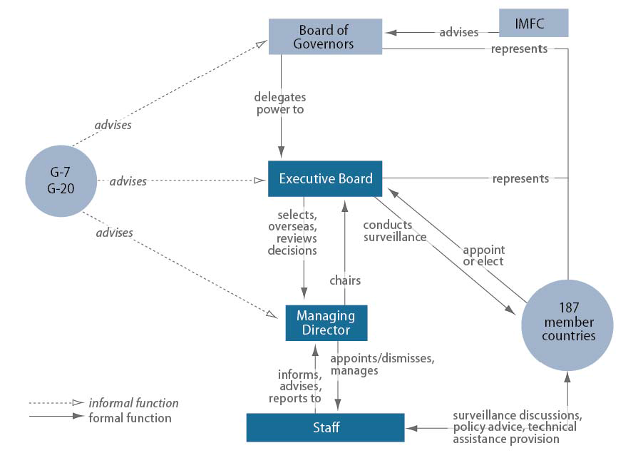
Structure of IMF

Slide 34
Contd…
The Board of Governors is the highest policy-making authority of the IMF. All countries are represented on the Board of Governors, usually at the finance minister or central bank governor level. IMF Governors usually meet annually at the fall IMF meetings. A committee of the Governors, the International Monetary and Financial Committee (IMFC), meets twice annually to consider major policy issues affecting the international monetary system and makes recommendations to the full Board of Governors. The Development Committee, a joint committee of the Boards of Governors of the IMF and World Bank, also meets at the same time to consider development policy issues and other matters affecting developing countries. The two committees generally issue communiqués at the close of their meetings, summarizing their findings and recommendations.

Slide 35
Contd…
Day-to-day authority over operational policy, lending, and other matters is vested in the Board of Executive Directors, a 24-member body that meets three or more times a week to oversee and supervise the activities of the IMF. The five largest shareholders are entitled to appoint their own Executive Director. The remaining members are elected by groups of countries, generally on the basis of geographical or historical affinity. A few countries—Saudi Arabia, China, and Russia— have enough votes to elect their own Executive Directors. In reforms approved by the Governors in December 2010, the IMF Articles of Agreement will eventually be amended so that the Executive Board will consist solely of elected Directors, doing away with the practice of some member countries appointing their representatives

Slide 36
Contd…
The IMF Executive Board selects the Managing Director of the IMF, who serves as its chairman and chief executive officer. The Managing Director is elected for a five-year renewable term of office. The Executive Board also approves the selection of the Managing Director’s principal assistants, the First Deputy Managing Director and three Deputy Managing Directors. The Managing Director manages the ongoing operations of the Fund (under the policy direction of the Executive Board); supervises some 2,800 staff members; and oversees the preparation of policy papers, loan proposals, and other documents that go before the Executive Board for its approval.

Slide 37
In addition to the official representation of the Board of Governors and the Executive Board, several other cross-cutting groups of countries are actively involved with the IMF. These include forums such as the Group of Seven (G-7) meeting of the finance ministers, the Group of 20 major economies (G-20), which in 2009 was declared by its members as the premier forum for international economic cooperation, and the Intergovernmental Group of Twenty-Four on International Monetary Affairs and Development (G-24), which coordinates the position of developing countries on monetary and development issues.

Slide 38
Quotas
Quotas are the primary national contribution to the IMF and are the foundation of country representation at the IMF. When a country joins the Fund, it is assigned a quota based on its relative weight in the global economy. Economic considerations include a member’s GDP, openness to trade, volume of current account transactions, and level of official reserves.

Slide 39
Quotas…
A country’s quota determines:
Subscriptions: the amount of financial resources each member is required to contribute to the Fund;
Access to Financing: the amount of financing a member may receive from the Fund; and Voting Power: the ability to formally influence the IMF’s decisions.

Slide 40
Quotas…
The total of all member countries’ quota subscriptions is 477 billion IMF Special Drawing Rights (SDRs), approximately US$668 billion. Upon joining the Fund, a country normally pays up to one quarter of its quota, the so-called “reserve tranche,” in the form of reserve assets, widely accepted foreign currencies (such as the U.S. dollar, euro, yen, pound sterling), or special drawing rights (SDRs). The remaining three-quarters are paid in the country’s own currency.

Slide 41
Voting and Influence at the IMF
The Executive Board or Board of Governors of the IMF can approve loans, policy decisions, and many other matters by a simple majority vote. However, a supermajority vote is required to approve major IMF decisions. The supermajority may require a 70% or 85% vote, depending on the issue. A 70% majority is required to resolve financial and operational issues such as the interest rate on IMF loans or the interest rate on SDR holdings. An 85% majority is required for the most important decisions, such as the admission of new members, increases in quotas, allocations of SDRs, and amendments to the IMF’s Articles of Agreement.

Slide 42
Voting and Influence at the IMF…
As Figure shows, voting at the IMF is highly concentrated, with 10 countries controlling over 50% of the voting shares (Table 1). With a voting share of 16.75%, the United States is the only country able to unilaterally veto major IMF decisions (i.e., those requiring an 85% majority). The United States also exercises a substantial amount of informal power at the IMF, given its large quota share and the location of the Fund in Washington, DC. According to one analyst, “the IMF is an instrument of the G-7 countries. There is no example that comes easily to mind of a position taken by the IMF on any systematic issue without the tacit, if not explicit, support of the United States and the other G-7 countries.”

Slide 43
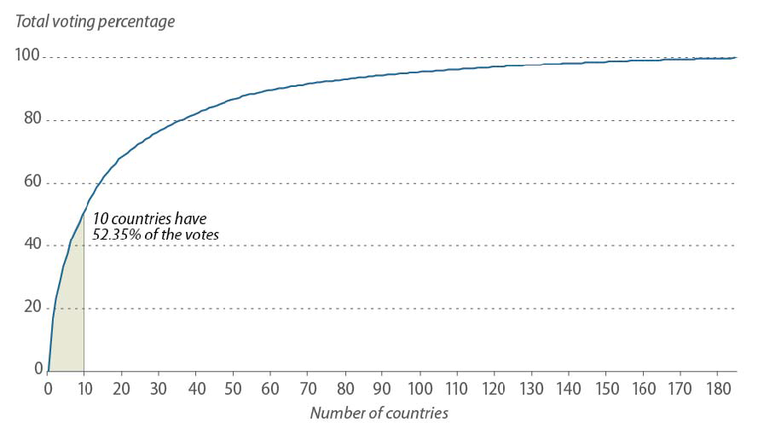

Slide 44
Table 1. IMF Members with Largest Quota and Voting Shares (as of July 10, 2014)
Member Quota share (percentage) Voting share (percentage)
United States 17.69 16.75
Japan 6.56 6.23
Germany 6.12 5.81
France 4.51 4.29
United Kingdom 4.51 4.29
China 4.00 3.81
Italy 3.31 3.16
Saudi Arabia 2.93 2.80
Canada 2.67 2.56
Russia 2.50 2.39

Slide 45
The IMF states that its programs are based on purely economic factors, in order to seek an acceptable balance between protecting the interests of individual members and those of the membership as a whole. In practice, however, many analysts contend that the IMF is a highly politicized institution, reflecting the wide power differential between a few advanced economies and the remaining membership. For example, some analysts argue that recent IMF lending to European countries has been greater, and on more lenient terms, than lending provided to developing countries. “History suggests that if this were happening to a poor country or developing country, the rich countries would have voted against the loan.

Slide 46
Functions of the IMF
In practice, the IMF’s mandate of promoting international monetary stability translates into three main functions:
surveillance of financial and monetary conditions in its member countries and in the world economy;
(2) financial assistance to help countries overcome major balance-of payments problems; and
(3) technical assistance and advisory services to member countries.

Slide 47
Surveillance
Each year, the IMF sends economists to each of its member countries to analyze the country's economic situation. The team examines fiscal and monetary policy, exchange rate, general macroeconomic stability, and any related policies, such as labor policy, trade policy, and social policy (such as the pension system). This process is known as an Article IV consultation, after the section authorizing it in the Articles of Agreement. The purpose of such consultation is to provide an outside check on national decisions that might have an affect on the international economic system.

Slide 48
Surveillance…
After the team finishes its analysis, the IMF executive board discusses the report and gives it to the leaders of the country in question as the official opinion of the IMF. A version of the report is also published and available as an IMF Public Information Notice (PIN). The IMF also performs similar reviews of regional policy by such organizations as the European Union (EU), the West African Economic and Monetary Union, and the Eastern Caribbean Currency Union.

Slide 49
Surveillance…
On a global level, the IMF also publishes its analysis of the world economic system in its World Economic Outlook twice per year and the Global Financial Stability Report, which focuses specifically on the international capital markets, also twice per year.

Slide 50
Financial Assistance
The central activity undertaken by the IMF is financial assistance to national treasury departments. Member countries with balance of payments problems can receive credits and loans to pay off their obligations and readjust their economic policies so that they will not face another crisis or near-crisis. To receive assistance, however, the member-country must agree, through a "letter of intent," to implement changes in its fiscal and monetary policies that IMF experts have determined are necessary. These conditions are the cause of some of the most vociferous resentment toward the IMF because they often involve very detailed changes in national policies. Nevertheless, IMF assistance is considered so essential to national economic health that countries generally agree even when they have strong reservations.

Slide 51
The loans are disbursed in phases to ensure that the receiving country moves forward with the reforms required of it. Loans are generally granted for relatively short periods of time, for just a few months, or for as long as ten years, depending on the type of loan. The receiving country must pay back loans on time, on a rigorous schedule, because the loans are intended to be temporary assistance.
Countries are discouraged from becoming dependent on IMF loans, and, in fact, may face extra charges if too much of their government funding comes from the IMF. Rather, the IMF hopes to play a role as a catalyst for private banks to lend to governments, because the extension of an IMF loan is intended to express confidence that the receiving country is getting its financial house in order.

Slide 52
Technical Assistance
The IMF provides technical assistance on fiscal and monetary policy, regulatory procedures, tax policy, and collection of statistics, among other issues. These programs are aimed at strengthening developing countries' abilities to reform and properly manage their macroeconomic policies. The IMF dispatches its own experts and private consultants on training missions to educate government officials and also runs the IMF Institute in Washington, D.C. to provide courses for officials.

Slide 53
In addition to these three main activities, the IMF also has instituted various programs to ensure the stability of financial system management on a global scale. For example, the IMF, along with the World Bank and other institutions, has drafted voluntary standards and codes for countries and financial institutions to adapt in order to increase accountability and transparency and to limit corruption. The IMF also has developed two systems of collection and dissemination of statistical information to help assess the economic viability of the domestic and international financial systems.

