Slide 1
(Part-3)
Mucoadhesive systems
Involves the use of bioadhesive polymers, which can adhere to the epithelial surface in the stomach.
Dosage form can sick to mucosal surface by following mechanisms.
The wetting theory
The diffusion theory
The absorption theory
The electron theory

Slide 2
Swellable system
A dosage form in the stomach will withstand gastric transits if bigger than pyloric sphincter, but should be small enough to be swallowed.
These system swells many times.
Cross linking should be optimum because highly cross linked don’t swell.
Chitosan, HPMC, Sodium starch glycolate, Carbopol are used.
Diclofenac, Ciprofloxacin are reported these systems.

Slide 3
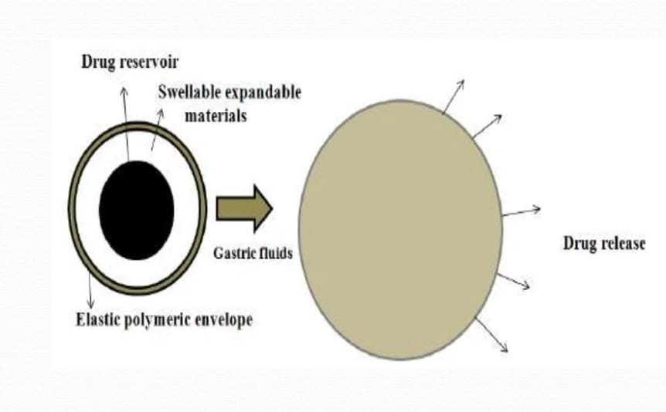

Slide 4
High density systems
These have density greater than that of gastric fluid (1.4g/cc).
Above 1.6g/cc is preferable, tend to withstand peristaltic movement of stomach.
Zinc oxide, Iron oxide, Titanium dioxide, barium sulfate are used as inert heavy core.

Slide 5
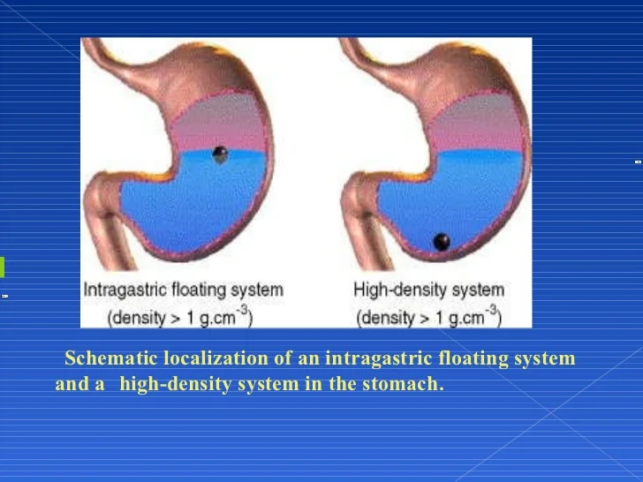

Slide 6
Thankyou

