Slide 1
Asthma and Anti-asthmatics
BP=602
Pharmacology III

Slide 2
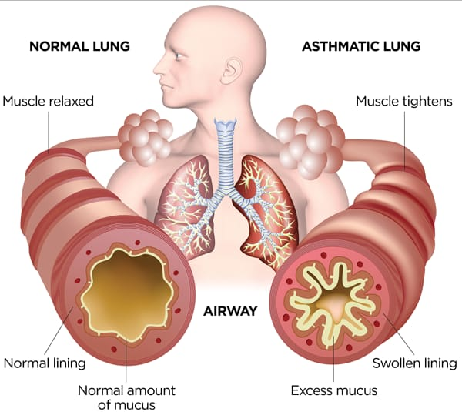
Asthma
Bronchial asthma is a respiratory disorder characterized by wheezing and difficulty in breathing due to increased resistance to airflow in the alveoli or small airways. This is caused by the spasm of the bronchial smooth muscles and also due to edema and swelling of bronchial mucous membrane. The viscid sputum causes blockage of small airways

Slide 3
Anti-asthmatic Drugs
Drugs for the treatment of asthma are-
Bronchodilators –
B₂ agonists – These drugs produces bronchodilation through B₂-receptors stimulation. Stimulation of these receptors increases Camp formation in bronchial muscle cell and produce relaxation .In addition increased cAMP in mast cells and other inflammatory cells decrease mediators release. There are two categories of B₂ agonists
Short acting- Orciprenaline, salbutamol, terbutaline, bitolterol procaterol pirbuterol etc
These drugs are given by inhalation reale rather than the oral route. However, terbutaline, orciprenaline etc.are also available as tablets , Oral route is not encouraged because the systemic effects are persistent, Inhalation route produce minimal side effects.
Long acting: Salmeterol and formoterol are long acting drugs and the effects last for about 12 hours
Theophylline - The exact mechanism of action of theophylline is not known. The proposed mechanisms are –
Inhibition of phosphodiesterases: Phosphodiesterases which degrades cyclic nucleotides intracellularly are blocked by theophylline Bronchodilation occur due increased cAMP
Blockade of adenosine receptors: Theophylline combines with the adenosine receptors and blocks it reg bronchodilation

Slide 4
Anticholinergies - Anticholinergic drugs cause bronchodilation by blocking cholinergic constrictor tone and bronchial secretion. They are less efficacious than B₂ agonists, but can add to their response. Atropine produces many side effects including dryness of mouth, hypotension, hallucination photophobia, urinary retention etc. Atropine also damages the cilia: therefore the use of atropine in the treatment of asthma is discontinued. However, ipratropium is almost free from side effects and does not produce cilliary damage, it is also not absorbed from GIT and therefore has to be given by inhalation route
2. Leukotriene modifiers - The cysteinyl leukotrienes (LT-C₄/D₄/E₄ ) are important mediators of bronchial asthma. Two cysteinyl leukotrienes receptor antagonist (montelukast, zafirlekast), and 5-LOX inhibitors (zileuton) are recently available. The plane montelukast is 3-6 hrs, while that of zafirlukast is 8-12 hrs. Dose-10 mg OD

Slide 5
3. Mast cell stabilizers -Sodium cromoglycate, Ketotofen
These drugs inhibit degranulation of mast cell by triggering stimuli. Release of mediator of asthma like histamine. LTs, PAF,. interleukins etc from mast cell as well as other inflammatory cell is prevented. Sodium chromoglycate is mast cell stabiliser, insoluble in water and is given as arresol. It is a prophylactic drug and has no bronchodilator action Dose: Sodium chromoglycate is administered as an aerosol 1 mg per dose 2 puffs 4 times a day. It is rapidly excreted unchanged in urine and bile. Its chief use is in the athma childhood, also used in allergic rhinitis
4. Glucocorticoids - Glucocorticoids like beclomethasone, flunisolide, triamcinolone, fluticasone and budesonide me given by inhalation and act to decrease the inflammatory process in the airways. In addition, the corticosteroids increase the sensitif D-receptors. With increased semivity of the receptors, the b-receptor agonist drugs become more effective. The glucocorticoids are contraindicated in patients with hypersensitivity to the corticosteroids, acute bronchospasm, status asthmatics or other cut of asthma. These are used cautiously in patients with compromised immune systems, glaucoma, kidney or liver disease. Convulsive disorders, or diabetes, thene taking systemic corticosteroids and during pregnancy

Slide 6
