Slide 1
Heme metabolism
Pratima Katiyar
School of Pharmaceutical Sciences

Slide 4
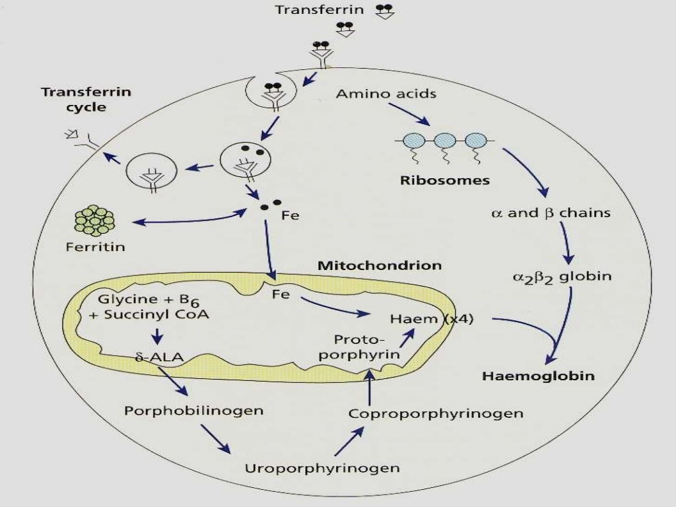

Slide 7
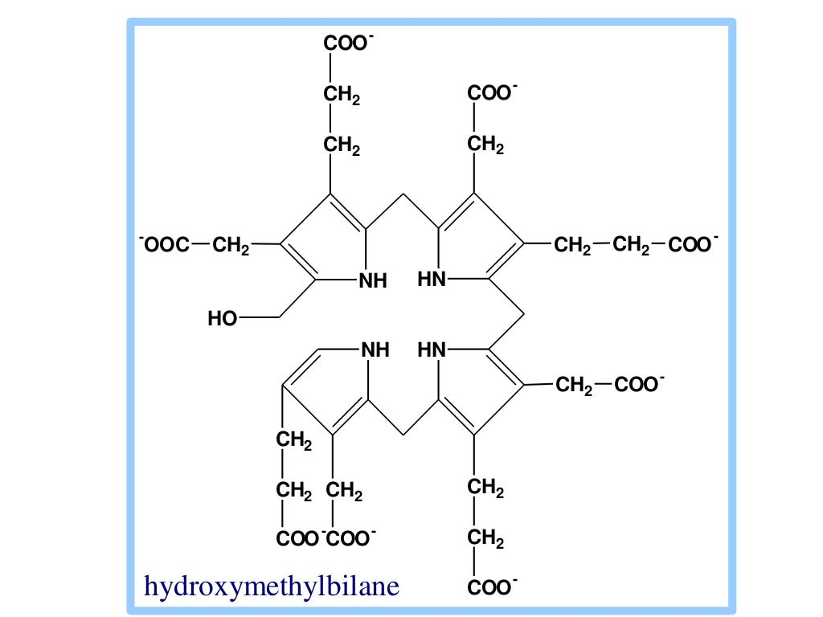

Slide 19
Referances
Heme Metabolism by Dr. Viyatprajana Acharya https://www.slideshare.net/ViyatprajnaAcharya/heme-metabolism-amp-jaundice
Textbook of biochemistry by Rahul B. Lovhare
Biochemistry by U, Satyanarayan

