Slide 1
ENDOCRINE SYSTEM
ANSHUMAN PRAJAPATI
M. PHARM, PHARMACOLOGY

Slide 2
Introduction
The endocrine system controls body activities by releasing mediators, called hormones.
A hormone (to excite or get moving) is a mediator molecule that is released in one part of the body but regulates the activity of cells in other parts of the body.
Most hormones enter interstitial fluid and then the bloodstream. The circulating blood delivers hormones to cells throughout the body.
Both neurotransmitters and hormone exert their effects by binding to receptors on or in their “target” cells.

Slide 4
Introduction
Exocrine glands (exo-outside) secrete their products into ducts that carry the secretions into body cavities, into the lumen of an organ, or to the outer surface of the body.
Exocrine glands include sudoriferous (sweat), sebaceous (oil), mucous, and digestive glands.
Endocrine glands (endo-within) secrete their products (hormones) into the interstitial fluid surrounding the secretory cells rather than into ducts. From the interstitial fluid, hormones diffuse into blood capillaries and blood carries them to target cells throughout the body.

Slide 6
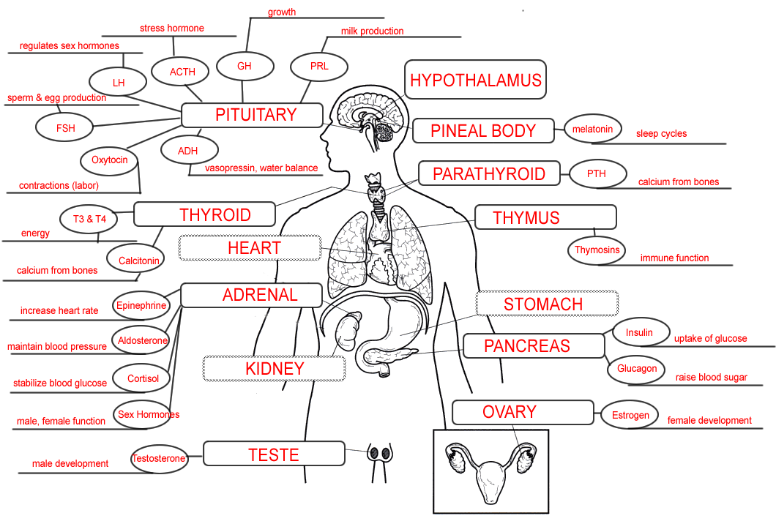

Slide 7
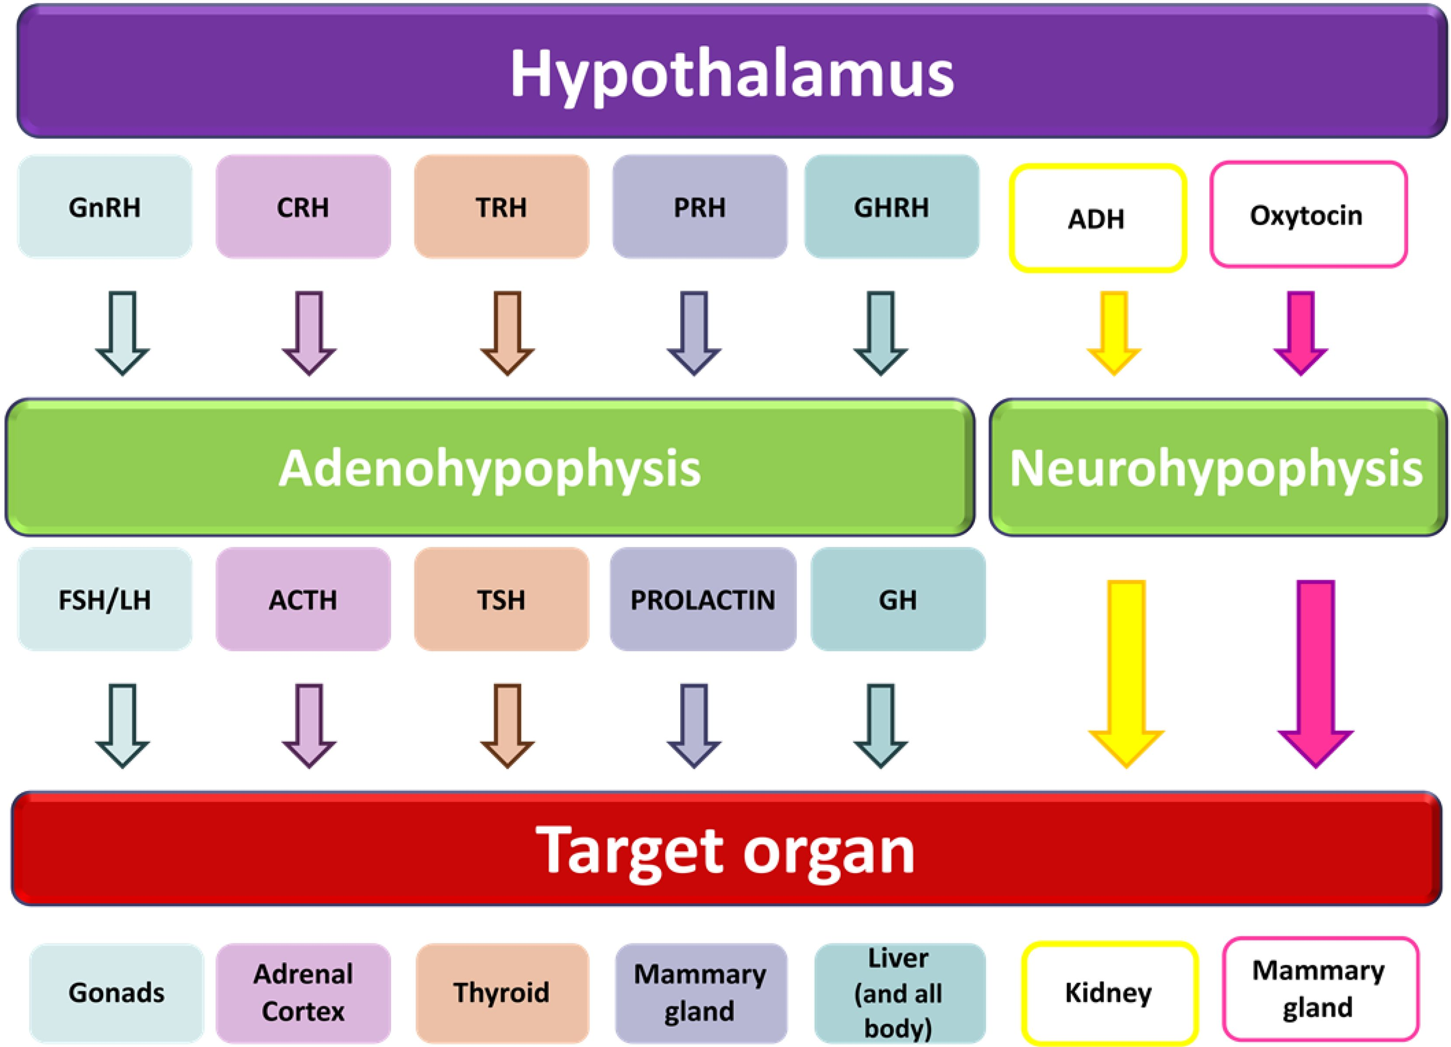

Slide 8
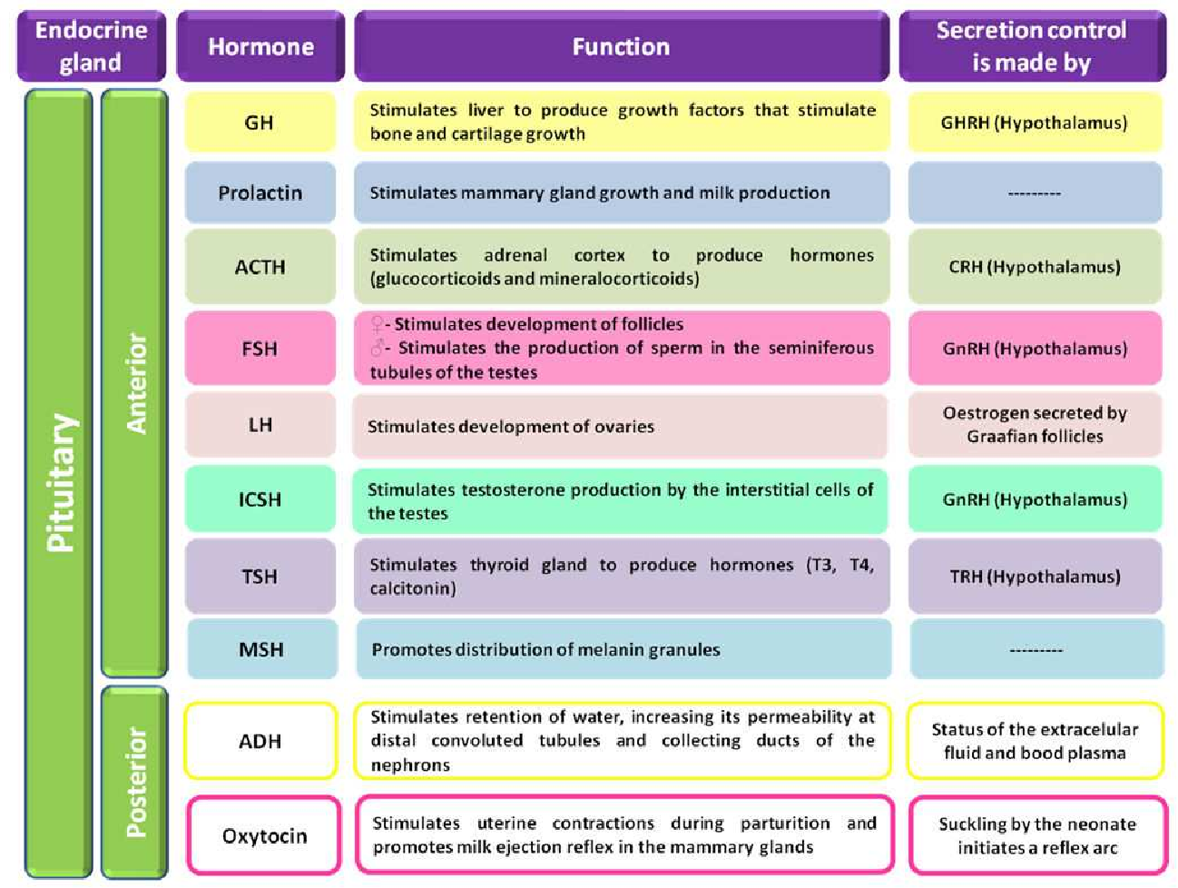

Slide 9
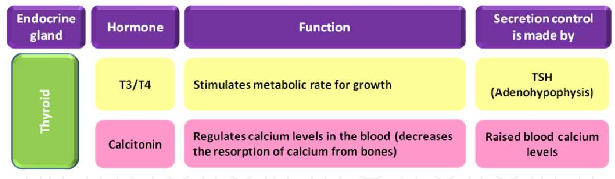
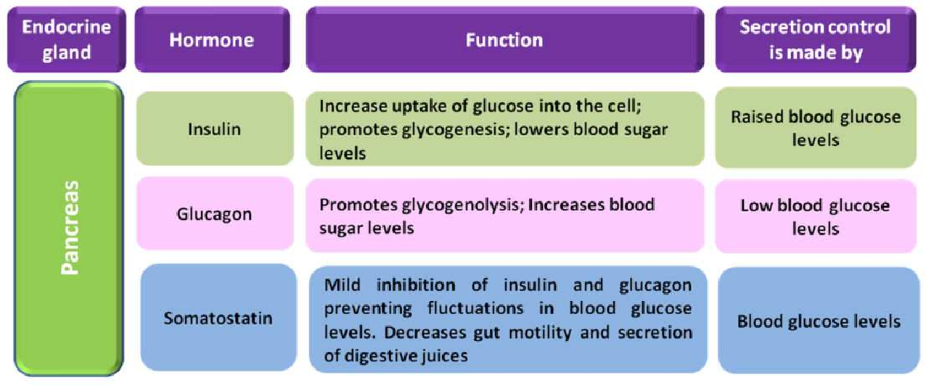

Slide 10
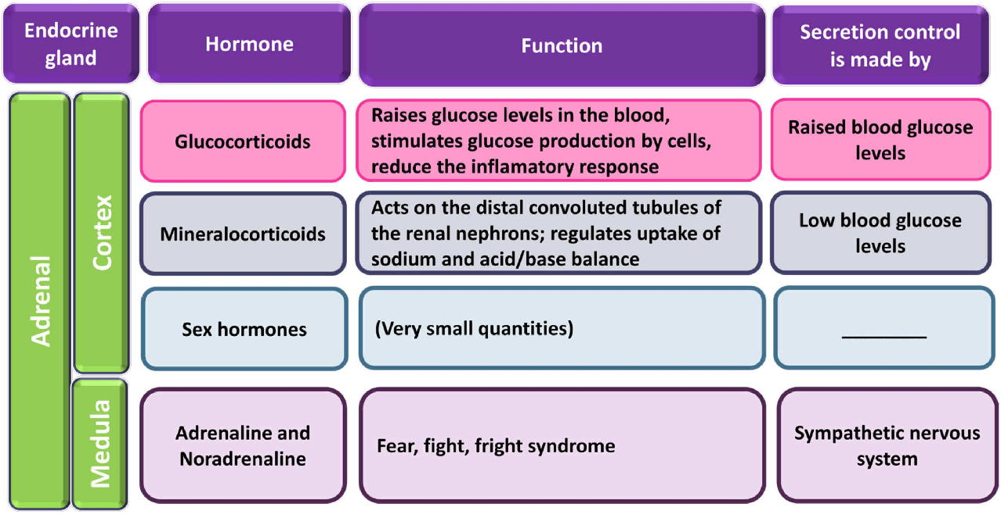

Slide 11
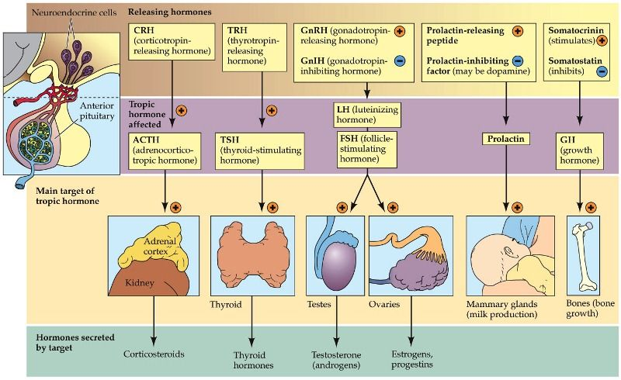

Slide 12
Hypothalamus (Detector)
↓
Release hormones
↓
Anterior lobe of Pituitary glands (Control centre)
↓
Trophic hormones to the endocrine glands
↓
Target gland (Effector)
↓
Raised blood level of target gland hormone
↓
Consumption of hormone
↓
Lowered blood level of target gland hormone

Slide 14
In labor, uterine contractions forces the baby’s head into cervix
↓+
Stretch receptors in uterine cervix (Detector)
↓
Nerve Stimulation or nerve impulse generation
↓
Hypothalamus & Posterior lobe of Pituitary glands (Control centre)
↓
Release of oxytocin
↓+
Uterine smooth muscles (Effector)
↓
Stronger contractions forces the baby’s head further into the cervix
↓
↓
Inhibition occurs after delivery when uterine contractions no longer stretch the cervix

