Slide 1
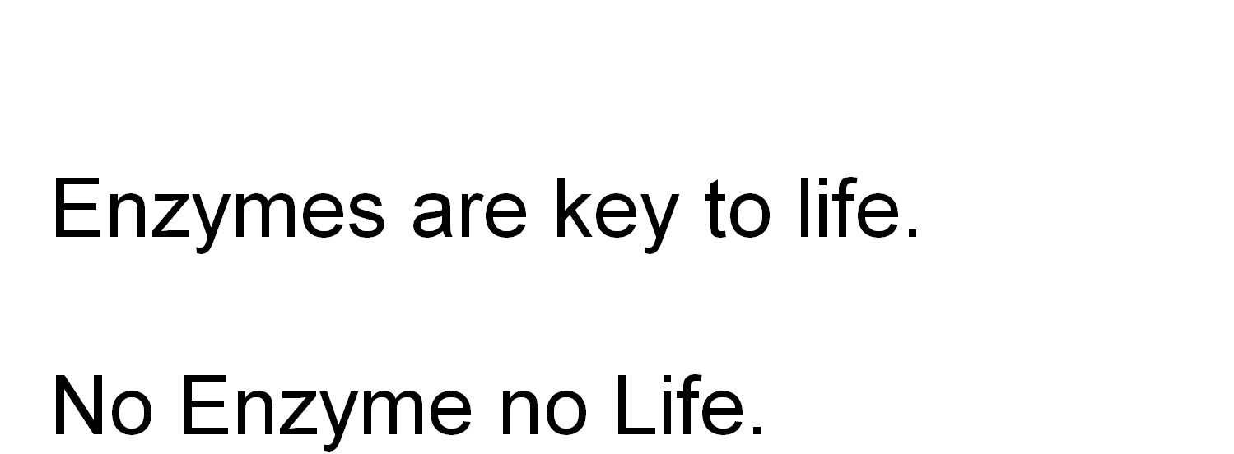

Slide 2
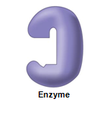
What is an enzyme?
globular protein which functions as a biological catalyst, speeding up reaction rate by lowering activation energy without being affected by the reaction it catalyse
Active site

Slide 3
Enzymes are protein in nature (?)
Globular protein.
Ribozymes are RNA molecule with enzymatic activity.
Catalytic behaviour of any enzyme depends upon its primary, secondary, tertiary or quaternary structure.
Enzymes of digestive tract and those found in blood are present in inactive form called zymogen or proezymes.

Slide 4
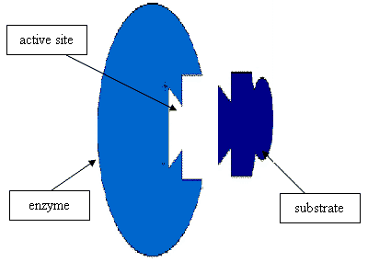
Active site
Enzymes are composed of long chains of amino acids that have folded into a very specific three-dimensional shape which contains an active site.
An active site is a region on the surface of an enzyme to which substrates will bind
and catalyses a chemical reaction.

Slide 5
Enzymes are highly specific for the type of the reaction they catalyze and for their substrate.
Notes:
Type of specificity recognized : Absolute specificity, group specificity, reaction specificity and stereospecificity
5

Slide 6
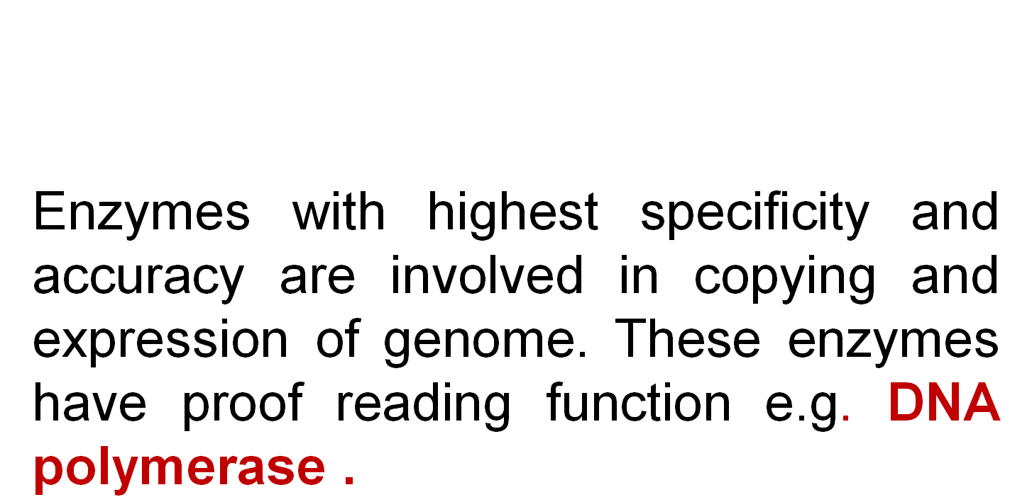

Slide 8
Mechanism of enzyme action
The enzymatic reactions takes place by binding of
the substrate with the active site of the enzyme
molecule by several weak bonds.
E + S ‹--------› ES --------› E + P
Formation of ES complex is the first step in the
enzyme catalyzed reaction then ES complex is
subsequently converted to product and free
enzyme.

Slide 9
"Lock and key" or Template model

Slide 10
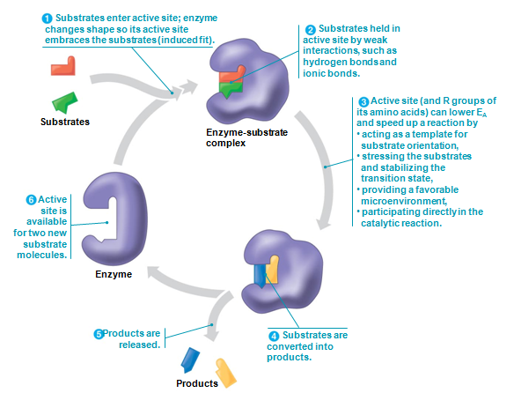
Induced-fit model

Slide 11
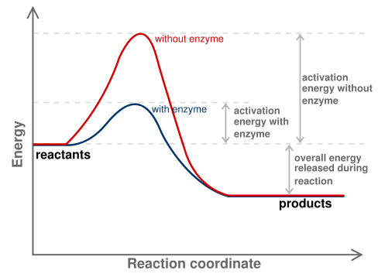
e.g. H₂O₂
e.g. O₂ + H₂O
Progress of Reaction

Slide 12
Nomenclature / enzyme classification
IUBMB has recommended system of nomenclature for enzymes & according to them each enzyme is assigned with two names:
Trivial name (common name, recommended
name).
Systemic name ( official name ).

Slide 13
Systemic name
Each enzyme is characterized by a code no.called
Enzyme Code no. or EC number and contain four
Figure (digit) separated by a dot.
e.g. EC m. n. o. p
First digit represents the class;
Second digit stands for subclass ;
Third digit stands for the sub-sub class or subgroup;
Fourth digit gives the serial number of the particular
enzyme in the list.
e.g. EC 2.7.1.1 for hexokinase.

Slide 14
Systemic name………
According to the IUBMB system of enzyme nomenclature enzymes are grouped into 6 major classes
EC 1 OXIDOREDUCTASES
EC 2 TRANSFERASES
EC 3 HYDROLASES
EC 4 LYASES
EC 5 ISOMERASES
EC 6 LIGASES
-

