Slide 1
GASTRORETENTIVE DRUG DELIVERY SYSTEM
Dr. Kalpana Kushwaha
Assistant professor
School of pharmaceutical sciences
Csjmu Kanpur

Slide 2
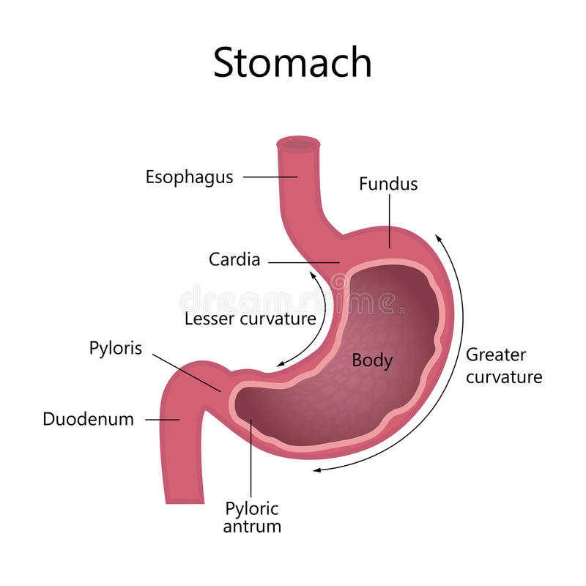
CONTENTS ( Part-1) Various Approaches For GRDDS -Floating drug delivery system -Mucoadhesive system -Swellable system -High density system

Slide 3
Floating Drug Delivery Systems
These are low density systems.
Have ability to float over gastric conditions.
The drug must have sufficient structure to form a cohesive gel barrier.
It must maintain an overall specific gravity lower than that ofgasstric contents(1.004-1.010)
Eased from the system at desired rate.

Slide 4
Floating Techniques
Effervescent
- Volatile liquid containing systems
- Gas generating systems
Non – effervescent
- Colloidal gel barrier systems
- Alginate beads
- Hollow microspheres
- Microporous compartment system

Slide 5
Effervescent systems
1.GAS GENERATING SYSTEMS
Effervescence is there.
Utilises effervescent reactions between carbonate/bicarbonate salts and citric/tartaric acid.
CO2 is released in presence of H2O.
When tablet is put in beaker it will sink.
2NaHCO3 + C4H6O6 → C4H4Na2O6 + 2CO2 + 2H20
With production of gas it rises up and floats.

Slide 6
2.Volatile liquid containing systems
The device consist of a bio erodible plug made up of PVA, polyethylene, etc. that gradually dissolves causing the inflatable chamber to release gas and collapse after a predetermined time to permit the spontaneous ejection of the inflatable systems from the stomach.
These systems are very less used as the gas generating systems are more safe.

Slide 7
Thankyou

