Slide 1
Hemorrhagic Fever

Slide 2
Hemorrhagic Fever
Viral hemorrhagic fevers are infectious diseases that can cause severe, life-threatening illness. They can damage the walls of tiny blood vessels, making them leak, and can hamper the blood's ability to clot. The resulting internal bleeding is usually not life-threatening, but the diseases can be.
Some viral hemorrhagic fevers include:
Dengue
Ebola
Lassa
Marburg
Yellow fever

Slide 3
Symptoms
Signs and symptoms of viral hemorrhagic fevers vary by disease. In general, early signs and symptoms can include:
Fever
Fatigue, weakness or general feeling of being unwell
Dizziness
Muscle, bone or joint aches
Nausea and vomiting
Diarrhea

Slide 4
Symptoms that can become life-threatening
More-severe symptoms include:
Bleeding under the skin, in internal organs, or from the mouth, eyes or ears
Nervous system malfunctions
Coma
Delirium
Kidney failure
Respiratory failure
Liver failure

Slide 5
Causes
Viral hemorrhagic fevers are spread by contact with infected animals or insects. The viruses that cause viral hemorrhagic fevers live in a variety of animal and insect hosts. Most commonly the hosts include mosquitoes, ticks, rodents or bats.
Some viral hemorrhagic fevers can also be spread from person to person

Slide 6
Mode of transmission
Some viral hemorrhagic fevers are spread by mosquito or tick bites. Others are spread by contact with infected body fluids, such as blood, saliva or semen. A few varieties can be inhaled from infected rat feces or urine.
If you travel to an area where a particular hemorrhagic fever is common, you can be infected there but not develop symptoms until after you return home. Depending on the type of virus, it can take from two to 21 days for symptoms to develop

Slide 7
DENGUE
Dengue viruses are spread to people through the bite of an infected Aedes species (Ae. aegypti or Ae. albopictus) mosquito. These mosquitoes also spread Zika, chikungunya, and other viruses.
Almost half of the world’s population, about 4 billion people, live in areas with a risk of dengue. Dengue is often a leading cause of illness in areas with risk.
Each year, up to 400 million people get infected with dengue. Approximately 100 million people get sick from infection, and 40,000 die from severe dengue.
Dengue is caused by one of any of four related viruses: Dengue virus 1, 2, 3, and 4. For this reason, a person can be infected with a dengue virus as many as four times in his or her lifetime.

Slide 8
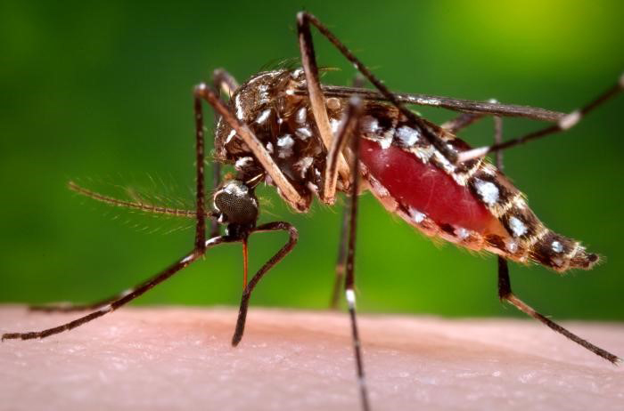
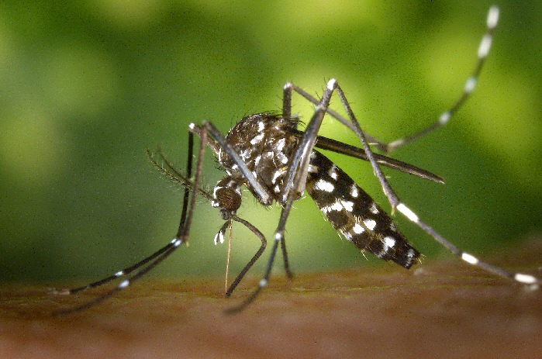
Ae. aegypti Ae. albopictus

Slide 9
Symptoms
Nausea, vomiting
Rash
Aches and pains (eye pain, typically behind the eyes, muscle, joint, or bone pain
Symptoms of severe dengue
Belly pain, tenderness
Vomiting (at least 3 times in 24 hours)
Bleeding from the nose or gums
Vomiting blood, or blood in the stool
Feeling tired, restless, or irritable

Slide 10
Dengue virus (DENV)
Dengue virus (DENV) belongs to the family Flaviviridae, genus Flavivirus.
It is a single-stranded positive-sense ribonucleic acid virus with 10,700 bases.
The genus Flavivirus includes other arthropod borne viruses such as yellow fever virus, West Nile virus, Zika virus, tick-borne encephalitis virus.
It infects ~50–200 million people annually, putting over 3.6 billion people living in tropical regions at risk and causing ~20,000 deaths annually.
There are four antigenically different serotypes of DENV based on the differences in their viral structural and nonstructural proteins. DENV infection causes a spectrum of illness ranging from asymptomatic to dengue fever to severe dengue shock syndrome.
Infection with one serotype confers lifelong immunity against that serotype, but heterologus infection leads to severe dengue hemorrhagic fever due to antibody-dependent enhancement

Slide 11
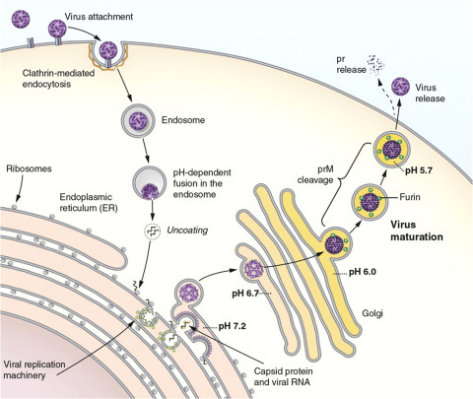
The DENV life cycle.

Slide 12
Diagnosis of dengue infections is based mainly on serological detection of either antigen in acute cases or antibodies in both acute and chronic infection.
Viral detection and real-time PCR detection though helpful is not feasible in resource poor setup.
Treatment of dengue depends on symptomatic management along with fluid resuscitation and may require platelet transfusion.

Slide 13
vaccine
A vaccine can help prevent dengue, which is caused by four distinct, but closely related dengue viruses, DENV-1, DENV-2, DENV-3, and DENV-4. Only one dengue vaccine is currently available for use:
A tetravalent, live-attenuated dengue vaccine (Dengvaxia®)

