Slide 1
Histoplasmosis

Slide 2
Histoplasmosis
Histoplasmosis is caused by two varieties of Histoplasma capsulatum: H. capsulatum var. capsulatum
H. capsulatum var. duboisii
H. capsulatum var. capsulatum causes pulmonary and disseminated infections in the eastern half of the United States and most of Latin America
H. capsulatum var. duboisii causes predominantly skin and bone lesions and is restricted to the tropical areas of Africa

Slide 3
Morphology
Both varieties of H. capsulatum are thermally dimorphic fungi existing as a hyaline mold in nature and in culture at 25°C and as an intracellular budding yeast in tissue and in culture at 37°C.
In culture, the mold forms of H. capsulatum var. capsulatum and var. duboisii are indistinguishable macroscopically and microscopically.
The mold colonies grow slowly and develop as white or brown hyphal colonies after several days to a week.
The mold form produces two types of conidia:
(1) large (8 to 15 µm), thick-walled, spherical macroconidia with spikelike projections (tuberculate macroconidia) that arise from short conidiophores
(2) small oval microconidia (2 to 4 µm) with smooth or slightly rough walls that are sessile or on short stalks .
The yeast cells are thin walled, oval, and measure 2 to 4 µm (var. capsulatum) or thicker walled and 8 to 15 µm (var. duboisii) .
The yeast cells of both varieties of H. capsulatum are intracellular in vivo and are uninucleated

Slide 4
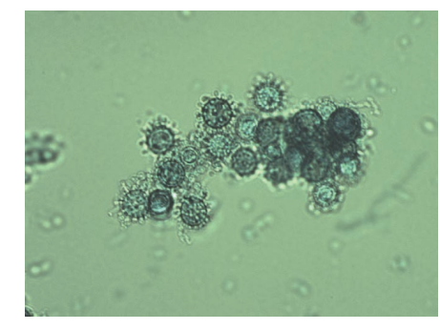
Histoplasma capsulatum mold phase showing tuberculate macroconidia.

Slide 5
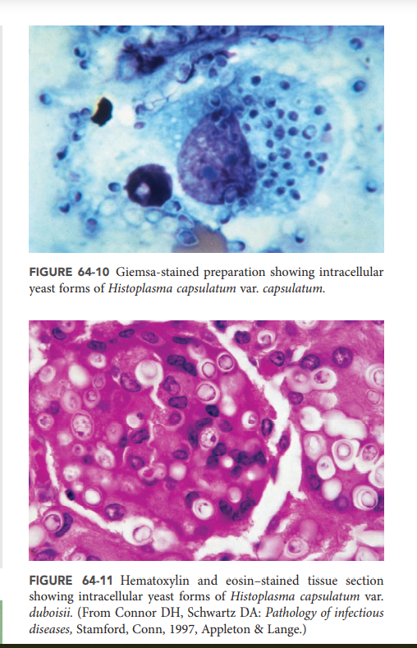

Slide 6
Epidemiology
Histoplasmosis capsulati is localized to the broad regions of the Ohio and Mississippi river valleys in the United States and occurs throughout Mexico and Central and South America .
Histoplasmosis duboisii, or African histoplasmosis, is confined to the tropical areas of Africa, including Gabon, Uganda, and Kenya .
The natural habitat of the mycelial form of both varieties of H. capsulatum is soil with a high nitrogen content, such as that found in areas contaminated with bird or bat droppings.
Outbbreaks of histoplasmosis have been associated with exposure to bird roosts, caves, and decaying buildings or urban renewal projects involving excavation and demolition. Aerosolization of microconidia and hyphal fragments in the disturbed soil, with subsequent inhalation by exposed individual
Immunocompromised individuals and children are more prone to develop symptomatic disease.

Slide 7
Clinical Syndromes
The usual route of infection for both varieties of histoplasmosis is via inhalation of microconidia, which in turn germinate into yeasts within the lung and may remain localized or disseminate hematogenously or by the lymphatic system.
The microconidia are rapidly phagocytosed by pulmonary macrophages and neutrophils, and it is thought that conversion to the parasitic yeast form takes place intracellularly.

Slide 8
Histoplasmosis Capsulati
The clinical presentation of histoplasmosis caused by H. capsulatum var. capsulatum is dependent upon the intensity of exposure and immunologic status of the host.
Asymptomatic infection occurs in 90% of individuals after a low-intensity exposure. In the event of an exposure to a heavy inoculum, however, most individuals exhibit some symptoms.
The selflimited form of acute pulmonary histoplasmosis is marked by a flulike illness with fever, chills, headache, cough, myalgias, and chest pain.
Radiographic evidence of hilar or mediastinal adenopathy and patchy pulmonary infiltrates may be seen.
Most acute infections resolve with supportive care and do not require specific antifungal treatment. In rare instances, very heavy exposure, acute respiratory distress syndrome may be seen.
In approximately 10% of patients, inflammatory sequelae such as persistent lymphadenopathy with bronchial obstruction, arthritis, arthralgias, or pericarditis may be seen a condition known as mediastinal fibrosis, in which persistent host response to the organism may result in massive fibrosis and constriction of mediastinal structures, including the heart and great vessels.

Slide 9
Progressive pulmonary histoplasmosis may follow acute infection in approximately 1 in 100,000 cases per year.
Chronic pulmonary symptoms are associated with apical cavities and fibrosis and are more likely to occur in patients with prior underlying pulmonary disease. These lesions generally do not heal spontaneously, and persistence of the organism leads to progressive destruction and fibrosis secondary to the immune response to the organism.
Disseminated histoplasmosis follows acute infection in 1 in 2000 adults and is much higher in children and immunocompromised adults. Disseminated disease may assume a chronic, subacute, or acute course. Chronic disseminated histoplasmosis is characterized by weight loss and fatigue, with or without fever.
Oral ulcers and hepatosplenomegaly are common. Subacute disseminated histoplasmosis is marked by fever, weight loss, and malaise. Oropharyngeal ulcers and hepatosplenomegaly are prominent. Bone marrow involvement may produce anemia, leukopenia, and thrombocytopenia. Other sites of involvement include the adrenals, cardiac valves, and CNS.
Untreated subacute disseminated histoplasmosis will result in death in 2 to 24 months.

Slide 10
Acute disseminated histoplasmosis
Acute disseminated histoplasmosis is a fulminant process most commonly seen in severely immunosuppressed individuals.
acute disseminated disease may present with a septic shock–like picture, with fever, hypotension, pulmonary infiltrates, and acute respiratory distress. Oral and gastrointestinal ulcerations and bleeding, adrenal insufficiency, meningitis, and endocarditis may also be seen. If untreated, acute disseminated histoplasmosis is fatal within days to weeks.

Slide 11
Histoplasmosis duboisii
In contrast to classic histoplasmosis, pulmonary lesions are uncommon in African histoplasmosis.
The localized form of histoplasmosis duboisii is a chronic disease characterized by regional lymphadenopathy with lesions of skin and bone. Skin lesions are papular or nodular and eventually progress to abscesses, which then ulcerate.
About one third of patients will exhibit osseous lesions characterized by osteolysis and involvement of contiguous joints. The cranium, sternum, ribs, vertebrae, and long bones are most frequently involved, often with overlying abscesses and draining sinuses.
A more fulminant disseminated form of Histoplasmosis duboisii may be seen in profoundly immunodeficient individuals.
Hematogenous and lymphatic dissemination to bone marrow, liver, spleen, and other organs occurs and is marked by fever, lymphadenopathy, anemia, weight loss, and organomegaly.
This form of the disease is uniformly fatal unless promptly diagnosed and treated.

Slide 12
Laboratory Diagnosis
By direct microscopy, culture of blood, bone marrow, or other clinical material, and by serology, including antigen detection in blood and urine . The yeast phase of the organism can be detected in sputum, bronchoalveolar lavage fluid, peripheral blood films, bone marrow, and tissue stained with Giemsa, GMS, or PAS stains .
In tissue sections, cells of H. capsulatum var. capsulatum are yeastlike, hyaline, spherical to oval, 2 to 4 µm in diameter, and uninucleate and have single buds attached by a narrow base. The cells are usually intracellular and clustered together. The cells of H. capsulatum var. duboisii are also intracellular, yeastlike, and uninucleate but are much larger (8 to 15 µm) and have thick “double-contoured” walls. They are usually in macrophages and giant cells.

Slide 13
Growth of the mycelial form in culture is slow, and once isolated, the identification must be confirmed by conversion to the yeast phase or by use of exoantigen testing or nucleic acid hybridization.
As with the other dimorphic pathogens, cultures of Histoplasma must be handled with care in a biosafety cabinet.
Serologic diagnosis of histoplasmosis employs tests for both antigen and antibody detection . Antibody detection assays include a CF assay and an ID test. These tests are usually used together to maximize sensitivity and specificity.
Detection of Histoplasma antigen in serum and urine by enzyme immunoassay has become very useful, particularly in diagnosing disseminated disease

Slide 14
The sensitivity of antigen detection is greater in urine specimens than in blood and ranges from 21% in chronic pulmonary disease to 92% in disseminated disease.
Serial measurements of antigen may be used to assess response to therapy and for establishing relapse of the disease.
PCR has been useful in the diagnosis of histoplasmosis

Slide 15
Treatment
itraconazole.
In cases of severe acute pulmonary histoplasmosis with hypoxemia and acute respiratory distress syndrome, a lipid formulation of amphotericin B should be administered. followed by itraconazole for 12 to 24 months, is recommended.
Histoplasmosis of the CNS is universally fatal if not treated. The therapy of choice is lipid amphotericin B followed by fluconazole for 9 to 12 months.

