Slide 1
Malaria

Slide 2
Malaria is a mosquito-borne infectious disease caused by various species of the parasitic protozoan called Plasmodium.
Infection with Plasmodium spp. (i.e., malaria) accounts for 1 to 5 billion febrile episodes and 1 to 3 million deaths annually

Slide 3
Causes of Malaria
There are many factors that can cause malaria, such as –
Bitten by a malarial vector (Anopheles stephensi)
Use of shared and infected syringes.
Organ transplantation.
Transfusion.
From an infected mother to her baby during birth.

Slide 4
Symptoms of malaria
Symptoms of malaria are exhibited within 7 to 18 days of being infected. Common symptoms include:
Fever, fatigue, chills, vomiting, and headaches
Diarrhoea, anaemia and muscle pain
Profuse sweating and convulsions
Bloody stools.
In severe cases, malaria can be devastating; it can lead to seizures, coma and eventually, death.

Slide 5
Plasmodium Species
Plasmodia are coccidian or sporozoan parasites of red blood cells, and as seen with other coccidia, they require two hosts:
mosquito for the sexual reproductive stages
humans and other animals for the asexual reproductive stages.
The five species of plasmodia that infect humans are
P. falciparum
P. knowlesi
P. vivax
P. ovale
P. malariae

Slide 6
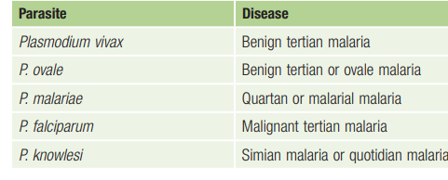

Slide 7
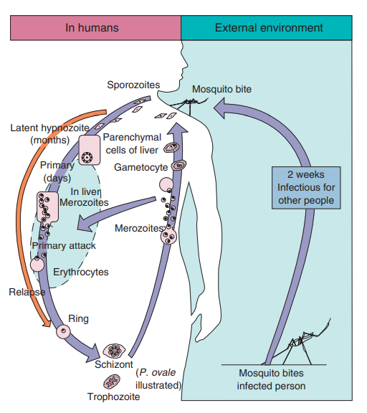

Slide 8
Life cycle
Bite of an Anopheles mosquito, which introduces infectious plasmodia sporozoites via its saliva.
The sporozoites are carried to the parenchymal cells of the liver, where asexual reproduction (schizogony) occurs.
This phase of growth is termed the exoerythrocytic cycle and lasts 8 to 25 days, depending on the plasmodial species. Some species (e.g., P. vivax, P. ovale) can establish a dormant hepatic phase in which the sporozoites (called hypnozoites or sleeping forms) do not divide.
The hepatocytes eventually rupture, liberating the plasmodia (termed merozoites at this stage), which in turn attach to specific receptors on the surface of erythrocytes.
Asexual replication progresses through a series of stages (ring, trophozoite, schizont) that culminates in rupture of the erythrocyte, releasing up to 24 merozoites.
Some merozoites also develop within erythrocytes into male and female gametocytes.

Slide 9
Plasmodium falciparum
P. falciparum demonstrates no selectivity in host erythrocytes and invades any red blood cell (RBC) at any stage in its existence. Also, multiple merozoites can infect a single erythrocyte. Thus three or even four small rings may be seen in an infected cell.
P. falciparum is often seen in the host cell at the very edge or periphery of the cell membrane, appearing almost as if it were “stuck” on the outside of the cell.
The typical crescentic gametocytes are diagnostic for the species

Slide 10
Clinical Syndromes
The incubation period of P. falciparum is the shortest of all the plasmodia, ranging from 7 to 10 days.
After the early influenza-like symptoms, P. falciparum rapidly produces daily (quotidian) chills and fever as well as severe nausea, vomiting, and diarrhea. The periodicity of the attacks then becomes tertian (36 to 48 hours), and fulminating disease develops.
The term malignant tertian malaria is appropriate for this infection. Because the symptoms of this type of malaria are similar to those of intestinal infections, the nausea, vomiting, and diarrhea.
P. falciparum is the most likely to result in death if left untreated. The increased numbers of erythrocytes infected and destroyed result in toxic cellular debris, adherence of RBCs to vascular endothelium and adjacent RBCs, and formation of capillary plugging by masses of RBCs, platelets, leukocytes, and malarial pigment.
Involvement of the brain (cerebral malaria) is most often seen in P. falciparum infection. Capillary plugging from an accumulation of malarial pigment and masses of cells can result in coma and death.
Kidney damage is also associated with P. falciparum malaria, resulting in an illness called blackwater fever. Intravascular hemolysis with rapid destruction of RBCs produces a marked hemoglobinuria and can result in acute renal failure, tubular necrosis, nephrotic syndrome, and death.
Liver involvement is characterized by abdominal pain, vomiting of bile, severe diarrhea, and rapid dehydration.

Slide 11
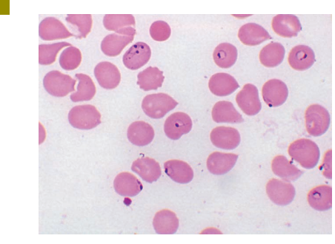
Laboratory Diagnosis
Thick and thin blood films are searched for the characteristic rings of P. falciparum, which frequently occur in multiples within a single cell as well as in the accolé position.

Slide 12
antigen detection using a rapid diagnostic test (RDT) is being used. RDTs use immunochromatographic lateral-flow strip technology and use monoclonal antibodies directed at either species-specific or pan-Plasmodium targets.
These tests are simple, rapid (results in < 20 minutes), and inexpensive.
P. falciparum–specific monoclonal antibodies have been developed for histidine-rich protein 2 (HRP-2) and P. falciparum lactate dehydrogenase..
Infected RBCs do not enlarge and become distorted as they do with P. vivax and P. ovale. Occasionally, reddish granules known as Maurer dots are observed in P. falciparum.

Slide 13
Treatment, Prevention
chloroquine or parenteral quinine.
Patients infected with chloroquine-resistant P. falciparum (or P. vivax) may be treated with other agents, including mefloquine ± artesunate, artemether-lumefantrine, atovaquone-proguanil (Malarone), quinine, quinidine, pyrimethamine-sulfadoxine (Fansidar), and doxycycline.
Amodiaquine, an analog of chloroquine, is effective against chloroquine-resistant P. falciparum.
Chemoprophylaxis and prompt eradication of infections are critical in breaking the mosquito-human transmission cycle. Control of mosquito breeding and protection of individuals by screening, netting, protective clothing, and insect repellents are also essential.

Slide 14
Plasmodium vivax
P. vivax is selective in that it invades only young, immature erythrocytes. Whereas the Duffy blood group antigen on the RBC surface has long been considered to be the primary receptor for P. vivax
In infections caused by P. vivax, infected RBCs are usually enlarged and contain numerous pink granules or Schüffner dots, the trophozoite is ring shaped but ameboid in appearance.

Slide 15
Clinical Syndromes
After an incubation period (usually 10 to 17 days), the patient experiences vague influenza-like symptoms with headache, muscle pains, photophobia, anorexia, nausea, and vomiting
As the infection progresses, increased numbers of rupturing erythrocytes liberate merozoites as well as toxic cellular debris and hemoglobin into the circulation. Together these produce the typical pattern of chills, fever, and malarial rigors. These paroxysms usually reappear periodically (generally every 48 hours) as the cycle of infection, replication, and cell lysis progresses.
P. vivax causes “benign tertian malaria,” which refers to the cycle of paroxysms every 48 hours (in untreated patients) and the belief that most patients tolerate the attacks and can survive for years without treatment.
Recent evidence, however, suggests that P. vivax can cause a spectrum of severe, life-threatening syndromes that are strikingly similar to those caused by P. falciparum

Slide 16
Laboratory Diagnosis
Microscopic examination of thick and thin films of blood is the method of choice for confirming the clinical diagnosis of malaria and identifying the specific species responsible for disease. The thick film is a concentration method and may be used to detect the presence of organisms.
It may be necessary to take repeated films at intervals of 4 to 6 hours.
RDTs may be used as an adjunct to microscopy in the diagnosis of malaria caused by P. vivax.

Slide 17
Treatment
Treatment of P. vivax infection involves a combination of supportive measures and chemotherapy. Bed rest, relief of fever and headache, regulation of fluid balance, and in some cases blood transfusion are supportive therapies. The chemotherapeutic regimens are as follows:
1. Suppressive: aimed at avoiding infection and clinical symptoms (i.e., a form of prophylaxis)
2. Therapeutic: aimed at eradicating the erythrocytic cycle
3. Radical cure: aimed at eradicating the exoerythrocytic cycle in the liver 4. Gametocidal: aimed at destroying erythrocytic gametocytes to prevent mosquito transmission
Chloroquine is the drug of choice for suppression and therapeutic treatment of P. vivax, followed by primaquine for radical cure and elimination of gametocytes

Slide 18
Plasmodium ovale
P. ovale is similar to P. vivax in many respects, including its selectivity for young, pliable erythrocytes.
The schizont of P. ovale, when mature, contains about half the number of merozoites seen in P. vivax, and the malarial pigment is a darker brown.
The clinical picture of tertian attacks for P. ovale (benign tertian or ovale malaria) infection is similar to that for P. vivax. Untreated infections last only about a year.
As with P. vivax, thick and thin blood films are examined for the typical oval host cell with Schüffner dots and a ragged cell wall. Serologic tests reveal cross-reaction with P. vivax and other plasmodia.

Slide 19
Plasmodium malariae
In contrast with P. vivax and P. ovale, P. malariae can infect only mature erythrocytes with relatively rigid cell membranes. As a result, the parasite’s growth must conform to the size and shape of the RBC
the parasite seen in the host cell: “band and bar forms,” as well as very compact dark staining forms.
composed of eight merozoites appearing in a rosette surrounding a dark brown central pigment granule. Occasionally, reddish granules called Ziemann dots appear in the host cell.

Slide 20
The incubation period for P. malariae is the longest of the plasmodia, usually 18 to 40 days but possibly several months to years. The early symptoms are influenza like, with fever patterns of 72 hours.
Untreated infections may last as long as 20 years.
Observing the characteristic bar and band forms and the rosette schizont in thick and thin films of blood establishes the diagnosis of P. malariae infection.
Treatment is similar to that for P. vivax and P. ovale infections.

