Slide 1
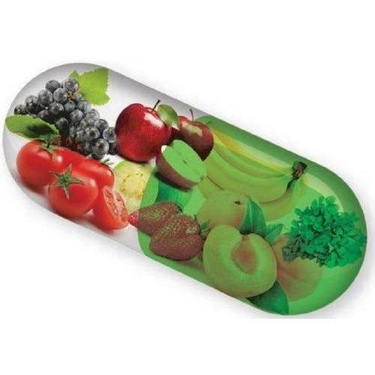
NUTRACEUTICALS
“LET’S FOOD BE YOUR MEDICINE”
Notes:
NUTRACEUTICALS

Slide 2
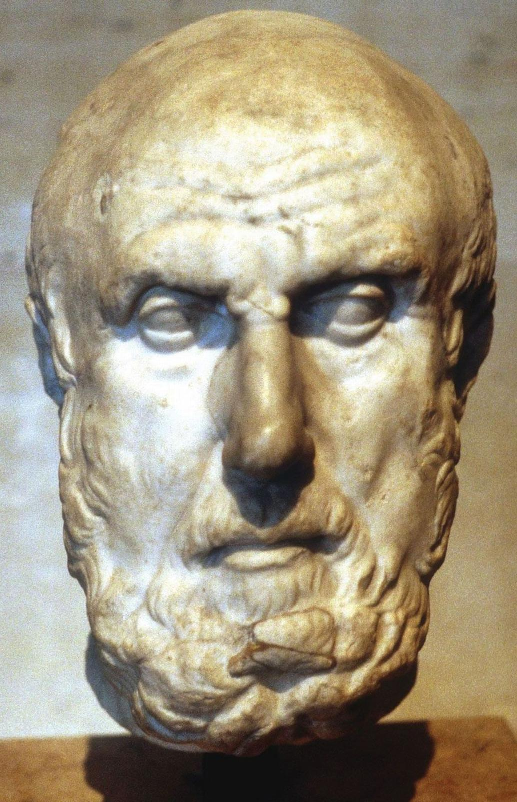
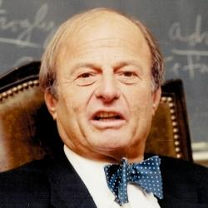
HISTORY
The word Nutraceutical was coined in 1989 by Dr. Stephen De Felice.
The Greek physician Hyppocrates, also known as the ” FATHER OF MEDICINE ” SAID.
“ LET THY FOOD BE THY MEDICINE, AND THE MEDICINE BE
THY FOOD ”.
The philosophy behind is :
“ FOCUS ON PREVENTION ”

Slide 3
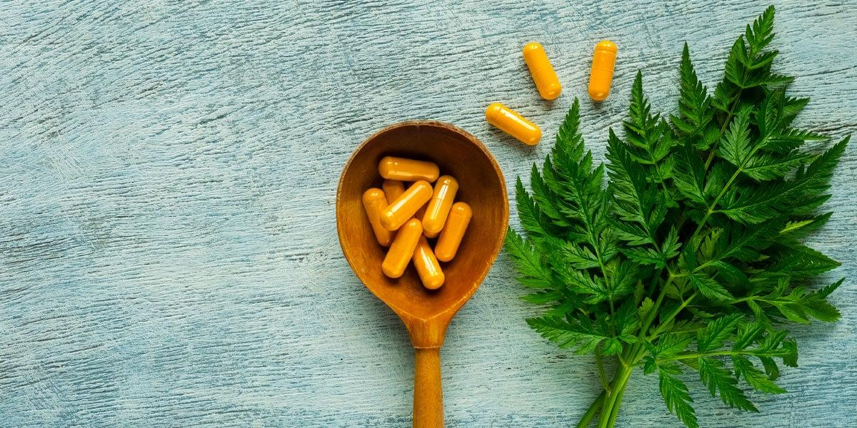
Foundation of Innovation in Medicine ( FIM ) defined Nutraceutical as
‘any substance that may be considered as food or part of food and provides medical and health benefits ’
The term Nutraceutical was coined by combining the two terms
NUTRITION + PHARMACEUTICAL

Slide 4
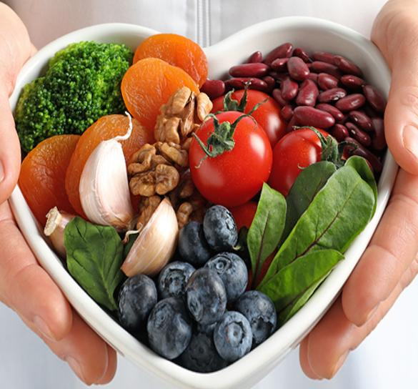
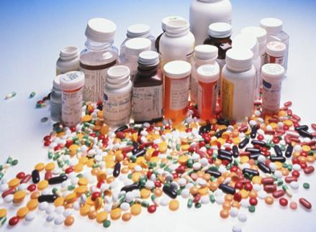
NUTRITION
Nutrients that may prevent the disease
PHARMACEUTICAL
Drugs used in the treatment of Disease

Slide 5
NUTRACEUTICALS comprises of:
NUTRIENTS : Substances which contains nutritional
functions, such as– Vitamins, Amino acids
HERBALS : Botanical products.
DIETARY SUPPLEMENTS : Probiotics , Prebiotics ,
Antioxidants

Slide 6
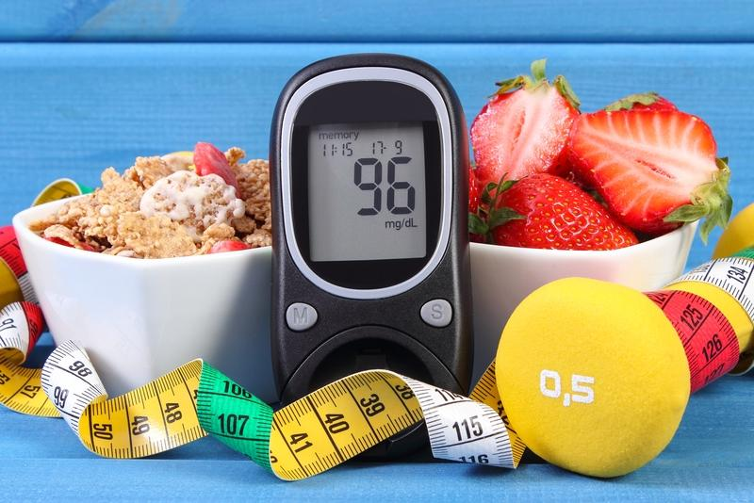
Areas covered by Nutraceutical products -
Therapeutic areas such as –
Cold and cough
Digestion
Prevention of certain cancers
Osteoporosis
Blood pressure
Cho lesterol
Diabetes

Slide 7
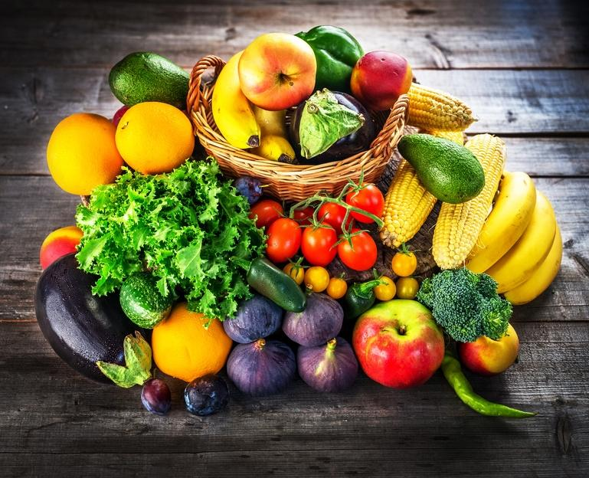
PHYTOCHEMICALS AS NUTRACEUTICALS:
Most of them exhibit their activity as –
Antioxidant
Detoxify agent
Or simply by physico – chemical in case of dietary fibres.
The major phytonutrients identified to have Nutraceutical properties include:
Isoprenoids
polyphonics

Slide 8
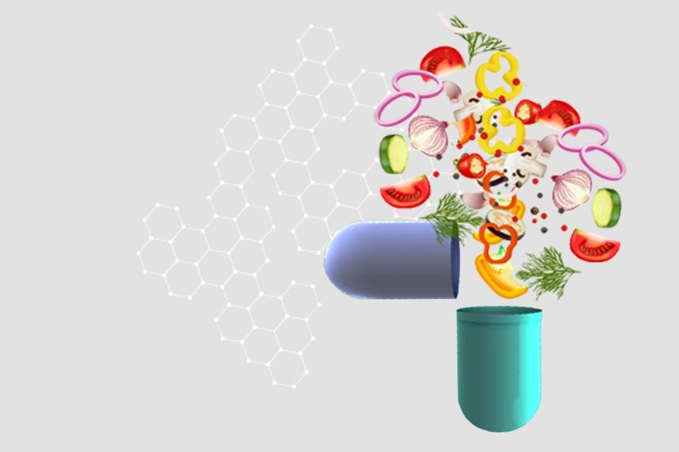
ISOPRENOIDS
It represents the largest class of phytonutrients.
Lycopene
beta-carotene
Alpha-carotene , are carotenoid terpenoids.
Terpenes act as antioxidants.
Two major terpene subclasses are:
CAROTENOIDS
LIMONOIDS

Slide 9
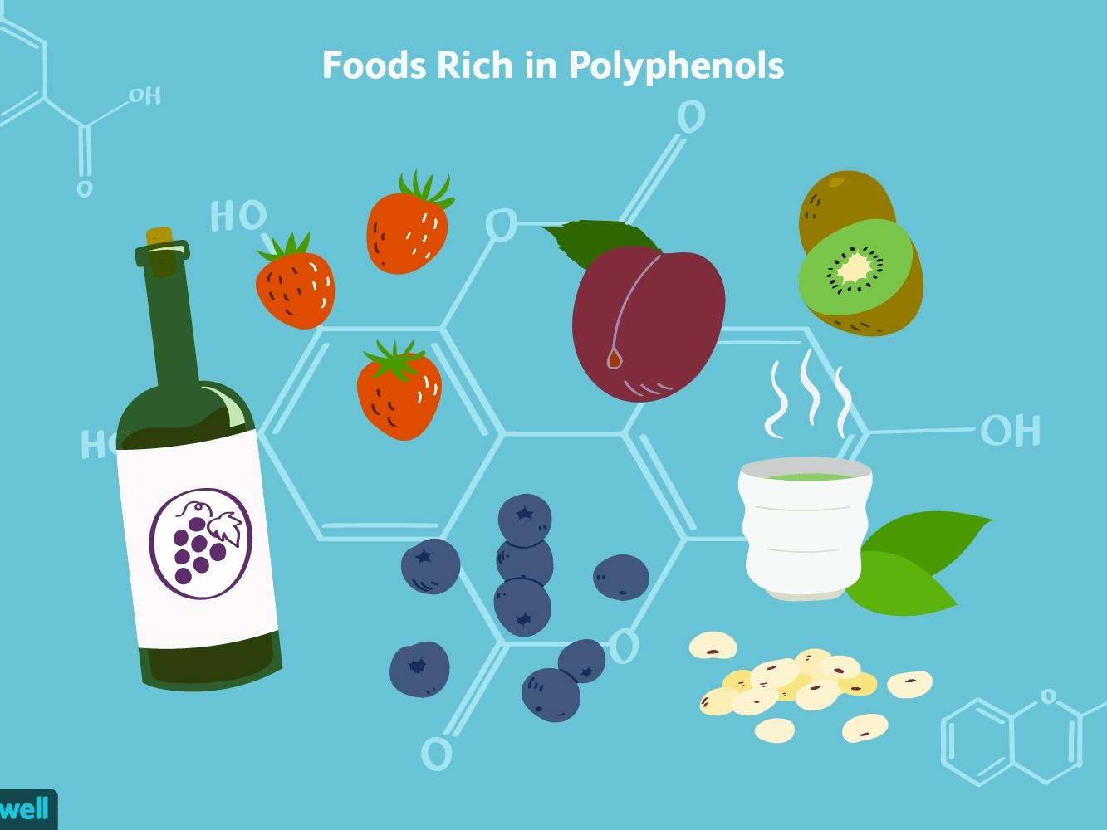
POLYPHENOLICS
These PHYTOCHEMICALS include the subclass flavonoids.
Grapes juice and red wine are good sources.
Apples, chocolates, and tea are good sources of flavonoids.
Flavonoids may also decrease the risk of cancer.
Cherry tomatoes have more flavonoids.
Flavonoids are not easily destroyed by cooking.

Slide 10
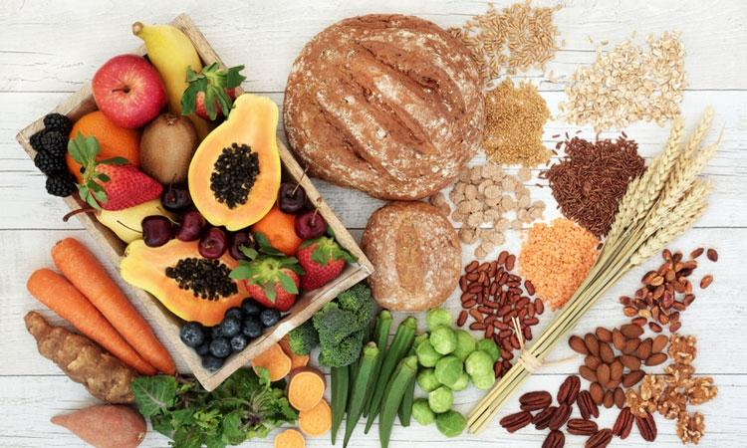
DIETARY FIBRE :
Structural carbohydrates of plants
Neither digested nor abserved.
Two types of dietary fibre are:
SOLUBLE
INSOLUBLE
INSOLUBLE – Predominant
Speedsup digestion
SOLUBLE- Regulates blood sugar levels
Source:- WHEAT , MAIZE , JOWAR, MOST FRUITS , RAGI .

Slide 11
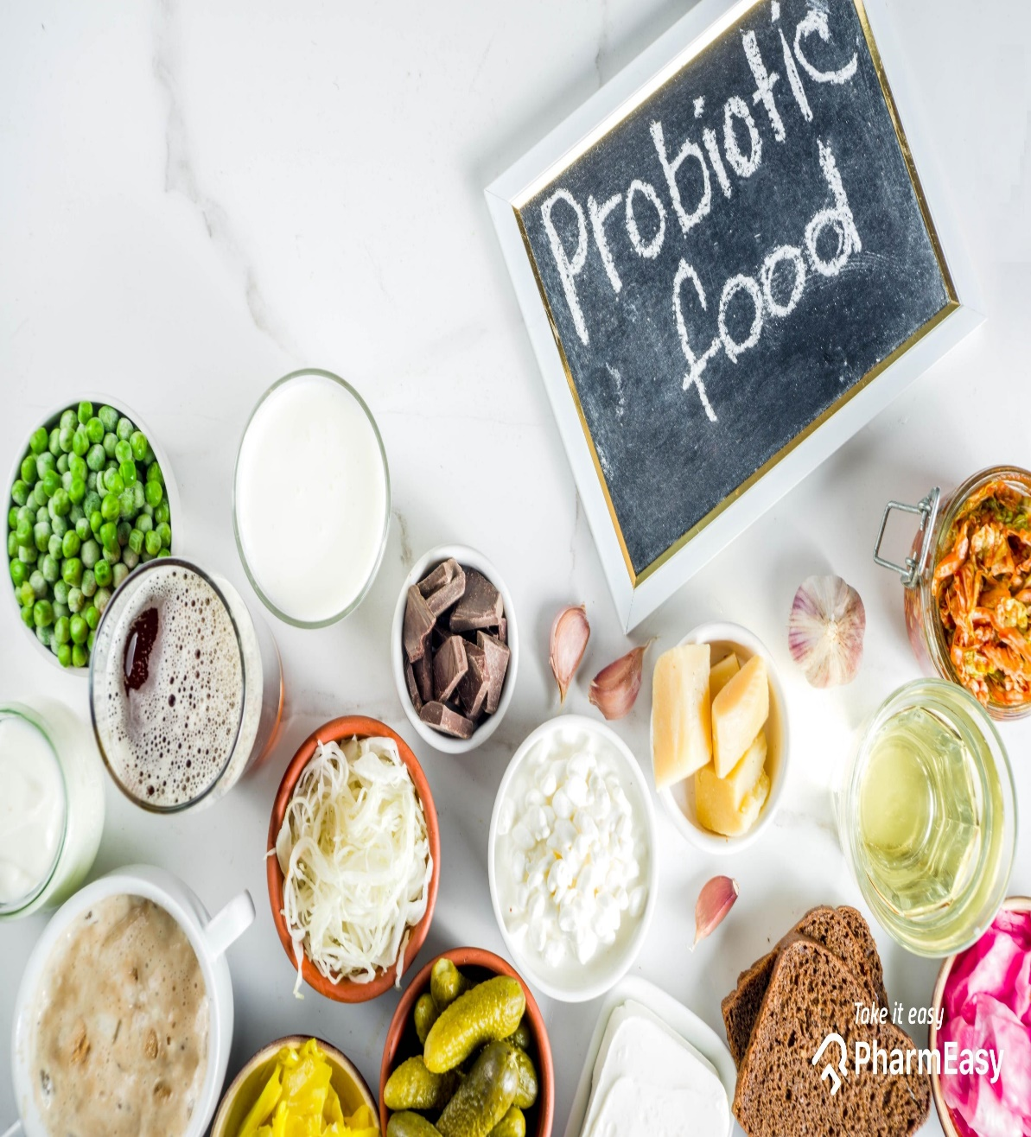
MICROBES AS NUTRACEUTICALS:
There are many microorganisms have Nutraceutical properties.
Lactobacillus bacteria
bifidobacterium streptococcus salvarius
saccharomyces , gives health benefits due to their action.
PROBIOTICS AND PREBIOTICS

Slide 12
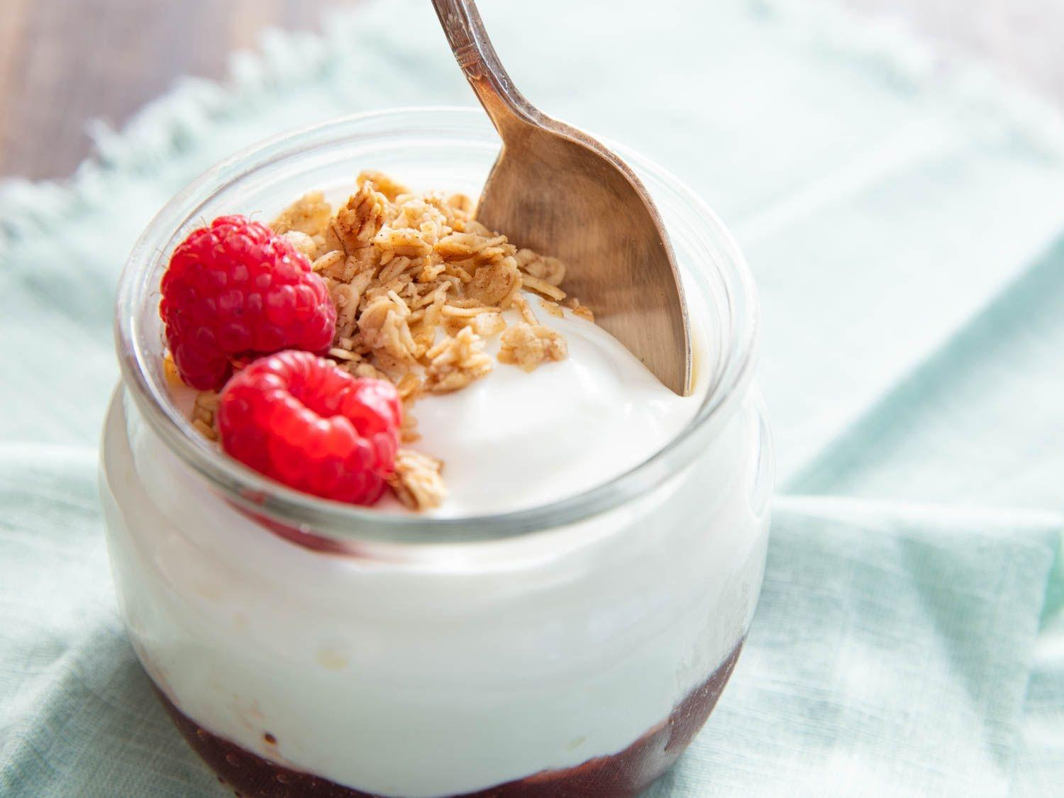
PROBIOTICS :
PROBIOTICS are live microbial food or feed supplements that benefit human health by microbial balance in the intestine.
Microorganisms used as probiotics mainly include , Lactobacillus, Enterococcus.
Other probiotics include strains of yeast belongs to Saccharomyces cerevisiae species.
Probiotic diary products like YOGHURT are good source of probiotics.

Slide 13
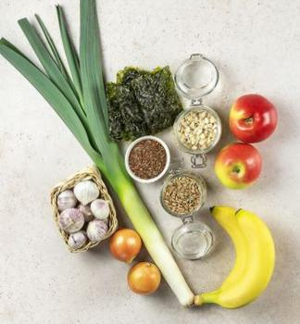
PREBIOTICS
Promote the growth of probiotics.
They are non-digestible food ingredients.
Prebiotics include dietary fibre and fructo oligosaccharides.
Source – Honey , beer , onian , Banana.

Slide 14
REFERENCES
Food science by B SRI LAKSHMI
WIKIPEDIA

Slide 15
An apple a day keeps the doctor away.........☺️
THANK YOU

