Slide 1
DR. Rajesh Pratap Singh Associate Professor Physical Education CSJM University Campus , Kanpur
Newton's Law Of Motion

Slide 2
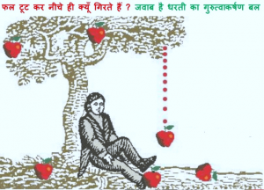

Slide 3
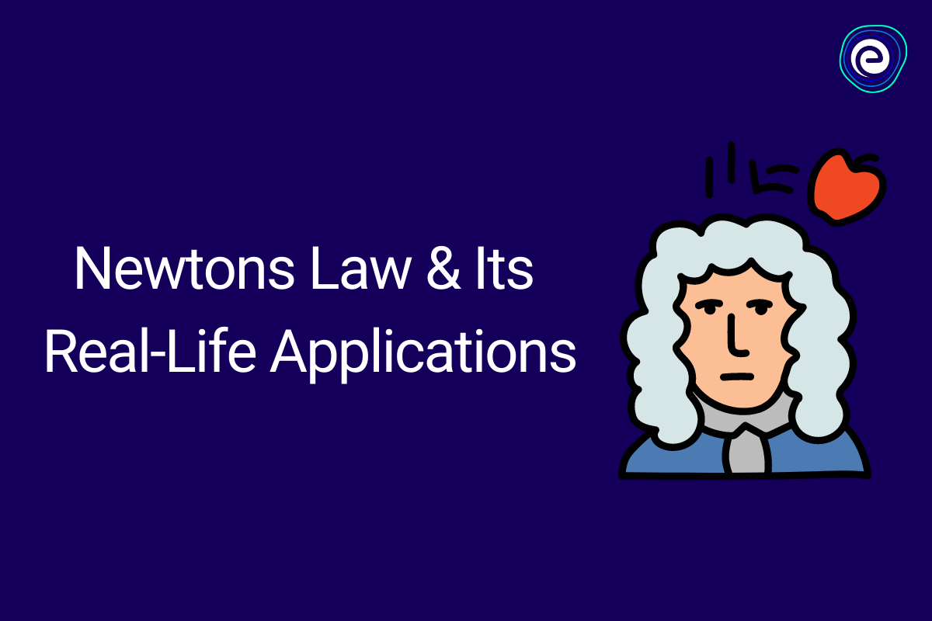

Slide 5
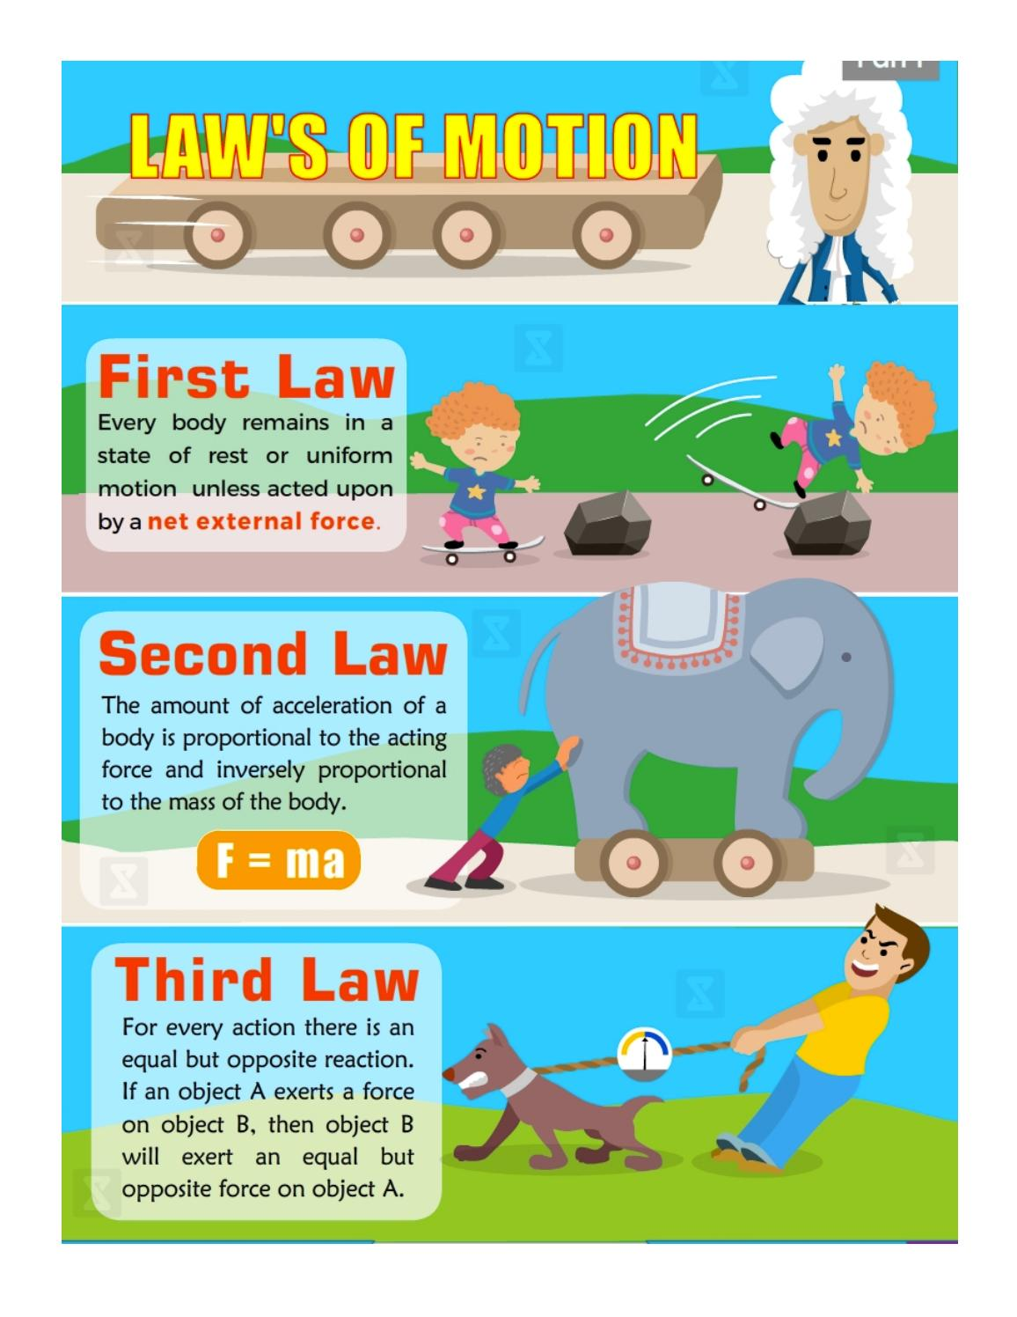

Slide 7
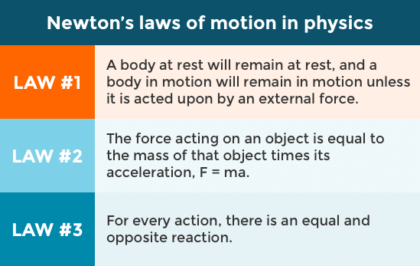

Slide 9
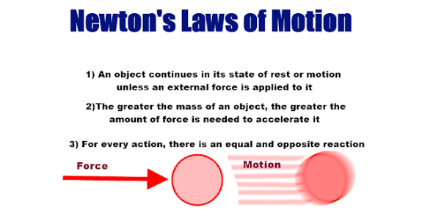

Slide 10
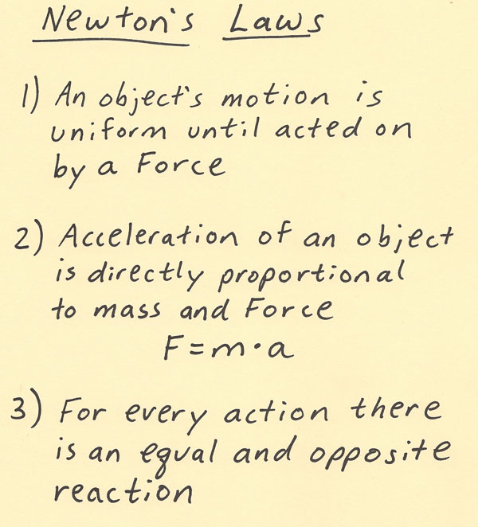

Slide 12
