Slide 1
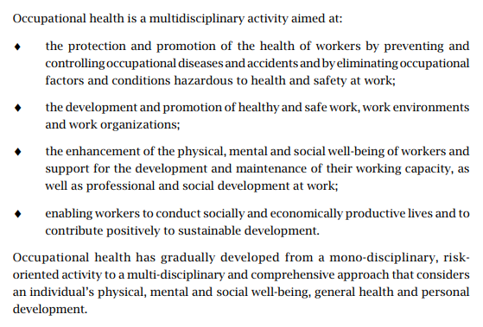
Occupational Health

Slide 2
Principles of Environmental Health: Physicians are increasingly called upon to address questions related to environmental health. Pollution of air and water, contamination of food, releases from nearby activities such as industrial facilities or waste sites, and hazards in the home are all common causes for concern among patients, community members, the media, and public officials. All health care providers should understand how to approach clinical and public health problems in environmental health, as well as the similarities and differences between occupational health and environmental health.
Although environmental health issues are important worldwide, the severity and nature of the problem differs geographically. Many developed countries have taken significant steps to address pervasive problems such as air pollution and contamination of drinking water. These countries continue to face issues around the safety of chemicals in consumer products, legacy contamination from historic land uses, and emerging concerns about recently identified chemical hazards. Disasters, such as fires, floods, major wind events, and industrial upset conditions can bring environmental health issues to the forefront, even in developed countries.

Slide 3
Developing countries, in contrast, have faced enormous increases in pollution. The dramatic expansion in motor vehicles worldwide, the shift of industrial production to nations where environmental laws are less stringent and their enforcement is often nonexistent, and the practice of shipping hazardous waste to less-developed countries for recycling or storage, have all created massive and relatively new environmental problems around the globe. Mining and petroleum drilling operations have caused serious environmental contamination with heavy metals and hydrocarbons (HC), respectively. Indoor use of cookstoves is now recognized to be one of the most significant environmental health threats to women’s and children’s health globally. Overall, air pollution and contamination of the water and food supply are very serious concerns in the developing world. Global threats such as climate change, depletion of natural resources, loss of biodiversity, and the pervasive presence of persistent, bioaccumulative chemicals in the environment threaten health throughout the world.

Slide 4
Occupational diseases
Occupational diseases are adverse health conditions in the human being, the occurrence or severity of which is related to exposure.
Physical exposure: heat, noise radiation
Chemical: dust , heavy metals, solvent radiation
Biological: tuberculosis, hepatitis, HIV, Virus
Psychosocial stressor: lack of control over work, inadequate personal work
Mechanical: accidents and injuries rather than occupational diseases

Slide 5
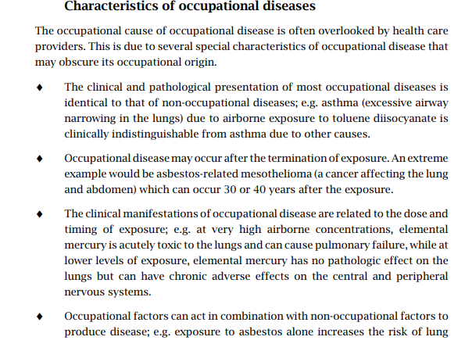

Slide 6
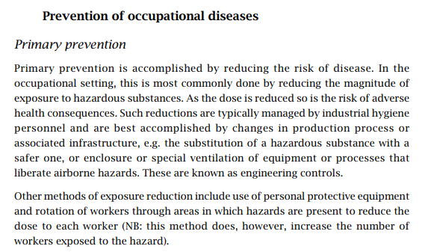

Slide 7
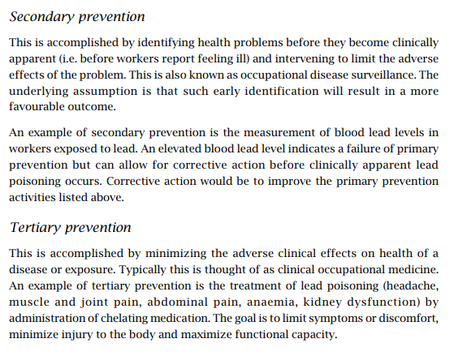

Slide 8
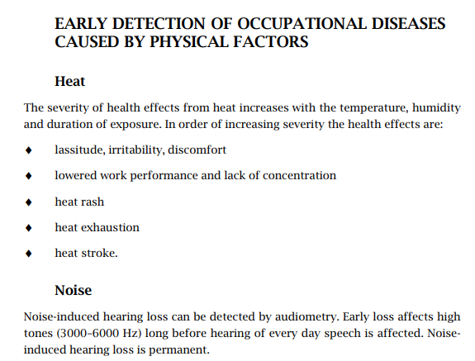

Slide 9
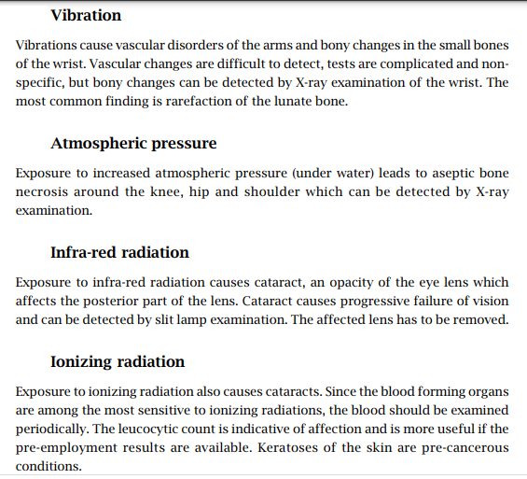

Slide 10
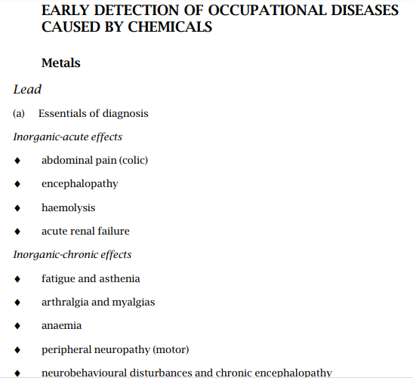

Slide 11
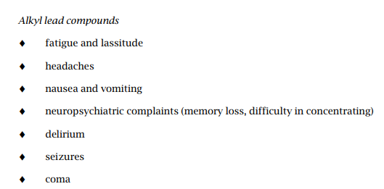

Slide 12
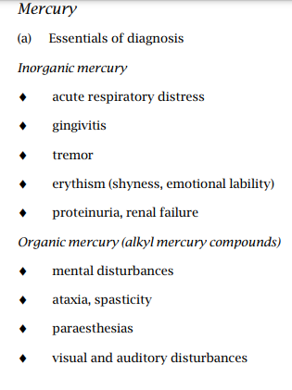

Slide 13
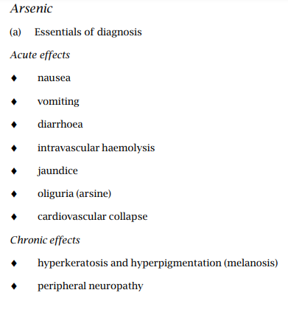

Slide 14
