Slide 1
POST-TRANSLATIONAL MODIFICATION

Slide 2
Proteolytic Cleavage
Proteolytic cleavage is the most common type of posttranslational modification.
In active precursors that are activated under proper conditions by limited proteolysis.
Inactive proteins that are activated by removal of polypeptides are called proproteins, whereas the excised polypeptides are termed propeptides.
Eg. conversion of trypsinogen and chymotrypsinogen to their active form and the formation of active insulin from the 84-residue proinsulin by the excision of its internal 33-residue C chain

Slide 3
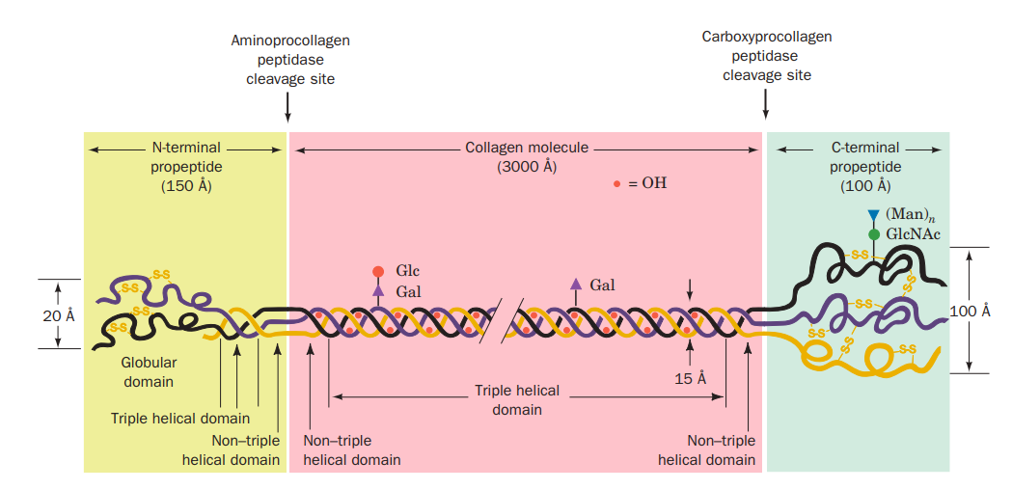
Propeptides Direct Collagen Assembly
Collagen biosynthesis is illustrative of many facets of post-translational modification.

Slide 4
Signal Peptides Are Removed from Nascent Proteins by a Signal Peptides
Proteins bearing a signal peptide are known as preproteins.
Once the signal peptide has passed through the membrane, it is specifically cleaved from the nascent polypeptide by a membrane-bound signal peptidase.
These and many other proteins are therefore subject to three sets of sequential proteolytic cleavages:
(1) the deletion of their initiating Met residue,
(2) the removal of their signal peptides,
(3) the excision of their propeptides
Eg. preproinsulin and preprocollagen.

Slide 5
Polyproteins
Some proteins are synthesized as segments of polyproteins, polypeptides that contain the sequences of two or more proteins.
Examples include many polypeptide hormones.
ubiquitin, a highly conserved eukaryotic protein involved in protein degradation

Slide 6
B. Covalent Modification
Proteins are subject to specific chemical derivatizations, both at the functional groups of their side chains and at their terminal amino and carboxyl groups.
Over 150 different types of side chain modifications, involving all side chains but those of Ala, Gly, Ile, Leu, Met, and Val, are known.
These include acetylations, glycosylations, hydroxylations, methylations, nucleotidylations, phosphorylations, and ADP-ribosylations as well as numerous “miscellaneous” modification.
Collagen Assembly Requires Chemical Modification-As the nascent procollagen polypeptides pass into the RER of the fibroblasts that synthesized them, the Pro and Lys residues are hydroxylated to Hyp, 3-hydroxy-Pro, and 5-hydroxy-Lys(Hyl). The enzymes that do so are sequence specific: Prolyl 4-hydroxylase and lysyl hydroxylase act only on the Y residues of the Gly-X-Y sequences, whereas prolyl 3- hydroxylase acts on the X residues but only if Y is Hyp. Glycosylation, which also occurs in the RER, subsequently attaches sugar residues to Hyl residues.
The procollagen molecules pass into the Golgi apparatus where they are packaged into secretory vesicles and secreted into the extracellular spaces of connective tissue

Slide 7
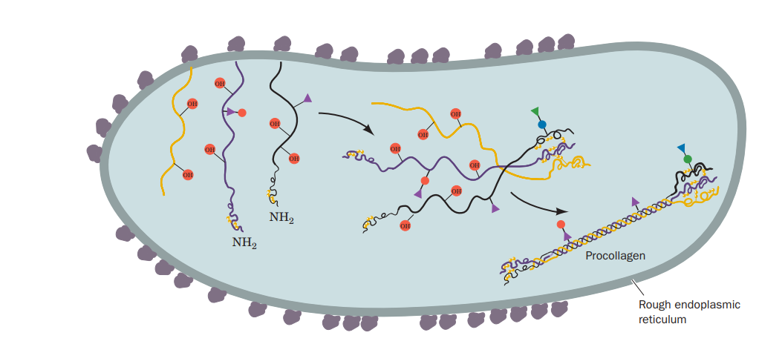
procollagen biosynthesis

Slide 8
C. Protein Splicing: Inteins and Exteins
Protein splicing is a post-translational modification process in which an internal protein segment (an intein) excises itself from a surrounding external protein, which it ligates to form the mature extein.

Slide 9
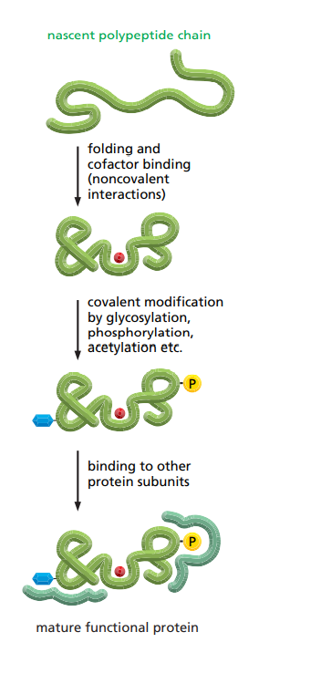

Slide 10
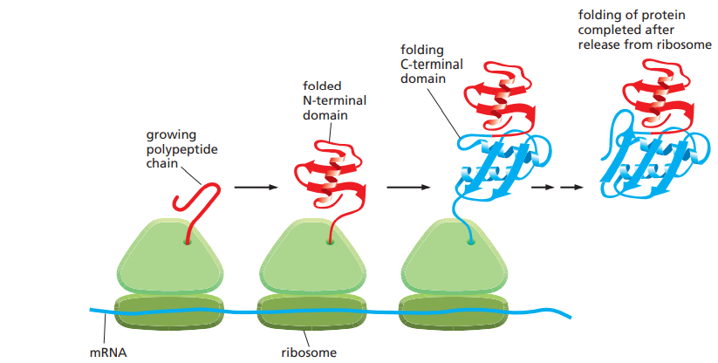
Co-translational protein folding

Slide 11
Molecular Chaperones Help Guide the Folding of Most Proteins
Most proteins probably do not begin to fold during their synthesis. Instead, they are met at the ribosome by a special class of proteins called molecular chaperones. Molecular chaperones are useful for cells because there are many different paths that can be taken to convert an unfolded or partially folded protein to its final compact conformation.

Slide 12
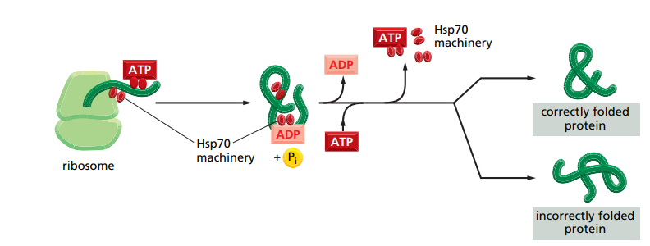
The Hsp70 family of molecular chaperones

Slide 13
The structure and function of the Hsp60 family of molecular chaperones

Slide 14
