Slide 1
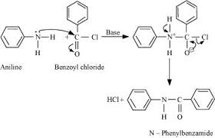
PREPARATION OF BENZANILIDE FROM ANILINE
(Schotten bouwman benzoylation reaction)
Requirements:
Aniline 2.5 ml
Benzoyl chloride 3.5 ml
Aqueous NaOH solution: 25 ml
Theory :
Schotten bouwman benzoylation reaction is the reaction between the aromatic amine aniline and benzoyl chloride in the presence of aqueous sodium hydroxide solution

Slide 2
Procedure:
1. Place 2.5 ml of aniline in a 250 ml clean conical flask add 25 ml of aqueous NaOH solution
2. Add carefully 3.5 ml of benzoyl chloride to the above mixture
3. Shake vigorously the reaction mixture for about 10-15 minutes ( till the disappearance of odour of benzoyl chloride).
4. Add 25 ml of cold water to disintegrate the solid mass.
5. Filter off the crude benzanilide and dried.
6. calculate the yield of dried product

