Slide 1
Application of Genetic Engineering

Slide 3
Pharmaceutical products of DNA technology
Recombinant DNA is a technology scientists developed that made it possible to insert a human gene into the genetic material of a common bacterium. This “recombinant” micro-organism could now produce the protein encoded by the human gene.

Slide 5
Recombinant insulin

Slide 6
Production of recombinant insulin
Attemps to produce insulin by recombinant DNA technology started in late 1970s.
The basic technique consisted of inserting human insulin gene and the promoter gene of lac operon on to the plasmids of E. coli.
By this method human insulin was produced.
It was in July 1980, seventeen human volunteers were, for the first time, administered recombinant insulin for treatment of diabetes at Guy's Hospital, London. And in fact, insulin was the first ever pharmaceutical product of recombinant DNA technology administered to humans.
Recombinant insulin worked well, and this gave hope to scientists that DNA technology could be successfully employed to produce substances of medical and commercial importance. An approval, by the concerned authorities, for using recombinant insulin for the treatment of diabetes mellitus was given in 1982.
And in 1986, Eli Lilly company received approval to market human insulin under the trade name Humulin.

Slide 7
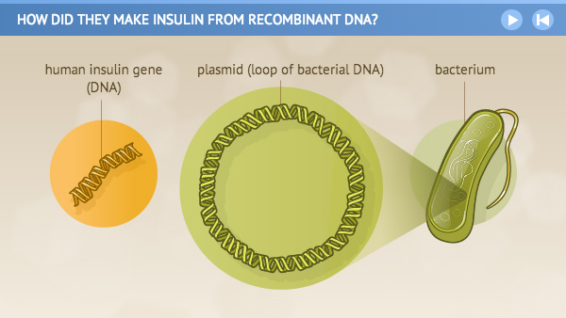
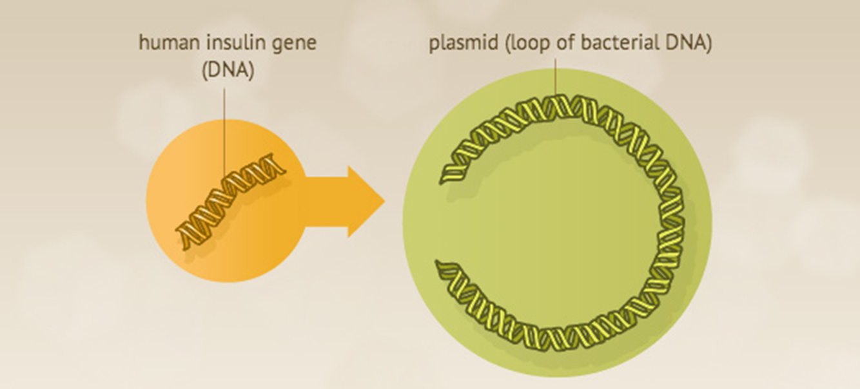
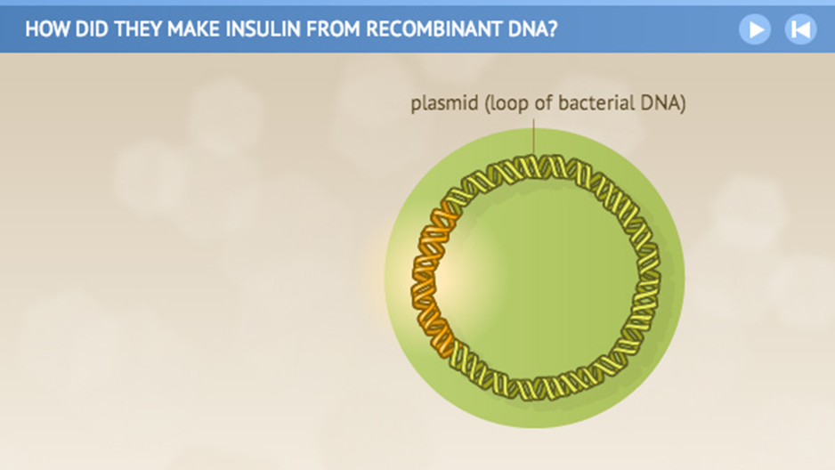
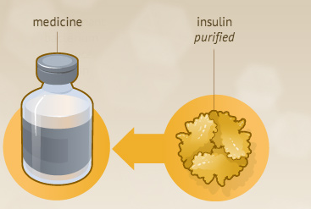
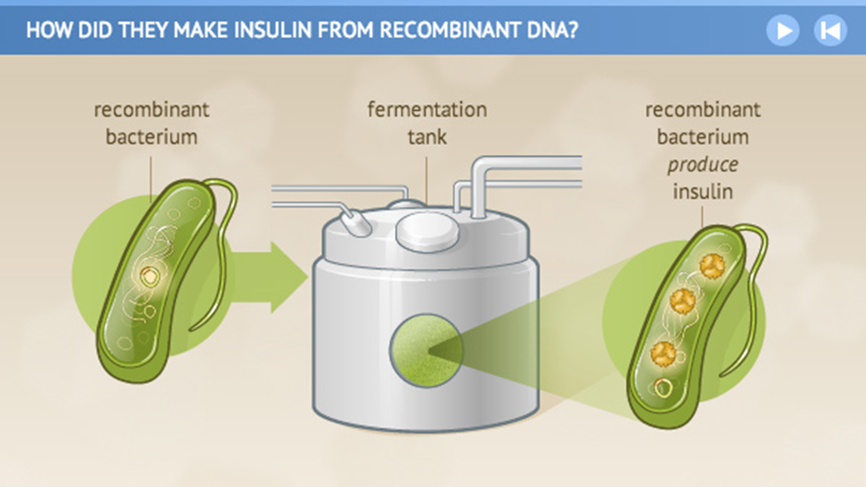
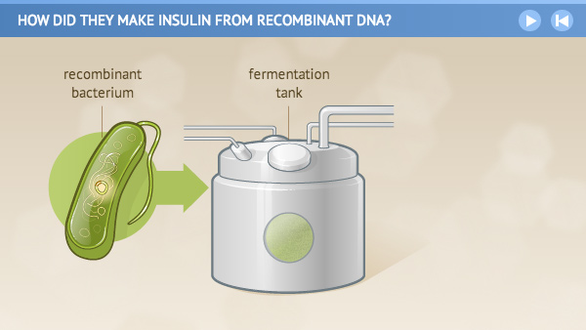
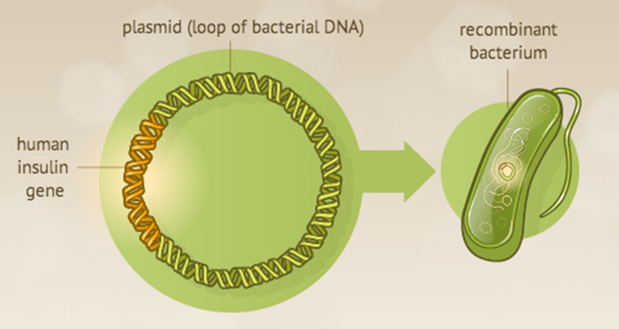
Production of recombinant insulin
Isolation of plasmid and Human insulin gene
insert the human insulin gene into the plasmid.
Formation of r-DNA
Put the “recombinant” bacteria
in large fermentation tanks
Return the plasmid to the bacteria
(Transformation)
Harvest and purify the substance for use as a medicine.
Recombinant bacteria use the gene to begin producing human insulin.

Slide 8
Production of recombinant insulin
The orginal technique of insulin synthesis in E. coli has undergone several changes, for improving the yield. e.g. addition of signal peptide, synthesis of A and B chains separately etc.
The procedure employed for the synthesis of two insulin chains A and B is illustrated in Fig.
The genes for insulin A chain and B chain are separately inserted to the plasmids of two different E. coli cultures. The lac operon system
(consisting of inducer gene, promoter gene, operator gene and structural gene Z for β-galactosidase) is used to express both the genes.
The presence of lactose in the culture medium induces the synthesis of insulin A and B chains in separate cultures.
The so formed insulin chains can be isolated, purified and joined
together to give a full-fledged human insulin.
Source: Adopted from Biochemistry (U. Satyanarayna)

Slide 9
Production of recombinant Vaccine

Slide 10
Production of recombinant Vaccine
The recombinant vaccines are an important group of therapeutic products.
A number of vaccines are now available for animals, and human which is going to have a major impact in the healthcare industry.
One of the initial vaccines produced by rDNA method involves the cloning of the surface antigen of the hepatitis B virus (HBsAg) in the yeast S. cerevisiae under the control of the alcohol dehydrogenase promoter.
A number of recombinant vaccines are now commercially prepared by the recombinant DNA technology, where only the outside coat protein of the microorganism is expressed in the host to create the vaccine.
The expressed protein can then be purified from the recombinant host and used for inoculation.
This method has the advantage of safe delivery of antigen without transferring the actual disease-causing microbe to the host. Currently recombinant vaccines for the hepatitis B virus, herpes type 2 viruses, and malaria is under trial for use in future.

Slide 11
Table: list of diseases along with the pathogenic organisms for which recombinant vaccines are developed
Source: Adopted from Biochemistry (U. Satyanarayna)

