Slide 1
EXPERIMENT: 05 (05/05/2022)
Objective: To synthesis phthalimide from Phthalic anhydride
Chemical required
Urea: 1 gram
Phthalic anhydride: 5 gram
Glassware required:
Round bottomed flask 250ml capacity
Beaker oil both (Heavy paraffin), Beaker, filtration set

Slide 2
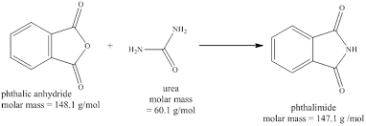
Principle and Method :
Cyclic anhydride (Phthalic anhydride) heated with urea/ammonia/ ammonium carbonate to get cyclic imide Phthalimide
Method :
1. Place together urea and Phthalic anhydride in a clean 250 ml RBF
2. Heated on oil bath gradually till both solids melts and heating is continued till get frothing appear
3. Discontinue the heating and leave the reaction mixture to cool the reaction mixture become solid mass
4. add 50 ml of ice cold water to disintegrate the solid in to powder.
5. Filter phathalimide
off and dried in oven,
6. purified and the dried yield is calculated and submitted
Melting point: 238 °C (460 °F)
Boiling point: 336 °C
Uses: Phathalimide is used as a precursor to synthesis Anthranilic acid, azo dyes and saccharin

