Slide 1
Unit 5
Regulation of gene expression
Operon
positive and negative regulation
Transcription of Operons Is Controlled by Induction and Repression
lac operon

Slide 2
Regulation of gene expression
Gene expression can be controlled at any of several stages, which can be divided broadly into
transcription
processing
and translation:
Transcription often is controlled at the stage of initiation.
Transcription is not usually controlled at elongation, but it may be controlled at termination to determine whether RNA polymerase is allowed to proceed past a terminator to the gene(s) beyond.
In bacteria, an mRNA is typically available for translation while it is being synthesized; this is called coupled transcription/translation.
(In eukaryotic cells, transcription takes place in the nucleus, and translation takes place in the cytoplasm.)
Translation in bacteria may be directly regulated, but more commonly it is passively modulated. The coding portion or open reading frame of a gene can be assembled either with common or rare codons, which correspond to common or rare tRNAs. mRNAs containing a number of rare codons take longer to translate.

Slide 3
Operon
The basic concept for the way transcription is controlled in bacteria is called the operon model and was proposed by François Jacob and Jacques Monod in 1961.
In bacteria, genes encoding the enzymes of a particular metabolic pathway are often grouped adjacent to one another in a cluster on the chromosome.
This pattern of organization allows all of the genes in the group to be expressed in a coordinated fashion through transcription into a single polycistronic mRNA encoding all the enzymes of the metabolic pathway. A regulatory sequence lying adjacent to the DNA being transcribed determines whether transcription takes place. This sequence is termed the operator .
The operator is located next to a promoter. Interaction of a regulatory protein with the operator controls transcription of the gene cluster by controlling access of RNA polymerase to the promoter. Such co-expressed gene clusters, together with the operator and promoter sequences that control their transcription, are called operons.

Slide 5
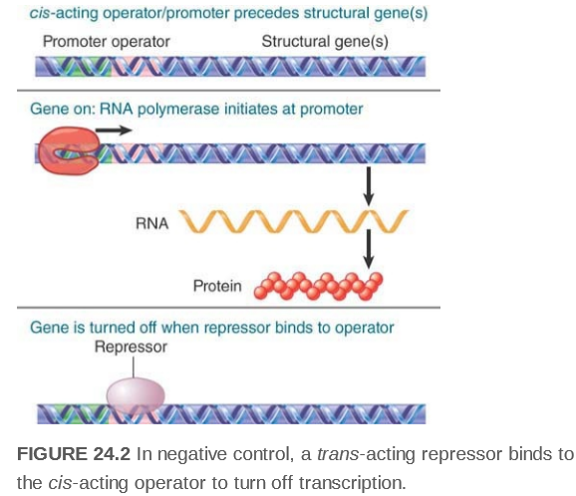
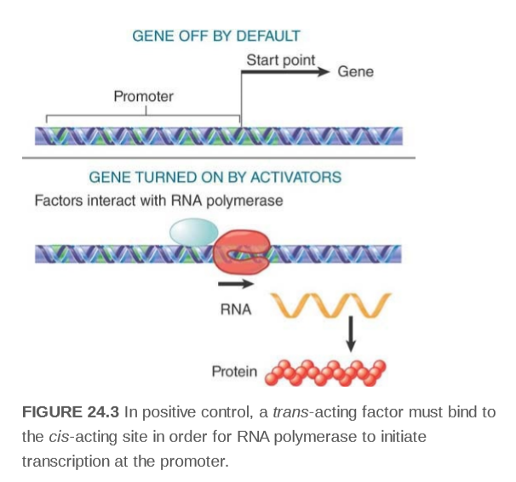
positive and negative regulation

Slide 6
Transcription of Operons Is Controlled by Induction and Repression
Induction
Increased synthesis of enzymes in response to the presence of a particular substrate is termed induction.
eg. In the absence of lactose, E. coli cells contain very little β galactosidase (less than 5 molecules per cell). However, lactose availability induces the synthesis of β galactosidase by activating transcription of the lac operon.
Substrates capable of activating synthesis of the enzymes that metabolize them are called co-inducers,or, inducers. Some substrate analogs can induce enzyme synthesis even though the enzymes are incapable of metabolizing them. These analogs are called gratuitous inducers. A number of thiogalactosides, such as IPTG (isopropyl -thiogalactoside, are excellent gratuitous inducers of β -galactosidase activity in E. coli.
Repression
Decreased synthesis of enzymes in response to a speciﬁc metabolite—is termed repression.
example, the enzymes of tryptophan biosynthesis in E. coli are encoded in the trp operon. If sufﬁcient Trp is available to the growing bacterial culture, the trp operon is not transcribed, so the Trp biosynthetic enzymes are not made; that is, their synthesis is repressed.
In repression, a metabolite, typically an end product, depresses synthesis of its own biosynthetic enzymes. Such metabolites are called co-repressors

Slide 8
lac operon
Two proteins to metabolized lactose: 𝛃-galactosidase, which catalyzes the hydrolysis of lactose to its component monosaccharides and galactoside permease (also known as lactose permease which transports lactose into the cell. All three structural genes are translated from a single mRNA transcript. A nearby gene, I, encodes the lac repressor, a protein that inhibits the synthesis of the three lac proteins. The target of the lac repressor is a region of the lac operon known as its operator, which lies near the beginning of the β-galactosidase gene. In the absence of inducer, lac repressor speciﬁcally binds to the operator to prevent the transcription of mRNA . lac Repressor Binds Two DNA Segments Simultaneously.

Slide 9
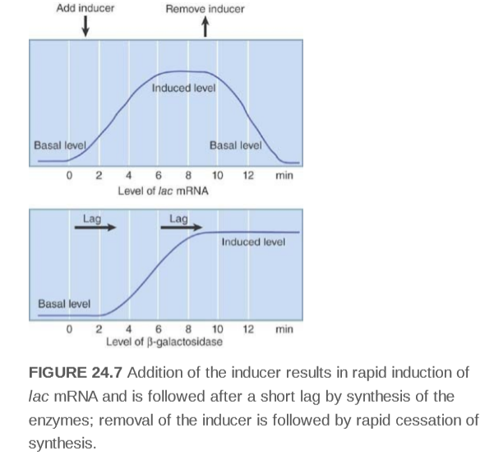
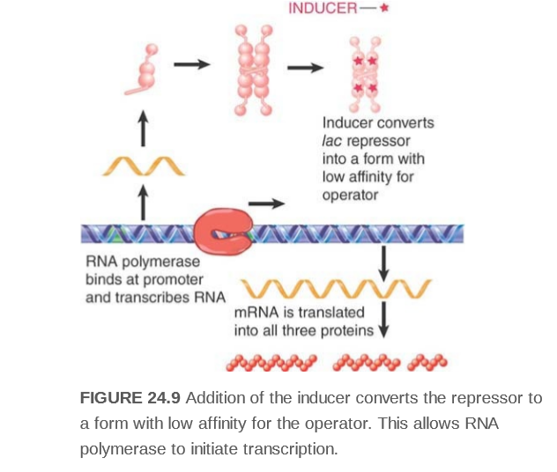

Slide 10
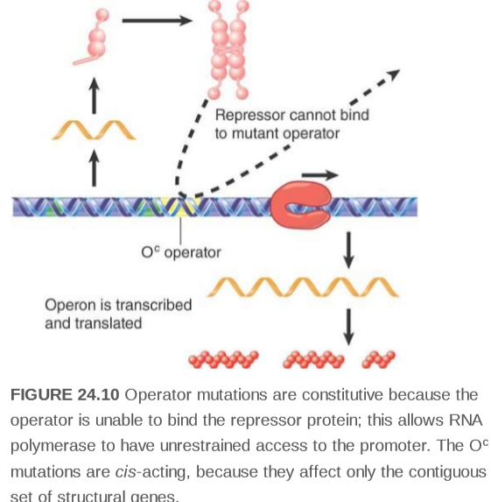
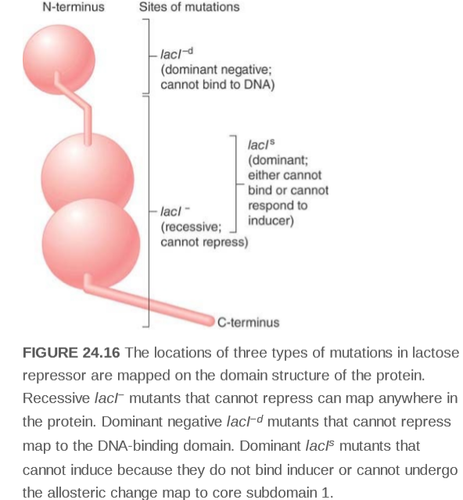
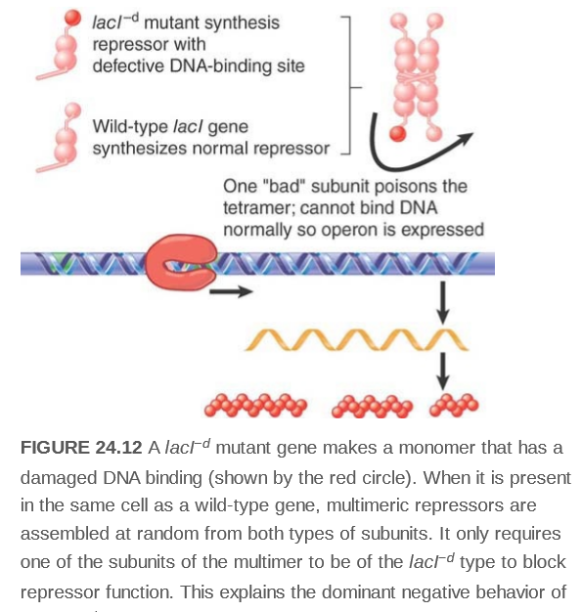

Slide 11
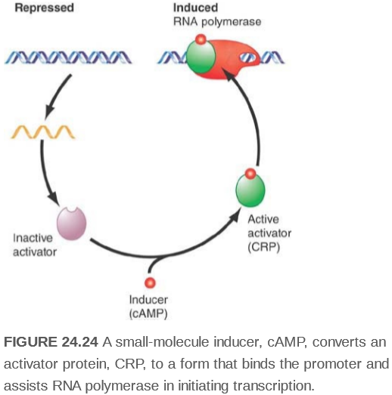
CAP Is a Positive Regulator of the lac Operon

Slide 12
Transcription by RNA polymerase from some promoters proceeds with low efﬁciency unless assisted by an accessory protein that acts as a positive regulator. One such protein is CAP, or catabolite activator protein. Its name derives from the phenomenon of catabolite repression in E. coli. Catabolite repression is a global control that coordinates gene expression with the total physiological state of the cell: As long as glucose is available, E. coli catabolizes it in preference to any other energy source, such as lactose or galactose. Catabolite repression ensures that the operons necessary for metabolism of these alternative energy sources, that is, the lac and gal operons, remain repressed until the supply of glucose is exhausted. Catabolite repression overrides the inﬂuence of any inducers that might be present. Catabolite repression is maintained until the E. coli cells become starved of glucose. Glucose starvation leads to activation of adenylyl cyclase, and the cells begin to make cAMP. (In contrast, glucose uptake is accompanied by deactivation of adenylyl cyclase.) The action of CAP as a positive regulator is cAMP-dependent. cAMP is a small-molecule inducer for CAP, and cAMP binding enhances CAP’s afﬁnity for DNA. CAP, also referred to as CRP (for cAMP receptor protein), is a dimer of identical 22.5-kD polypeptides. The N-terminal domains bind cAMP; the C-terminal domains constitute the DNA-binding site. Two molecules of cAMP are bound per dimer. The CAP–(cAMP)2 complex binds to speciﬁc target sites near the promoters of operons . Binding of CAP–(cAMP)2 to DNA causes the DNA to bend more than 80° This CAP-induced DNA bending near the promoter assists RNA polymerase holoenzyme binding and closed promoter complex formation. Contacts made between the CAP–(cAMP)2 complex and the α-subunit of RNA polymerase holoenzyme activate transcription.

