Slide 1
INSTITUTE OF FINE ARTS
CSJM UNIVERSITY, KANPUR
Presentation on
Presented by:
Anamika Tiwari
Assistant Professor
Applied Art (Visualisation)
ADVERTISING CAMPAIGN

Slide 2
ADVERTISING
CAMPAIGN (Meaning and its process)
1

Slide 3
WHAT’ S
ADVERTISING
CAMPAIGN?
An Advertising Campaign involves a series of
advertisement messages that share a
single idea and theme and placing them
in various advertising media to reach a
desired target group.

Slide 4
HOW CAN AN ADVERTISING CAMPAIGN HELP?
Influence buying decision
Educate customers
Building a strong brand image
Reminders
Keep product in public eye

Slide 5
ADVERTISING CAMPAIGN PLANNING…
It is always better to have a well-planned
strategy to promote your brand, product
or services. Advertising campaigns do that
for you. Whether you offer a product or a
service, choose to promote your brand
online or offline-advertising campaign help
by guiding you through the process.

Slide 6
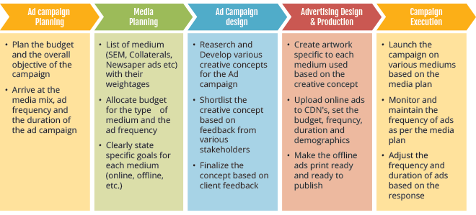

Slide 7
1.ANALYZING THE MARKET
The first step is to do a market
research for the product to be
advertised. One needs to find
out the product demand,
competitors etc.

Slide 8
2.DEFINE
YOUR TARGET
AUDIENCE
One need to know who
are going to buy the product
and who should be targeted.

Slide 9
3.SETTING THE BUDGET
The next step is to set the budget
keeping in mind all the factors like
media, presentations, paper works,
etc which have a role in the process
of advertising and the places where
there is a need of funds. The budget
should be flexible so that it can be
change according to the market in
a period of time.

Slide 10
Legals checklist
4.DECIDING A PROPER THEME
The theme for the campaign has
to be decided as in the colours to
used, the graphics should be similar
or almost similar in all ads, the music
and the voices to be used, the designing
of the ads, way the message will be
delivered, the language to be used etc.

Slide 11
5.SELECTION OF MEDIA
The media or numbers of medias
selected should be the one which
will reach the target customers. Mostly
used media tools are print media and
electronic media. Print media includes
newspaper, magazines, posters, and hoardings.
Electronic media includes radio, television,
sending messages on mobile.

Slide 12
6.EXECUTING THE CAMPAIGN
Finally, the campaign has to be
executed and then the feedback
has to be noted.
Top tip: Your USP might be something as intangible as friendly bar-staff or being near to the station.

Slide 13
WHAT MAKES AN ADVERTISING
CAMPAIGN EFFECTIVE?
IDENTIFY THE PURPOSE OF THE CAMPAIGN
CREATE A PERSONAL CONNECT
KEEP IT SIMPLE
REPITITION CAN BE EFFECTIVE
CHOOSE THE RIGHT TIME FOR LAUNCHING
THE CAMPAIGN

Slide 14
EXAMPLES OF SOME FAMOUS
ADVERTISING CAMPAIGNS
1. AMUL- The Taste of India
2. ARIEL MATIC- Share The Load
3. MERI MAGGI- Me And Meri Maggi
4. SURF EXCEL- Daag Ache Hain
5. FEVIKWIK- Todo Nahi Jodo

Slide 15
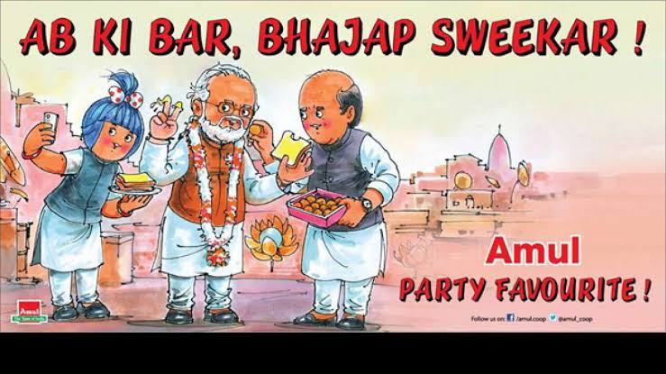
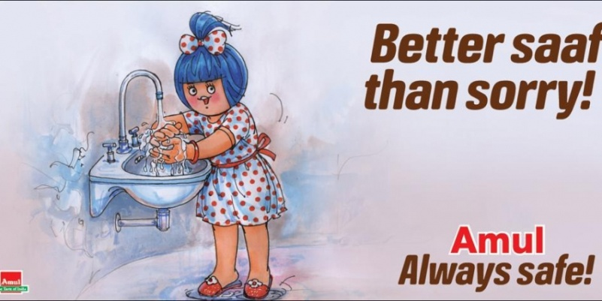
AMUL – Be it bollywood, olympics,politics cricket, it wouldn‘t be
wrong to say one can stay up to date with current affairs with the AMUL GIRL.
The longest running ad campaign in India was conceived by noted ad man
Sylvester daCunha in 1956 and is now run by his son Rahul daCunha.
This campaign capture the imagination of every Indian, irrespective of religion,
language, gender or age.
IN A NUTSHELL
• Find one clear idea to promote • Grab attention
• Include a clear call to action

Slide 16
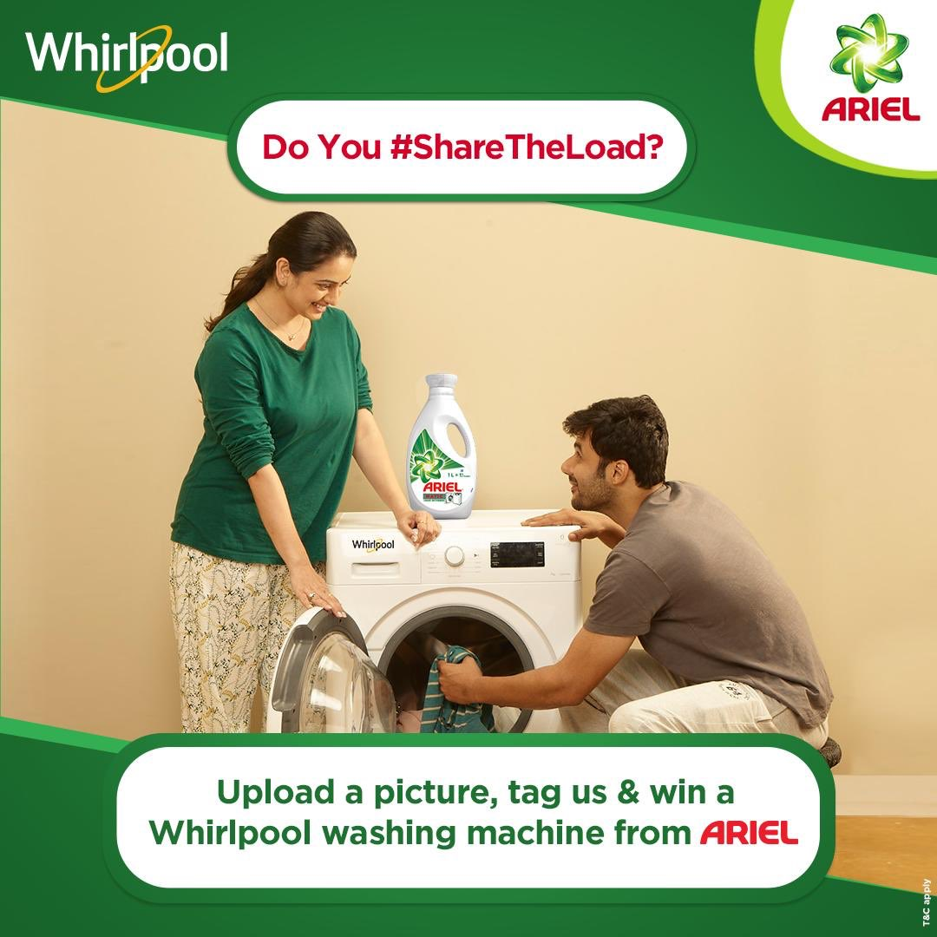
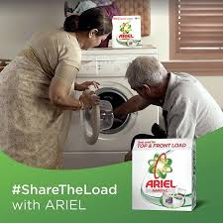
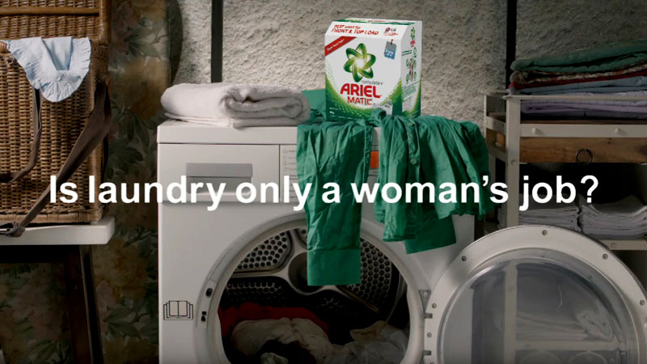
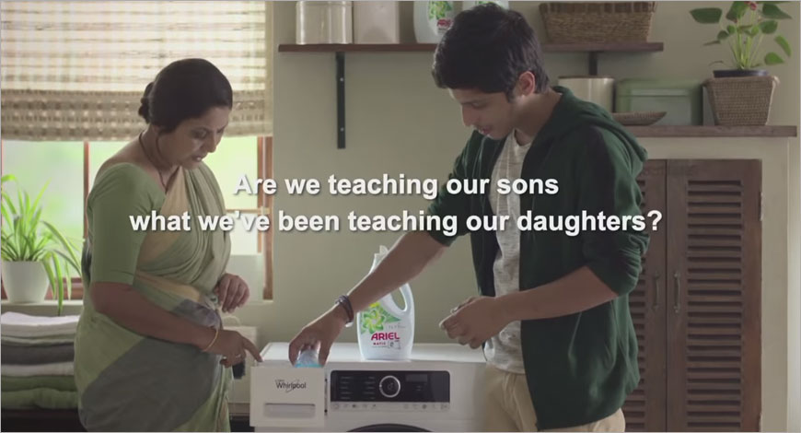
2. ARIEL MATIC

Slide 17
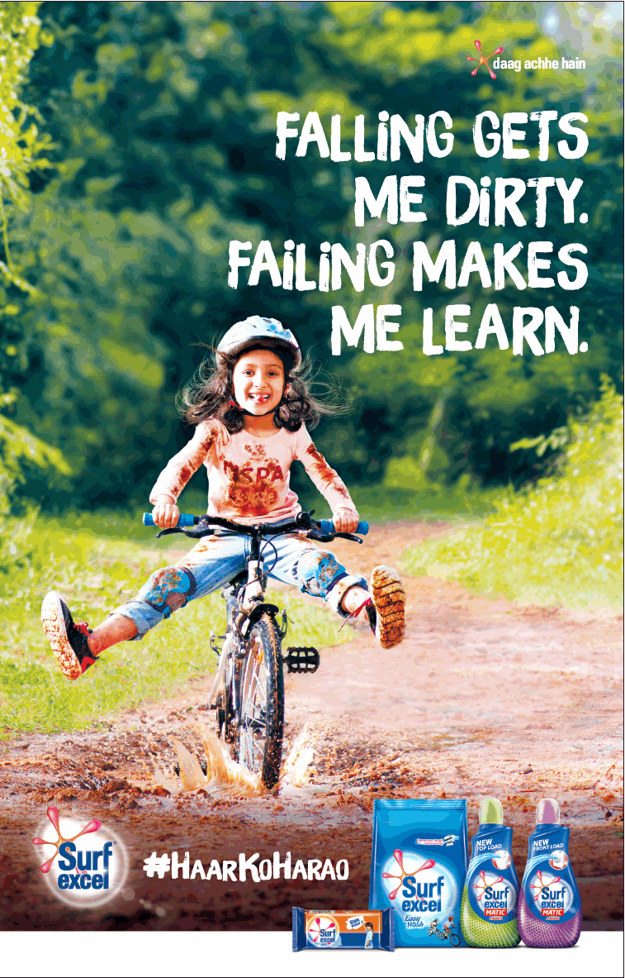
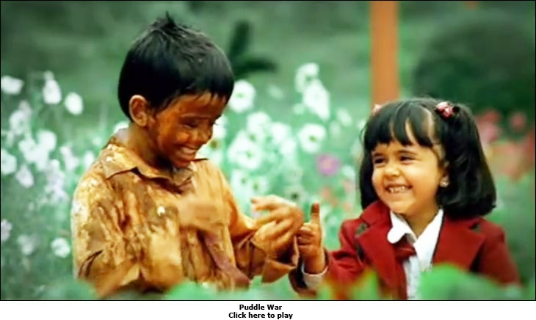
3. SURF EXCEL

Slide 18
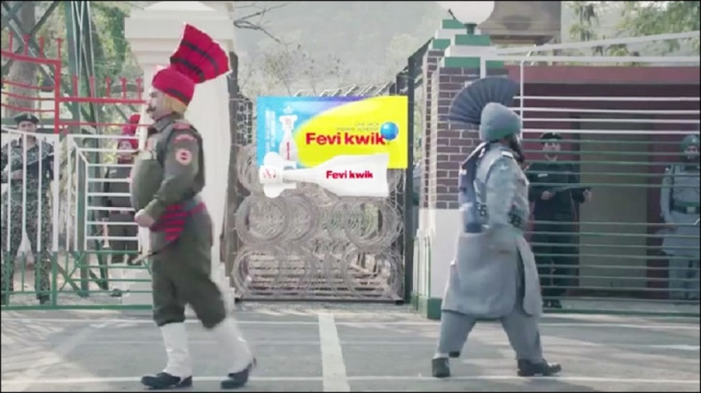
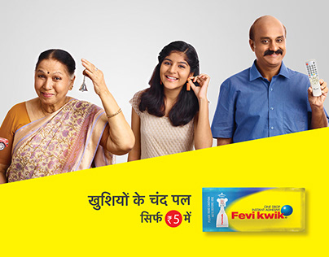
4.FEVIKWIK

Slide 19
9
CONCLUSION
To create an effective advertising campaign
one need to understand the entire process
behind an advertising campaign.
It starts with an in-depth analysis of
the company and products to be advertised,
followed by extensive research on the
market and the targeted population.

Slide 20
THANKYOU

