Slide 1
DR. Rajesh Pratap Singh Associate Professor Physical Education CSJM University Campus , Kanpur
Motion of Freely Falling Body

Slide 4
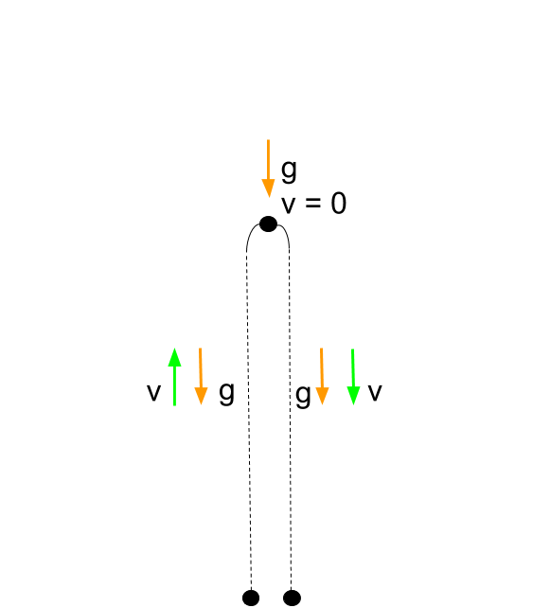

Slide 12
