Slide 1
Subject: Computer Graphics and Multimedia Applications Code: BCA401N
BY
Dr MAYUR RAHUL
(E762)
DEPARTMENT OF COMPUTER APPLICATION
UIET, CSJM UNIVERSITY, KANPUR

Slide 2
OUTLINE
Solid modeling
Representing solids
Regularized boolean set operations

Slide 3
Solid modeling
Solid Modeling is the computer modeling of 3D solid objects.
The objective of Solid Modeling is to ensure that every surface is geometrically correct.
It is considered the most complex aspect to master in computer-aided design (CAD) because it requires the CAD software to simulate the object from within and outside.
This is critical as it lets designers provide cutaways of the design, such as an engine and its components.
In short, solid modeling allows the design, creation, visualization and animation of digital 3D models.

Slide 4
Representing solids
Based on assumed mathematical properties, any scheme of representing solids is a method for capturing information about the class of semi-analytic subsets of Euclidean space.
This means all representations are different ways of organizing the same geometric and topological data in the form of a data structure.
All representation schemes are organized in terms of a finite number of operations on a set of primitives.
Therefore, the modeling space of any particular representation is finite, and any single representation scheme may not completely suffice to represent all types of solids.
For example, solids defined via combinations of regularized boolean operations cannot necessarily be represented as the sweep of a primitive moving according to a space trajectory, except in very simple cases.
This forces modern geometric modeling systems to maintain several representation schemes of solids and also facilitate efficient conversion between representation schemes.

Slide 5
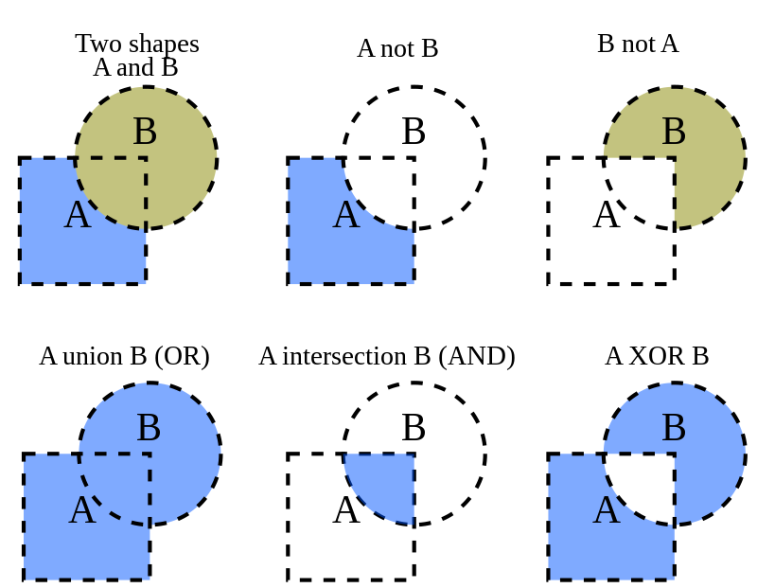
Regularized boolean set operations
Boolean operations on polygons are a set of Boolean operations (AND, OR, NOT, XOR, ...) operating on one or more sets of polygons in computer graphics.
These sets of operations are widely used in computer graphics, CAD, and in EDA (in integrated circuit physical design and verification software).

Slide 6
REFERENCES
https://www.tutorialspoint.com/
https://www.studytonight.com/
https://www.geeksforgeeks.org/
https://www.javatpoint.com/

