Slide 1
Subject: Operating System Code: BCA402N Lecture 16
BY
Dr MAYUR RAHUL
(E762)
DEPARTMENT OF COMPUTER APPLICATION
UIET, CSJM UNIVERSITY, KANPUR

Slide 2
OUTLINE
The critical section problem
Semaphores

Slide 3
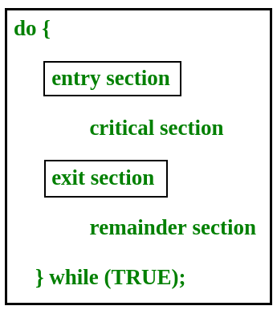
The critical section problem
The critical section is a code segment where the shared variables can be accessed.
An atomic action is required in a critical section i.e. only one process can execute in its critical section at a time.
All the other processes have to wait to execute in their critical sections.
In the given diagram, the entry section handles the entry into the critical section.
It acquires the resources needed for execution by the process.
The exit section handles the exit from the critical section.
It releases the resources and also informs the other processes that the critical section is free.

Slide 4
Solution to the Critical Section Problem
The critical section problem needs a solution to synchronize the different processes. The solution to the critical section problem must satisfy the following conditions −
Mutual Exclusion: Mutual exclusion implies that only one process can be inside the critical section at any time. If any other processes require the critical section, they must wait until it is free.
Progress: Progress means that if a process is not using the critical section, then it should not stop any other process from accessing it. In other words, any process can enter a critical section if it is free.
Bounded Waiting:Bounded waiting means that each process must have a limited waiting time. Itt should not wait endlessly to access the critical section.

Slide 5
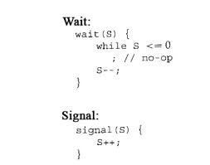
Semaphores
Semaphores are integer variables that are used to solve the critical section problem by using two atomic operations, wait and signal that are used for process synchronization.
Wait:The wait operation decrements the value of its argument S, if it is positive. If S is negative or zero, then no operation is performed.
Signal: The signal operation increments the value of its argument S.

Slide 6
REFERENCES
https://www.tutorialspoint.com/dbms/dbms_overview.htm
https://www.studytonight.com/dbms/database-model.php
https://www.geeksforgeeks.org/introduction-of-process-synchronization/\
https://www.javatpoint.com/os-process-synchronization-introduction

