Slide 1
Biosensors

Slide 5
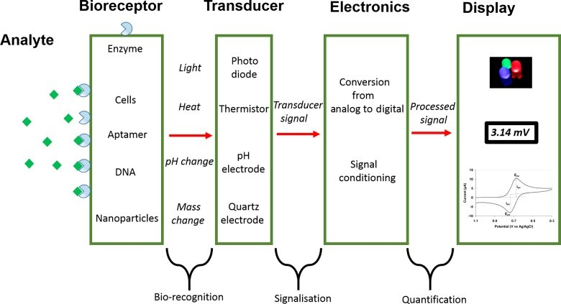

Slide 12
