Slide 1
Enzyme Technology

Slide 16
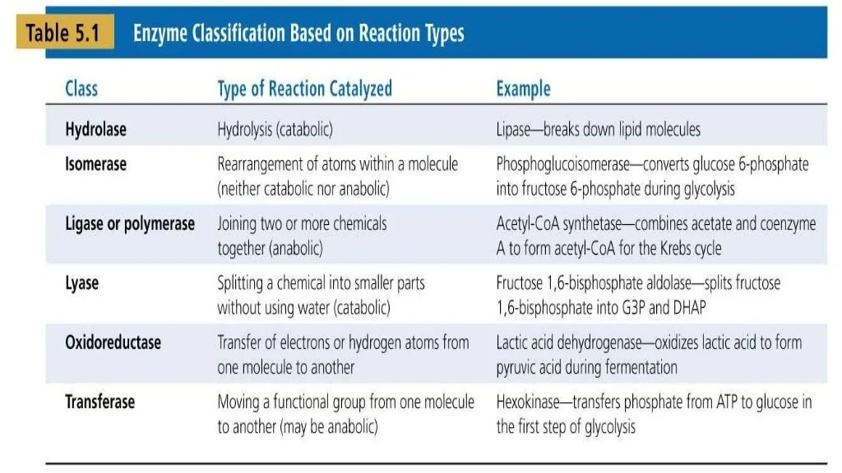

Slide 21
