Slide 1
Fermentation
General requirements of Fermentation

Slide 2
Contents
Introduction
Fermentation methods
Study of media
Fermenter
Sterilization
Aeration
Agitation
Scale up studies

Slide 6
Major Fermentation Products

Slide 7
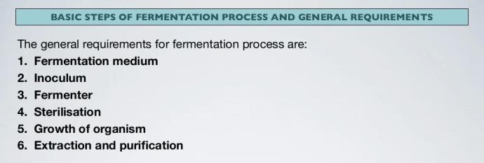

Slide 10
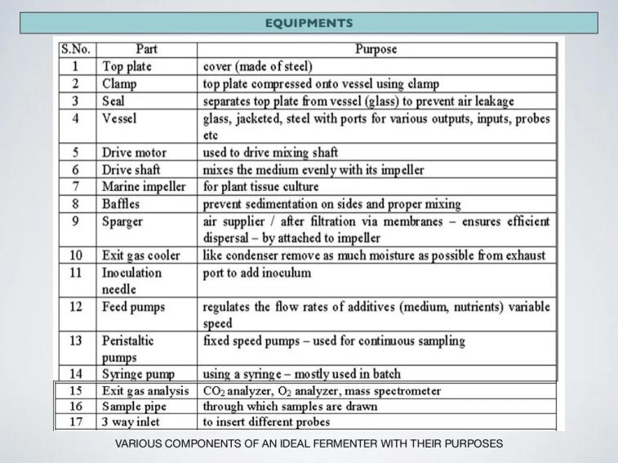

Slide 14
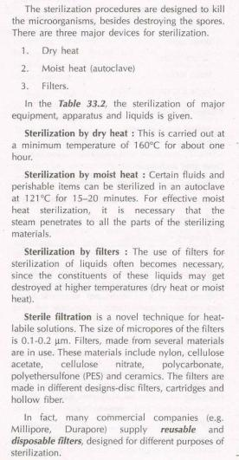
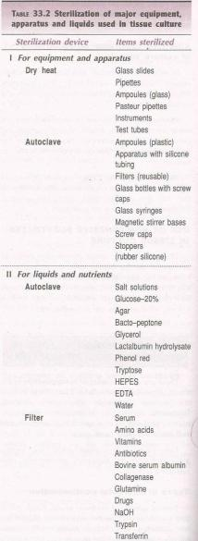
Sterilization

Slide 16
