Slide 1
Medical microbiology
Early discovery of pathogenic microorganism

Slide 2
Dutch biologist Anton van Leeuwenhoek in 1674 - ground microscopic lenses at a drop of water and discovered a world of millions of tiny “animalcules.
In 1840, the German pathologist Friedrich Henle proposed criteria for proving that microorganisms were responsible for causing human disease (the “germ theory” of disease).

Slide 3
In 1865 –Pasteur-Silk worm Disease by Protozoa
In 1860- Joseph Lister –Disinfection of surgical wounds
Robert Koch and Louis Pasteur confirmed this theory in the 1870s and 1880s with a series of elegant experiments proving that microorganisms were responsible for causing anthrax, rabies, plague, cholera, and tuberculosis.

Slide 4
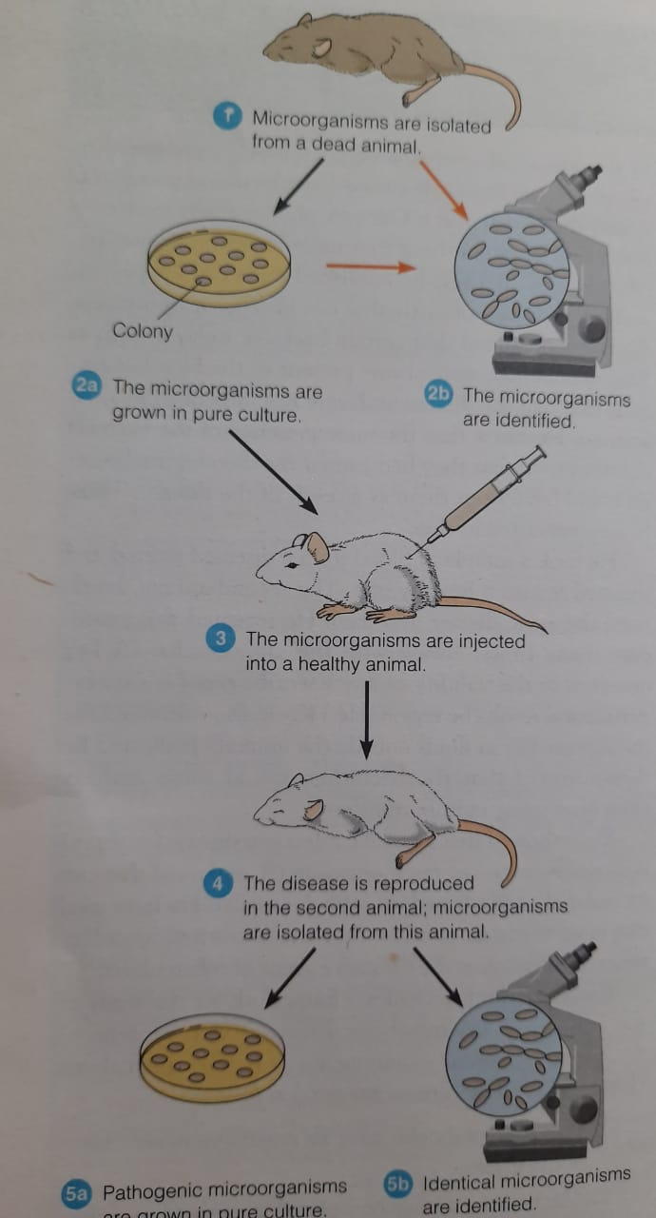

Slide 5
Vaccination
1746-Edward Jenner-small pox
1880-Pasateur-Cholera

Slide 6
The era of chemotherapy began in 1910, when the German chemist Paul Ehrlich discovered the first antibacterial agent, a compound effective against the spirochete that causes syphilis.
Alexander Fleming’s discovery of penicillin in 1928, Gerhard Domagk’s discovery of sulfanilamide in 1935, and Selman Waksman’s discovery of streptomycin in 1943.
In 1946, the American microbiologist John Enders was the first to cultivate viruses in cell cultures, leading the way to the large-scale production of virus cultures for vaccine development. Thousands of scientists have followed these pioneers, each building on the foundation established by his or her predecessors, and each adding an observation that expanded our understanding of microbes and their role in disease.

