Slide 1
YOGIC SCIENCE
EFFECT OF YOGA ON VARIOUS DISEASES

Slide 2
Asthma
Asthma is a condition in which your airways narrow and swell and may produce extra mucus. This can make breathing difficult and trigger coughing, a whistling sound (wheezing) when you breathe out and shortness of breath. For some people, asthma is a minor nuisance

Slide 3
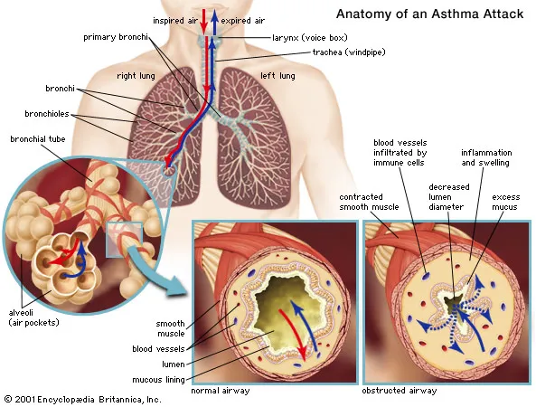

Slide 4
Common Asthma Triggers
Tobacco Smoke.
Dust Mites.
Outdoor Air Pollution.
Pests (e.g., cockroaches, mice)
Pets.
Other Triggers.

Slide 5
EFFECY OF YOGA ON ASTAMA
Nadi Shodhan pranayama (Alternate Nostril Breathing technique)
Kapal Bhati
Ardha Matsyendrasana (Sitting Half Spinal Twist)
Pavanamuktasana (Wind Relieving Pose)
Setu Bandhasana (Bridge Pose)
Bhujangasana (Cobra Pose)
Badhakonasana (Butterfly Pose)
Poorvottanasana (Upward Plank Pose)
Shavasana (Corpse Pose)

Slide 6
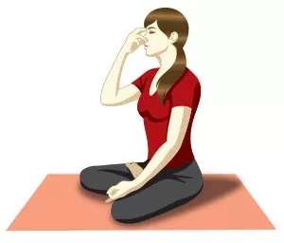
Nadi Shodhan pranayama (Alternate Nostril Breathing technique)
Begin with this pranayama to calm your mind and relieving the body of accumulated stress. This breathing technique has a healing effect on many respiratory and circulatory problems.

Slide 7
Kapal Bhati
This breathing technique relaxes the mind and energizes the nervous system. It also clears all the nadis (energy channels) and improves blood circulation.

Slide 8
Ardha Matsyendrasana (Sitting Half Spinal Twist)
The Sitting Half Spinal Twist opens the chest and improves the supply of oxygen to the lungs, thereby reducing the probability of asthma restricting you.

Slide 9
Jaundice
Jaundice is a condition in which the skin, whites of the eyes and mucous membranes turn yellow because of a high level of bilirubin, a yellow-orange bile pigment. Jaundice has many causes, including hepatitis, gallstones .
You can get jaundice if a gallstone passes out of the gallbladder into the bile duct and blocks the flow of bile

Slide 10
Jaundice may occur if the liver can't efficiently process red blood cells as they break down. It's normal in healthy newborns and usually clears on its own. At other ages, it may signal infection or liver disease.
Symptoms include yellowing of the skin and whites of the eyes.

Slide 11
Effect of asana and yogic practice on jaundice
Bandha : This asana helps tone and strengthen your abdominal organs especially the liver.
Sarvangasana: It also helps strengthen the liver, kidneys and respiratory system. Also, perform these yoga poses for a healthy liver and stronger immunity.
Matsyasana: This asana not only boosts birth circulation to your head but also tones all your abdominal organs and eliminate toxins.

Slide 12
Ujjayi breathing: Ujjayi breath brings relaxation in the body and mind immediately.
Yoga nidra: Yoga nidra or yogic sleep proves to be a good relaxing technique for the body and mind and replenish the body naturally, helping it get proper restful sleep.
Vaman dhauti: Vaman dhauti is the process of vomiting by stimulating the root of your tongue with index and middle finger. This process helps get rid of excess bile and gas in the elementary canal.

Slide 13
Hepatitis
Hepatitis damages the liver, making it less able to move bilirubin into the bile ducts. Hepatitis may be acute (short-lived) or chronic (lasting at least 6 months). Acute viral hepatitis is a common cause of jaundice, particularly jaundice that occurs in young and otherwise healthy people.

Slide 14
BLOOD PRESSURE
A normal blood pressure level is less than 120/80 mmHg
What is blood pressure means?
What is blood pressure? Blood pressure is the force of your blood pushing against the walls of your arteries. Each time your heart beats, it pumps blood into the arteries. Your blood pressure is highest when your heart beats, pumping the blood

Slide 15
A condition in which the force of the blood against the artery walls is too high.
Usually hypertension is defined as blood pressure above 140/90, and is considered severe if the pressure is above 180/120.
High blood pressure often has no symptoms. Over time, if untreated, it can cause health conditions, such as heart disease and stroke.
Eating a healthier diet with less salt, exercising regularly and taking medication can help lower blood pressure.

Slide 16
Systolic and diastolic pressure
The first number, called systolic blood pressure, measures the pressure in your arteries when your heart beats.
The second number, called diastolic blood pressure, measures the pressure in your arteries when your heart rests between beats.

Slide 17
Yoga asana to cure blood pressure
Meditation
Alom- vilom
Savasana
Makarasana
pranayama

