Slide 1
Merits of sampling | Demerits of sampling
Saves time | In case of small population, sampling is impossible
In case of infinite population, sampling is the only method which can be used | Results may be false, inaccurate and misleading
Reduces the cost of experiments | Personal biased

Slide 2
Methods of sampling
Random
Systematic
Stratified
Cluster
Non-Random

Slide 3
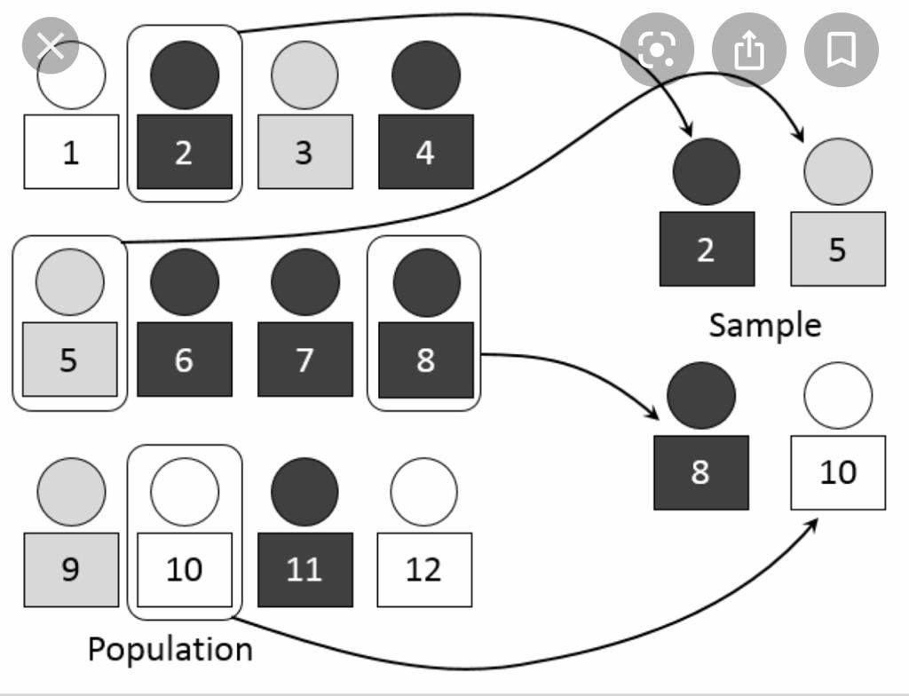
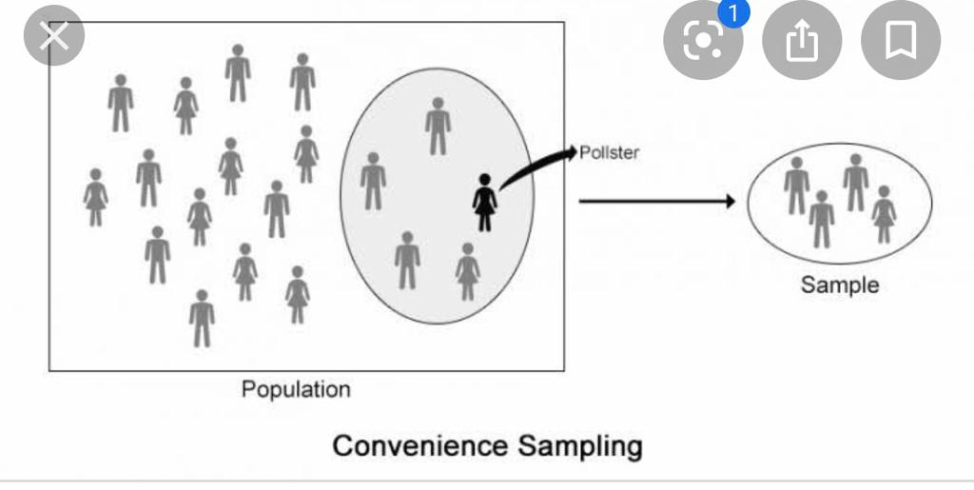
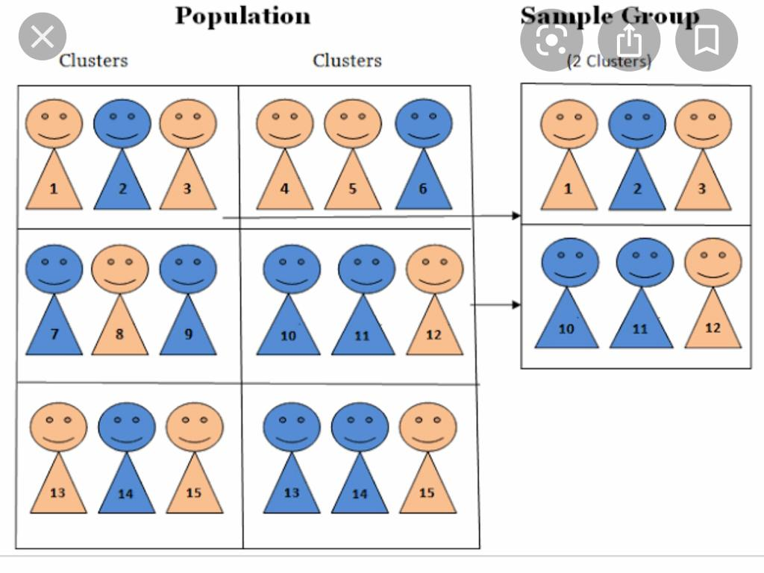
Random
Systematic
Stratified
Cluster
Non-random

