Slide 1
Stages of a Bioprocess
A biotechnical process to produce a product can be subdivided into five successive major segments, with some overlap:
• upstream processing
• fermentation
• downstream processing
• product finishing
• treatment of waste if any

Slide 2
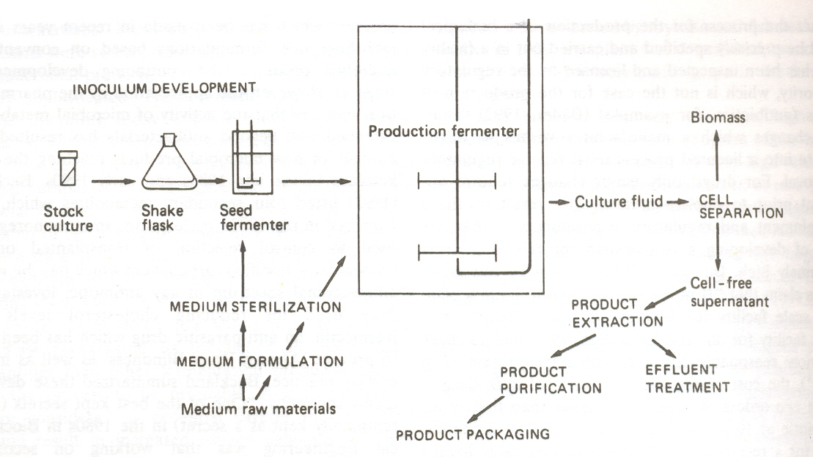
Stages of a Traditional Bioprocess

Slide 3
Stages of a Bioprocess (Details)
Preparation of sterile medium.
Addition (inoculation) of microbe ( pure culture) into this medium
Cultivation (incubation) under controlled conditions
Sterilising fermentation apparatus and preparing and sterilising feed streams to the fermentor
FERMENTATION
Isolation and purification of the product from the fermented medium
Packaging of the product
Treatment of the waste products if any

Slide 4
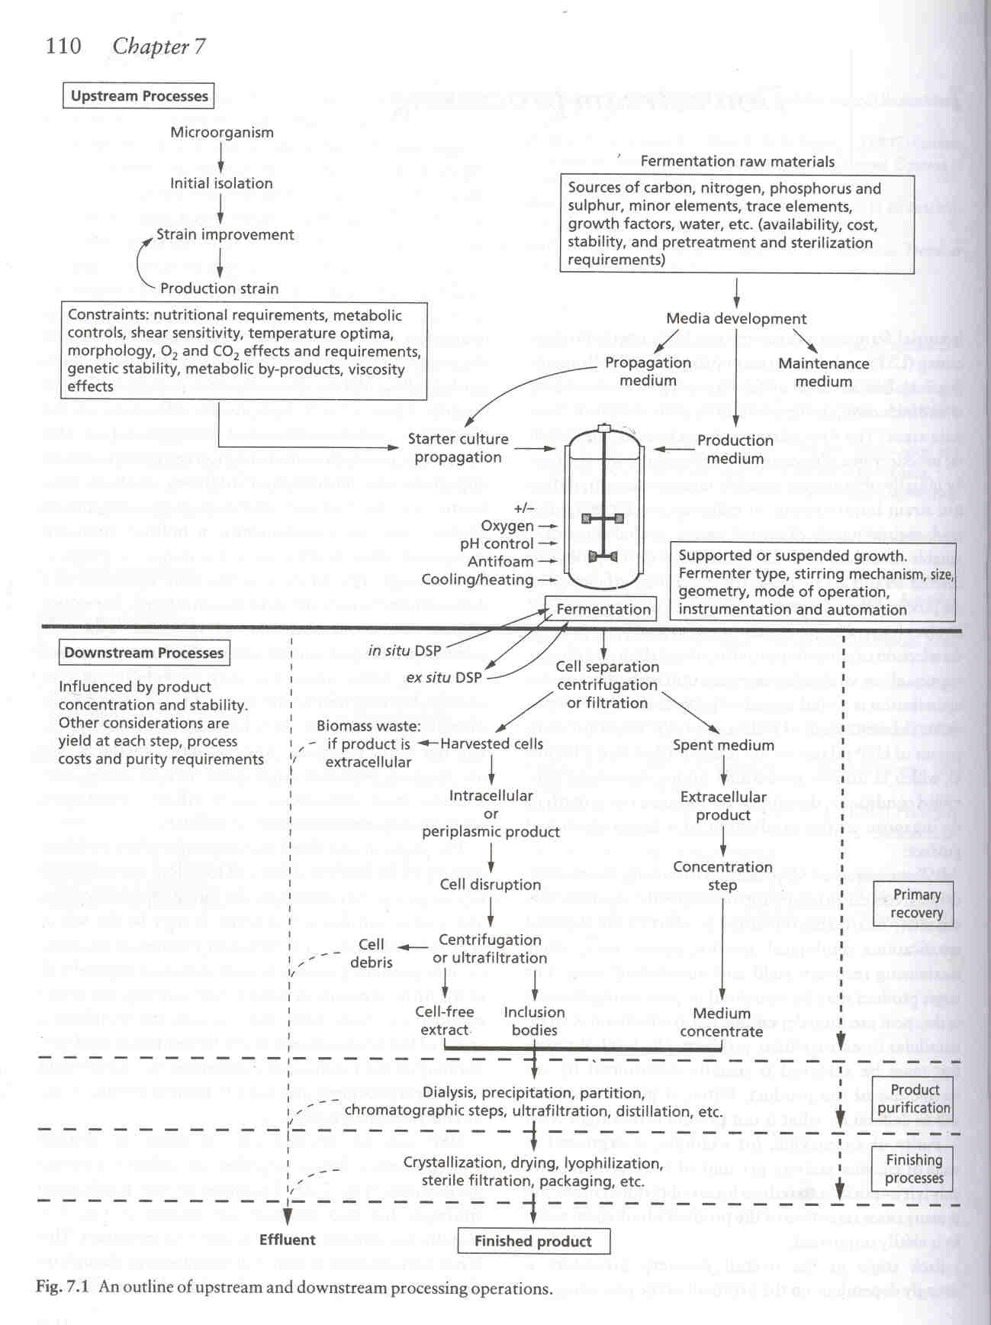
Unit Operations in a Bioprocess

Slide 5
Upstream Processing
“Pure Upstream processing” has essentially
three functions:
Growth of a pure culture of microorganisms in one or more steps its scale up and strain development.
Sterilization of the apparatus and piping.
Mixing and sterilizing the necessary raw materials and fermentation media to be supplied to the fermentation unit.

Slide 6
Fermentation Stage
Sometimes considered as an Upstream process while some bioprocess engineers consider it as a separate Stage in itself. Never considered as a downstream processing stage
Actual fermentation is commonly a batch or fed batch process in a stirred tank fermentor.
It lasts from a few hours to several days.
The optimal conditions for growth of the organisms and production of the product are established. Those include temperature, pH, sterile aeration and, in fed-batch processes, continuous addition of substrate at its optimal composition.

