Slide 1
Structure of immune system
1. Lymphoid Organs: Consist of central and peripheral lymphoid organs
 | Central or Primary lymphoid organs- Examples include thymus and bone marrow- They host the development of immune cells (hematopoiesis)
 | Peripheral or Secondary lymphoid organs- Examples include lymph node, spleen, and MALT (Mucosa associated lymphoid tissue)
2. Lymphoid Cells
 | Consist of lymphocytes such as T cells, B cells and NK cells

Slide 2
Structure of immune system
3.Other cells of immune system-
 | Include phagocytes such as macrophage and microphages (neutrophil, eosinophil & basophil), dendritic cells, mast cells and platelets.
4.Cytokines-
 | They are the soluble products secreted from various cells of immune system Include interleukins, interferons, tumor necrosis factors, colony stimulating factors, etc.

Slide 3
Central lymphoid organ - Bone marrow
All the cells in blood are originated from pluripotent hematopoietic stem cells of bone marrow and the process is called a hematopoiesis.
In early fetal life, hematopoiesis occurs in liver; gradually the stem cells migrate to bone marrow.
By birth, the stem cells occupy most of the bone marrow space of large bones.

Slide 4
Central lymphoid organ - Bone marrow
As the individual ages, hematopoietic activity in large bones decreases and after puberty hematopoiesis is mostly confined to axial bones such as pelvis, vertebrae, sternum, skull & ribs.
Progenitor T and B cells originate in bone marrow.
Further development of B cells occurs in bone marrow itself.
Progenitor T cells migrate to thymus for further proliferation.

Slide 5
Central lymphoid organ - Thymus
Site of proliferation and maturation of T cells.
Development:
Developed in the embryonic life (third month) from third/fourth pharyngeal pouch.
Highly active at birth, continues to grow for many years, reaches its peak size at puberty, and then it degenerates.
Structure: Thymus has two lobes surrounded by a fibrous capsule. Septa arising from capsule divide thymus into lobules, and each lobule is differentiated into an outer cortex & an inner medulla

Slide 6
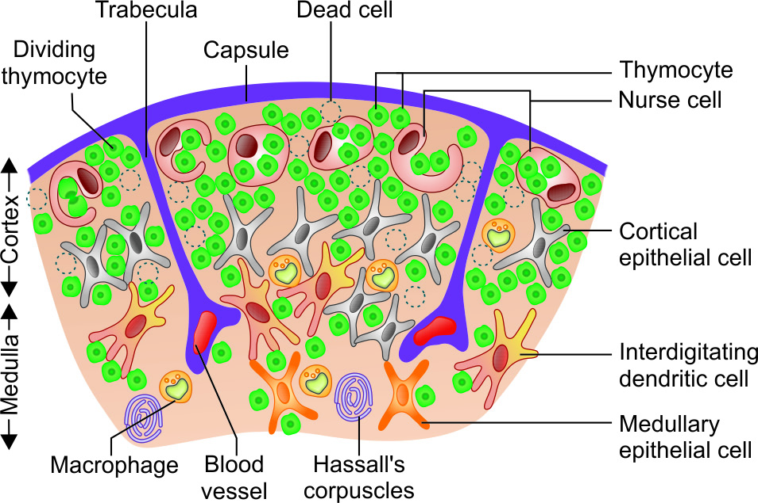
Thymus -Cortex
Densely populated and contains:
Thymocytes- Lymphocytes of thymus (immature and many in number).
Cortical epithelial cells and
Nurse cells (specialized epithelial cells with long membrane extensions that surround many thymocytes)

Slide 7
Thymus -Medulla
Sparsely populated and contains:
Thymocytes which are relatively more mature and fewer in number
Medullary epithelial cells
Interdigitating dendritic cells
Hassall’s corpuscles (concentric layers of degenerating epithelial cells)

Slide 8
Thymic hormones
Produced from the epithelial cells of thymus.
They are believed to attract the precursor T cells (progenitor T cells) from bone marrow.
Thymulin
Thymopoietin
Thymosin

Slide 9
Maturation of T cells
Cell to cell interaction between thymocytes & thymic stromal cells (including epithelial cells, dendritic cells & macrophages)
Effect of thymic hormones.

Slide 10
Central tolerance
Only 2-5% of the developing T cells become mature and released out from thymus.
Remaining T cells are destroyed as they are either not capable of recognizing MHC or are believed to be self-reacting in nature.
Destruction of such self-reacting T cells prevents development of autoimmunity (immune response against self-antigens).
Such tolerance to self-antigens mediated by thymus that occurs in embryonic life is called as central tolerance.

Slide 11
Defect in thymus
Leads to defect in maturation of T lymphocytes that in turn results in severe life threatening cell mediated immunodeficiency disorders.
DiGeorge syndrome (immunodeficiency disorder) - congenital aplasia of thymus.
Nude mice- Mice with congenital absence of thymus.

Slide 12
PERIPHERAL LYMPHOID ORGAN - Lymph Node
Small bean shaped organs.
Occur in clusters or in chains, distributed along the length of lymphatic vessels.
Lymph nodes act as physiological barriers - filter the microbial antigens carried to lymph node by activating the T and B cells.

Slide 13
Lymph Node - Structure
Thymus is divided into three parts:
Cortex
Medulla (both are B cell areas)
Paracortex (T cell area).
Bears the lymphatic vessels (efferent and afferent) and blood vessels.

Slide 14
Lymph Node - Structure
Thymus is divided into three parts:
Cortex
Medulla (both are B cell areas)
Paracortex (T cell area)
Bears the lymphatic vessels (efferent and afferent) and blood vessels.

Slide 15
Lymph Node - Cortex
Contains lymphoid follicles that are composed of:
B cells
Few special type of dendritic cells (called follicular dendritic cells)
Occasional T cells.
Lymphoid follicles are mainly of two types:
Primary lymphoid follicles
Secondary lymphoid follicles

Slide 16
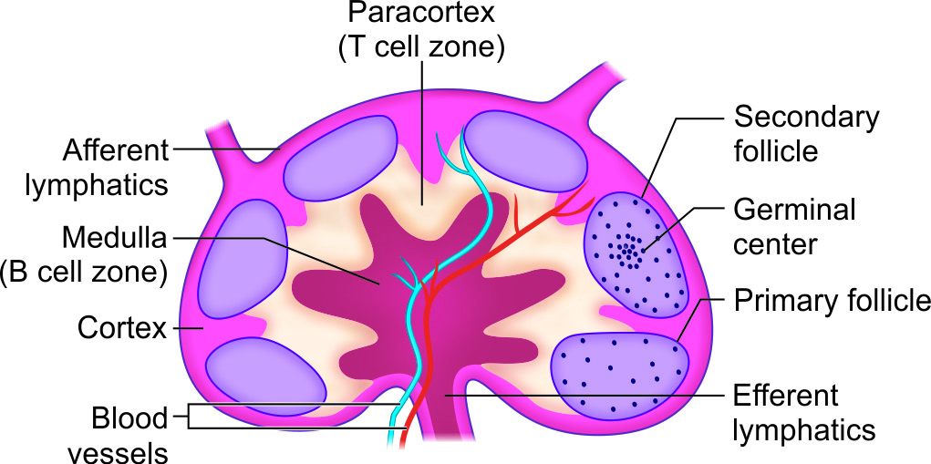
Primary lymphoid follicles
Found before the antigenic stimulus.
Smaller
Contain resting B cells.

Slide 17
Secondary lymphoid follicles
Following contact with an antigen - resting B cells starts dividing and become activated.
Activated B cells differentiate rapidly in to plasma cells and memory B cells.
Follicles become larger called secondary lymphoid follicles.

Slide 18
Secondary lymphoid follicles
Has two areas:
Central area - germinal center
Peripheral zone - mantle area; contains activated B cells.

Slide 19
Lymph Node – Paracortical area and Medulla
Paracortical are:
Present in between cortex and medulla.
T cell area of lymph node (rich in naive T cells).
Contains macrophages and interdigitating dendritic cells, which trap the antigens and present to T cells.
Medulla:
Innermost area of lymph node.
Rich in B-lymphocytes (mainly plasma cells).

Slide 20
Spleen
Largest secondary lymphoid organ.
Acts as physiological barrier similar to lymph node in clearing the microbial antigens through the antigenic stimulation of T and B cells.

Slide 21
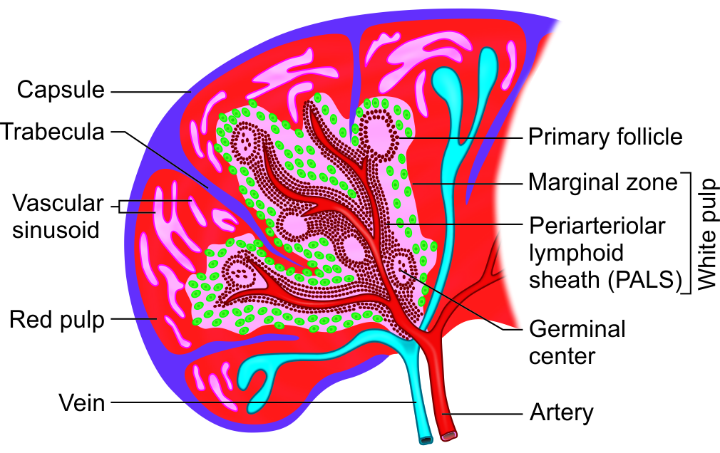
Spleen - Structure
Situated below the diaphragm on left side of the abdomen.
Adult spleen measures about 5-inch in length & weighs around 150gm.
Divided into two compartments: central white pulp and outer red pulp, surrounded by capsule and intervened by trabeculae.

Slide 22
Spleen - Structure
White pulp:
Central densely populated area.
Contains T cells and B cells.
It has two parts:
Periarteriolar lymphoid sheath (PALS), which is T cell area
Marginal zone is located peripheral to the PALS and is populated by B cell lymphoid follicles

Slide 23
Spleen - Structure
Red pulp:
Area that surrounds the sinusoids.
Filled with red blood cells (RBCs).
Older and defective RBCs are destroyed here.

Slide 24
Defect in spleen
Increased incidence of bacterial sepsis caused primarily by capsulated bacteria such as:
Streptococcus pneumoniae
Neisseria meningitides
Haemophilus influenzae.

Slide 25
Refrences
Textbook of Medical Microbiology by Ananthnarayan, Paniker
Textbook of Medical Microbiology by Satish Gupte
Textbook of Medical Microbiology by S. Bhat, A.S.Sastry
Textbook of Medical Microbiology by D.R.Arora, Brij bala Arora

