Slide 1
School of Health Sciences
C.S.J.M.U KANPUR
Dr.Aamena Zaidi
Assistant Professor

Slide 2
CONSTIPATION

Slide 3
GASTROINTESTINAL DISEASES
Digestive disorders are among the most common problems in health care approximately 30 to40 percent of adults claim to have frequent indigestion.
Dietary habits and specific food types can play a significant role in the onset,treatment and prevention of many GI disorders.
In many cases,diet can play a role in improving patient’s sense of well-being.

Slide 5
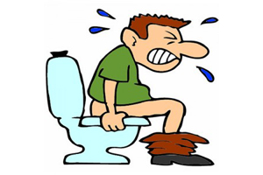
CONSTIPATION
Constipation is a symptoms and not a disease.it is a passage of firm or hard pellet like stools at infrequent and long interval with difficult to expel.
On the last leg of digestion trip food travels through colon where water is absorbed and the remaining food is transformed into waste or stools.
If too much water is absorbed by the colon the result is hard dry stool constipation.if the colon muscle is sluggish the result is hard dry stools.
In constipation there may be less than 3 motion per week or painful defacation.

Slide 6
In this condition, there is resistance to movement of intestinal contents;consequently there is distension and infrequent or difficult evacuation of feces from the intestine.
The frequency of bowel movements varies greately among individuals.for some ,daily elimination is normal;in other equally healthy person,regular evacuation occurs every second or third day.
Insufficient or infrequent emptying of the bowel may lead to malaise,headache,coated tongue,foul breath and lack of appetite.These symptoms usually disappear after satisfactory evacuation has taken place.

Slide 8
TYPES OF CONSTIPATION
1. Atonic constipation.
2.Spastic constipation.

Slide 9
ATONIC CONSTIPATION
Atonic occurs when there is a lack of normal muscle tone or strength in the colon. Also, known as lazy colon or colon stasis, it may result in chronic constipation. When your intestines are backed up, as in constipation, it slows the rate in which your stomach can empty, which in turn may cause heartburn.
Atonic colon is essentially a "vicious circle" phenomena. Constipation can lead to reduced bowel activity, which in turn can lead to a worsening of constipation, and so on.

Slide 10
CAUSES
While the cause of atonic colon is often unknown, chronic laxative use can be to blame. A relatively rare cause is Hirschsprung's disease, which causes blockages in part or all of the large intestine due to a lack of nerve cells that are needed for normal muscle movement. But Hirschsprung's disease isn't something you can develop or catch, it is a congenital condition, which means that it is present from birth. It is also known as congenital megacolon.

Slide 11
SPASTIC CONSTIPATION
A colon spasm is a spontaneous and sudden contraction of the muscles in your colon. The colon is part of the large intestine. It’s responsible for forming, storing, and excreting feces.
Colon spasms are frequently associated with irritable bowel syndrome (IBS). These spasms can be a sign or symptom of the condition. In fact, colon spasms are so common with IBS that the intestinal disorder is also sometimes known as “spastic colon.” However, not everyone with IBS experiences increased motility, or bowel movements, so the term doesn’t apply for every person with IBS.

Slide 12
CAUSES
Colon spasms are typically a symptom of an underlying health condition. IBS is the most common underlying health condition that can cause colon spasms. Other conditions may also cause these contractions. These include:
ulcerative colitis
Crohn’s disease
distended, or enlarged, colon
trapped gas
bacterial infection in the gut
a bowel or intestinal obstruction

Slide 13
SYMPTOMS OF CONSTIPATION
Passing fewer than three stools a week
Having lumpy or hard stools
Straining to have bowel movements
Feeling as though there's a blockage in your rectum that prevents bowel movements
Feeling as though you can't completely empty the stool from your rectum
Needing help to empty your rectum, such as using your hands to press on your abdomen and using a finger to remove stool from your rectum

Slide 15
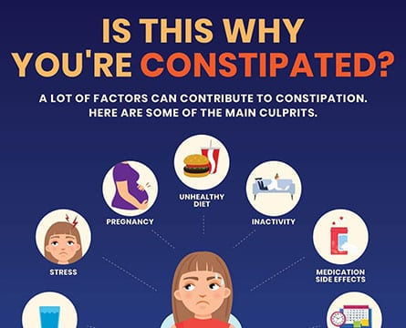
RISK FACTORS OF CONSTIPATION
Factors that may increase your risk of constipation include:
Being an older adult
Being a woman
Being dehydrated
Eating a diet that's low in fiber

Slide 17
Getting little or no physical activity
Taking certain medications, including sedatives, opioid pain medications, some antidepressants or medications to lower blood pressure
Having a mental health condition such as depression or an eating disorder

Slide 18
COMPLICATIONS OF CONSTIPATION
Complications of constipation include:
Swollen veins in your anus (hemorrhoids). Straining to have a bowel movement may cause swelling in the veins in and around your anus.
Torn skin in your anus (anal fissure). A large or hard stool can cause tiny tears in the anus.
Stool that can't be expelled (fecal impaction). Chronic constipation may cause an accumulation of hardened stool that gets stuck in your intestines.
Intestine that protrudes from the anus (rectal prolapse). Straining to have a bowel movement can cause a small amount of the rectum to stretch and protrude from the anus.

Slide 20
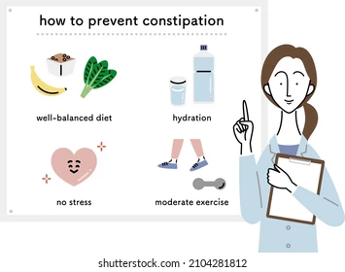
PREVENTION
Include plenty of high-fiber foods in your diet, including beans, vegetables, fruits, whole grain cereals and bran.
Eat fewer foods with low amounts of fiber such as processed foods, and dairy and meat products.
Drink plenty of fluids.

Slide 22
Stay as active as possible and try to get regular exercise.
Try to manage stress.
Don't ignore the urge to pass stool.
Try to create a regular schedule for bowel movements, especially after a meal.
Make sure children who begin to eat solid foods get plenty of fiber in their diets.

Slide 23
DIETARY CONSIDERATION
Soluble Fiber-
Soluble fiber is completely digested by the body and aids in reducing cholesterol, stabilizing blood sugar, and getting rid of other toxins present in the gastrointestinal tract. Soluble fiber functions as a bulking agent and slows down the movement of waste through the gastrointestinal tract. Examples of foods that contain soluble fiber include oats, beans, legumes, sweet potatoes, onions, and fruits such as apples, bananas, and pears.
plenty of liquids-
Fluid helps your body process fiber without discomfort. A good starting goal is eight 8-ounce glasses of fluid per day.

Slide 24
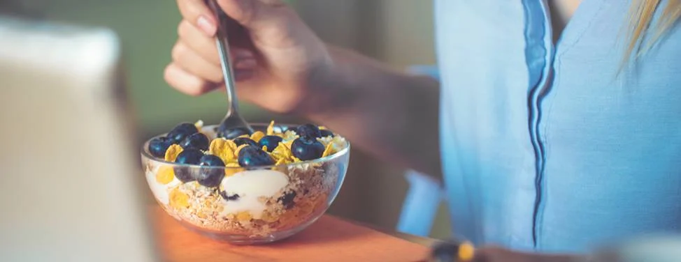

Slide 25
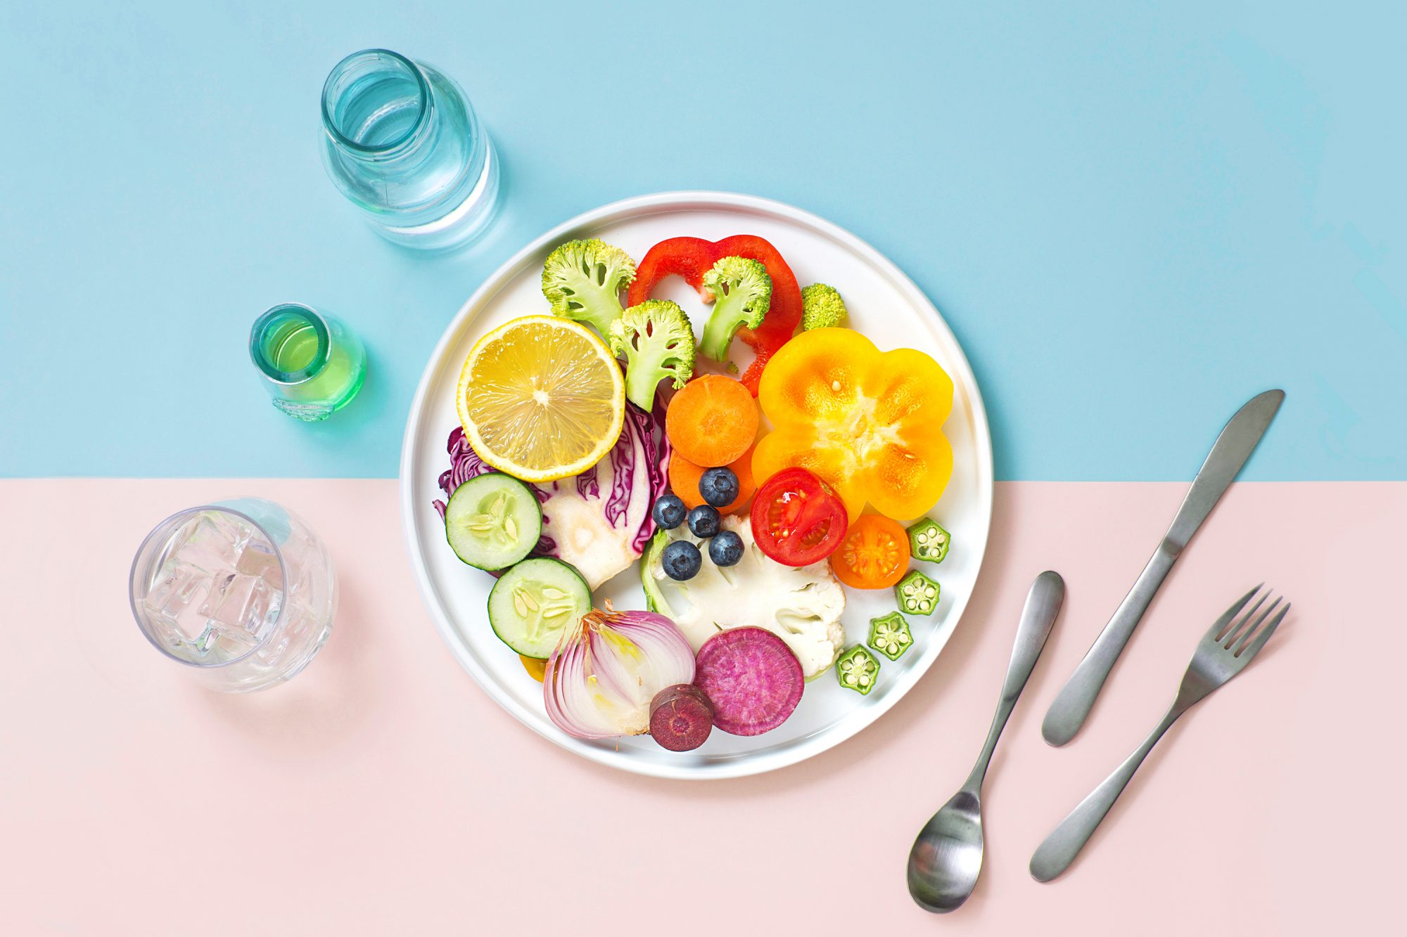
Gradually increase your fiber intake-
Your daily goal should be between 25-35 grams daily.
Fiber is mostly found in plant foods, such as fruits and vegetables, beans, legumes, whole grain cereals, breads, and oatmeal.
Eat 3-5 servings of fruits and vegetables daily.
Choose whole fruit instead of juice.
Eat the skins and seeds for extra fiber.
Try to have a fruit or vegetable with each meal or snack.

Slide 27
Eat cereals, breads, and pastas that are made with 100% whole grain.
Have brown or wild rice in place of white rice or potatoes.
Choose hot cereals like oatmeal or cold cereals with at least 5 grams of fiber.
Choose whole wheat breads, whole corn or wheat tortillas, and whole grain crackers instead of refined products.
Eat more beans, lentils, and peas. Add them to soups and casseroles, or have as a main entrée.
Beans are also a great source of protein, so you can use them as a substitute for meat at mealtimes.
Beans can be gas forming, so add them gradually. If you experience bloating or discomfort, you may want to limit them in your diet.

Slide 28
THANK YOU!

