Slide 1
Fermentation
General requirements of Fermentation

Slide 4
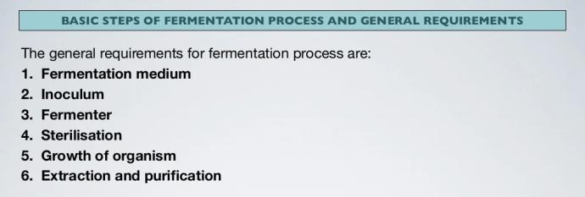

Slide 6
Major Fermentation Products

