Slide 1
HYPERTENSION
By- Dr Aamena Zaidi
Assistant Professor
School of Health Sciences

Slide 2
What is hypertension?
High blood-pressure(HBP) or hypertension means high pressure (tension) in the arteries.
Normal blood pressure is below 120/80, blood pressure between 120/80 and 139/89 is called “pre-hypertension”, and a blood pressure of 140/90 or above is considered high.
It is classified as either
primary (essential) or secondary.

Slide 3
DEFINATIONS
Pulmonary hypertension (PH) is haemodynamic and pathophysiological condition defined as mean pulmonary artery pressure >25 mmHg at rest by Right heart Catheterization (RHC).
Pulmonary arterial hypertension(PAH) is a clinical condition characterized by the presence of pre-capillary PH in absence of other causes of pre-capillary PH such as PH due to lung diseases, chronic thromboembolic PH, or other rare diseases.

Slide 4
SECONDARY HYPERTENSION
DEFINITION:
The elevation of blood pressure due to a specific underlying disorder.
CAUSES(include but not limited to):
Renal Parenchymal Diseases
Primary Aldosteronism
Cushing’s Syndrome
Pheochromocytoma

Slide 5
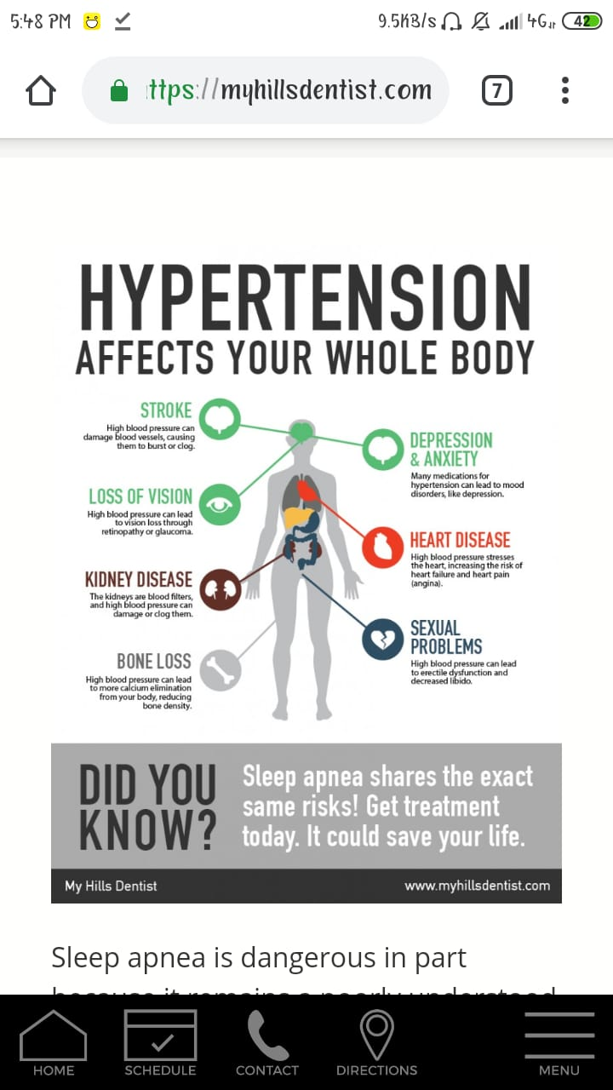

Slide 6
Signs and Symptoms
Diagnosed through repeat blood pressure readings.
Primary Hypertension does not have symptoms other than high blood pressure.
Secondary Hypertension
Most likely caused by Renal Disorders, symptoms you will see:
Decreased urine formation
Increased sodium and water retention

Slide 7
Causes
Some conditions that can cause hypertension includes:
Preeclampsia(a condition that occurs only during pregnancy)
Tumor of the adrenal gland
Kidney diseases
Liver diseases
Obesity
Sleep apnea
Acromegaly (a metabolic disorder caused by too much growth hormone)
Certain medicines e.g. Birth control pills

Slide 9
Blood Pressure Category | Systolic mmHg (upper#) |  | Diastolic mm Hg (lower #)
Normal | Less than 120 | and | Less than 80
Prehypertension | 120-139 | or | 80-89
High Blood Pressure (Hypertension) Stage 1 | 140-159 | or | 90-99
High Blood Pressure (Hypertension) Stage 2 | 160 of higher | or | 100 of higher
Hypertensive Crisis (Emergency care needed) | Higher than 180 | or | Higher than 110

Slide 10
Thank You

