Slide 1
Karnaugh Maps (K-map)
Alternate representation of a truth table
Red decimal = minterm value
Note that A is the MSB for this minterm numbering
Adjacent squares have distance = 1
Valuable tool for logic minimization
Applies most Boolean theorems & postulates automatically (when procedure is followed)
B A
0
1
0 1
B
0 | 1
2 | 3
2-variable K-Maps
0 | 1
2 | 3
form 1
form 2
A

Slide 2
Karnaugh Maps (K-map)
Alternate forms of 3-variable K-maps
Note end-around adjacency
Distance = 1
C AB
0 1
Note: A is MSB, C is LSB for minterm 00 numbering
01
0 | 1
2 | 3
6 | 7
4 | 5
BC
A
00 01 11 10
11
10
form 1
0
1
0 | 1 | 3 | 2
4 | 5 | 7 | 6
C
B
0 | 1
2 | 3
6 | 7
4 | 5
0 | 1 | 3 | 2
4 | 5 | 7 | 6
form 2
B
A
A
C

Slide 3
K-mapping & Minimization Steps
Step 1: generate K-map
Put a 1 in all specified minterms
Put a 0 in all other boxes (optional)
Step 2: group all adjacent 1s without including any 0s
All groups (aka prime implicants) must be rectangular and contain a “power-of-2” number of 1s
1, 2, 4, 8, 16, 32, …
An essential group (aka essential prime implicant) contains at least 1 minterm not included in any other groups
A given minterm may be included in multiple groups
Step 3: define product terms using variables common to all minterms in group
Step 4: sum all essential groups plus a minimal set of remaining groups to obtain a minimum SOP

Slide 4
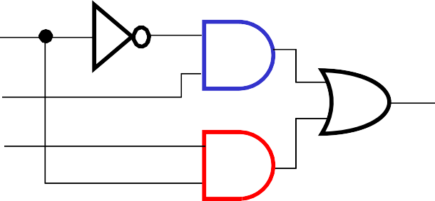
K-map Minimization Example
Z=Σ_{A,B,C}(1,3,6,7)
Recall SOP minterm implementation
8 gates
Note: this group not needed since 1s are already covered
BC
A | B C | Z | Row value
0 | 0 0 | 0 | 0
0 | 0 1 | 1 | 1
0 | 1 0 | 0 | 2
0 | 1 1 | 1 | 3
1 | 0 0 | 0 | 4
1 | 0 1 | 0 | 5
1 | 1 0 | 1 | 6
1 | 1 1 | 1 | 7
27 gate I/O
K-map results
4 gates
11 gate I/O
A
00 01 11 10
0
1
0 1 1 0
0 1
3 2
₀ 4
⁵ 0 1 ⁷ ⁶ 1
essential prime implicants
A
C B
A’
A’C
Z=AC + AB
AB

Slide 5
K-map Minimization Goals
Larger groups:
Smaller product terms
Fewer variables in common
Smaller AND gates
In terms of number of inputs
Fewer groups:
Fewer product terms
Fewer AND gates
Smaller OR gate
In terms of number of inputs
Alternate method:
Group 0s
Could produce fewer and/or smaller product terms
Invert output
Use NOR instead of OR gate

Slide 6
4-variable K-maps
Note adjacency of 4 corners as well as sides
Variable ordering for this minterm numbering: ABCD
CD
_{AB} 00 01 11 10
C
00
01
11
10
0 | 1 | 3 | 2
4 | 5 | 7 | 6
12 | 13 | 15 | 14
8 | 9 | 11 | 10
0 | 1 | 3 | 2
4 | 5 | 7 | 6
12 | 13 | 15 | 14
8 | 9 | 11 | 10
B
A
D
form 2
form 1

Slide 7
5-variable K-map
Note adjacency between maps when overlayed
distance=1
Variable order for this minterm numbering:
A,B,C,D,E (A is MSB, E is LSB)
_{BC} DE _{00 BC} DE ₀₀
01 11 10 01 11 10
00
01
11
10
0 | 1 | 3 | 2
4 | 5 | 7 | 6
12 | 13 | 15 | 14
8 | 9 | 11 | 10
00
01
11
10
16 | 17 | 19 | 18
20 | 21 | 23 | 22
28 | 29 | 31 | 30
24 | 25 | 27 | 26
A=0
A=1

Slide 8
5-variable K-map
Changing the variable used to separate maps changes minterm numbering
Same variable order for this minterm numbering:
A,B,C,D,E (A is MSB, E is LSB)
_{AB} CD_{00 AB} CD₀₀
01 11 10 01 11 10
00
01
11
10
0 | 2 | 6 | 4
8 | 10 | 14 | 12
24 | 26 | 30 | 28
16 | 18 | 22 | 20
00
01
11
10
1 | 3 | 7 | 5
9 | 11 | 15 | 13
25 | 27 | 31 | 29
17 | 19 | 23 | 21
E=0
E=1

Slide 9
6-variable K-map
Variable order for minterm numbers: ABCDEF
_{CD} EF _{00 CD} EF ₀₀
01 11 10 01 11 10
00
01
11
10
0 | 1 | 3 | 2
4 | 5 | 7 | 6
12 | 13 | 15 | 14
8 | 9 | 11 | 10
00
01
11
10
16 | 17 | 19 | 18
20 | 21 | 23 | 22
28 | 29 | 31 | 30
24 | 25 | 27 | 26
A=0
_{CD} EF ₀₀
01 11 10
_{CD} EF ₀₀
01 11 10
00
01
11
10
32 | 33 | 35 | 34
36 | 37 | 39 | 38
44 | 45 | 47 | 46
40 | 41 | 43 | 42
00
01
11
10
48 | 49 | 51 | 50
52 | 53 | 55 | 54
60 | 61 | 63 | 62
56 | 57 | 59 | 58
A=1
B=0
B=1

Slide 10
Don’t Care Conditions
Sometimes input combinations are of no concern
Because they may not exist
Example: BCD uses only 10 of possible 16 input combinations
Since we “don’t care” what the output, we can use these “don’t care” conditions for logic minimization
The output for a don’t care condition can be either 0 or 1
WE DON’T CARE!!!
Don’t Care conditions denoted by:
X, -, d, 2
X is probably the most often used
Can also be used to denote inputs
Example: ABC = 1X1 = AC
B can be a 0 or a 1

Slide 11
Don’t Care Conditions
Truth Table
K-map
Minterm
A | B | C | Z
0 | 0 | 0 | 0
0 | 0 | 1 | 1
0 | 1 | 0 | X
0 | 1 | 1 | 1
1 | 0 | 0 | 0
1 | 0 | 1 | 0
1 | 1 | 0 | 1
1 | 1 | 1 | 1
BC
A
00 01 11 10
0
1
0 1 1 X
0 1
3 2
Z=Σ_{A,B,C}(1,3,6,7)+d(2)
Maxterm
Z=Π_{A,B,C}(0,4,5)+d(2)
₀ 4
⁵ 0 1 ⁷ ⁶ 1
Z=B+A’C
Notice Don’t Cares are same for both minterm & maxterm
A C
B
A’
A’C
Circuit analysis:
G=3 G_{IO}=8
(compared to G=4 & G_{IO}=11 w/o don’t care)
Z=AC + B

Slide 12
Design Example
Hexadecimal to 7-segment display decoder
A common circuit in calculators
7-segments (A-G) to represent digits (0-9 & A-F)
A logic 1 turns on given segment
A
F
B
G
E
C
D
active (on) segments for a given HEX value
7 segments
In3 In2 In1 In0
A B C D F F
Hex to 7-segment decoder
= don’t care
Circuit block diagram

Slide 13
HEX to 7-seg Design Example
Create truth table from specification
A
In3 In2 In1 In0 |  |  |  | A | B | C | D | E | F | G
0 | 0 | 0 | 0 | 1 | 1 | 1 | 1 | 1 | 1 | 0
0 | 0 | 0 | 1 | 0 | 1 | 1 | 0 | 0 | 0 | 0
0 | 0 | 1 | 0 | 1 | 1 | 0 | 1 | 1 | 0 | 1
0 | 0 | 1 | 1 | 1 | 1 | 1 | 1 | 0 | 0 | 1
0 | 1 | 0 | 0 | 0 | 1 | 1 | 0 | 0 | 1 | 1
0 | 1 | 0 | 1 | 1 | 0 | 1 | 1 | 0 | 1 | 1
0 | 1 | 1 | 0 | 1 | 0 | 1 | 1 | 1 | 1 | 1
0 | 1 | 1 | 1 | 1 | 1 | 1 | 0 | 0 | X | 0
1 | 0 | 0 | 0 | 1 | 1 | 1 | 1 | 1 | 1 | 1
1 | 0 | 0 | 1 | 1 | 1 | 1 | X | 0 | 1 | 1
1 | 0 | 1 | 0 | 1 | 1 | 1 | 0 | 1 | 1 | 1
1 | 0 | 1 | 1 | 0 | 0 | 1 | 1 | 1 | 1 | 1
1 | 1 | 0 | 0 | 1 | 0 | 0 | 1 | 1 | 1 | 0
1 | 1 | 0 | 1 | 0 | 1 | 1 | 1 | 1 | 0 | 1
1 | 1 | 1 | 0 | 1 | 0 | 0 | 1 | 1 | 1 | 1
1 | 1 | 1 | 1 | 1 | 0 | 0 | 0 | 1 | 1 | 1
F
B
G
E
C
D
= don’t care

Slide 14
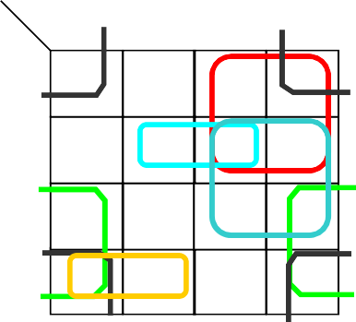
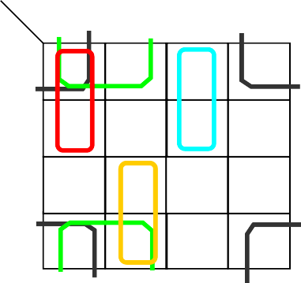
HEX to 7-seg Design Example
Generate K-maps & obtain logic equations
In1 In0 In3 In2
00
01
11
10
In3 In2 In1 In0 |  |  |  | A | B | C | D | E | F | G
0 | 0 | 0 | 0 | 1 | 1 | 1 | 1 | 1 | 1 | 0
0 | 0 | 0 | 1 | 0 | 1 | 1 | 0 | 0 | 0 | 0
0 | 0 | 1 | 0 | 1 | 1 | 0 | 1 | 1 | 0 | 1
0 | 0 | 1 | 1 | 1 | 1 | 1 | 1 | 0 | 0 | 1
0 | 1 | 0 | 0 | 0 | 1 | 1 | 0 | 0 | 1 | 1
0 | 1 | 0 | 1 | 1 | 0 | 1 | 1 | 0 | 1 | 1
0 | 1 | 1 | 0 | 1 | 0 | 1 | 1 | 1 | 1 | 1
0 | 1 | 1 | 1 | 1 | 1 | 1 | 0 | 0 | 0 | 0
1 | 0 | 0 | 0 | 1 | 1 | 1 | 1 | 1 | 1 | 1
1 | 0 | 0 | 1 | 1 | 1 | 1 | 0 | 0 | 1 | 1
1 | 0 | 1 | 0 | 1 | 1 | 1 | 0 | 1 | 1 | 1
1 | 0 | 1 | 1 | 0 | 0 | 1 | 1 | 1 | 1 | 1
1 | 1 | 0 | 0 | 1 | 0 | 0 | 1 | 1 | 1 | 0
1 | 1 | 0 | 1 | 0 | 1 | 1 | 1 | 1 | 0 | 1
1 | 1 | 1 | 0 | 1 | 0 | 0 | 1 | 1 | 1 | 1
1 | 1 | 1 | 1 | 1 | 0 | 0 | 0 | 1 | 1 | 1
00 | 01 | 11 | 10
1 | 0 | 1 | 1
0 | 1 | 1 | 1
1 | 0 | 1 | 1
1 | 1 | 0 | 1
K-map for A output
A = In2’In0’ + In3’In1 + In2 In1
+ In3 In0’ + In3’In2 In0 + In3 In2’In1’
In1 In0 In3 In2
00
00 | 01 | 11 | 10
1 | 1 | 1 | 1
1 | 0 | 1 | 0
0 | 1 | 0 | 0
1 | 1 | 0 | 1
01
11
10
K-map for B output
B = In2’In0’ + In2’In1’ + In3’In1’In0’
+ In3 In1’In0 + In3’In1 In0

Slide 15
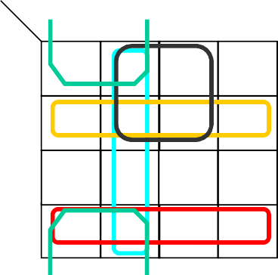
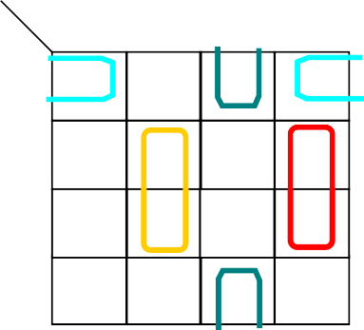
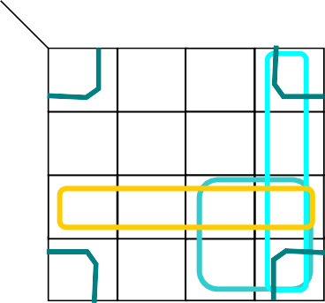
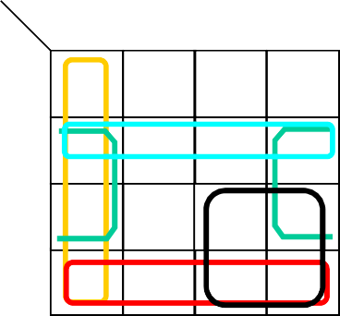
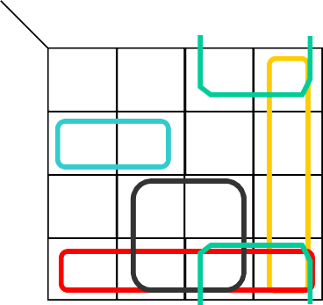
HEX to 7-seg Design Example
K-maps & logic equations for outputs C-G
In1 In0 In1 In0 In1 In0
In1 In0 In3 In2
00
01
11
10
K-map for F output
In3 In2
00 01 11 10
1 1 1 0
1 1 1 1
0 1 0 0
1 1 1 1
In3 In2
00 01 11 10
1 0 1 1
0 1 0 1
1 1 0 1
1 X 1 0
In3 In2
00 01 11 10
1 0 0 1
0 0 0 1
1 1 1 1
1 0 1 1
00 | 01 | 11 | 10
1 | 0 | 0 | 0
1 | 1 | X | 1
1 | 0 | 1 | 1
1 | 1 | 1 | 1
00
01
11
10
00
01
11
10
00
01
11
10
K-map for C output K-map for D output K-map for E output
C = In3 In2’ + In1’In0 + In2’In1’ + In3’In0 + In3’In2 D = In3’In2’In0’ + In2’In1 In0 + In2 In1’In0
+ In3 In1’ + In2 In1 In0’
E = In2’In0’ + In3 In2 + In1 In0’ + In3 In1
F = In1’In0’ + In3 In2’ + In2 In0’ + In3 In1 + In3’In2
G = In3 In2’ + In1 In0’ + In3 In0 + In3’In2 In1’ + In2’In1
In1 In0 In3 In2
00
01
11
10
K-map for G output
00 | 01 | 11 | 10
0 | 0 | 1 | 1
1 | 1 | 0 | 1
0 | 1 | 1 | 1
1 | 1 | 1 | 1

Slide 16
HEX to 7-seg Design Example
Remaining steps to complete design:
Draw logic diagram (sharing common gates)
Analyze for optimization metirc: G, G_{IO}, G_{del}, P_{del}
See next page for logic diagram & circuit analysis
Simulate circuit for design verification
Debug & fix problems when output is incorrect
Check truth table against K-map population
Check K-map groups against logic equation product terms
Check logic equations against schematic
Optimize circuit for area and/or performance
Use Boolean postulates & theorems
Re-simulate & verify optimized design

Slide 17
HEX to 7-seg Design Example
# loads on PIs 9
In3
9 In2
9 In1
In3’
1+8
In2’
1+7
In1’
In3’
G1 G2 G3 G4 G17 G18
G6 G7 G5 G10 G11
Prop delay in gates #inputs + # loads
In0
2+1 G10
In3 In1’ 3+1
In0
In3’
G20
6+0
A
In3’
In2
2+2 G11
G1 G5 G19 G20 G21
9
1+9
In3 In1
In0
In0’
2+2 G12
In1 3+1
In0
In3
G21
5+0 B
In2’ In0’ In3’
In1 In2 In1
1+9
2+3 G1
In2 ₂₊₁
G13
In0’
In3 In0 In2’
In1
In1’ In3’
In2’ 3+1 In0’
In2
In1’ 3+1
In0
2+1 G22
5+0
C G22 G23 G24 G25 G26
E
G6
2+1 G2
2+1 G14
2+1 G3
G23
5+0
D
In3
2+1 G15
G1 G8 G9 G12
In0’
2+1 G4
In1’ In0’ In3’
4+0
2+1 G16
G24
In2’ In1’
In3
In2’ In1’
In0 In3 In2 In1 In0’
2+1 G5
2+3 G6
In2’
G17 In1 3+2
In0 In2
G11 G12 G13 G16
In2 3+1
In0 In3
G25
5+0 F
G6 G9 G14 G15 G27
2+1 G7
In2’ In1’ In3’ In1’ In0’
3+1 G18 In1 3+1
In0’ In3’
In2 In1’
G26
5+0 G
Circuit Analysis
2+1 G8
2+1 G9
G = 38 G_{IO} = 141
3+1 G19
3+1 G27
G_{del} = 3 P_{del} = 30
worst case path:
In0→In0’→G1 →A

