Slide 1
Microbial Genetics
LT-7
Dr Manishi Tripathi

Slide 2
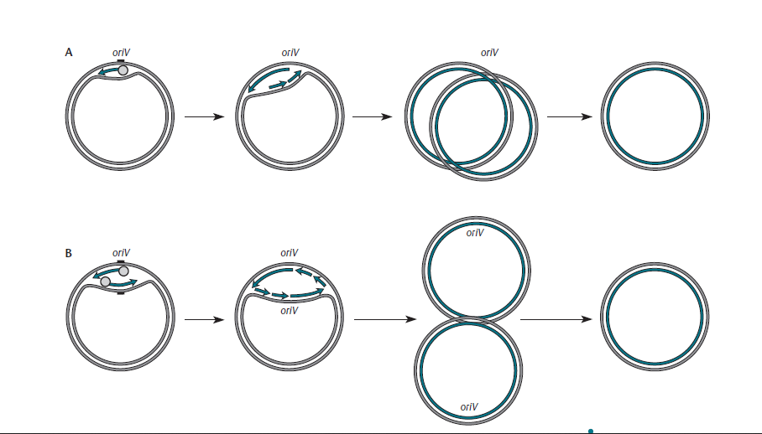
Replication THETA REPLICATION

Slide 3
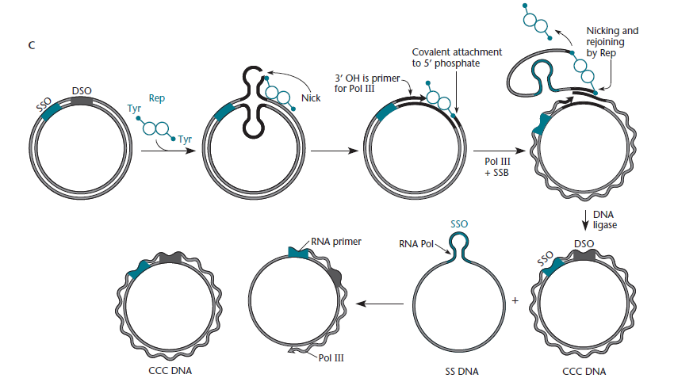
ROLLING-CIRCLE REPLICATION

Slide 4
HOST RANGE
Some plasmids, such as those with ori regions of the ColE1 plasmid type, including pBR322, pET, and pUC, have a narrow host range. These plasmids replicate only in E. coli and some other closely related bacteria, such as Salmonella and Klebsiella species.
In contrast, plasmids with a broad host range include the RK2 and RSF1010 plasmids, as well as the RC plasmids, like pBBR1MCS . The host ranges of these plasmids are truly remarkable. Plasmids with the ori region of RK2 can replicate in most types of gram- negative proteobacteria, and RSF1010-derived plasmids

Slide 5
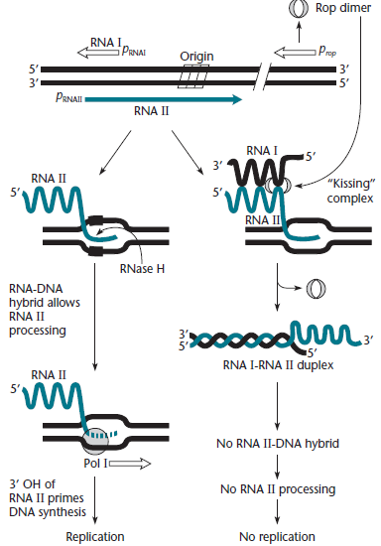
REGULATION OF COPY NUMBER Regulation of the replication of ColE1-derived plasmid

Slide 6
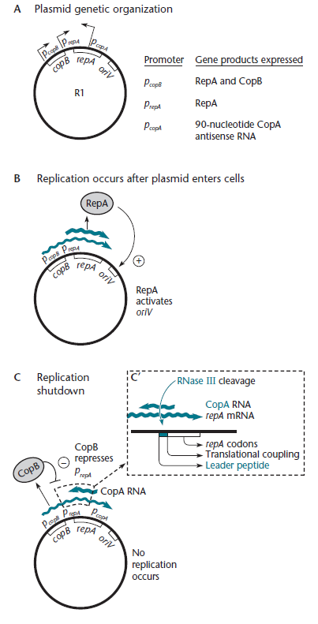
Regulation of replication of the IncFII plasmid R1

Slide 7
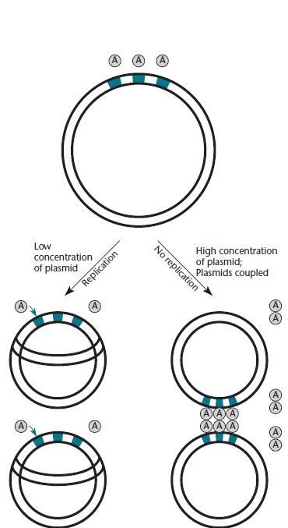
The “handcuffing” or “coupling” model for regulation of iteron plasmids

