Slide 1
Evaluating Performance of a model
Supervised learning-Classification
In Supervised Learning, one major task is classification. The responsibility of classification model is to assign class label to target feature based on the value of the predictor features.
In the problem of predicting the win/loss in a cricket match, the classifier will assign a class value win/loss to target feature based on the value of other features like whether team won the toss, number of spinners in the team, number of wins the team had in the tournament.

Slide 2
Evaluating Performance of a model….
There are four possibilities with regards to the cricket match win/loss prediction:
The model predicted win and the team won
The model predicted win and the team lost
The model predicted loss and the team won
The model predicted win and the team lost

Slide 3
Evaluating Performance of a model….
True Positive: We predict as true and it is actually also true.
True Negative: We predict false and it is actually also false.
False Positive: We predict true however it was not (type 1 error)
False Negative: We predict false however it was true( type 2 error)
* Note:- the Obvious class of interest is ‘win’

Slide 4
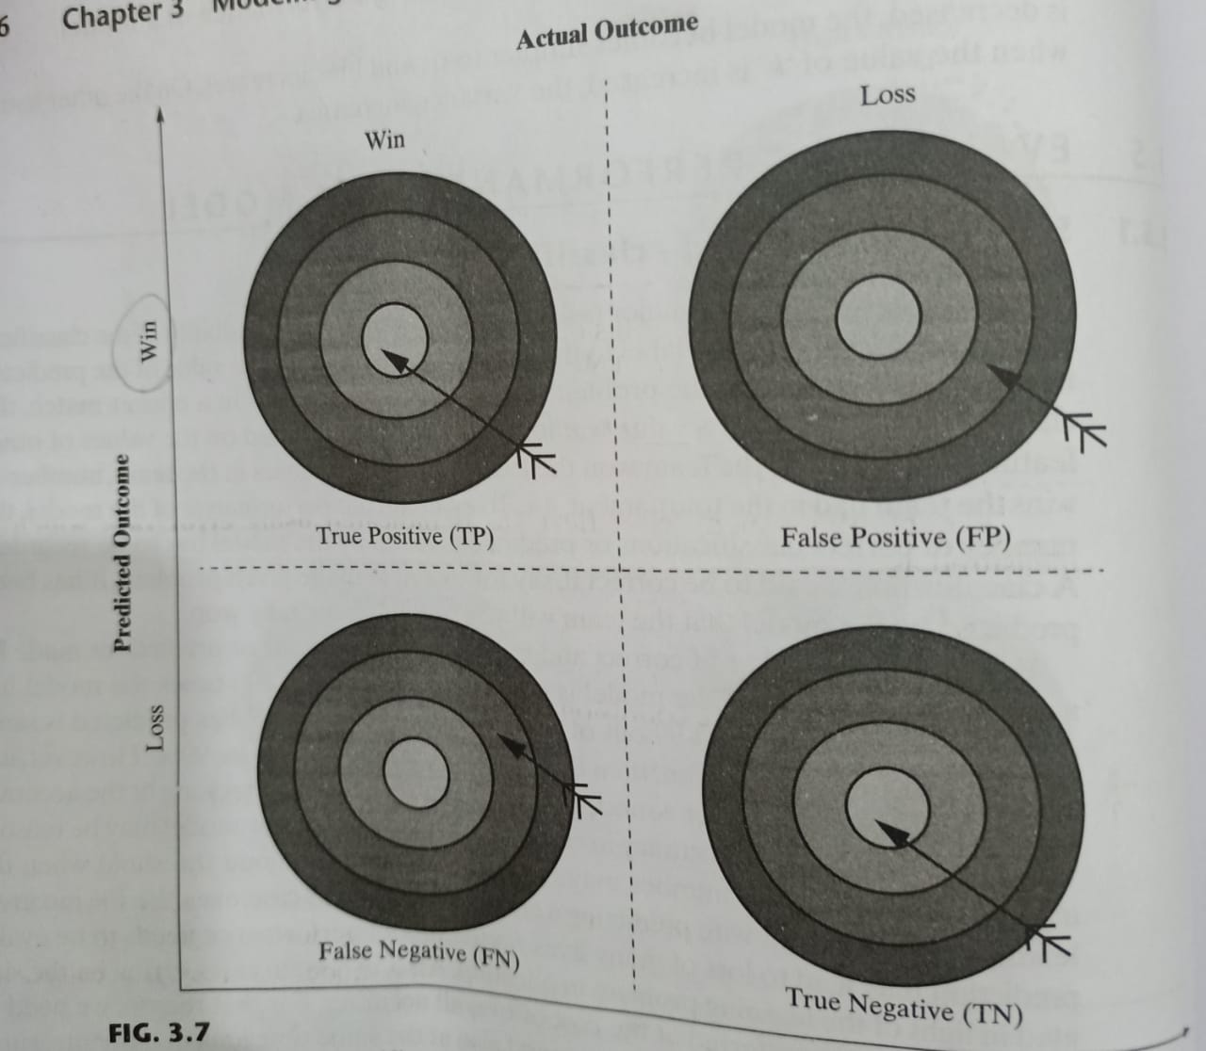
Evaluating Performance of a model….

Slide 5
PARAMETERS
Accuracy = (TP+TN)/(TP+TN+FP+FN)
Specificity= TN/(TN+FP) (Also Known as true negative rate)
Sensitivity=TP/(TP+FN) (Also known as true positive rate or recall)
Precision= TP/(TP+FP)

Slide 6
 | TRUE | FALSE
TRUE | TRUE POSITIVE | FALSE POSITIVE
FALSE | FALSE NAGATIVE | TRUE NEGATIVE

Slide 7
Lets assume the Confusion Matrix of the win/loss prediction of cricket match..
 | Actual Win | Actual loss
Predicted Win | 85 | 4
Predicted loss | 2 | 9

Slide 8
Construct the Confusion Matrix for the cat class
 |  | Actual Class
Predicted Class |  | Cat | Dog | Rabbit
 | Cat | 5 | 2 | 0
 | Dog | 3 | 3 | 2
 | Rabbit | 0 | 1 | 11

Slide 9
Solution: Confusion Matrix
Predicted/Actual | Cat | Not Cat
Cat | 5 | 2
Not cat | 3 | 17

Slide 10
Receiver operating characteristics(ROC) curves
As we have till now, Accuracy is the most popular measure, there are quite a number of other measures to evaluate the performance of supervised learning model.
Visualization is an easier and more effective way to understand the model performance. It is also helps to comparing the efficiency of two models
Receiver operating characteristics(ROC)curve helps in visualizing the performance of a classification model.

Slide 11
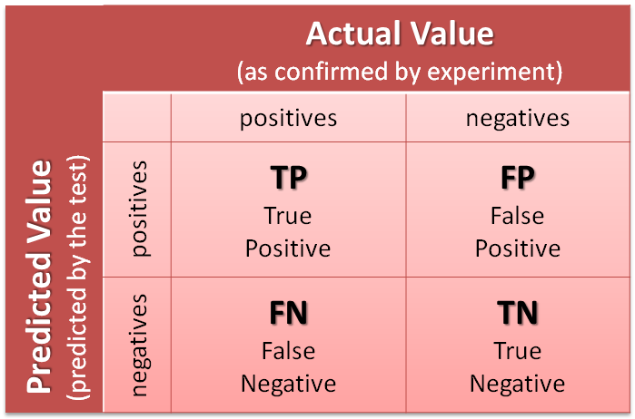
Receiver operating characteristics(ROC) curves……

Slide 12
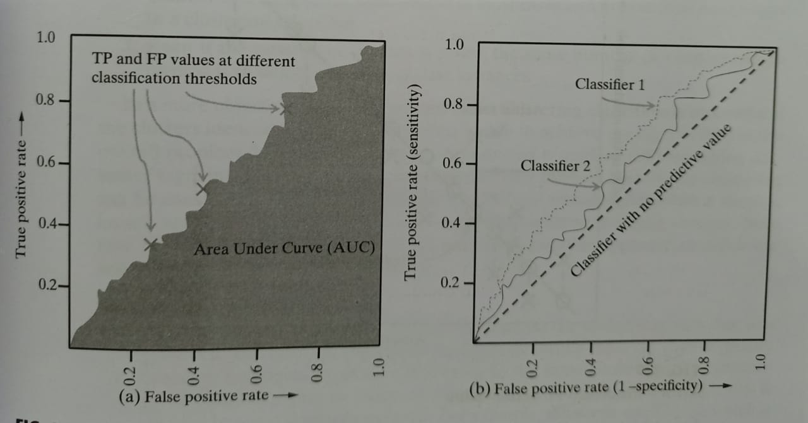
Receiver operating characteristics(ROC) curves……
TPR = TP/TP+FN, FPR = FP/FP+TN

Slide 13
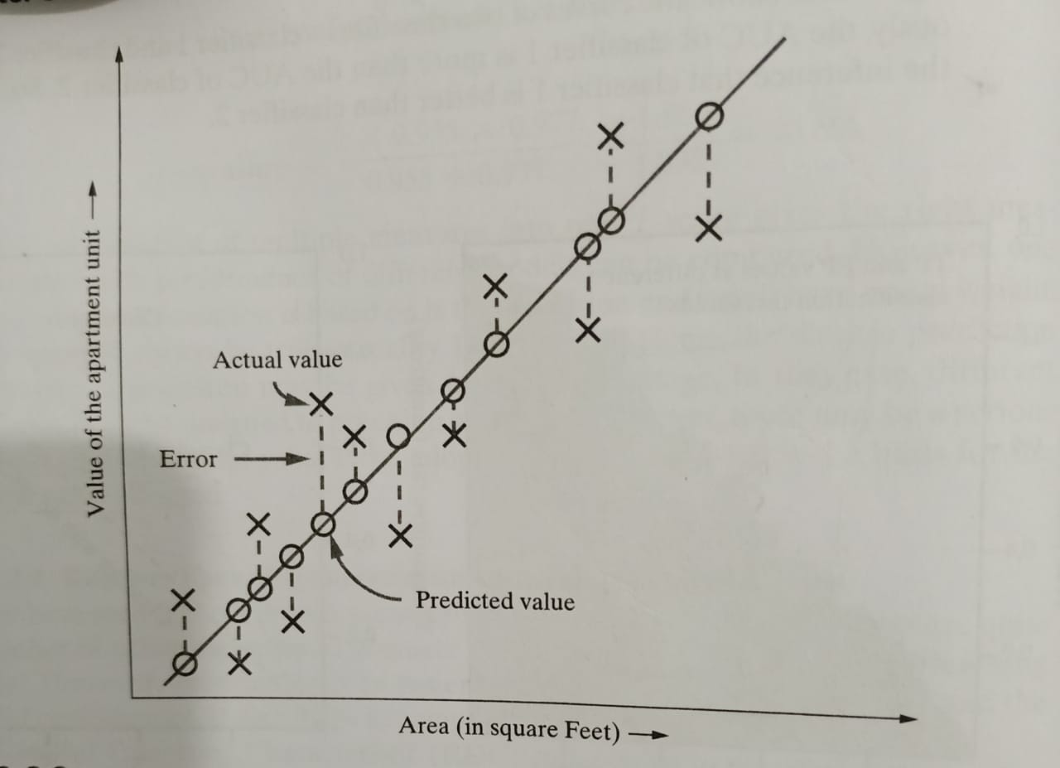
Supervised Learning- Regression
A regression Model which ensures that the difference between predicted and actual values is low can be considered as good model.

Slide 14
Unsupervised learning-clustering
Internal evaluation
In this approach the evaluation methods generally measure cluster quality based on homogeneity of data belonging to the same cluster And heterogeneity of data belonging to the different clusters
Silhouette coefficient which is one of the most popular internal evaluation method uses distance between data element as a similarity measure.
The value of silhouette width ranges between -1 and +1 ,with a high value indicating high intra-cluster homogeneity and inter-cluster heterogeneity

Slide 15
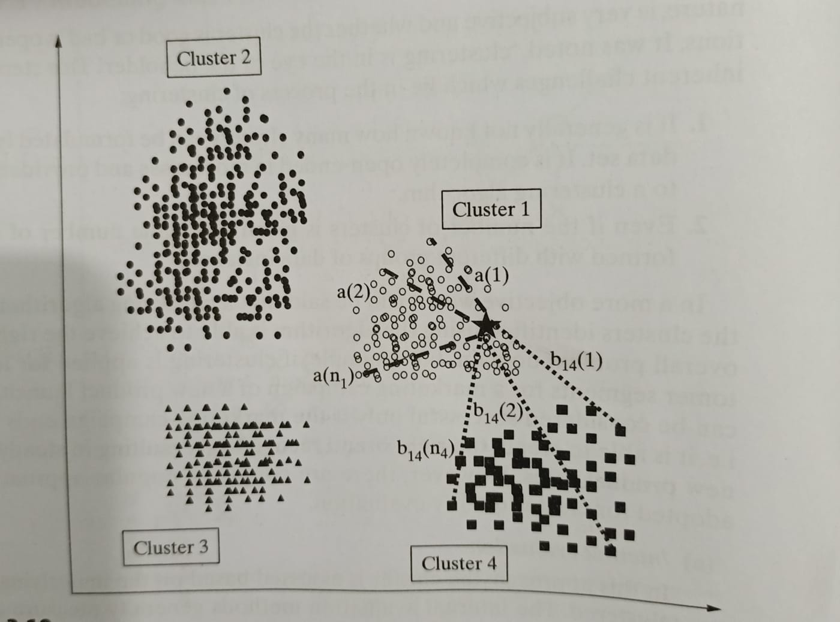
Unsupervised learning-clustering….

