Slide 1
Preparing to Model
Introduction
Machine can learn and become artificially intelligent-Alan Turing
Gradually the next few decades Some concept of Neural Networks, recurrent Neural Network, Reinforcement Learning, Deep Learning etc. which took machine learning to new heights.
Supervised learning as we saw implies learning from past data, also called training data. Machine can learn or get trained from the past data and assign classes or values to unknown data termed as test data. This helps to solve the problems related to predictions.
Unsupervised learning does not have labelled data. This is much like human beings trying to group together objects of similar shape.
Reinforcement learning in which machine tries to learn by itself through penalty/reward mechanism.
We saw some of the application of machine learning in different domains such as banking and finance, insurance and healthcare.

Slide 2
Machine learning Activities
The first step in Machine learning activity starts with data. A thorough review and exploration of the data is needed to understand the type of the data, the quality of the data and relationship between different data elements.
-preparation activities done once the input data comes into the machine learning system
Understand the type of data in the given input dataset.
Explore the data to understand the nature and quality.
Explore the relationship.
Do the necessary remediation.
Apply pre-processing steps as needed

Slide 3
Machine learning Activities…….
Once the data is prepared for modelling, then the learning task start off
The input data is divided into parts- training data and the test data
Consider different models or learning algorithms for selection
Train the model based on the training data for supervised learning problem and apply to unknown data
After the model is trained(for supervised learning), and applied for the input data, the performance of the model is evaluated.

Slide 4
Four step process of Machine learning
Detailed process of Machine learning
Input data
Preparing to model
(Step-1)
Learning (Step-2)
Performance improvement
(Step-4)
Performance Evaluation
(Step-3)

Slide 5
Basic type of Data in machine Learning
A dataset is a collection of related information or records.
Each row of dataset is called record. Each data set also has multiple attributes.
Attributes can also termed as feature, variable, dimension or field.
Value of an attribute may vary from record to record

Slide 6
Basic type of Data in machine Learning….
Data can be broadly be divided into following two types:
1. Qualitative data
2. Quantitative data
Qualitative data: provides information about quality of an object or information which can not be measured. Qualitative data is also called categorical data.
1. Nominal data
2. Ordinal data

Slide 7
Basic type of Data in machine Learning….
Nominal data: is one which has no numerical value, but a named value. It is used for assigning named values to attributes. Nominal values can not be quantified. Ex. Of Nominal data are..
-Blood group: A, B,O, AB etc.
-Nationality: Indian, American, British etc.
-Gender: Male, female, other
It is obvious mathematical operations such as addition, subtraction, multiplication etc. can not performed on nominal data.
Basic count is possible. So mode(most frequently occurring value) can be identified for nominal data

Slide 8
Basic type of Data in machine Learning….
Ordinal data: is assign named values to attributes that arranged in a sequence of increasing or decreasing so that we can say whether a value is better than another value. Examples are
-Customer satisfaction: ‘very happy’, ‘happy’, ‘Unhappy’
-Grades: A, B, C etc.
-Hardness of Metal: ‘very hard’, ‘Hard’, ‘Soft’
Like nominal data basic counting is possible for ordinal data. The mode can be identified

Slide 9
Basic type of Data in machine Learning….
Quantitative data: relates to information about the quantity of an object-hence can be measured. If we consider the attributes ‘marks’ it can be measured using scale of measurement. It is also termed as numeric data. There are two types of quantitative data..
1. Interval data
2. Ratio data
Interval data: is numeric data for which not only the order is known, but exact difference between value is also known. Ex.-date, time
Ratio data: represent numeric data for which exact value can be measured. Absolute zero is available for ratio data. Ex.-height, age weight, salary..

Slide 10
Modelling and Evaluation

Slide 11
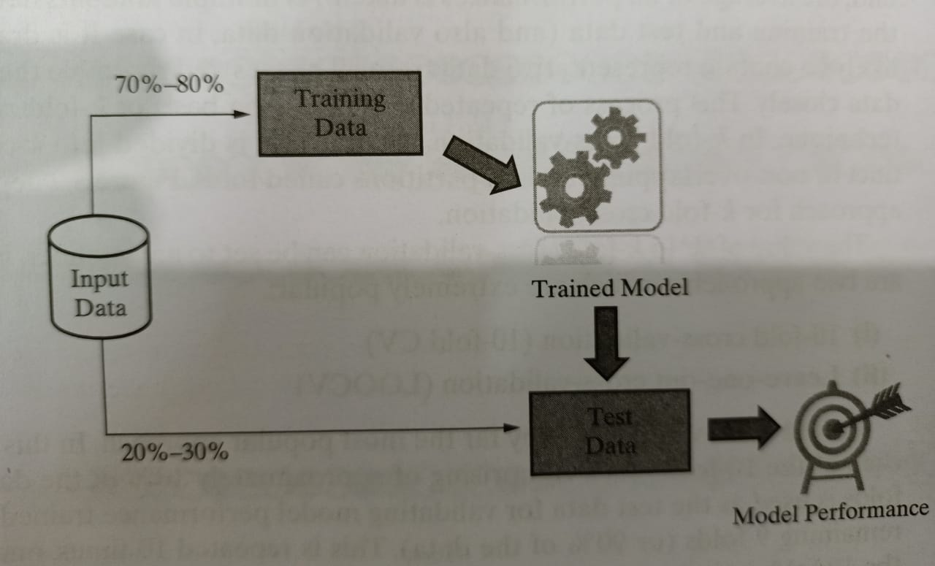
Training a Model(For Supervised Learning)
Holdout Method

Slide 12
Training a Model(For Supervised Learning)……
K-fold Cross-Validation Method: A special variant of holdout method, called repeated holdout , is some times employed to ensure the randomness of the composed data sets. In repeated holdout, several random holdouts are used to measure the model performance. In the end the average of all performance is taken.
This process of repeated holdout is the basis of k-fold cross-validation technique. In this the data is divided into k-completely distinct or non-overlapping random partitions called folds.
There are two approaches which are popular
10-fold cross-validation
Leave-one-out cross-validation

Slide 13
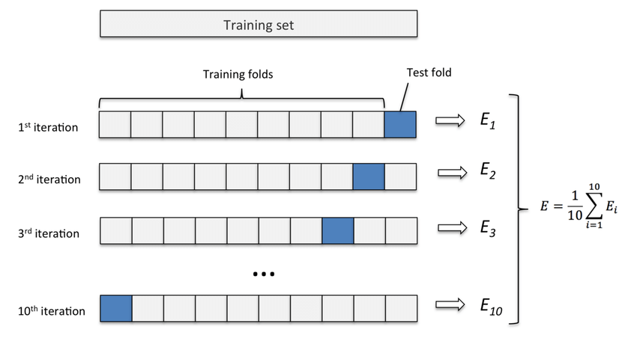
Training a Model(For Supervised Learning)……
K-fold Cross Validation

Slide 14
Training a Model(For Supervised Learning)……
Bootstrap Sampling: Bootstrap sampling or simply bootstrapping is a popular way to identify training and test data set.
It uses the technique of Simple Random Sampling with replacement(SRSWR), which is a well-known technique in sampling theory for drawing random sample
Bootstrapping randomly picks data instances from the input data set with the possibility of the same data instance to picked multiple times

Slide 15
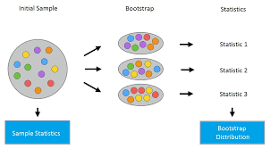
Training a Model(For Supervised Learning)……
Bootstrap Sampling

Slide 16
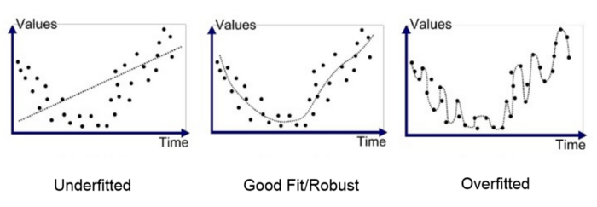
Model Representation and Interpretability
Underfitting
Overfitting
Bias
Variance

