Slide 1
​POLYMERASE CHAIN REACTION (PCR)
Polymerase chain reaction (abbreviated PCR) is a laboratory technique for rapidly producing (amplifying) millions to billions of copies of a specific segment of DNA, which can then be studied in greater detail.
PCR involves using short synthetic DNA fragments called primers to select a segment of the genome to be amplified, and then multiple rounds of DNA synthesis to amplify that segment.
PCR is a rapid and versatile in vitro method for amplifying defined target DNA sequences present within the source of DNA.
Selective amplification of a specific target DNA sequence from a heterogenous collection of DNA molecules (such as genomic DNA).

Slide 2
Its principle is based on the use of DNA polymerase which is an in vitro replication of specific DNA sequences.
This method can generate tens of billions of copies of a particular DNA fragment (the sequence of interest, DNA of interest, or target DNA) from a DNA extract (DNA template).
STEPS:
Denaturation
Annealing (Primer Annealing)
Elongation (DNA Synthesis)

Slide 3
Components Of PCR constitutes the following:
DNA Template– The DNA of interest from the sample.
DNA Polymerase– Taq Polymerase is used. It is thermostable and does not denature at very high temperatures.
Source: Thermophilus aquaticus
Oligonucleotide Primers- These are the short stretches of single-stranded DNA complementary to the 3’ ends of sense and anti-sense strands.
dNTPs – They are the building blocks for the synthesis of DNA.
Buffer System– Magnesium and Potassium provide optimum conditions for DNA denaturation and renaturation. It is also important for fidelity, polymerase activity, and stability.

Slide 4
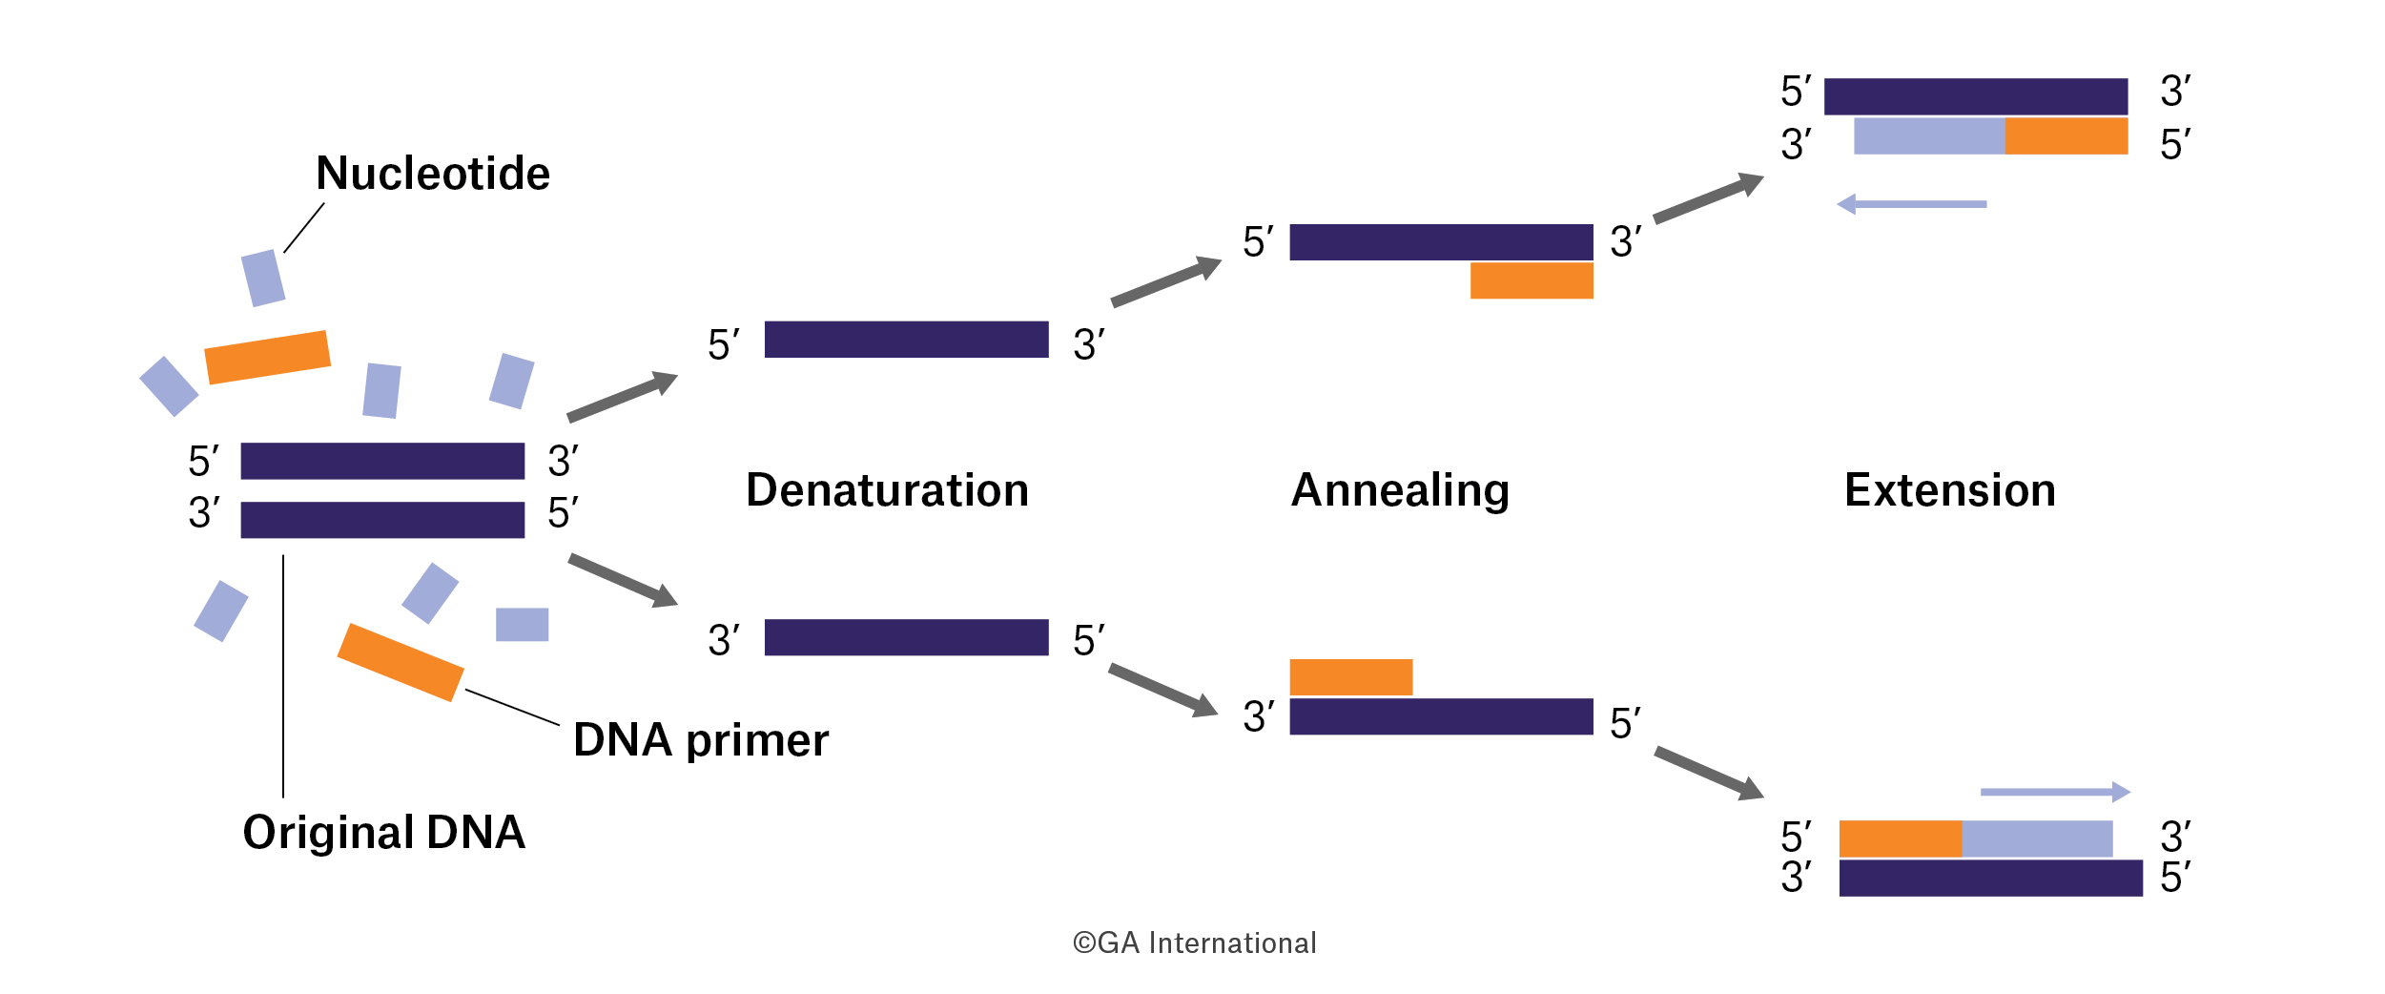

Slide 5
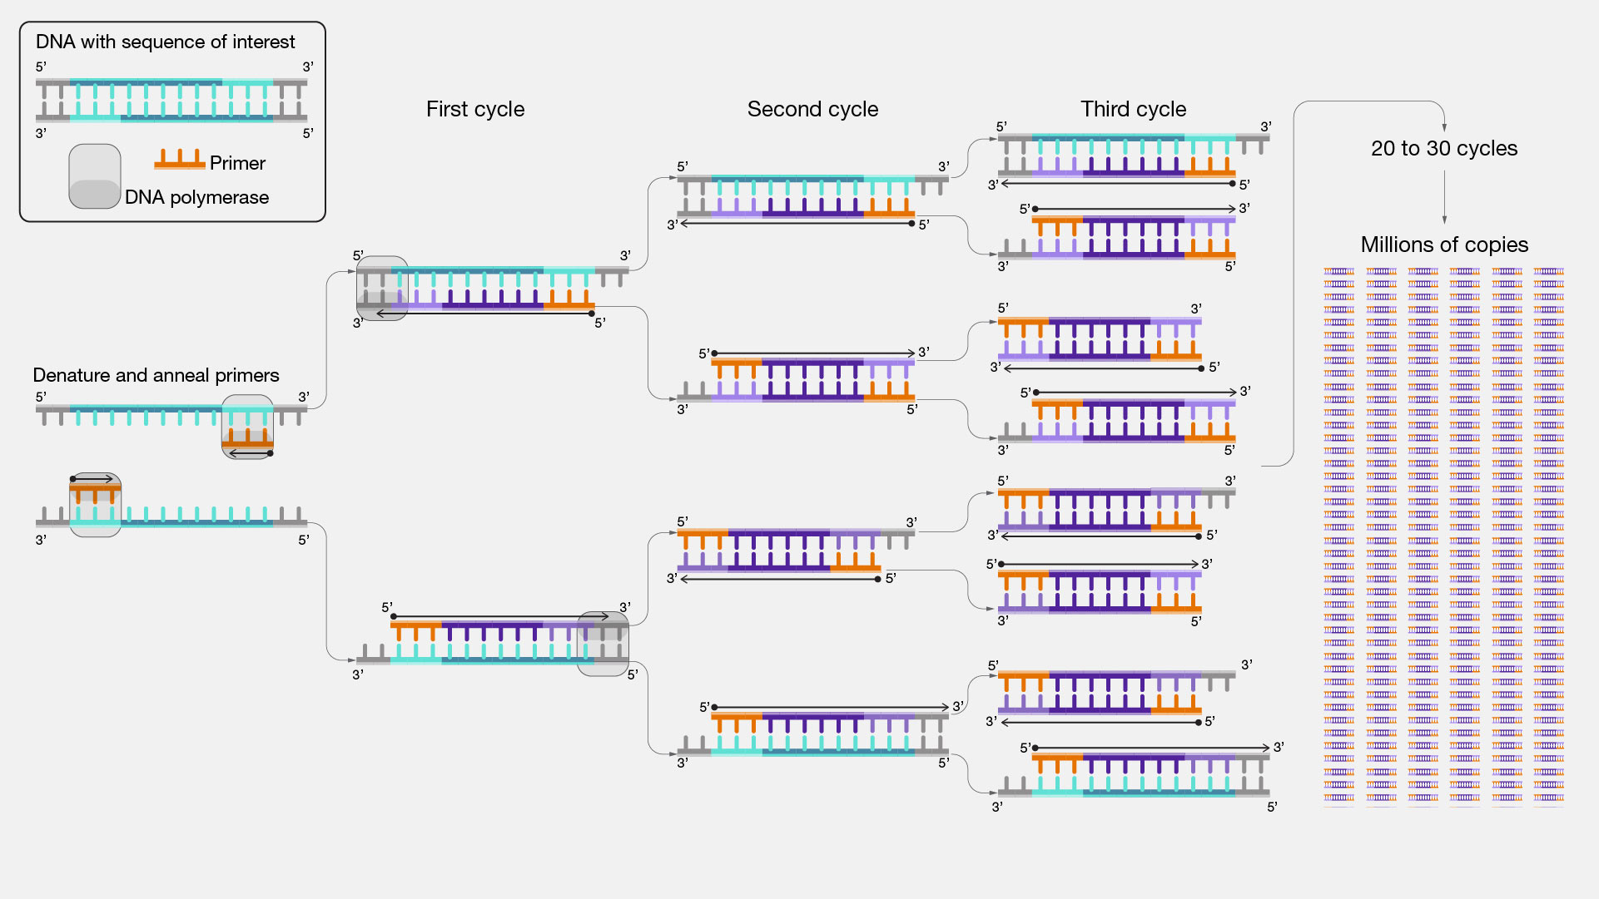
They add deoxyribonucleotides at the 3′-OH group of the growing DNA strand. The DNA strand grows in 5’→3’ direction by their polymerisation activity.

Slide 6
Steps
Denaturation
It is the separation of the two strands of DNA, obtained by raising the temperature.
The first period is carried out at a temperature of 94°C, called the denaturation temperature.
At this temperature, the matrix DNA, which serves as matrix during the replication, is denatured: the hydrogen bonds cannot be maintained at a temperature higher than 80°C and the double-stranded DNA is denatured into single-stranded DNA (single-stranded DNA).

Slide 7
2. Annealing
The second step is hybridization Or primer annealing.
It is carried out at a temperature generally between 50 and 70°C, called annealing temperature or primer hybridization temperature.
Decreasing the temperature allows the hydrogen bonds to reform and thus the complementary strands to hybridize.
The primers, short single-strand sequences complementary to regions that flank the DNA to be amplified, hybridize more easily than long strand matrix DNA.
The higher the hybridization temperature, the more selective the hybridization, the more specific it is.

Slide 8
Wallace Rule
Tm = 2(A+T) + 4(G+C)
Annealing temperature is typically 5 degree below the calculated Tm of the primers.
For Primer Design, some prior DNA sequence information from the target DNA
is required.
Melting temperature at which half of the DNA strands are in double stranded state.

Slide 9
As per Wallace rule

Slide 10
3. Elongation
The third period is carried out at a temperature of 72°C, called elongation temperature.
It is the synthesis of the complementary strand.
At 72°C, Taq polymerase binds to primed single-stranded DNAs and catalyzes replication using the deoxyribonucleoside triphosphates present in the reaction mixture.
The regions of the template DNA downstream of the primers are thus selectively synthesized.
In the next cycle, the fragments synthesized in the previous cycle are in turn matrix and after a few cycles, the predominant species corresponds to the DNA sequence between the regions where the primers hybridize.
It takes 20–40 cycles to synthesize an analyzable amount of DNA (about 0.1 μg). Each cycle theoretically doubles the amount of DNA present in the previous cycle.
It is recommended to add a final cycle of elongation at 72°C, especially when the sequence of interest is large (greater than 1 kilobase), at a rate of 2 minutes per kilobase .

Slide 11
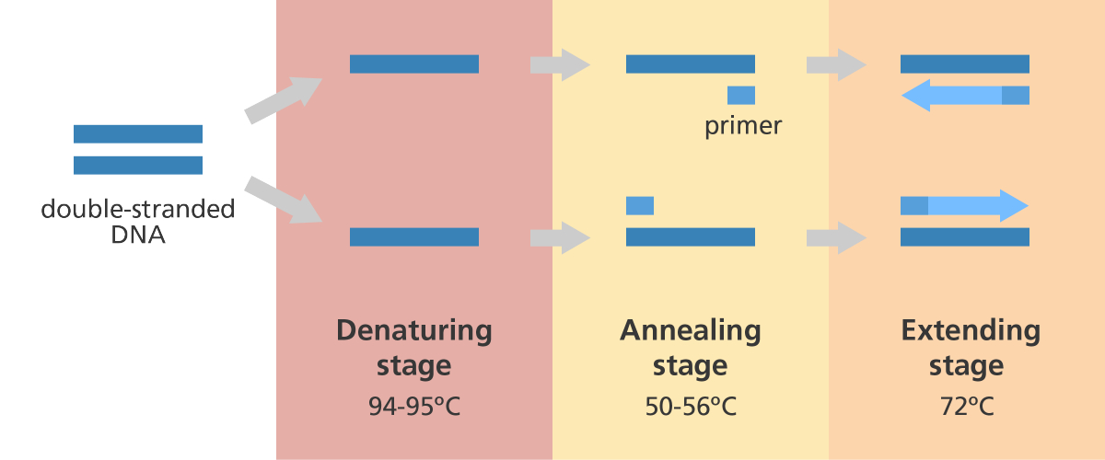

Slide 12
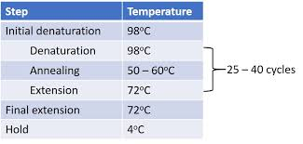

Slide 13
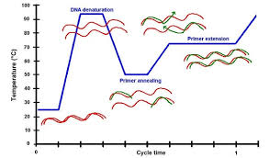

Slide 14
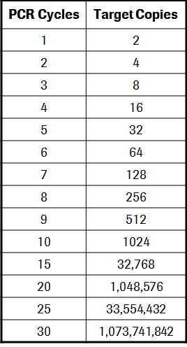
No. of Copies: 2^{n}

Slide 15
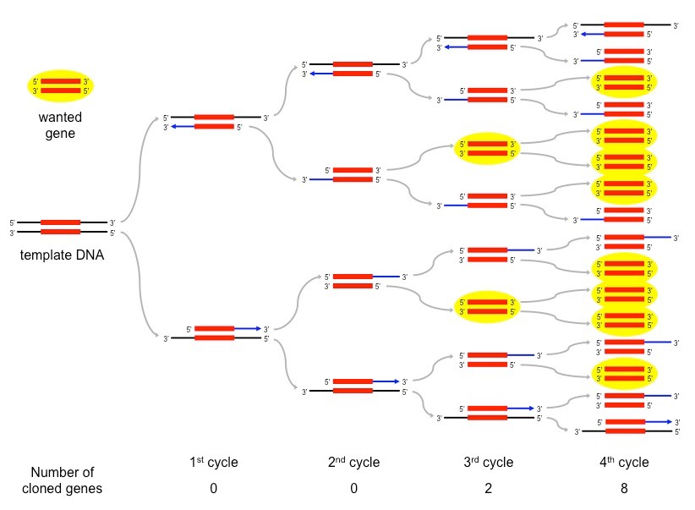

Slide 16
Fidelity of Thermostable Enzymes
High-Fidelity DNA Polymerases are important for applications in which the DNA sequence needs to be correct after amplification.
Taq DNA Polymerase is a highly thermostable DNA polymerase from the thermophilic bacterium Thermus aquaticus. The enzyme catalyzes 5'→3' synthesis of DNA, has no detectable 3'→5' exonuclease (proofreading) activity and possesses low 5'→3' exonuclease activity.
Pfu DNA Polymerase is a high-fidelity, thermostable enzyme of approximately 90kDa isolated from Pyrococcus furiosus. The enzyme replicates DNA at 75°C, catalyzing the polymerization of nucleotides in the 5´→3´ direction in the presence of magnesium. Pfu DNA Polymerase also possesses 3´→5´ exonuclease (proofreading) activity. Base misincorporations that may occur during polymerization are rapidly excised by this proofreading activity. Consequently, Pfu DNA Polymerase is recommended for use in PCR and primer extension reactions that require high-fidelity synthesis. Pfu DNA Polymerase-generated PCR fragments are blunt-ended. No 5' → 3' exonuclease.

Slide 17
Vent® DNA Polymerase is a high-fidelity thermophilic DNA polymerase. The fidelity of Vent DNA Polymerase is 5-15-fold higher than that observed for Taq DNA Polymerase. This high fidelity derives in part from an integral 3'→5' proofreading exonuclease activity in Vent DNA Polymerase. It is isolated from Thermococcus litoralis. No 5' → 3' exonuclease.
Pwo polymerase is a thermostable DNA polymerase used for the polymerase chain reaction. The abbreviation stands for Pyrococcus woesei, a thermophilic archaeon, from which this polymerase was isolated. It has proofreading activity. No 5' → 3' exonuclease.
A novel Pyrococcus-like enzyme fused with a processivity-enhancing domain, increases fidelity and speed. Phusion DNA Polymerase is an ideal choice for cloning and can be used for long or difficult amplicons. With an error rate > 50-fold lower than that of Taq DNA Polymerase and 6-fold lower than that of Pyrococcus furiosus DNA Polymerase, Phusion is one of the most accurate thermostable polymerases available. Phusion DNA Polymerase possesses 5´→ 3´ polymerase activity, 3´→ 5´ exonuclease activity and will generate blunt-ended products. No 5' → 3' exonuclease.

Slide 18
There are many applications of PCR.
It is a technique now essential in cellular and molecular biology. It permits, especially in a few hours, the “acellular cloning” of a DNA fragment through an automated system, which usually takes several days with standard techniques of molecular cloning.
On the other hand, PCR is widely used for diagnostic purposes to detect the presence of a specific DNA sequence of this or that organism in a biological fluid. It is also used to make genetic fingerprints, whether it is the genetic identification of a person in the context of a judicial inquiry, or the identification of animal varieties, plant, or microbial for food quality testing, diagnostics, or varietal selection. PCR is still essential for performing sequencing or site-directed mutagenesis.

Slide 19
Applications of PCR:
The amplification of gene fragments as fast alternative of cloning.
The modification of DNA fragments.
The sensitive detection of pathogenic microorganisms, if desired followed by an accurate genotyping.
DNA analysis of arachaeological specimens.
The detection of mutations relevant for inherited diseases, malignant transformation or tissue typing.
The analysis of genetic markers for forensic applications, for paternity testing and for the mapping of hereditary traits.
The species-specific amplification of DNA segments between interspersed-repeat elements.
The study of gene expression.

Slide 20
Reverse transcription polymerase chain reaction (RT-PCR) is a laboratory technique combining reverse transcription of RNA into DNA (in this context called complementary DNA or cDNA) and amplification of specific DNA targets using polymerase chain reaction (PCR).
Reverse transcription (RT)-PCR is used to amplify RNA targets. The RNA template is converted into complementary cDNA by the enzyme reverse transcriptase. The cDNA serves later as a template for exponential amplification using PCR.

Slide 21
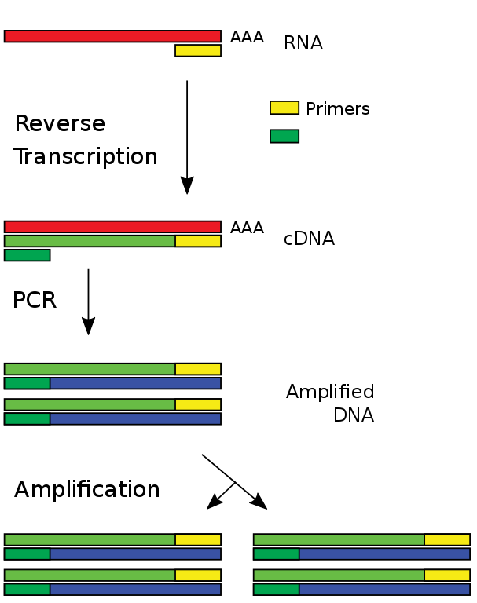

Slide 22
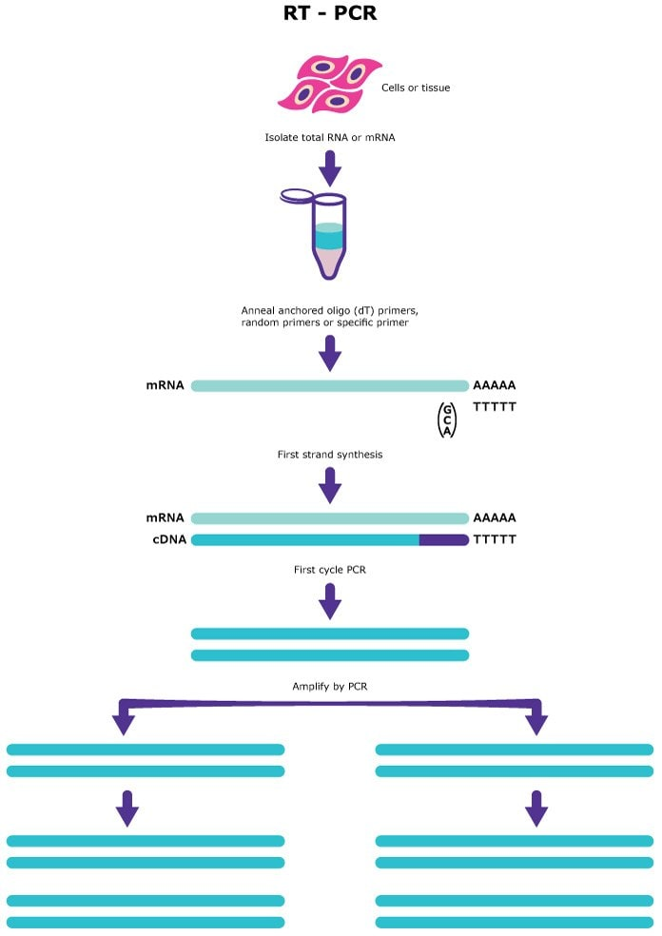

Slide 23
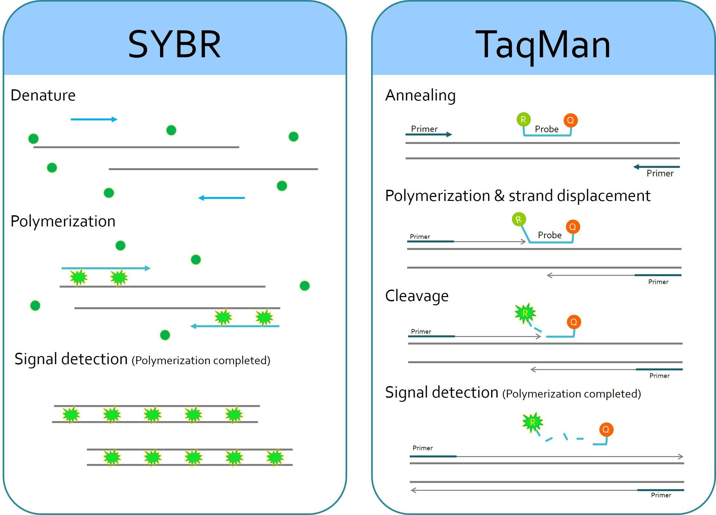
A real-time polymerase chain reaction (real-time PCR) (Sometimes referred to as qPCR) is a laboratory technique of molecular biology based on the polymerase chain reaction (PCR). It monitors the amplification of a targeted DNA molecule during the PCR (i.e., in real time), not at its end, as in conventional PCR.

Slide 24
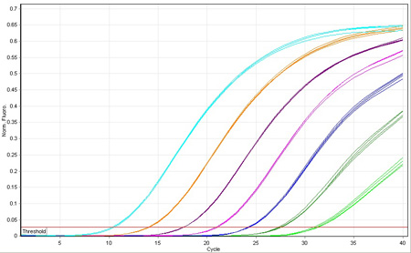
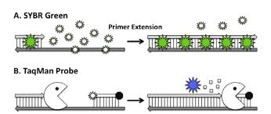
Fluorescent Dye: SYBR Green binds to minor groove of the dsDNA

Slide 25
