Slide 1
Assay for the fused proteins
Note that a polyhistidine tag at the C terminus can function for both assay and purification.

Slide 2
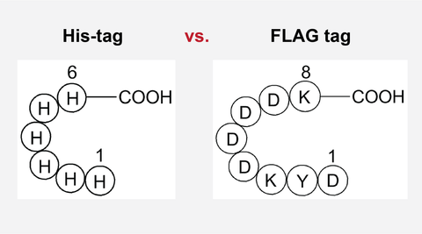
FLAG-tag, or FLAG octapeptide, or FLAG epitope, is a peptide protein tag that can be added to a protein using recombinant DNA technology, having the sequence DYKDDDDK (where D=aspartic acid, Y=tyrosine, and K=lysine).
It is one of the most specific tags and it is an artificial antigen to which specific, high affinity monoclonal antibodies have been developed and hence can be used for protein purification by affinity chromatography and also can be used for locating proteins within living cells.
Cellular localization studies by immunofluorescence, immunoprecipitation or detection by SDS PAGE protein electrophoresis and Western blotting.

Slide 3
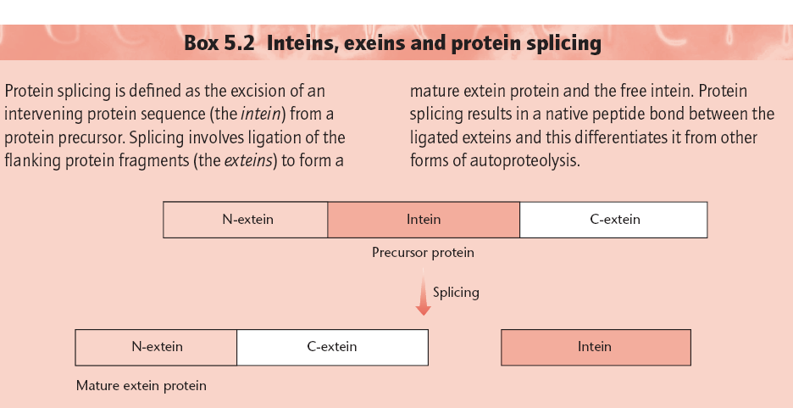
Problem: The affinity purification systems described above suffer from the disadvantage that a protease is required to separate the target protein from the affinity tag. Also, the protease has to be separated from the protein of interest.
Intein Based Vectors

Slide 4
The system utilizes a protein splicing element, an intein, from the Saccharomyces cerevisiae VMA1 gene. The intein is modified such that it undergoes a self-cleavage reaction at its N terminus at low temperatures in the presence of thiols, such as cysteine, dithiothreitol or β-mercaptoethanol. The gene encoding the target protein is inserted into a multiple cloning site (MCS) of a vector to create a fusion between the C terminus of the target gene and the N terminus of the gene encoding the intein. DNA encoding a small (5 kDa) chitin-binding domain from Bacillus circulans was added to the C terminus of the intein for affinity purification.
The above construct is placed under the control of
an IPTG-inducible T7 promoter. When crude extracts
from induced cells are passed through a chitin column,
the fusion protein binds and all contaminating
proteins are washed through. The fusion is then
induced to undergo intein-mediated self-cleavage on
the column by incubation with a thiol. This releases
the target protein, while the intein chitin-binding
domain remains bound to the column.
(Next Figure)

Slide 5
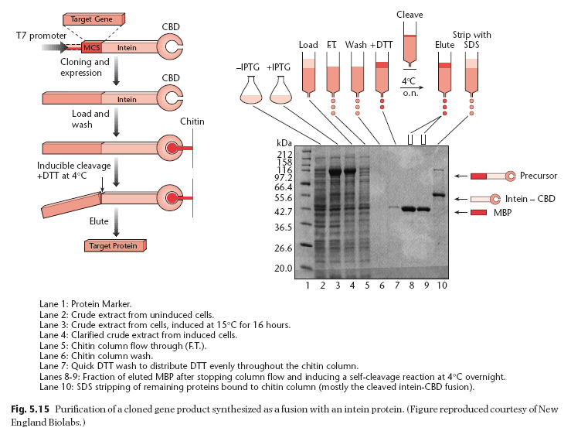

Slide 6
Inclusion Bodies: Methodologies to reduce the formation of IBs
High level expression of recombinant protein in Escherichia coli often results in aggregation of the expressed protein molecules into inclusion bodies.
Use of high temperature during protein expression, high inducer concentration and expression under strong promoter systems often results in expression of the desired protein at a high translational rate. This exhausts bacterial protein quality control system and the partially folded and mis-folded protein molecules aggregate to form inclusion bodies.
Reduced environment of bacterial cytosol, lack of eukaryotic chaperones and post-translational machinery also contribute to the formation of inclusion bodies.

Slide 7
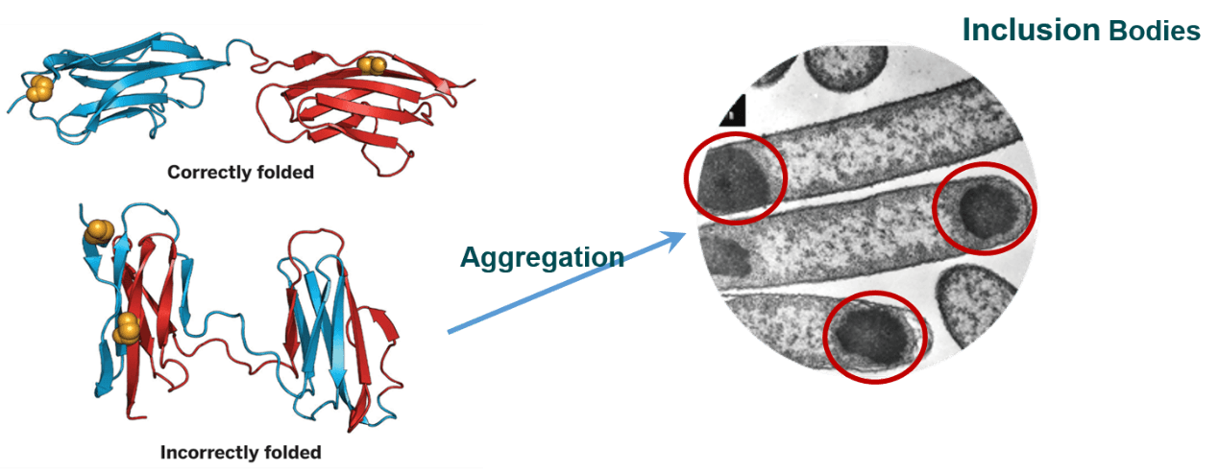

Slide 8
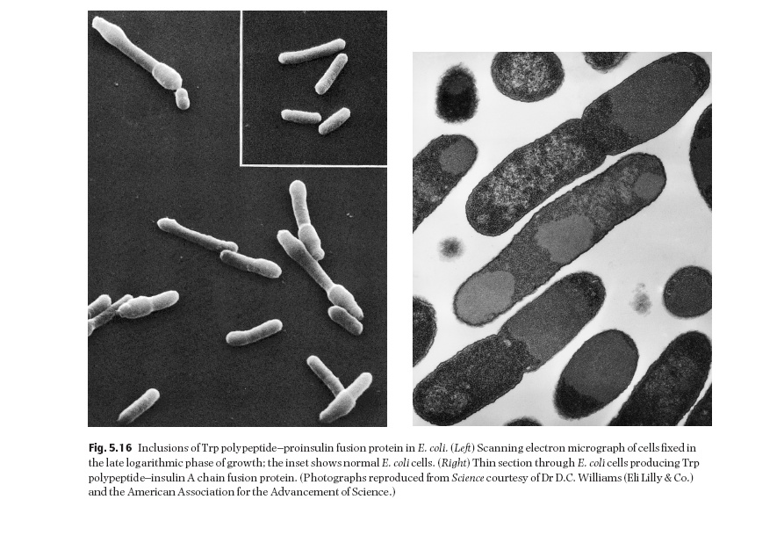

Slide 9
Formation of inclusion bodies imposes a great hurdle in production and purification of recombinant proteins using E. coli as host.
Inclusion bodies need extensive processing involving isolation from cell, solubilization, refolding and purification to produce the bioactive proteins.

Slide 10
Two parameters that can be manipulated to reduce
inclusion-body formation are temperature and
growth rate. There are a number of reports which
show that lowering the temperature of growth
increases the yield of correctly folded, soluble protein.
Media compositions and pH values
that reduce the growth rate also reduce inclusion body
formation.
Renaturation of misfolded proteins
can sometimes be achieved following solubilization
in guanidinium hydrochloride

Slide 11
Recovery of bioactive proteins from inclusion bodies
As protein molecules are in an aggregated state in inclusion bodies, it is a challenging task to solubilize inclusion bodies and refold the solubilized proteins into bioactive form.
The conventional strategy to purify proteins from inclusion bodies consists of four major steps: isolation of purified inclusion bodies, solubilization of inclusion bodies, refolding of solubilized proteins and purification of refolded proteins by various chromatographic techniques.
Solubilization of inclusion bodies and refolding of solubilized protein molecules into native conformation are the most crucial steps in the recovery of bioactive protein from inclusion bodies.

Slide 12
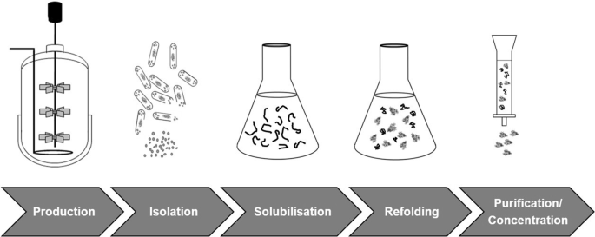

Slide 13
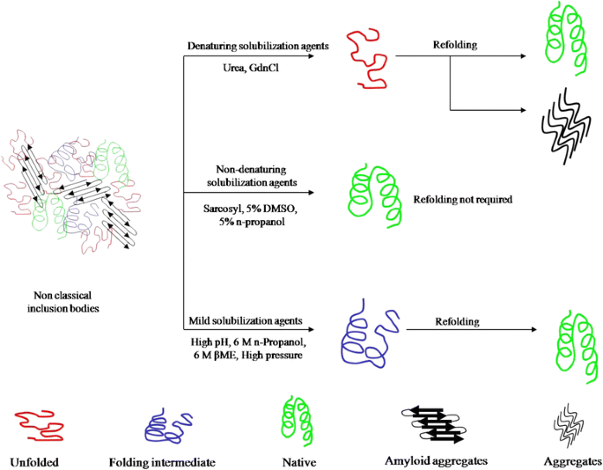

Slide 14
Traditionally, inclusion bodies are solubilized using high concentration of denaturants and chaotropes like urea and guanidine hydrochloride (GdnHCl).
For proteins containing multiple cysteine residues, β-mercaptoethanol or dithiothreitol are added in these solubilization agents to reduce incorrect disulfide bonds.
Solubilization of inclusion bodies using high concentration of chaotropes results in complete disruption of protein structure. This, in some cases, leads to aggregation of protein molecules during refolding process. As inclusion body aggregates have been shown to have native-like secondary structures and can have activity, it is advantageous to use a “mild” solubilization process which does not completely unfold these native-like protein structures

Slide 15
Three ‘genetic’ methods of preventing inclusion body formation have been described.
In the first of these, the host cell is engineered to overproduce a
chaperon (e.g. DnaK, GroEL or GroES proteins) in addition to the protein of interest
Castanie et al. (1997) have developed a series of vectors which are compatible with pBR322-type plasmids and which encode the overproduction of chaperons. These vectors can be used to test the
effect of chaperons on the solubilization of heterologous
gene products.
Even with excess chaperon there is no guarantee of proper folding. The second method involves making minor changes to the
amino acid sequence of the target protein.
For example, cysteine-to-serine changes in fibroblast growth factor minimized inclusion-body formation (Rinas et al. 1992).

Slide 16
The third method is derived from the observation that many proteins produced as insoluble aggregates in their native state are synthesized in soluble form as thioredoxin fusion proteins.
Davis et al. (1999) have shown that the NusA and GrpE proteins, as well as bacterioferritin, are even better than thioredoxin at solubilizing proteins expressed at a high level.
Kapust and Waugh (1999) have reported that the maltose-binding protein is also much better than thioredoxin.

Slide 17
Recombinant Protein and Its Expression Systems

Slide 18
Choosing an appropriate protein expression system is the key to the success of recombinant protein expression. Several factors need to be taken into consideration, including target protein property, intended application, protein yield and cost. Furthermore, challenges exist for many protein expression projects, especially for large protein, membrane protein, nuclear protein and proteins with heavy post-translational modifications.
Nowadays, there are several expression systems for use. Different systems have different features and applications. Here, we will introduce four systems which are commonly used in research and industrial. They are bacteria expression system, yeast expression system, baculovirus expression system and mammalian expression system.

Slide 19
Bacteria Expression System
E. coli expression system is the primary use and most mature expression system. The main method is transfer a vector which inserted target DNA fragment to host cell. And then induce protein expression by IPTG.
As the earliest development and the most widely used classical expression system, the E. coli expression system has the advantages of clear genetic background, fast breeding, low cost, high expression, easy purification of the product, good stability, strong anti-pollution ability and wide application range. However, there are many shortcomings in the prokaryotic expression system: not all proteins are soluble. Incorrectly folded proteins formed in cytoplasm can form insoluble aggregates called inclusion bodies, which leads to the difficult purification. Moreover, the post-translational modification processing of the prokaryotic expression system is imperfect and the biological activity of the expressed product is low.
Thus, other more sophisticated systems are also being developed; such systems may allow for the expression of proteins previously thought impossible in E. coli, for example, glycosylated proteins.

Slide 20
Yeast Expression System
Yeast expression system contains merits from both prokaryotic and eukaryotic expression system. It is being widely used in the field of genetic engineering. Complete gene sequence of Saccharomyces cerevisiae are sequenced in 1996. The use of S. cerevisiae in the brewing and bread industry has been known for thousands of years and is considered to be GRAS (generally recognized as safe) creatures that do not produce toxins and has also been recognized by FDA. Thus, the productions expressed from yeast system need not a lot of host safety experiments.
However, compared with the new yeast system, S. cerevisiae expression system is not suitable for high-density culture; lacking strong and strict regulation promoter. And the secretion efficiency is low. Especially, many target protein which molecular weight greater than 30kD almost does not secrete.

Slide 21
All of below advantages make yeast expression system an ideal host for producing large quantities of properly folded proteins in a short period of time:
High yield
High productivity
Genetics can be easily manipulated
Chemically defined media
Complex post-translational modifications
Stable production strains
Durability
Ease of scaling up
Low protein production cost

Slide 22
However, compared with the new yeast system, S. cerevisiae expression system is not suitable for high-density culture; lacking strong and strict regulation promoter. And the secretion efficiency is low. Especially, many target protein which molecular weight greater than 30kD almost does not secrete.

Slide 23
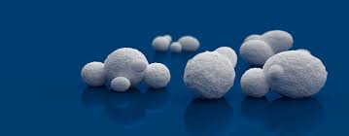
methanol yeast expression system have been developed
In recent years, methylotrophic yeasts, such as
Pichia pastoris, have proved extremely popular as
hosts for the overexpression of heterologous proteins.
There are a number of reasons for this.
First, the alcohol oxidase (AOX1) promoter is one of the strongest and most regulatable promoters known.
Second, it is possible to stably integrate expression
plasmids at specific sites in the genome in either
single or multiple copies.
Third, the strains can be cultivated to very high density. To date, over 300 foreign proteins have been produced in P. pastoris.
Fourth, Compared with S. cerevisiae, its translation is closer to mammalian cells and does not undergo hyperglycosylation.
Proteins (Gram per liter)
can be produced

Slide 24
Recombinant Protein Expression in Pichia Pastoris
Pichia pastoris is a methylotrophic yeast and can be used as a heterologous expression system .
It is a single-celled microorganism that is easy to manipulate and culture as Escherichia coli
As a eukaryote, it possesses the capabilities of post-translational modifications performed by higher eukaryotic cells.
Proteins that express as inactive inclusion bodies in bacterial expression systems can therefore be produced as biologically active molecules in P. pastoris, with correct proteolytic processing, folding, disulfide bond formation and glycosylation.
The protein expression levels in P. pastoris system are also generally much higher. As yeast, it shares the advantages of easy genetic manipulations with Saccharomyces; moreover, it possesses the advantage of 10-100 folds higher heterologous protein expression levels. All the above features have made Pichia a very useful protein expression system.

Slide 25
Pichia pastoris is a type of methylotrophic yeast and thus is capable of metabolizing methanol as its sole carbon source.
The first step in the metabolism of methanol is the oxidation of methanol into formaldehyde by molecular oxygen. The reaction also generates hydrogen peroxide except for formaldehyde.
To avoid the toxicity of hydrogen peroxide, methanol metabolism normally takes place within the peroxisome, a specialized cellular organelle.
Alcohol oxidase, the enzyme that catalyzes the oxidation of methanol has a poor affinity for oxygen, and thus Pichia pastoris has to generate large amounts of the enzyme as compensation.
The promoter regulating the production of the enzyme is therefore used to drive heterologous protein expression in Pichia.

Slide 26
There are two genes code for alcohol oxidase in Pichia, AOX1 and AOX2 . Generally, a majority of the activity of the enzymes relies on the AOX1 gene. Its expression is largely controlled by methanol.
A plasmid-born version of the AOX1 promoter is applied to induce expression of inserted gene of interest for the desired heterologous protein.
The expression of the AOX1 gene is controlled at the level of transcription. The regulation of AOX1 gene includes a repression mechanism and an induction mechanism.
Since growth on glucose can repress transcription process even when methanol exists; growth on glycerol is recommended for optimal induction with methanol.
As to the expression pattern of heterologous protein in Pichia pastoris, it can be either intracellular or secreted, depending on the chosen expression vector. Secretion requires the presence of a signal peptide on the protein via secretory pathway. A major advantage of secreted expression of heterologous protein is that Pichia pastoris itself secrets very low levels of native proteins. Thus the secreted heterologous comprises the majority of the total protein in Pichia growth medium and therefore simplifies subsequent purification procedure of the protein.

Slide 27
P. pastoris has become a highly successful system for the expression of heterologous genes.
Principles and Elements:
a．A promoter derived from the alcohol oxidase I (AOX1) gene of P. pastoris that is appropriate for the precise expression of foreign genes. b. Similar techniques of the molecular genetic manipulation in P.pastoris to those from Saccharomyces cerevisiae, one of the most well-characterized experimental systems in modern biology. c. P. pastoris prefers respiratory growth, which is a key physiological trait which allows its culturing at high cell densities relative to fermentative yeasts.

Slide 28
In the pPICZ
vectors, the zeocin-resistance gene is driven by the EM-7 promoter for selection in E. coli and the TEF1 promoter for selection in Pichia.
N-terminal α-factor secretion signal

Slide 29
Map of integration of a heterologous gene into the genome of Pichia pastoris. (A) Single copy integration.

Slide 30
Summary
As a highly accepted system for protein expression, P. pastoris has its distinguished traits in following aspects:
Ability to grow to high cell densities
Robust inducible promoters
Ease of manipulation
Extra process to stabilize product
High production output
Secretory protein production
Requirements for precise fermentation conditions
Capable of multiple posttranslational modification
Demands of MetOH induction (necessary for explosive-safe fermentors)

Slide 31
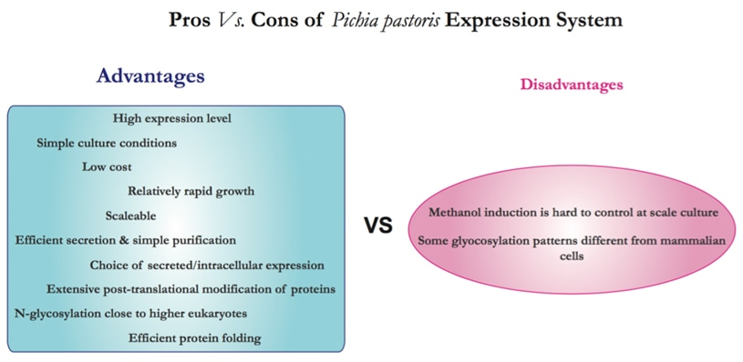

Slide 32
Baculovirus Expression System
The insect expression system is a widely used eukaryotic expression system that has the ability to translate and modify foreign proteins similar to higher eukaryotes. The expression of exogenous protein in the insect cell system by recombinant baculovirus is a more popular expression method.
The protein level is up to 1 ~ 500mg / L.
Baculovirus is the largest group of known insect viruses and is the earliest, most studied and applicable insect virus. The baculovirus genome is a single closed circular double-stranded DNA molecule with a size of 80-160 kb. Its genome can be replicated and transcribed in insect nuclei. It is the ideal carrier for the expression of large fragments of DNA.

Slide 33
The main advantages of baculovirus system include:
Recombinant protein has complete biological function, such as protein correct folding and disulfide bond;
Improved solubility
Post-translation modification;
High level of expression, up to 50% of the total protein amount;
Accommodate large insert protein;
Simultaneously express multiple genes.
Capable of producing cytotoxic proteins
Suitable for the production of large proteins and protein complexes
Lower-cost
Operational safety: baculovirus are noninfectious to vertebrates
Easy to scale up in bioreactors

Slide 34
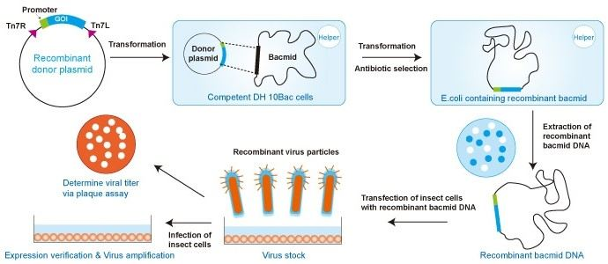
The bacmid is essentially a very large plasmid containing the baculovirus genome
The baculovirus-insect cell expression system utilizes recombinant baculoviruses (insect viruses) and their ability to manufacture high yields of biologically active proteins from infected insect cells. The proteins of interest can be easily purified from infected cells or their supernatants using tag and affinity chromatography.

Slide 35
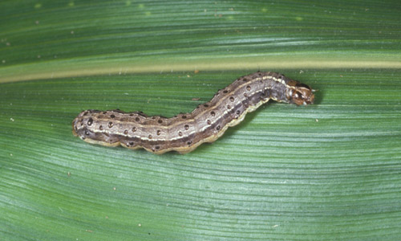
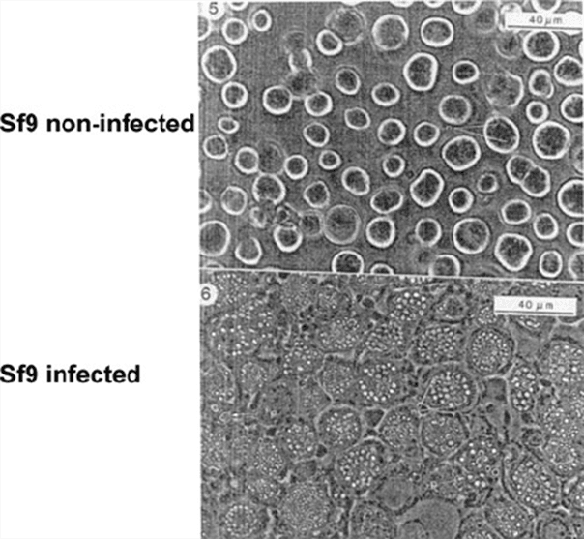
Insect: Spodoptera frugiperda
Source of Sf9 Cells

Slide 36
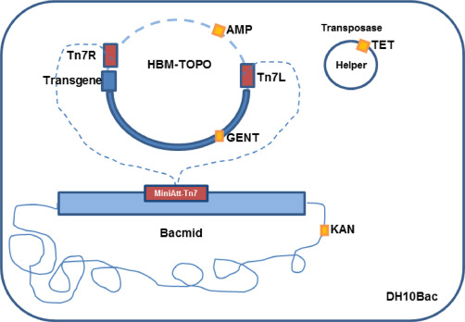
Baculovirus Expression System

Slide 37
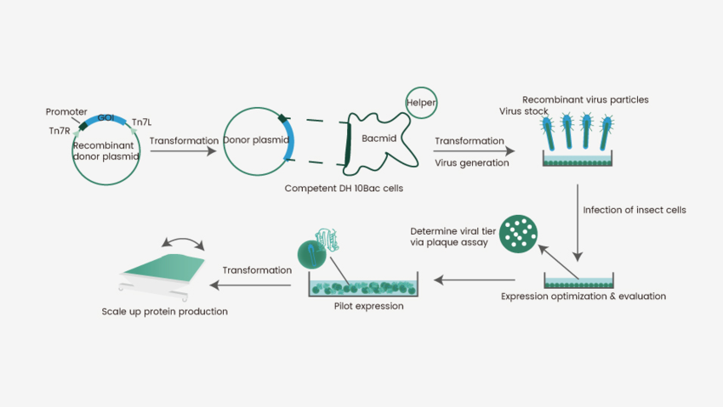
Baculovirus Expression System

Slide 38
Mammalian Expression Systems
The main advantage of mammalian cell expression is that the mammalian cells can properly and efficiently recognize the signals for synthesis, processing and secretion of eukaryotic proteins.
Therefore expression systems utilizing mammalian cells for recombinant protein manufacture are able to introduce proper protein folding, post-translational modifications, and protein assembly, which are important for complete biological activity.
HEK293 cells | CHO cells
Human Embryonic Kidney cells The most commonly used line for transient production, not as frequently used for therapeutic protein production Easy to transfect Adaptable for suspension culture Transient expression | Chinese Hamster Ovary cells Predominant cell line for therapeutic protein production due to preferred post-translational modifications Adaptable for suspension culture Transient and stable expressions

Slide 39
The foreign protein produced by mammalian cells, which is closer to the native protein, has much more activity than proteins produced by prokaryotic expression system or by other eukaryotic expression system, such as yeast and insect cells. The disadvantage of the technique is complicated, high requirement, low yield and sometimes viral infections exist.

Slide 40
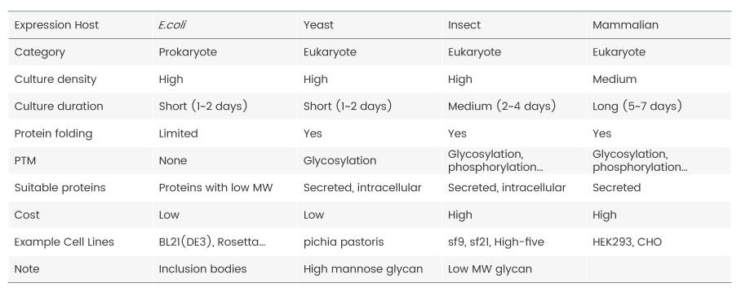
Comparison between different expression system

Slide 41
Bacterial Expression System | Yeast Expression System | Insect Expression System | Mammalian Expression System
Application | Prokaryotic protein, simple eukaryotic protein | Intracellular/Secreted Protein, Disulfide-bonded protein, Glycosylated protein | Membrane protein, Large-size protein, Viral vaccines, signaling proteins, cytokines, kinases | Complex eukaryotic protein, Protein need accurate PTM

