Slide 1
Assay for the fused proteins
Note that a polyhistidine tag at the C terminus can function for both assay and purification.

Slide 2
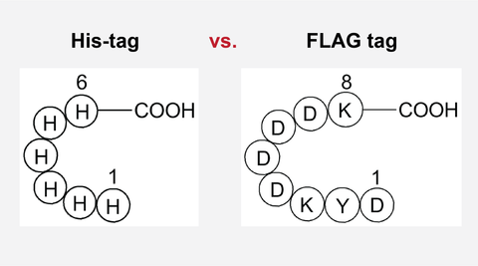
FLAG-tag, or FLAG octapeptide, or FLAG epitope, is a peptide protein tag that can be added to a protein using recombinant DNA technology, having the sequence DYKDDDDK (where D=aspartic acid, Y=tyrosine, and K=lysine).
It is one of the most specific tags and it is an artificial antigen to which specific, high affinity monoclonal antibodies have been developed and hence can be used for protein purification by affinity chromatography and also can be used for locating proteins within living cells.
Cellular localization studies by immunofluorescence, immunoprecipitation or detection by SDS PAGE protein electrophoresis and Western blotting.

Slide 3
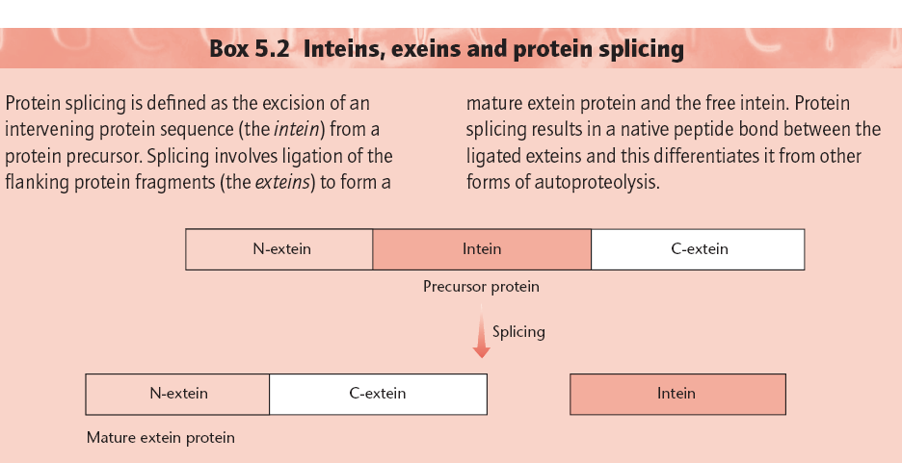
Problem: The affinity purification systems described above suffer from the disadvantage that a protease is required to separate the target protein from the affinity tag. Also, the protease has to be separated from the protein of interest.
Intein Based Vectors

Slide 4
The system utilizes a protein splicing element, an intein, from the Saccharomyces cerevisiae VMA1 gene. The intein is modified such that it undergoes a self-cleavage reaction at its N terminus at low temperatures in the presence of thiols, such as cysteine, dithiothreitol or β-mercaptoethanol. The gene encoding the target protein is inserted into a multiple cloning site (MCS) of a vector to create a fusion between the C terminus of the target gene and the N terminus of the gene encoding the intein. DNA encoding a small (5 kDa) chitin-binding domain from Bacillus circulans was added to the C terminus of the intein for affinity purification.
The above construct is placed under the control of
an IPTG-inducible T7 promoter. When crude extracts
from induced cells are passed through a chitin column,
the fusion protein binds and all contaminating
proteins are washed through. The fusion is then
induced to undergo intein-mediated self-cleavage on
the column by incubation with a thiol. This releases
the target protein, while the intein chitin-binding
domain remains bound to the column.
(Next Figure)

Slide 5
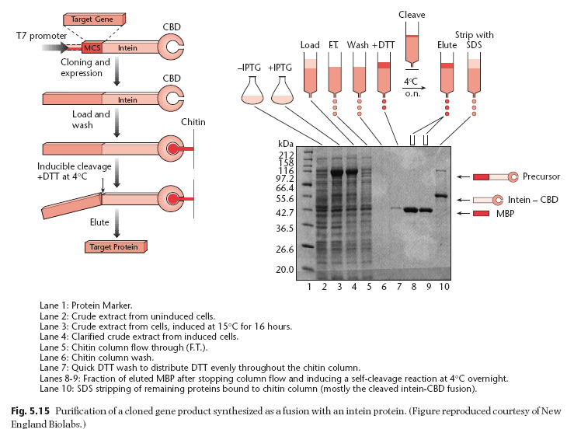

Slide 6
Inclusion Bodies: Methodologies to reduce the formation of IBs
High level expression of recombinant protein in Escherichia coli often results in aggregation of the expressed protein molecules into inclusion bodies.
Use of high temperature during protein expression, high inducer concentration and expression under strong promoter systems often results in expression of the desired protein at a high translational rate. This exhausts bacterial protein quality control system and the partially folded and mis-folded protein molecules aggregate to form inclusion bodies.
Reduced environment of bacterial cytosol, lack of eukaryotic chaperones and post-translational machinery also contribute to the formation of inclusion bodies.

Slide 7
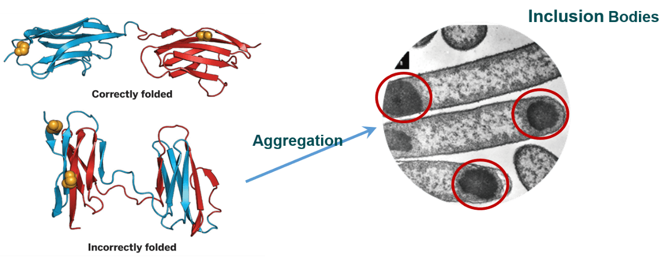

Slide 8
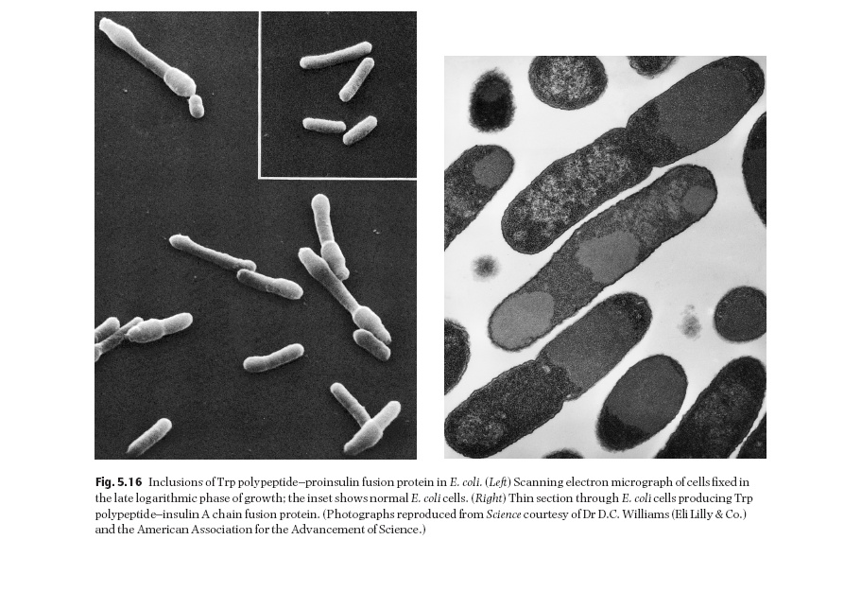

Slide 9
Formation of inclusion bodies imposes a great hurdle in production and purification of recombinant proteins using E. coli as host.
Inclusion bodies need extensive processing involving isolation from cell, solubilization, refolding and purification to produce the bioactive proteins.

Slide 10
Two parameters that can be manipulated to reduce
inclusion-body formation are temperature and
growth rate. There are a number of reports which
show that lowering the temperature of growth
increases the yield of correctly folded, soluble protein.
Media compositions and pH values
that reduce the growth rate also reduce inclusion body
formation.
Renaturation of misfolded proteins
can sometimes be achieved following solubilization
in guanidinium hydrochloride

Slide 11
Recovery of bioactive proteins from inclusion bodies
As protein molecules are in an aggregated state in inclusion bodies, it is a challenging task to solubilize inclusion bodies and refold the solubilized proteins into bioactive form.
The conventional strategy to purify proteins from inclusion bodies consists of four major steps: isolation of purified inclusion bodies, solubilization of inclusion bodies, refolding of solubilized proteins and purification of refolded proteins by various chromatographic techniques.
Solubilization of inclusion bodies and refolding of solubilized protein molecules into native conformation are the most crucial steps in the recovery of bioactive protein from inclusion bodies.

Slide 12
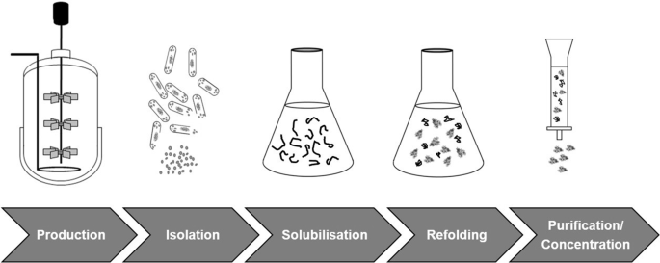

Slide 13
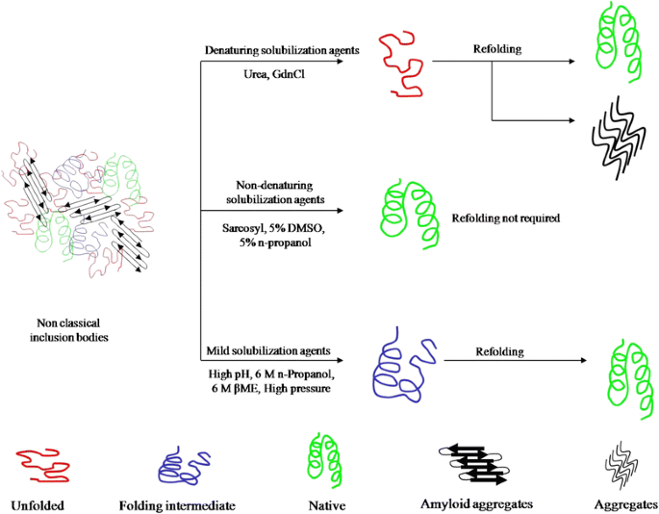

Slide 14
Traditionally, inclusion bodies are solubilized using high concentration of denaturants and chaotropes like urea and guanidine hydrochloride (GdnHCl).
For proteins containing multiple cysteine residues, β-mercaptoethanol or dithiothreitol are added in these solubilization agents to reduce incorrect disulfide bonds.
Solubilization of inclusion bodies using high concentration of chaotropes results in complete disruption of protein structure. This, in some cases, leads to aggregation of protein molecules during refolding process. As inclusion body aggregates have been shown to have native-like secondary structures and can have activity, it is advantageous to use a “mild” solubilization process which does not completely unfold these native-like protein structures

Slide 15
Three ‘genetic’ methods of preventing inclusion body formation have been described.
In the first of these, the host cell is engineered to overproduce a
chaperon (e.g. DnaK, GroEL or GroES proteins) in addition to the protein of interest
Castanie et al. (1997) have developed a series of vectors which are compatible with pBR322-type plasmids and which encode the overproduction of chaperons. These vectors can be used to test the
effect of chaperons on the solubilization of heterologous
gene products.
Even with excess chaperon there is no guarantee of proper folding. The second method involves making minor changes to the
amino acid sequence of the target protein.
For example, cysteine-to-serine changes in fibroblast growth factor minimized inclusion-body formation (Rinas et al. 1992).

Slide 16
The third method is derived from the observation that many proteins produced as insoluble aggregates in their native state are synthesized in soluble form as thioredoxin fusion proteins.
Davis et al. (1999) have shown that the NusA and GrpE proteins, as well as bacterioferritin, are even better than thioredoxin at solubilizing proteins expressed at a high level.
Kapust and Waugh (1999) have reported that the maltose-binding protein is also much better than thioredoxin.

Slide 17
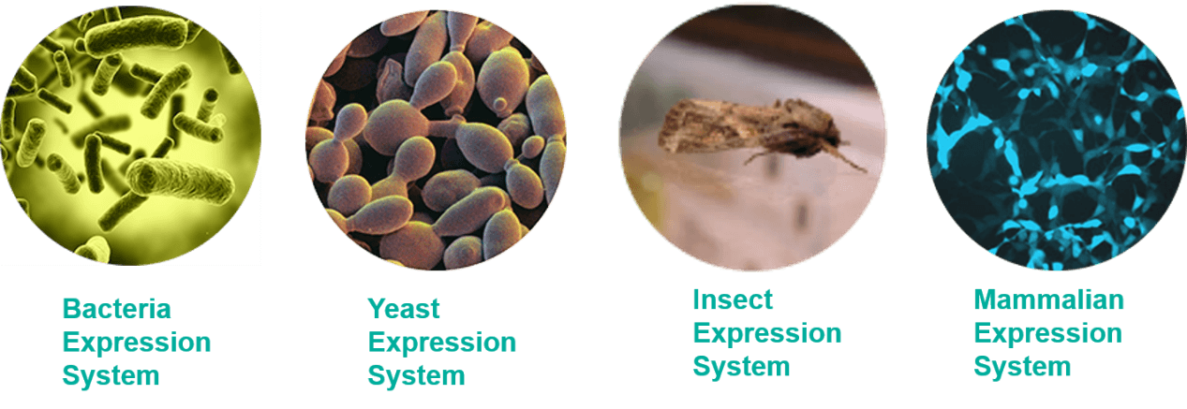
Recombinant Protein and Its Expression Systems

Slide 18
Choosing an appropriate protein expression system is the key to the success of recombinant protein expression. Several factors need to be taken into consideration, including target protein property, intended application, protein yield and cost. Furthermore, challenges exist for many protein expression projects, especially for large protein, membrane protein, nuclear protein and proteins with heavy post-translational modifications.
Nowadays, there are several expression systems for use. Different systems have different features and applications. Here, we will introduce four systems which are commonly used in research and industrial. They are bacteria expression system, yeast expression system, baculovirus expression system and mammalian expression system.

Slide 19
Bacteria Expression System
E. coli expression system is the primary use and most mature expression system. The main method is transfer a vector which inserted target DNA fragment to host cell. And then induce protein expression by IPTG.
As the earliest development and the most widely used classical expression system, the E. coli expression system has the advantages of clear genetic background, fast breeding, low cost, high expression, easy purification of the product, good stability, strong anti-pollution ability and wide application range. However, there are many shortcomings in the prokaryotic expression system: not all proteins are soluble. Incorrectly folded proteins formed in cytoplasm can form insoluble aggregates called inclusion bodies, which leads to the difficult purification. Moreover, the post-translational modification processing of the prokaryotic expression system is imperfect and the biological activity of the expressed product is low.
Thus, other more sophisticated systems are also being developed; such systems may allow for the expression of proteins previously thought impossible in E. coli, for example, glycosylated proteins.

