Slide 1
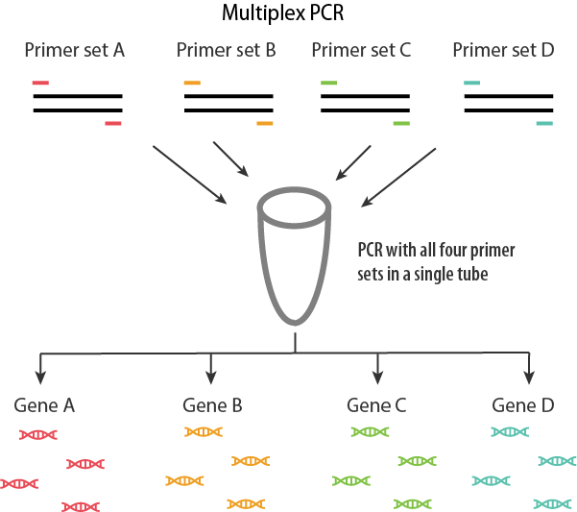
Multiplex-PCR
Multiplex PCR is a widely used molecular biology technique for amplification of multiple targets in a single PCR experiment. In a multiplex-PCR assay, different target DNA sequences can be amplified simultaneously by using multiple primer pairs in a reaction mixture. Annealing temperature and primer sets should be optimized so that all primer pairs can work correctly within a single reaction. Amplicon sizes of different genes such as their base pair length should be different so that distinct bands can be visualized by gel electrophoresis.

Slide 2
Multiplex PCR has been used in pathogen identification, high throughput SNP genotyping, mutation analysis, gene deletion analysis, template quantification, linkage analysis, RNA detection and forensic studies.

Slide 3
Nested PCR
Nested PCR is used to increase the specificity of DNA amplification by reducing the non-specific amplification of DNA.
A nested PCR assay has 2 sets of primers (outer pair and inner pair) for a single locus and two successive PCRs.
In the first PCR run, the outer pair primers are used to generate DNA products as the regular PCR does and thus their DNA products may contain non-specifically amplified DNA fragments.
These products then enter a second run of PCR using the second set “inner” primers whose binding sites are completely or partially different from and located after the 3’end of each of the outer pair primer used in the first PCR reaction. Therefore a second PCR product was produced and shorter than the first one.
If the wrong locus was amplified by mistake in the first round, it’s very unlikely it would also be amplified a second time by the second pair of primers, thus in this way nested PCR greatly increases the specificity of PCR.

Slide 4
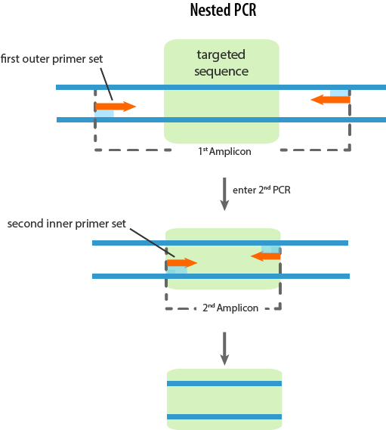

Slide 5
Touch Down PCR
The term “Touch Down” means at the earlier PCR cycles, the annealing temperature is set as high.
Then the annealing temperature is reduced in increments for every subsequent set of cycles. The principle behind this is that the annealing temperature during a PCR reaction determines the specificity of primer annealing.
Touch Down PCR increases the specificity of PCR by using higher annealing temperatures at the earlier cycles and increases the efficiency by lowering the annealing temperatures gradually toward the end of cycles. This method dramatically increases the quality of outcome of PCR .
A typical Touch Down PCR cycling condition has two phases. The first phase of touchdown programming uses an annealing temperature that is approximately 10°C above the calculated Tm (melting temperature). The temperature is reduced by 1°C every successive cycle until the calculated Tm range is reached. This is done for a total of 10-15 cycles. Phase 2 follows generic PCR amplification of up to 20-25 cycles using the final annealing temperature reached in the touchdown phase.

Slide 6
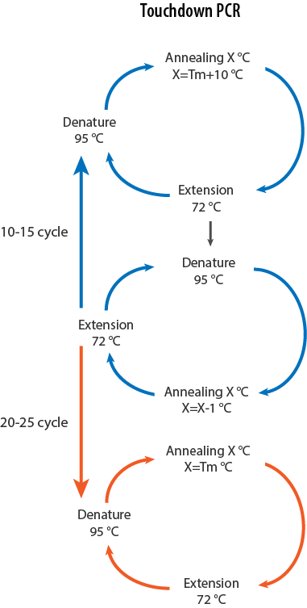

Slide 7
This technique is based on the principle of initiating the polymerase reaction at or above the primer annealing temperature, thereby preempting possible extensions of the primers nonspecifically annealed at ambient temperature (20°-55°C) at which Taq Pol retains partial activity.

Slide 8
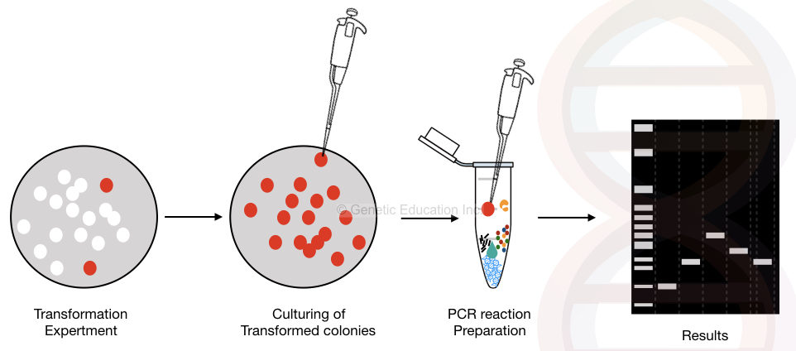
Colony PCR

Slide 9
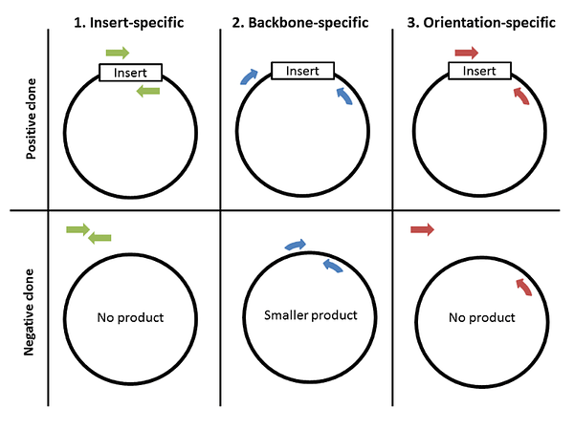
Concept

Slide 10
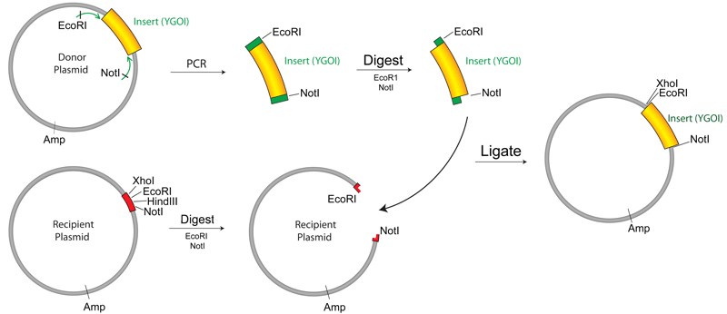
Plasmid Cloning by PCR
Experimental Procedure
Run PCR and purify the PCR product: Run PCR to amplify your insert DNA
Digest your DNA
Isolate your insert and vector by gel purification
Ligate your insert into your vector
Transformation
Isolate the Finished Plasmid
Verify your Plasmid by Sequencing

Slide 11
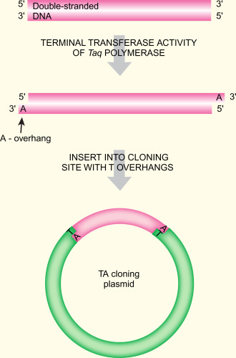
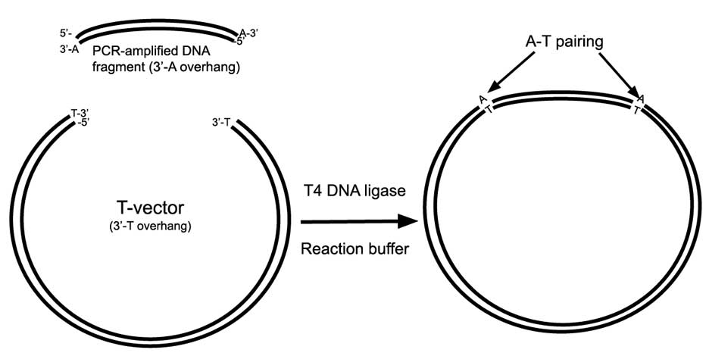
TA Cloning Vector

Slide 12
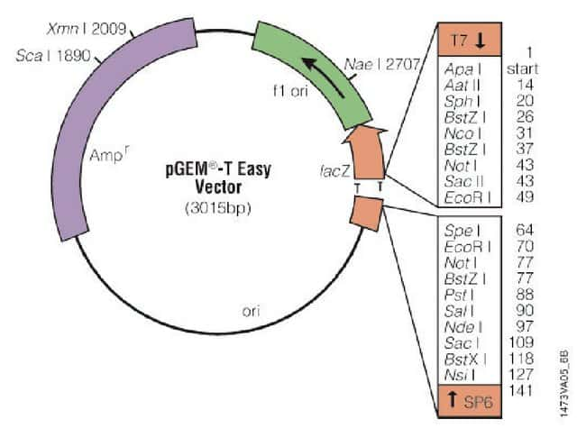
T vector

Slide 13
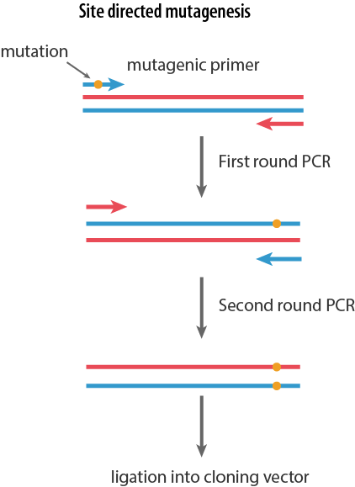
Site directed mutagenesis
This is an important molecular biology method to introduce specific and intentional mutations to the DNA sequence of a gene or any genetic products. During this process, firstly a short DNA primer is synthesize which contains the expected mutation and is complementary to the template DNA around the mutation sit so it can hybridize with the DNA sequence of interest. The mutation can be a single or multiple base changes, deletion or insertion. The primer is then elongated by DNA polymerase. Thus the amplified gene then contains the mutated site, which are then incorporated into a host cell as a vector and cloned. At last, mutants are selected by DNA sequencing to select those with desired mutations. This method can be used to study the function of a gene or protein, or for creating variants of an enzyme with new and improved functions.

Slide 14
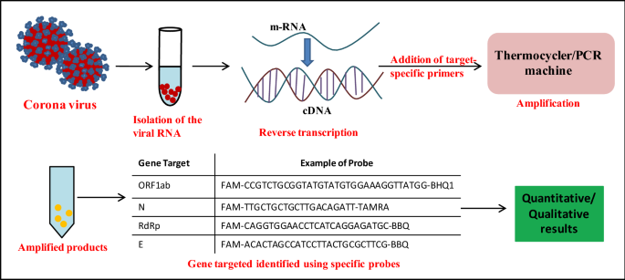
Viral, Fungal and Bacterial Detection
The principle of the method is simple; when a pure PCR product of the 16S gene is obtained, sequenced, and aligned against bacterial DNA data base, then the bacterium can be identified.
18S rRNA for fungal species identification.

Slide 15
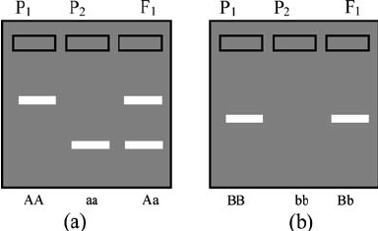
Molecular Markers
Restriction fragment length polymorphism (RFLP)
Randomly amplified polymorphic DNA (RAPD)
Amplified fragment length polymorphism (AFLP)
DNA markers can be codominant (a) or dominant (b) in nature.

Slide 16
Restriction fragment length polymorphism (RFLP)
In molecular biology, restriction fragment length polymorphism (RFLP) is a technique that exploits variations in homologous DNA sequences, known as polymorphisms, in order to distinguish individuals, populations, or species or to pinpoint the locations of genes within a sequence.
The first step in this process is to isolate the DNA from the target.
Once the the DNA is isolated from the sample it is subjected to restriction digestion using restriction enzymes.
The digested DNA sample is then subjected to gel electrophoresis, in which the DNA is separated based on its size. Many DNA fragments with slight differences in length are produced.
The gel is then exposed to a chemical to denature double-stranded DNA to become single- stranded.
This is followed by southern blotting where DNA is transferred from gel to nylon membrane.
The nylon membrane is then exposed to solution with radioactive complementary nucleotide probes that hybridize to specifically chosen DNA sequences on nylon membrane.
The membrane is then placed against X- ray film, where hybridized radioactive probes cause exposure of X-ray film, producing an autoradiogram.
RFLP analysis is carried out to detect differences in pattern to confirm polymorphisms.

Slide 17
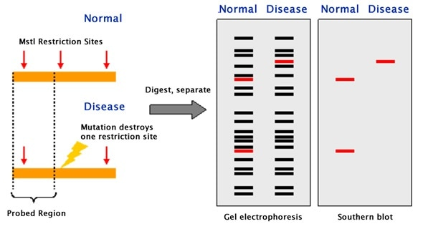

Slide 18
Applications of Restriction Fragment Length Polymorphism (RFLP)
RFLP analysis was formerly an important tool in genome mapping, localization of genes for genetic disorders, determination of risk for disease, and paternity testing.
RFLP can be used in many different settings to accomplish different objectives:
In paternity cases or criminal cases to determine the source of a DNA sample. (i.e. it has forensic applications).
Determining the disease status of an individual. (e.g. it can be used in the detection of mutations)
To measure recombination rates which can lead to a genetic map with the distance between RFLP loci.
In the characterization of genetic diversity or breeding patterns in animal populations.
RFLP has been developed for chromosomes mapping of humans, mice, maize, tomato, rice, etc.

Slide 19
2. Randomly amplified polymorphic DNA (RAPD)
Randomly amplified polymorphic DNA (RAPD) is a PCR-based technique which uses arbitrary primers which bind to the nonspecific sites on the DNA and amplify the DNA. These amplified fragments are then migrated on agarose gel and difference in the band pattern is observed.
DOMINANT Marker

Slide 20
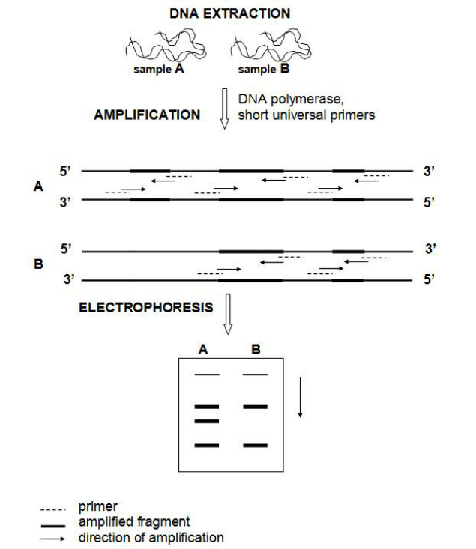

Slide 21
3. Amplified fragment length polymorphism (AFLP)
Amplified fragment length polymorphism (AFLP) is a PCR-based technique that uses selective amplification of a subset of digested DNA fragments to generate and compare unique fingerprints for genomes of interest.
Dominant Marker

Slide 22
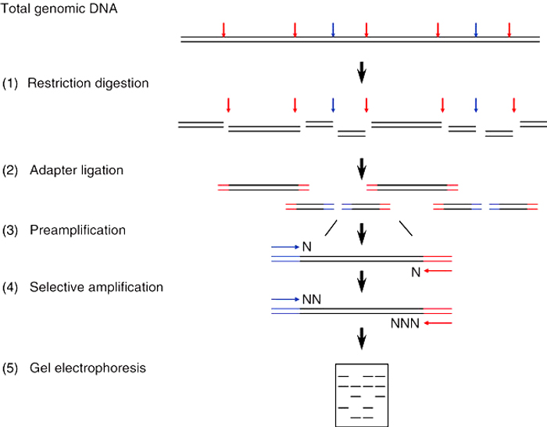
AFLP

Slide 23
Differences

