Slide 1
Mutation Detection
RFLP
RAPD
AFLP
SSCP
DGGE
OLA
MCC
PTT

Slide 2
Polymorphismrefers to the presence of two or more variant forms of a specific DNA sequence that can occur among different individuals or populations. The most common type of polymorphism involves variation at a single nucleotide (also called a single-nucleotide polymorphism, or SNP).

Slide 3
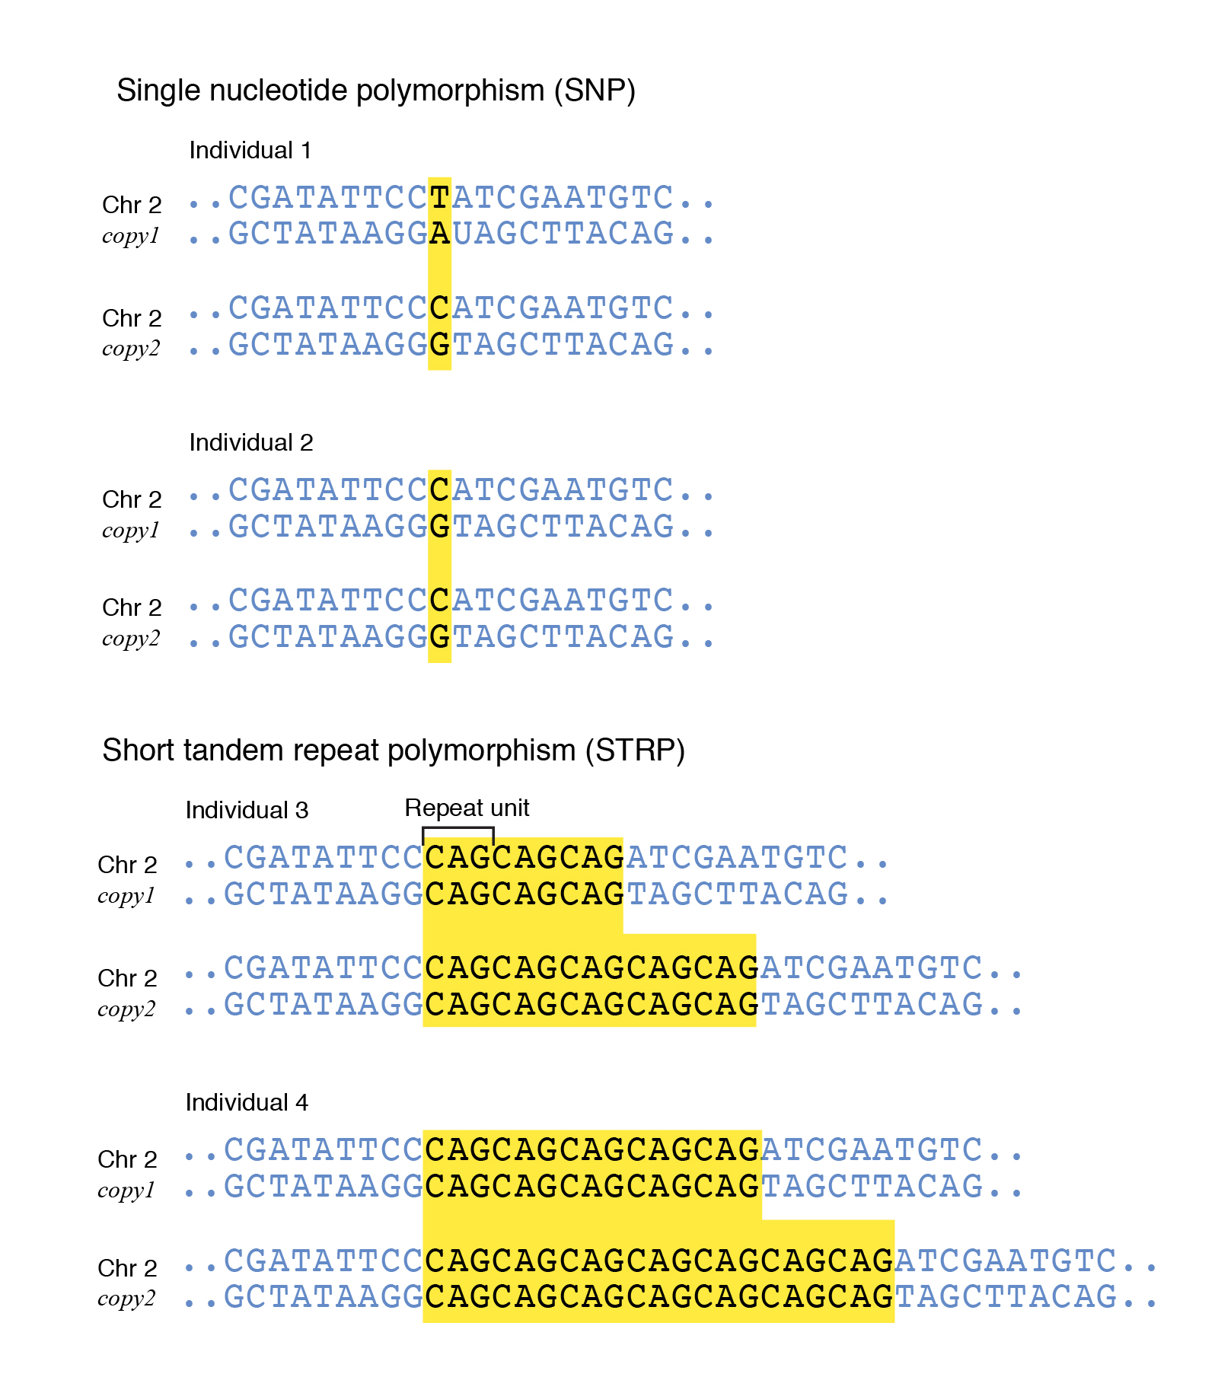

Slide 4
Single-strand conformation polymorphism (SSCP)
Single-strand conformation polymorphism (SSCP), or single-strand chain polymorphism, is defined as a conformational difference of single-stranded nucleotide sequences of identical length as induced by differences in the sequences under certain experimental conditions. This property allows sequences to be distinguished by means of gel electrophoresis, which separates fragments according to their different conformations.
A single nucleotide change in a particular sequence, as seen in a double-stranded DNA, cannot be distinguished by gel electrophoresis techniques, which can be attributed to the fact that; the physical properties of the double strands are almost identical for both alleles.
After denaturation, single-stranded DNA undergoes a characteristic 3-dimensional folding and may assume a unique conformational state based on its DNA sequence. The difference in shape between two single-stranded DNA strands with different sequences can cause them to migrate differently through an electrophoresis gel, even though the number of nucleotides is the same, which is, in fact, an application of SSCP.

Slide 5
SSCP used to be a way to discover new DNA polymorphisms apart from DNA sequencing but is now being supplanted by sequencing techniques on account of efficiency and accuracy.

Slide 6
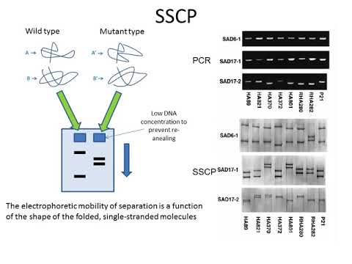

Slide 7
Temperature gradient gel electrophoresis (TGGE) and denaturing gradient gel electrophoresis (DGGE) are forms of electrophoresis which use either a temperature or chemical gradient to denature the sample as it moves across an acrylamide gel. TGGE and DGGE can be applied to nucleic acids such as DNA and RNA, and (less commonly) proteins. TGGE relies on temperature dependent changes in structure to separate nucleic acids. DGGE separates genes of the same size based on their different denaturing ability which is determined by their base pair sequence. DGGE was the original technique, and TGGE a refinement of it.

Slide 8
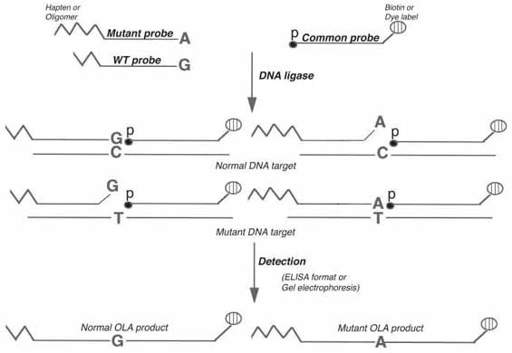
Oligonucleotide Ligation Assay
DNA ligase catalyzes the ligation of the 3' end of a DNA fragment to the 5' end of a directly adjacent DNA fragment. This mechanism can be used to interrogate a SNP by hybridizing two probes directly over the SNP polymorphic site, whereby ligation can occur if the probes are identical to the target DNA.
If the allele-specific probe matches the target DNA, it will fully hybridize to the target DNA and ligation can occur. Ligation does not generally occur in the presence of a mismatched 3' base.

Slide 9
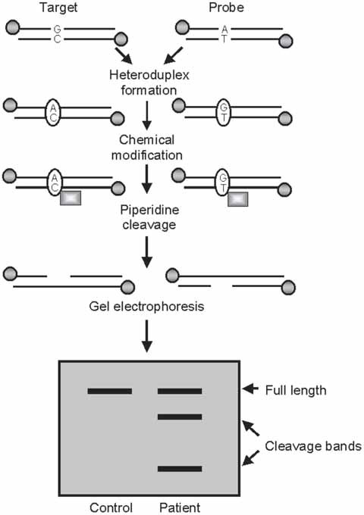
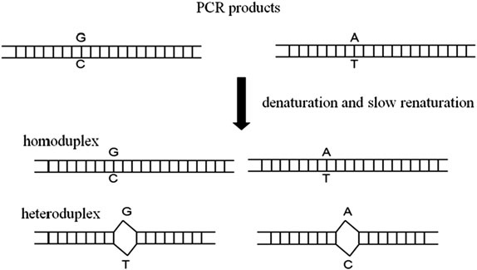
Mismatch chemical cleavage

Slide 10
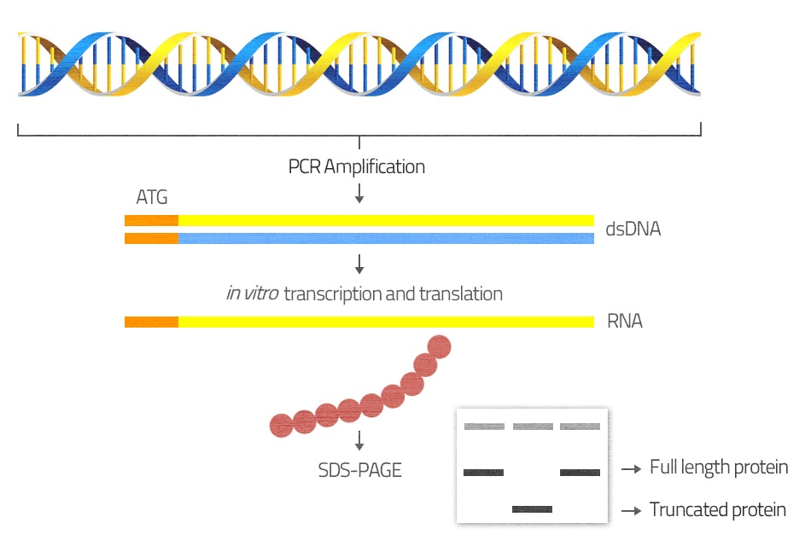
The protein truncation test (PTT) is a simple and fast method to screen for biologically relevant gene mutations. The method is based on the size analysis of products resulting from in vitro transcription and translation.

Slide 11
A

Slide 12
End of Unit IV

