Slide 1
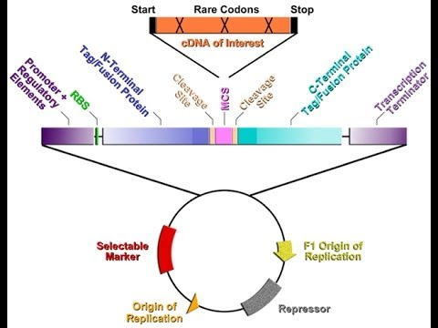
Expression Vectors
A vector which is designed to allow expression (transcription and translation) of the inserted section of DNA. The vector carries a promoter (normally inducible) on one side of the cloning site, and a transcription terminator on the other side. These must be recognisable by the intended Host cell. The vector may also carry a ribosome binding sequence (for bacterial expression) and a start codon, depending on the nature of the inserted DNA. Some expression vectors produce fusion Proteins.

Slide 2
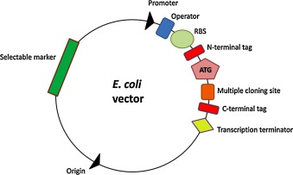
N or C terminal tags offer several potential advantage such as improved expression,
Solubility, improved detection and purification.
Such vector-carried promoters have been optimized for binding of the E. coli RNA
polymerase and many of them can be regulated easily by changes in the growth
conditions of the host cell.

Slide 3
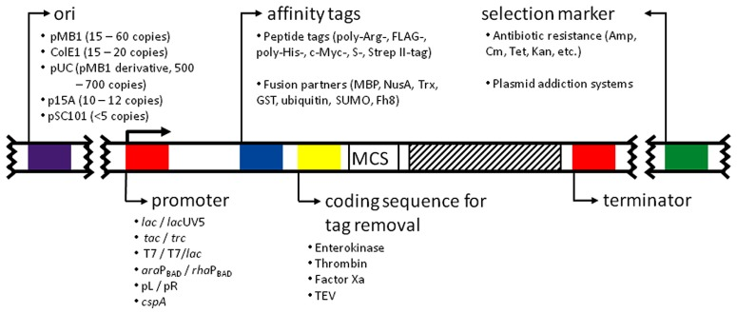
Elements of Expression Vector

Slide 5
Promoters: critical element of an expression vector
Lac Promoter: Induced by IPTG, weak
trp Promoter: Induced by 3-beta-indoleacrylic acid
To minimize the problems associated with high-level expression, it is usual to use a vector
in which the cloned gene is under the control of a regulated promoter.
Regulated Promoters
tac Promoter: Hybrid of trp and lac Promoter, stronger than either of them, Induced
By IPTG

Slide 6
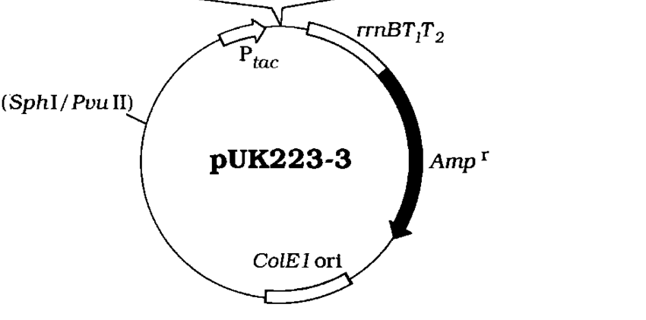

Slide 7
2. T7 Promoter: Strong & Regulated
pET Bacterial Recombinant Protein Vector
The pET vector system is a powerful and widely used system for expressing recombinant proteins in E. coli. The gene of interest is cloned into the pET vector under the control of the strong bacteriophage T7 transcription and translation regulatory system. Activation of expression is achieved by providing T7 RNA polymerase within the cell. When the system is fully induced, nearly all of the cell’s resources are devoted to expressing the gene of interest. With just a few hours of induction, the recombinant protein could comprise nearly half of the cell’s total protein.

Slide 8
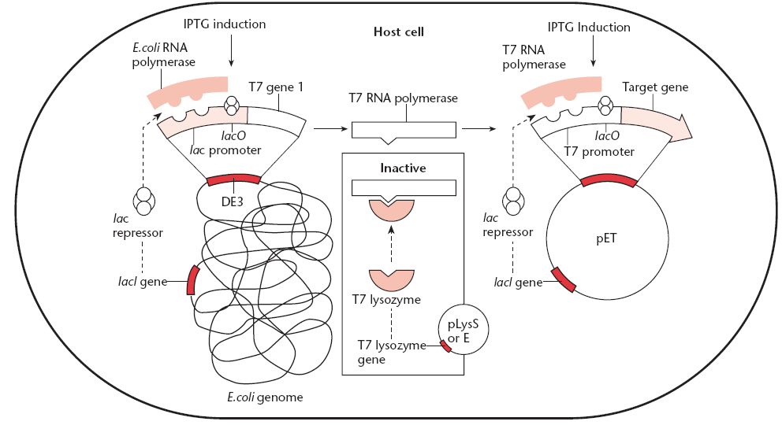

Slide 9
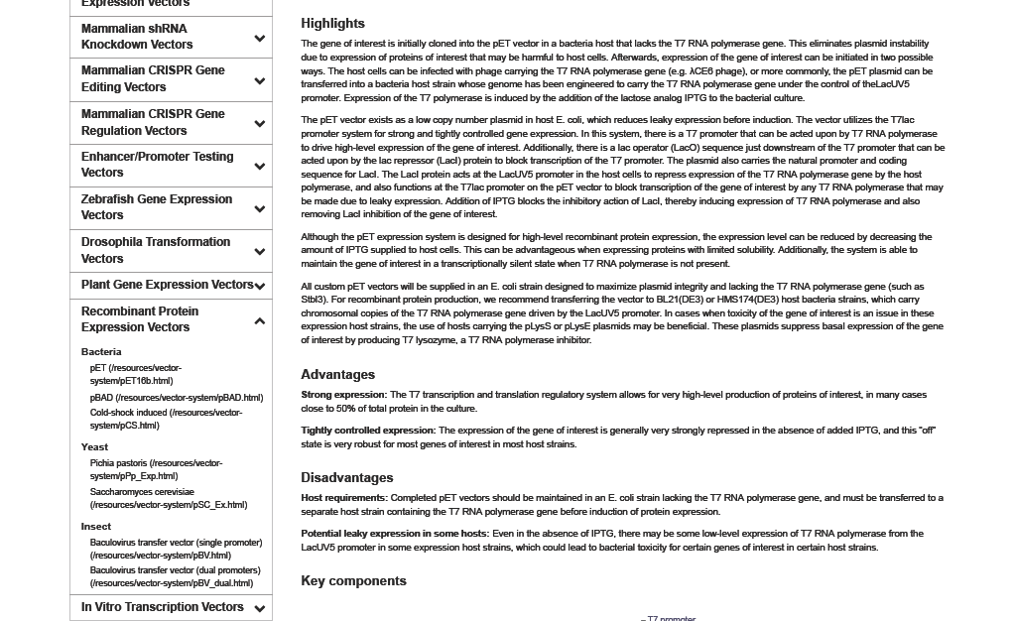

Slide 10
T7 promoter: Drives high-level transcription of the gene of interest when T7 RNA polymerase is present. When placed immediately upstream of a LacO element, the entire cassette is known as the T7lac promoter.
LacO: Binding site for LacI. This element inhibits activity of the T7 promoter when LacI protein is present, preventing leaky expression of the gene of interest.
RBS: The ribosome-binding site and translation initiation element from T7 bacteriophage. This allows for efficient production of the protein of interest.
ORF: The open reading frame of your gene of interest is placed here.
T7 terminator: Signal sequence to terminate the transcript made from the gene of interest, preventing run-on transcription.
Ampicillin: Ampicillin resistance gene. It allows the plasmid to be maintained by ampicillin selection in E. coli.
pBR322 ori: pBR322 origin of replication. Plasmids carrying this origin as well as the Rop gene exist in low copy numbers in E. coli.
Rop: Repressor of primer. It encodes a small protein that regulates plasmid copy number. The presence of the Rop protein, in combination of pBR322 origin of replication on the plasmid, results in low copy numbers of the plasmid.
LacI: The E. coli natural promoter and coding sequence for the lac repressor. In the absence of induction of the system (i.e. without IPTG), the LacI protein represses transcription of the gene of interest from the T7lac promoter, as well as transcription of T7 RNA polymerase from the LacUV5 promoter in host strains used for recombinant protein production.
pET Vector

Slide 11
3. The λ P_{L} promoter system combines very tight transcriptional control with high levels of gene expression.
This is achieved by putting the cloned
gene under the control of the PL promoter carried on
a vector, while the PL promoter is controlled by a cI
repressor gene in the E. coli host. This cI gene is itself
under the control of the tryptophan (trp) promoter

Slide 12
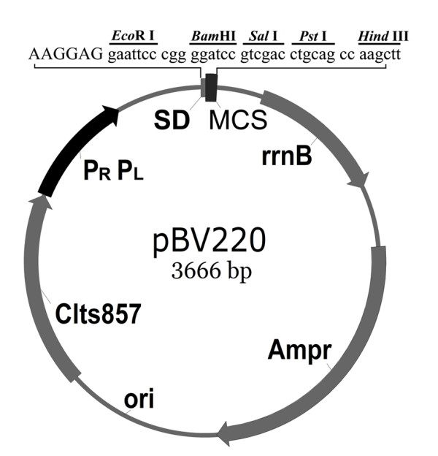
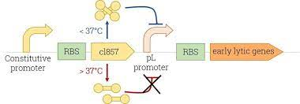
Temperature Responsive System
The creation of the cI857 repressor mutant of λcI made it thermo-labile above 37°C , meaning repression becomes inactive above a certain temperature. This system is widely used for industrial production of recombinant proteins in E. coli under up-shift in temperature

Slide 13
4. The pBAD vectors, offer extremely tight control of expression of cloned genes. The pBAD
vectors carry the promoter of the araBAD (arabinose) operon and the gene encoding the positive and negative regulator of this promoter, araC. AraC is a transcriptional regulator that forms a complex with L-arabinose.

Slide 14
Protein Purification facilitation
Many cloning vectors have been engineered so that
the protein being expressed will be fused to another
protein, called a tag, which can be used to facilitate
protein purification. Examples of tags include glutathione-
S-transferase, the MalE (maltose-binding)
Protein (MBP) and multiple histidine residues (HIS₆ Tag), which can easily be purified by affinity chromatography.
What kind of resins or support medium is used for the purification of 1. Glutathione S-transferase (GST), 2. MBP (Maltose binding protein), and 3. His-tagged recombinant proteins?
Gultathione Sepharose
Amylose Resin
Ni-NTA (Nitriloacetic Acid)

Slide 15
The tag vectors are usually constructed so that the
coding sequence for an amino acid sequence cleaved
by a specific protease is inserted between the coding
sequence for the tag and the gene being expressed.
After purification, the tag protein can be cleaved off
with the specific protease to leave a normal or nearly
normal protein.

