Slide 1
Protein Purification facilitation
Many cloning vectors have been engineered so that
the protein being expressed will be fused to another
protein, called a tag, which can be used to facilitate
protein purification. Examples of tags include glutathione-
S-transferase, the MalE (maltose-binding)
Protein (MBP) and multiple histidine residues (HIS₆ Tag), which can easily be purified by affinity chromatography.
What kind of resins or support medium is used for the purification of 1. Glutathione S-transferase (GST), 2. MBP (Maltose binding protein), and 3. His-tagged recombinant proteins?
Gultathione Sepharose
Amylose Resin
Ni-NTA (Nitriloacetic Acid)

Slide 2
The tag vectors are usually constructed so that the
coding sequence for an amino acid sequence cleaved
by a specific protease is inserted between the coding
sequence for the tag and the gene being expressed.
After purification, the tag protein can be cleaved off
with the specific protease to leave a normal or nearly
normal protein.

Slide 3
To use a polyhistidine fusion for purification, the
gene of interest is first engineered into a vector in
which there is a polylinker downstream of six histidine
residues and a proteolytic cleavage site. In the
example shown here. the cleavage site is that
for enterokinase. After induction of synthesis of the
fusion protein, the cells are lysed to get lysate.
The lysate is then applied to a column containing
immobilized divalent nickel, which selectively binds
the polyhistidine tag. After washing away any
contaminating proteins, the fusion protein is eluted
from the column and treated with enterokinase to
release the cloned gene product.

Slide 4
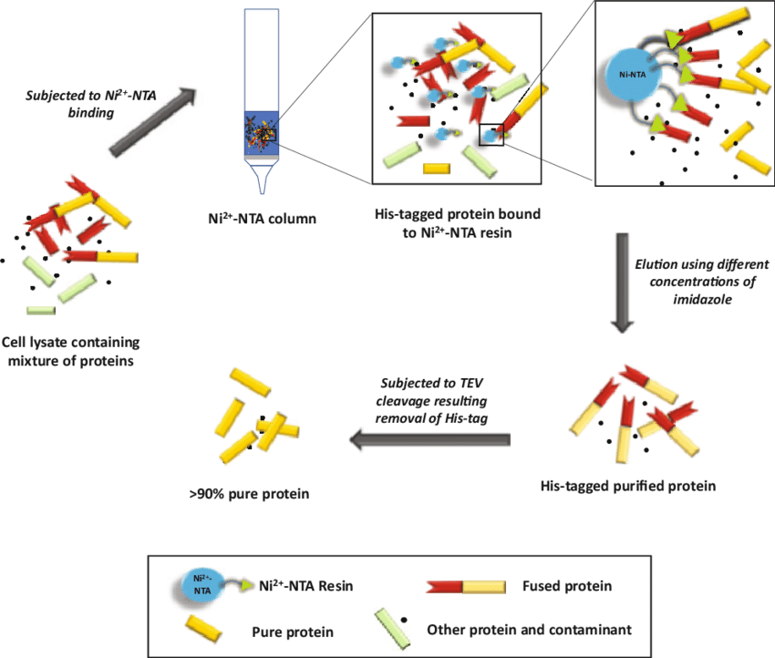

Slide 5
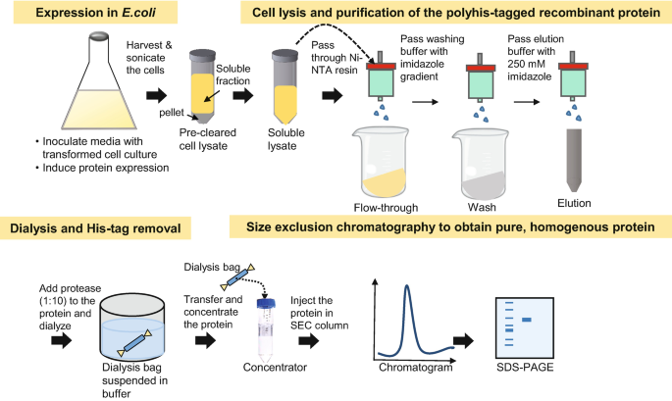
Purification

Slide 6
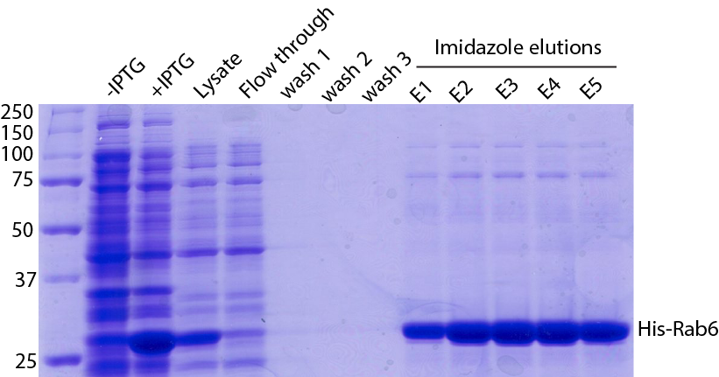

Slide 7
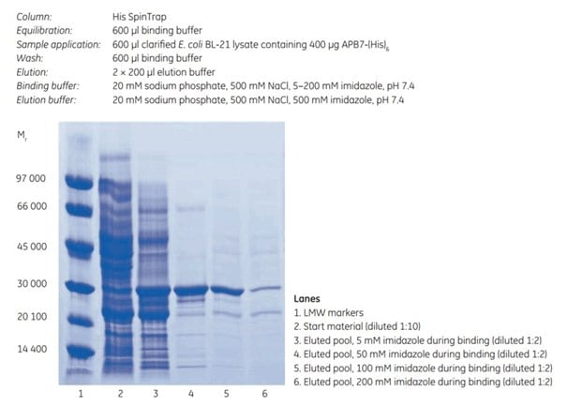

Slide 8
Purifying tagged proteins
What is tagged protein purification?
Tagged protein purification uses affinity chromatography (AC) to purify recombinant proteins that have been engineered to include a specific peptide or protein sequence (tag). Common choices for protein affinity tags are polyhistidine (histidine-tag), glutathione S-transferase (GST), maltose-binding protein (MBP), Strep-tag® II, and FLAG™ tags. His-tagged proteins are purified with a variant of affinity chromatography called IMAC (immobilized metal affinity chromatography).
Why should I add a tag to the protein?
Tags simplify purification and enable scientists to use standard protocols. It improves the yield, purity, and solubility of the protein of interest, and minimizes the number of purification steps needed. You can also use tags for detection.
When should I use tagged protein purification?
You can use affinity purification of tagged proteins as the only purification step in applications that do not require very high purity. When you need very high purity – or purity between 95% and 99% – you can use this technique as the first (capture) step and follow it with a size exclusion chromatography (SEC) step. A tag might also increase the solubility of the target protein, prevent proteolysis, and increase protein detection.
When selecting the tag, consider that the tag can interfere with the structure or function of the target protein. That means you might need to remove the tag using a tag cleavage protocol. Adding a cleavage recognition sequence between protein and tag enables protease, a cleavage enzyme, to cleave off the tag after purification.

Slide 9
How does it work?
With an affinity tag attached, the target protein is specifically and reversibly bound to a chromatographic resin containing a binding substance (ligand) with affinity to the tag.
Tagged protein purification step-by-step
1. Apply the sample to the column in conditions that favor the tag and ligand binding. Wash any unbound material out of the column.
2. Elute the bound tagged protein. This is typically done using a competitive ligand.
3. The eluted protein is usually at a high concentration. If you need to remove the tag before using the protein, you can perform cleavage using a site-specific protease.

Slide 10
2. MBP-tagged Protein
Amylose Resin
Elution with Maltose

Slide 11
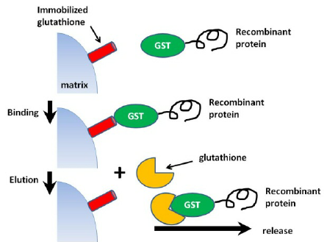
3. GST-Tagged Protein
>Glutathione Sepharose
>Elution with Reduced
Glutathione

Slide 12
 | His | Strep tag II | GST | MBP
Size of tag | 6 aa | 8 aa | M_{r} 26 000 | M_{r} 40 000
Protein binding capacity | 40 mg/mL | 6 mg/mL | 30 mg/mL | 10 mg/mL
Purity | + | +++ | ++ | ++
Increased solubility | No | No | Yes | Yes
Risk for interference with function | Low | Low | High | High

