Slide 1
Isolation of Plasmid

Slide 2
By isopycnic centrifugation in a CsCl – EtBr gradient
Alkaline lysis method

Slide 3
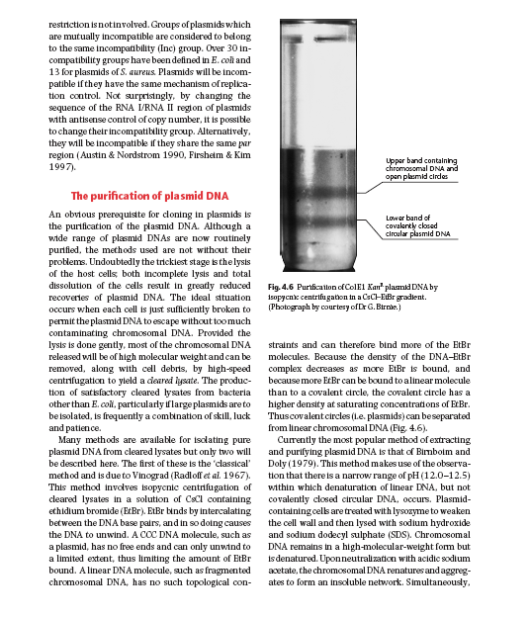
Old and Primrose
Chapter 4

Slide 4
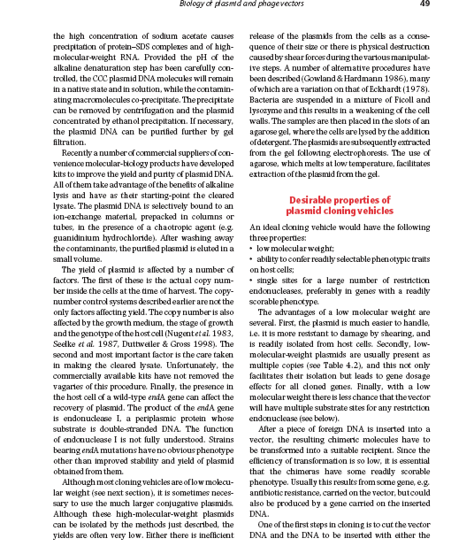
Old and Primrose
Chapter 4

