Slide 1
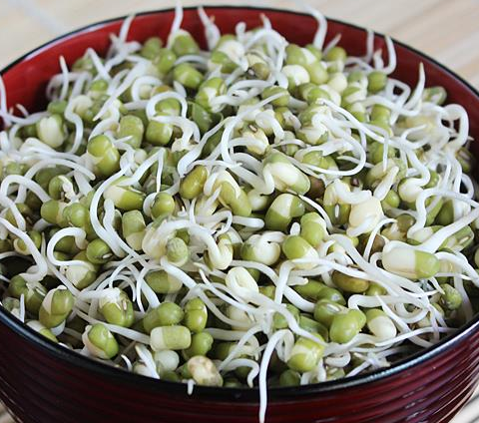
Endonucleases
>>>Break internal phosphodiester bonds
A.
Mung Bean Nuclease: is a nuclease derived from sprouts of the mung bean (Vigna radiata).
>Single-stranded (ssDNA or RNA) specific endonuclease
> Catalyzes the removal of single-stranded extension in double-stranded DNA
Mung Bean can be used for:
1. Removal of both 3' and 5' single-stranded overhangs from double-stranded DNA to create blunt ends
2. Cleavage of single-stranded DNA and RNA
3. Cleavage of the single-stranded region in a DNA hairpin
4. Remove ssDNA from a mixture also containing dsDNA
Mung bean nuclease requires Zn²⁺. The addition of EDTA or SDS causes irreversible inactivation.

Slide 2
B. Nuclease S1
Aspergillus oryzae
S1 Nuclease (Zinc dependent ) degrades single-stranded nucleic acids (ssDNA or RNA), releasing 5'-phosphoryl mono- or oligonucleotides.
It is five times more active on DNA than on RNA.
S1 Nuclease can introduce breaks into double-stranded DNA, RNA and DNA/RNA hybrids at high enzyme and low salt concentrations.
Applications:
1. Removal of single-stranded overhangs of DNA fragments 2. S1 transcript mapping 3. Cleavage of hairpin loops
Blunt Ends
Nuclease P1 found in Penicillium citrinum
Nuclease protection assays

Slide 3
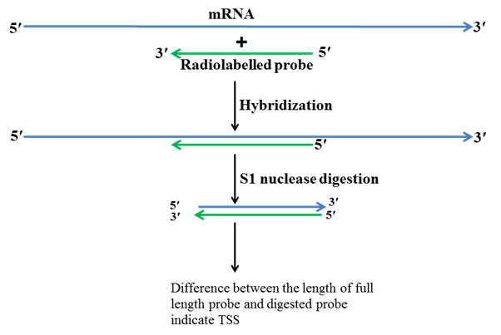
>Finding the Transcription Start Site (TSS)
>Also Intron Site

Slide 4
RNase A degrades single-stranded RNA at C and U residues.
RNase H (Ribonuclease H) is an endoribonuclease that specifically hydrolyzes the phosphodiester bonds of RNA which is hybridized to DNA.
This enzyme does not digest single or double-stranded DNA.
It can be used remove mRNA during second strand cDNA synthesis.
DNaseI

Slide 5
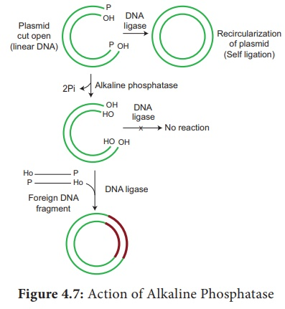
Alkaline Phosphatase : Remove phosphate group fron the 5’ end of the DNA molecule
Source: E. coli or Calf Intestinal Tissue

Slide 6
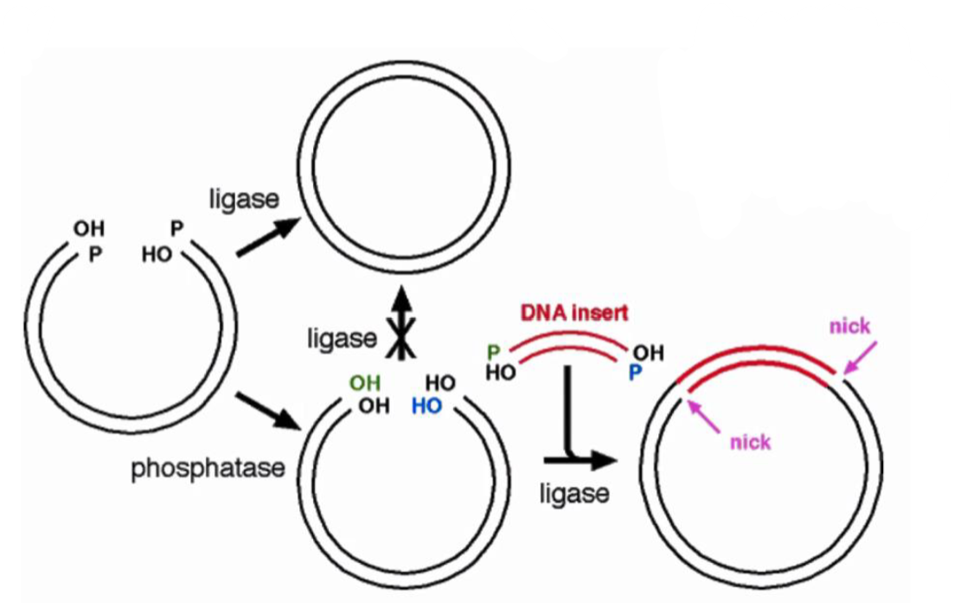
>>>>>>>>>>>>>Host repairs one nick at each join

Slide 7
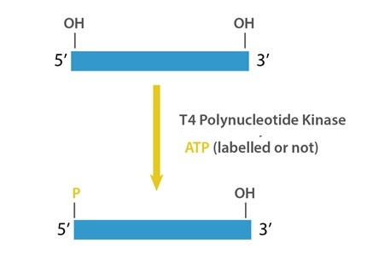
T4 Polynucleotide kinase
Addition of Phosphate Group at the 5’ end
5' phosphorylation of DNA/RNA for subsequent ligation

Slide 8
Terminal Deoxynucleotidyl Transferase (TdT)
Terminal transferase catalyzes the addition of deoxynucleotides to the 3' hydroxyl terminus of DNA molecules.
Homopolymeric tailing of linear duplex DNA with any type of 3'-OH terminus
Homopolymer tailing is the way for the ligation of blunt ended DNA fragments. tailing involves using an enzyme terminal deoxynucleotidyl transderase.
This enzyme will repeadly add nucleotide to the 3` end of the double stranded DNA molecule

Slide 9
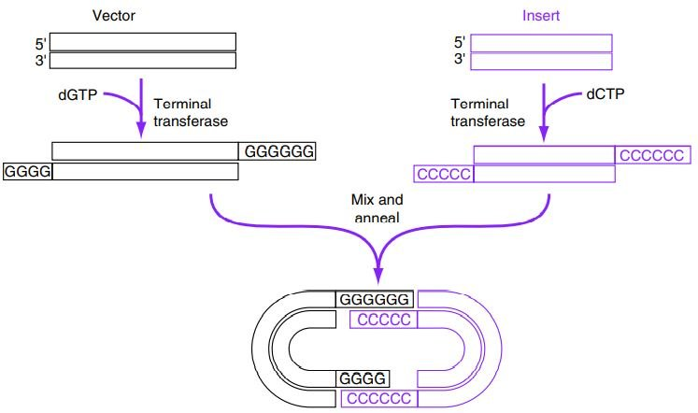

Slide 10
Adapters and Linkers

