Slide 1
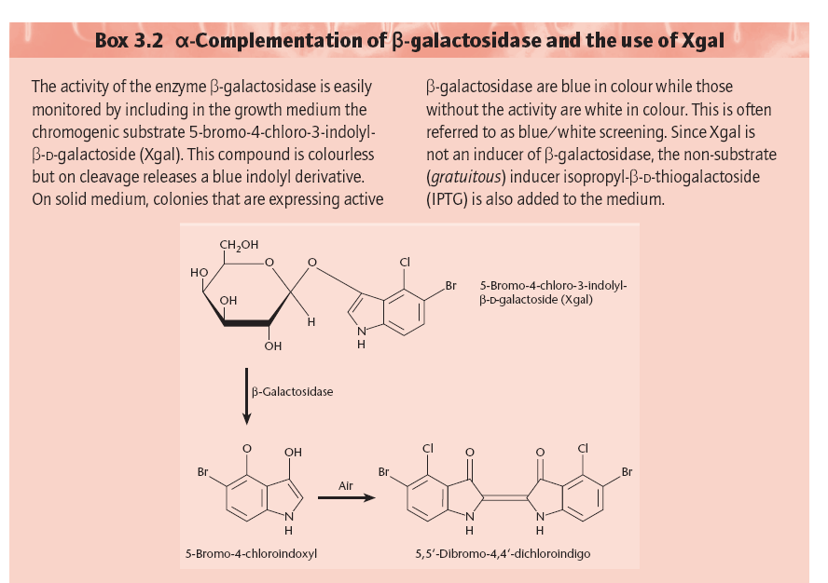
α-complementation and blue-white screening

Slide 2
Ref: Chapter 3, Old and primrose

Slide 3
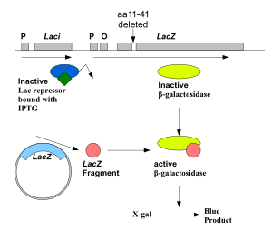
The lac Z fragment, whose synthesis can be induced by IPTG, is capable of intra-allelic complementation with a defective form of β-galactosidase enzyme encoded by host chromosome (mutation lacZDM15 in E. coli JM109, DH5α and XL1-Blue strains). In the presence of IPTG in growth medium, bacteria synthesise both fragments of the enzyme. Both the fragments can together hydrolyse X-gal (5-bromo-4-chloro-3-indolyl- beta-D-galactopyranoside) and form blue colonies when grown on media.
Insertion of foreign DNA into the MCS located within the lac Z gene causes insertional inactivation of this gene at the N-terminal fragment of beta-galactosidase and abolishes intra-allelic complementation. Thus bacteria carrying recombinant plasmids in the MCS cannot hydrolyse X-gal, giving rise to white colonies, which can be distinguished on culture media from non-recombinant cells, which are blue.
α-complementation

Slide 4
The host E. coli strain carries the lacZ deletion mutant (lacZΔM15) which contains the ω-peptide, while the plasmids used carry the lacZα sequence which encodes the first 59 residues of β-galactosidase, the α-peptide. Neither is functional by itself. However, when the two peptides are expressed together, as when a plasmid containing the lacZα sequence is transformed into a lacZΔM15 cells, they form a functional β-galactosidase enzyme.
The blue/white screening method works by disrupting this α-complementation process. The plasmid carries within the lacZα sequence an internal multiple cloning site (MCS). This MCS within the lacZα sequence can be cut by restriction enzymes so that the foreign DNA may be inserted within the lacZα gene, thereby disrupting the gene that produces α-peptide. Consequently, in cells containing the plasmid with an insert, no functional β-galactosidase may be formed.
The rescue of function of the mutant β-galactosidase by the α-peptide is called α-complementation.

Slide 5
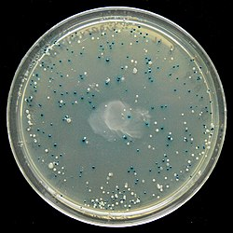
The blue–white screen is a screening technique that allows for the rapid and convenient detection of recombinant bacteria in vector-based molecular cloning experiments. This method of screening is usually performed using a suitable bacterial strain, but other organisms such as yeast may also be used. DNA of transformation is ligated into a vector. The vector is then inserted into a competent host cell viable for transformation, which are then grown in the presence of X-gal. Cells transformed with vectors containing recombinant DNA will produce white colonies; cells transformed with non-recombinant plasmids (i.e. only the vector) grow into blue colonies.
An LB agar plate showing the result of a blue white screen

Slide 6
pUC vector series
A series of small plasmids (about 2.7 kb) have been developed (by Messings and co-workers in1983) at the University of California and hence the name pUC e.g. pUC7, 8,9,12,13, 18 and 19 etc.
These are high copy number plasmids that carry an ampicillin resistance gene and an origin of replication, both from pBR322.
High Copy Number: Because of the lack of rop gene and single point mutation in the ori of pMB1.
They also have a multiple cloning site (MCS) – a sequence of DNA that carries unique sites for many REs.
The MCS is inserted in to a portion of lacZ gene (lacZ’; alpha peptide) that codes for the (part of) enzyme β-galactosidase.
When such plasmids are introduced into E. coli, the colonies are blue on plates containing X-gal (5-bromo-4-chloro-3-indolyl-β-d-galactopyranoside, the substrate for β- galactosidase) and IPTG (isopropyl thiogalactoside, an inducer).

Slide 7
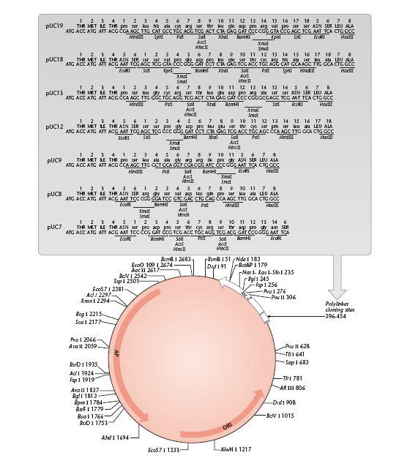
The insertion of the MCS into the lacZ′
fragment does not affect the ability of the α-peptide to mediate complementation, but cloning DNA fragments into the MCS does.

Slide 8
Recombinants and non-recombinants can therefore be distinguished simply by plating the transformed cells onto agar containing ampicillin and X-gal.
All colonies that grow on this medium are made up of transformed cells because only transformants are ampicillin resistant.
Blue colonies contain cells with functional β-galactosidase enzymes and hence with undisrupted lacZ′ genes these colonies are therefore non-recombinants.
The white colonies comprise cells without β-galactosidase activity and hence with disrupted lacZ′ genes; these are recombinants.
Thus cells containing recombinant plasmids form white (not blue) colonies.

Slide 9
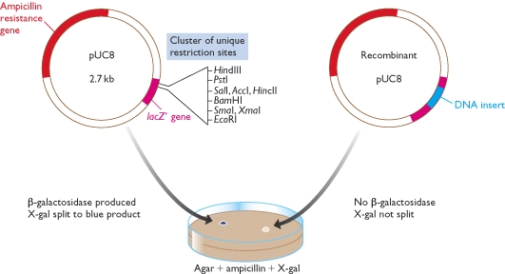
Recombinant selection with pUC8

Slide 10
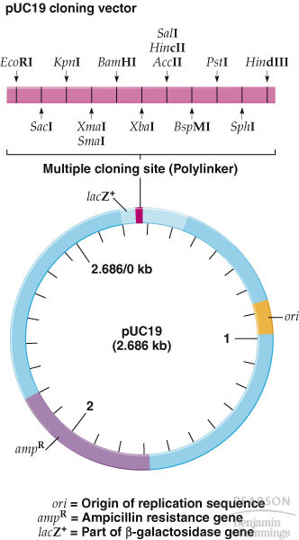
1) ori
2) A dominant selectable
Marker
3) Cleavage sites for cloning
4) (high copy no.)
The plasmid cloning vector pUC19. This plasmid has an origin of replication (ori), an ampR selectable marker, and a polylinker located within part of the β-galactosidase gene lacZ+.

