Slide 1
Labeling of DNA

Slide 2
The SI unit of radioactive activity is the becquerel (Bq), in honor of the scientist Henri Becquerel. One Bq is defined as one transformation, decay, or disintegration per second. Since sensible sizes of radioactive material contain many atoms, a Bq is a tiny measure of activity; amounts giving activities on the order of GBq (gigabecquerel, 1 x 10⁹ decays per second) or TBq (terabecquerel, 1 x 10¹² decays per second) are commonly used.
Another unit of radioactivity is the curie, Ci, it is equal, by definition, to the activity of any radionuclide decaying with a disintegration rate of 3.7 × 10¹⁰ Bq, so that 1 curie (Ci) = 3.7 × 10¹⁰ Bq.
Counts per minute (cpm) is a measure of radioactivity. It is the number of atoms in a given quantity of radioactive material that are detected to have decayed in one minute. Disintegrations per minute (dpm) is also a measure of radioactivity.

Slide 3
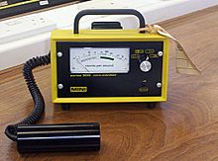
Radioactivity measurement:
Geiger-Muller counter (G-M Counter)
The Geiger Muller counter (Gas based counter) is an instrument used for measuring ionizing radiation.
It detects ionizing radiation such as alpha particles, beta particles and gamma rays using the ionization effect produced in a Geiger–Müller tube.
It is one of the best-known radiation detection instruments
Readout: Count per second
Absorbed dose

Slide 4
Radioisotopes which are commonly used in the biological research
³²P, ³³P, ¹³¹I, ³⁵S, ¹⁴C, ⁴⁵Ca, ³H

Slide 5
ATP, [γ-³²P]- 1 mCi Perkin Elmer
ATP, [γ-³²P]- 3000Ci/mmol 10mCi/ml EasyTide Lead, 250 µCi

Slide 6
Labeling and Detection
of Nucleic acid
In molecular biology, hybridization (is a phenomenon in which single-stranded deoxyribonucleic acid (DNA) or ribonucleic acid (RNA) molecules anneal to complementary DNA or RNA.
Though a double-stranded DNA sequence is generally stable under physiological conditions, changing these conditions in the laboratory (generally by raising the surrounding temperature) will cause the molecules to separate into single strands.
These strands are complementary to each other but may also be complementary to other sequences present in their surroundings. Lowering the surrounding temperature allows the single-stranded molecules to anneal or “hybridize” to each other.
Nucleic acid hybrids can be formed between two strands of DNA, two strands of RNA
or one strand of DNA and one of RNA.

Slide 7
Nucleic acid hybridization with a labeled probe is the only way to detect a complementary target sequence in a complex nucleic acid mixture.
Nucleic acid probes are oligonucleotides or polynucleotides that can bind with high specificity to complementary sequences.
Probes can be complementary to either DNA or RNA and can be from as few as 20 nt to hundreds of nt long.
DNA probes
RNA probes
Oligonucleotide probes

Slide 8
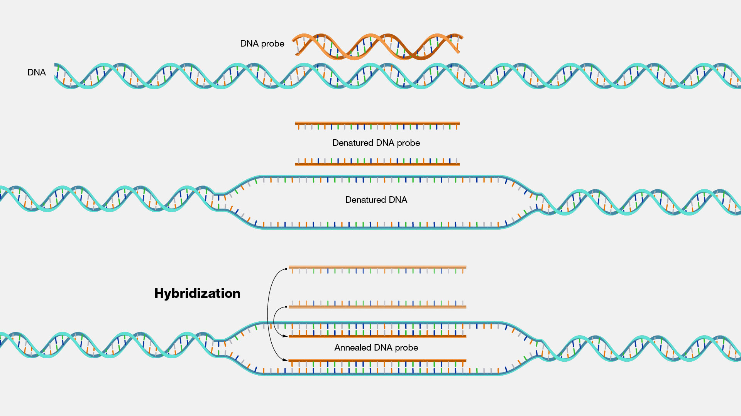

Slide 10
Oligonucleotide probes are short stretches of single-stranded DNA or RNA used to detect the presence of complementary nucleic acid sequences (target sequences) by hybridization.
In molecular biology, a nucleic acid probe is a fragment of DNA or RNA which can be radioactively or fluorescently labeled. These probes can be used to detect the presence of nucleotide sequences in analyzed RNA or DNA that are complementary to the sequence in the probe.
The labeled probe is first denatured (by heating or under alkaline conditions such as exposure to sodium hydroxide) into single stranded DNA (ssDNA) and then hybridized to the target ssDNA (Southern blotting) or RNA (northern blotting) immobilized on a membrane or in situ.

Slide 11
DNA probes
DS OR SS
RNA probes
SS
Oligonucleotide probes
SS
Heterologous Probe: Probe that is similar, but not exactly the
same
Mouse probe can be used to search a human genomic library.
2. Homologous: Probe that is exactly complementary to the nucleic acid sequence of interest

Slide 12
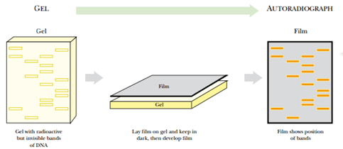
The labeling with radioisotopes or radioactive isotopes is called radiolabelling.
Autoradiography

Slide 13
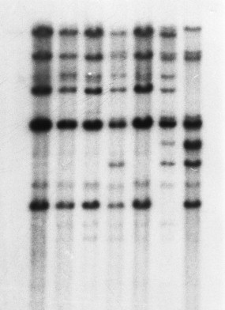
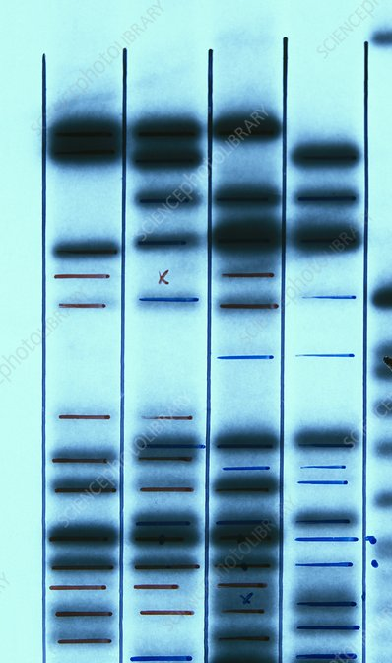
Autoradiography

Slide 14
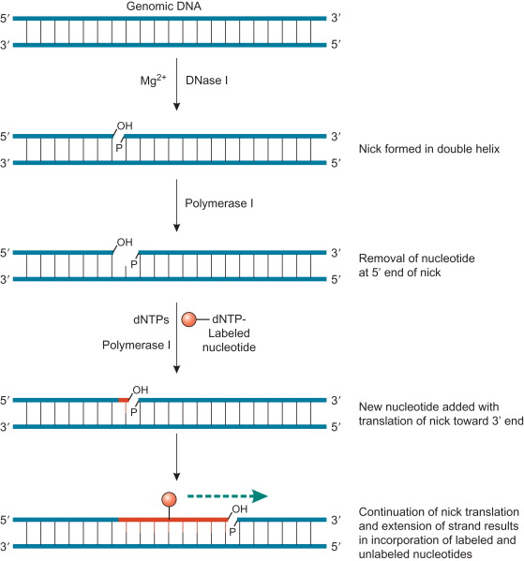
Label Location
There are two ways to label a DNA molecule –
by the ends (end labeling) OR all along the molecule (uniform labeling)
Uniform labeling:
A. Nick translation
The endonuclease DNase I is used to
create nicks at random sites in the strand
of double stranded target DNA
DNA polymerase I is used to add nucleotide residues to the free 3’-hydroxyl ends created during the DNase I nicking process.
As the DNA polymerase I extends the 3’-end, the 5’- tp 3’ exonulecase activity of the enzyme simultaneously removes bases from the 5’-end of the nick.
Sequential addition of bases on to 3’-end with the simultaneous removal of bases from the 5’-end results in translation of the nick
Along the DNA molecule.
DNA ligase

Slide 15
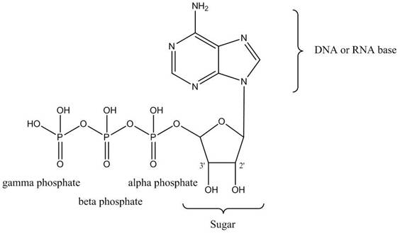
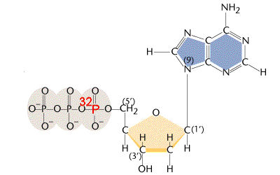
Pancreatic DNase I
E. coli DNA polymerase I
DNA ligase
When performed in the presence of a radioactive ([α-³²P]dNTP the newly synthesized
strand becomes radioactivity labeled.

Slide 16
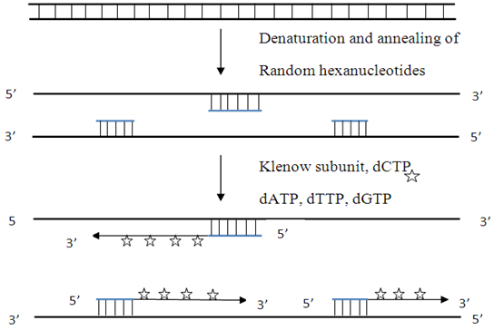
B. Random priming:
This is an alternative method for
preparing uniformly labeled DNA is by oligo-nucleotide –primed
DNA synthesis with hexanucleotide (or longer oligomers) of
random sequences
The klenow fragment is used as this
enzyme lacks the 5’-3’ exonuclease
activity of DNA Polymerase I.
It fills gaps between adjacent primers.
Labeled nucleotides are incorporated
Into new DNA that is synthesized.

Slide 18
Catalyzed by

Slide 20
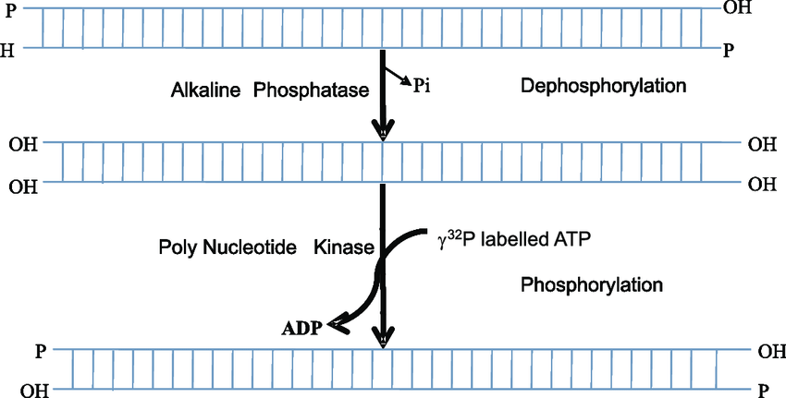
B. 5’-end labeling
Alkaline Phosphatase
T4 polynucleotide Kinase
O

Slide 21
5'-end labeling for DNA we use gamma P, but it is alpha that is used at the 3' end?

Slide 22
MCQ
Nucleic acids are readily labeled with tags that facilitate detection or purification. Which of the following components are required for the 3’- end labeling of DNA with radioactive phosphorous?
(A) Terminal deoxynucleotidyl transferase and (gamma) γ – ³²P dNTP
(B) Polynucleotide kinase and (gamma) γ – ³²P dNTP
(C) Terminal deoxynucleotidyl transferase and (alpha) α – ³²P dNTP
(D) Polynucleotide kinase and (alpha) α – ³²P dNTP

