Slide 1
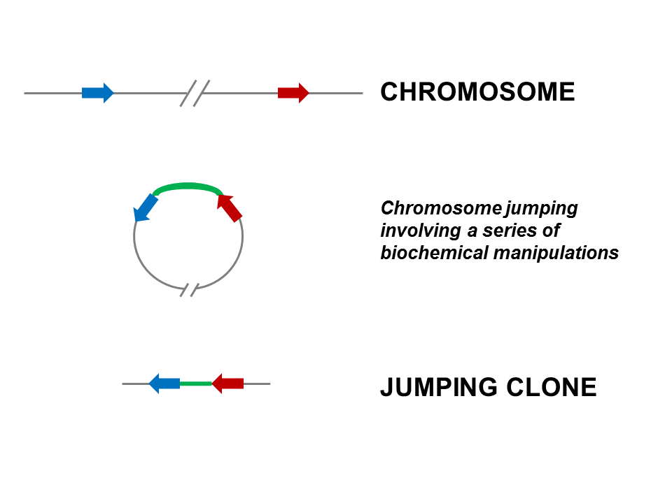
Jumping libraries or junction-fragment libraries are collections of genomic DNA fragments generated by chromosome jumping. These libraries allow the analysis of large areas of the genome and overcome distance limitations in common cloning techniques. A jumping library clone is composed of two stretches of DNA that are usually located many kilobases away from each other. The stretch of DNA located between these two "ends" is deleted by a series of biochemical manipulations carried out at the start of this cloning technique.

Slide 2
Western blot is often used in research to separate and identify proteins. In this technique a mixture of proteins is separated based on molecular weight, and thus by type, through gel electrophoresis. These results are then transferred to a membrane producing a band for each protein.
Procedure
A. A western blot is a laboratory method used to detect specific protein molecules from among a mixture of proteins. This mixture can include all of the proteins associated with a particular tissue or cell type. Western blots can also be used to evaluate the size of a protein of interest, and to measure the amount of protein expression. This procedure was named for its similarity to the previously invented method known as the Southern blot.
B. The first step in a western blot is to prepare the protein sample by mixing it with a detergent called sodium dodecyl sulfate, which makes the proteins unfold into linear chains and coats then with a negative charge. Next, the protein molecules are separated according to their sizes using a method called gel electrophoresis. Following separation, the proteins are transferred from the gel onto a blotting membrane. Although this step is what gives the technique the name "western blotting," the term is typically used to describe the entire procedure.

Slide 3
C. Once the transfer is complete, the membrane carries all of the protein bands originally on the gel. Next, the membrane goes through a treatment called blocking, which prevents any nonspecific reactions from occurring. The membrane is then incubated with an antibody called the primary antibody, which specifically binds to the protein of interest. Following incubation, any unbound primary antibody is washed away, and the membrane is incubated yet again, but this time with a secondary antibody that specifically recognizes and binds to the primary antibody. The secondary antibody is linked to a reporter enzyme that produces color or light, which allows it to be easily detected and imaged. These steps permit a specific protein to be detected from among a mixture of proteins.

Slide 4
The 8 basic steps of the science of Western blotting have remained the same for the last 40 years.
1. First, sample preparation: lysing and denaturing the proteins. 2. Next, gel electrophoresis. 3. Then membrane transfer. 4. After that blocking. 5. Then incubating the primary antibody. 6. And, then incubating the secondary antibody. 7. Next detection. 8. And, finally analysis.

Slide 5
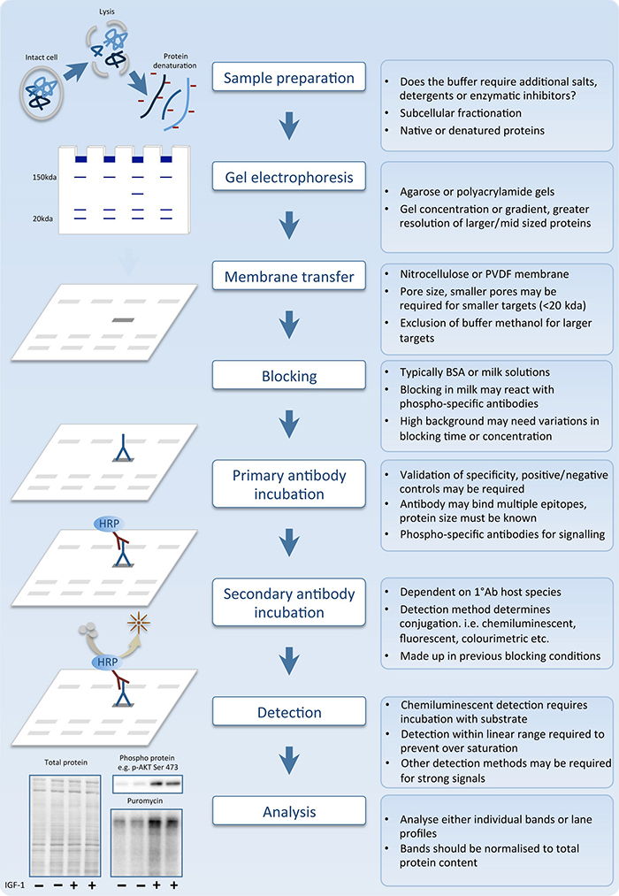

Slide 6
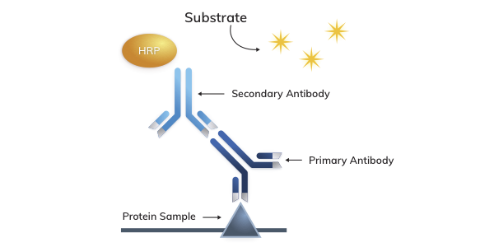
Horseradish Peroxidase (HRP) has a high turnover rate that allows HRP secondary antibodies to generate strong signal in a short time span. HRP secondary antibodies are commonly used in western blot (WB), immunohistochemistry (IHC) and ELISA.

Slide 7
The northern blot technique was developed in 1977 by James Alwine, David Kemp, and George Stark at Stanford University. Northern blotting takes its name from its similarity to the first blotting technique, the Southern blot, named for biologist Edwin Southern.
The term "western blot" was given by W. Neal Burnette in 1981, although the method itself originated in 1979 in the laboratory of Harry Towbin at the Friedrich Miescher Institute in Basel, Switzerland.

Slide 9
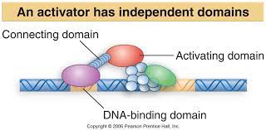
Yeast two-hybrid system
Yeast two-hybrid system or Y2H) is a molecular biology technique used to discover protein–protein interactions for their physical interactions (such as binding) between two proteins.
The Y2H technique allows detection of interacting proteins in living yeast cells.
It is based on the fact that a eukaryotic gene expression is promoted by
Transcription factors called activators that contain two distinct domains. One is called DNA binding domains (DBD) that binds to regulatory sequences and another is activation domain (AD) that interacts with RNA polymerase and stimulates expression of the associated gene.

Slide 10
The yeast-2-hybrid system is a simple scientific technique used to screen a library of proteins for potential interactions:
Firstly, a transcription factor is broken into two parts – a DNA-binding domain (BD) and a catalytic activation domain (AD)
The DNA-binding domain is fused to a protein of interest called the bait (e.g. an enzyme)
The activation domain is fused to a number of potential binding partners – called the prey (e.g. different ligands)
If the bait and prey interact, the two parts of the transcription factor are reconstituted and activate transcription of a gene
If the bait and prey do not interact, the two parts of the transcription factor remain separate and transcription doesn’t occur
The yeast-2-hybrid system detects protein-protein interactions according to the activation of a reporter gene:
The reporter gene may encode for the production of a protein that causes a visible colour change (e.g. ß-galactosidase)
Alternatively, the reporter gene may encode for the production of an essential amino acid that is required for the yeast to grow on a deficient media (hence yeast growth would indicate successful interaction between bait and prey)

Slide 11
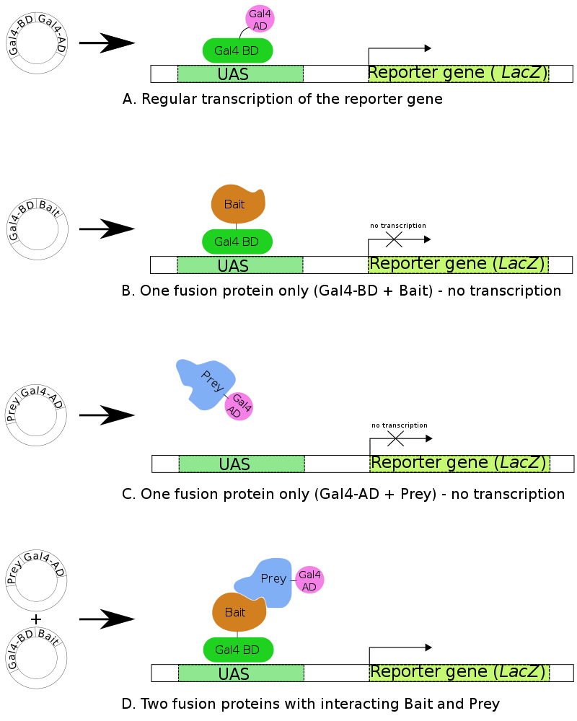
Y2H

Slide 12
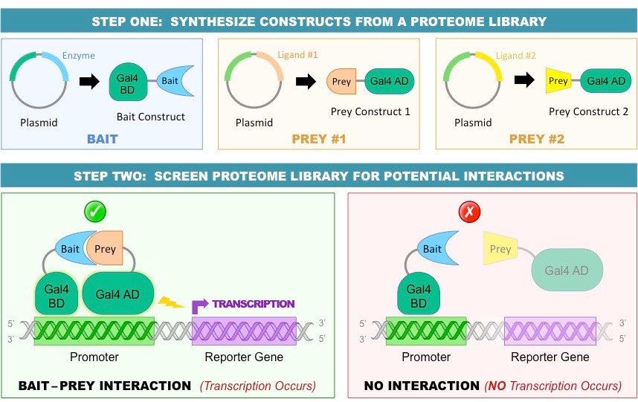

Slide 13
Application
The yeast two-hybrid screening system is a technique used for identifying molecular interactions and characterizing interaction pairs.
Y2H methods are used to identify and validate therapeutic targets, discover protein interaction modulators, identify drug targets.

Slide 14
Yeast One Hybrid System
The one-hybrid variation of this technique is designed to investigate protein–DNA interactions and uses a single fusion protein in which the AD is linked directly to the binding domain.

Slide 15
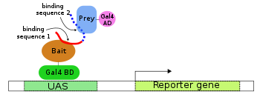
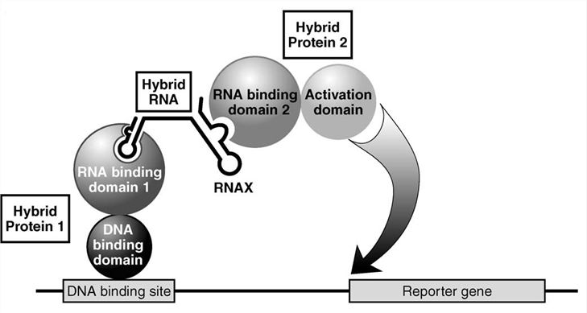
Yeast Three Hybrid System
RNA-protein interactions have been investigated through a three-hybrid variation of the two-hybrid technique. In this case, a hybrid RNA molecule serves to adjoin together the two protein fusion domains—which are not intended to interact with each other but rather the intermediary RNA molecule (through their RNA-binding domains).

Slide 16
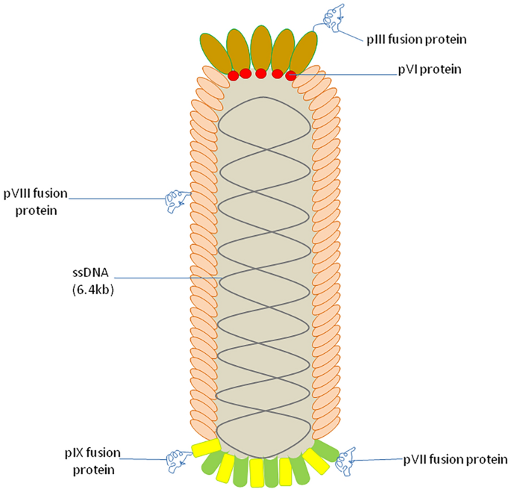
Phage display
Phage display is a laboratory technique for the study of protein–protein, protein–peptide, and protein–DNA interactions that uses bacteriophages to connect proteins with the genetic information that encodes them.
The most common bacteriophages used in phage display are M13 and fd filamentous phage
Major Coat Protein: pVIII
Minor Coat Protein: Piii
Gene encoding the minor coat protein
Is most commonly used for the recombinant
Formation with the DNA encoding the
Foreign target peptide.

Slide 17
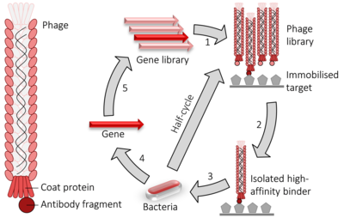
Phage display cycle. 1) fusion proteins for a viral coat protein + the gene to be evolved (typically an antibody fragment) are expressed in bacteriophage. 2) the library of phage are washed over an immobilised target. 3) the remaining high-affinity binders are used to infect bacteria. 4) the genes encoding the high-affinity binders are isolated. 5) those genes may have random mutations introduced and used to perform another round of evolution. The selection and amplification steps can be performed multiple times at greater stringency to isolate higher-affinity binders.

Slide 18
Maximum Gene Expression (Covered during Expression Vector Classes)
Strong Promoter
Codon Optimization
Induction
End of Unit III

